Slide 1
UNIT 4
EXCEPTION- CONCURRENCY-AND STREAMS

Slide 2
Exception handling mechanism- new look try/catch mechanism in Java 7. I/O Basics: Bytestream& Character Stream- Getting user input- Reading console input & Writing console output- Reading and Writing files-new filesystem API NIO2
Multithreading: Thread class & Runnable Interface- Inter Thread Communication- Synchronization of threads using Synchorized keyword and lock method-thread pool and Executors framework-Futures and callables-Fork-Join in Java 7-Deadlock conditions.
Notes:
IT0206- Java Programming
Prepared by - Subashini.N.J

Slide 3
EXCEPTION

Slide 4
An exception is an abnormal condition that arises in a code sequence at run time.
In other words, an exception is a run-time error.
Different Types of Errors:-
Compilation Error -- syntax error
Logical Error
Runtime Error -- Exception

Slide 5
Exception-Handling Fundamentals

Slide 6
→Exceptions handle unexpected situations – Illegal argument, network failure, or file not found
1) Checked Exception
The classes that extend Throwable class except RuntimeException and Error are known as checked exceptions
e.g.IOException, SQLException etc. Checked exceptions are checked at compile-time.
2) Unchecked Exception
The classes that extend RuntimeException are known as unchecked exceptions
e.g. ArithmeticException, NullPointerException, ArrayIndexOutOfBoundsException etc. Unchecked exceptions are not checked at compile-time rather they are checked at runtime.
Notes:
IT0206- Java Programming
Prepared by - Subashini.N.J

Slide 7
→This is the general form of an exception-handling block:
try {
// block of code to monitor for errors
}
catch (ExceptionType1 exOb) {
// exception handler for ExceptionType1
}
catch (ExceptionType2 exOb) {
// exception handler for ExceptionType2
}
// ...
finally {
// block of code to be executed before try block ends
}
→Java exception handling is managed via five keywords:
try
catch
throw
throws
finally.

Slide 8
Program statements that you want to monitor for exceptions are contained within a try block. If an exception occurs within the try block, it is thrown.
Your code can catch this exception (using catch)
System-generated exceptions are automatically thrown by the Java run-time system.
To manually throw an exception, use the keyword throw.
Any exception that is thrown out of a method must be specified as such by a throws clause.
Any code that absolutely must be executed after a try block completes is put in a finally block.

Slide 9
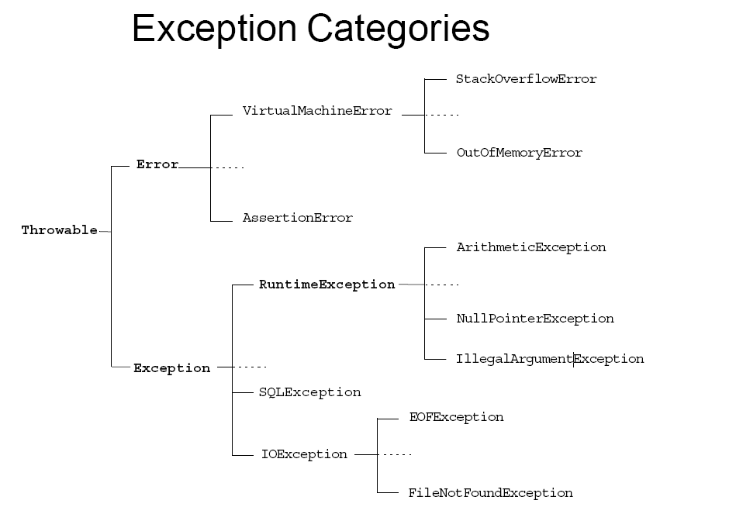

Slide 10
class Exc0 {
public static void main(String args[]) {
int d = 0;
int a = 42 / d;
}
}
java.lang.ArithmeticException: / by zero
at Exc0.main(Exc0.java:4)

Slide 11
the exception is caught by the default handler provided by the Java run-time system.
Any exception that is not caught by your program will ultimately be processed by the default handler.
The default handler displays a string describing the exception, prints a stack trace from the point at which the exception occurred, and terminates the program.

Slide 12
Exception Example:-
1 public class AddArguments {
2 public static void main(String args[]) {
3 int sum = 0;
4 for ( int i=0;i<=args.length;i++) {
5 sum += Integer.parseInt(args[i]);
6 }
7 System.out.println("Sum = " + sum);
8 }
9 }

Slide 13
java AddArguments 1 2 3 4
Sum = 10
java AddArguments 1 two 3.0 4
Exception in thread "main" java.lang.NumberFormatException: For input string: "two“ at java.lang.NumberFormatException.forInputString(NumberFormatException.java:48)
at java.lang.Integer.parseInt(Integer.java:447)
at java.lang.Integer.parseInt(Integer.java:497)
at AddArguments.main(AddArguments.java:5)

Slide 14
Common scenarios where exceptions may occur
int a=50/0;//ArithmeticException
String s=null;
System.out.println(s.length());//NullPointerException
String s="abc";
int i=Integer.parseInt(s);//NumberFormatException
int a[]=new int[5];
a[10]=50; //ArrayIndexOutOfBoundsException

Slide 15
Rule: At a time only one Exception is occured and at a time only one catch block is executed.
Rule: All catch blocks must be ordered from most specific to most general i.e. catch for ArithmeticException must come before catch for Exception .

Slide 16
Using try and catch

Slide 17
class Exc2 {
public static void main(String args[]) {
int d, a;
try { // monitor a block of code.
d = 0; a = 42 / d;
System.out.println("This will not be printed.");
}
catch (ArithmeticException e) { // catch divide-by-zero error
System.out.println("Division by zero.");
System.out.println("Exception: " + e); // description of exception
} } }
This program generates the following output:
Division by zero.
Exception: java.lang.ArithmeticException: / by zero

Slide 18
Multiple catch Clauses

Slide 19
A try-catch statement can use multiple catch clauses:
try {
// code that might throw one or more exceptions
} catch (MyException e1) {
// code to execute if a MyException exception is thrown
} catch (MyOtherException e2) {
// code to execute if a MyOtherException exception is thrown
} catch (Exception e3) {
// code to execute if any other exception is thrown
}

Slide 20
throw

Slide 21
→till now we have only been catching exceptions that are thrown by the Java run-time system. However, it is possible for your program to throw an exception explicitly, using the throw statement.
→The general form of throw is shown here:
throw ThrowableInstance;
→Here, ThrowableInstance must be an object of type Throwable or a subclass of Throwable.
→Simple types, such as int or char, as well as non-Throwable classes, such as String and Object, cannot be used as exceptions.
→There are two ways we can obtain a Throwable object:
  using a parameter into a catch clause, or
  creating one with the new operator.

Slide 22
// Demonstrate throw.
class ThrowDemo {
static void demoproc() {
try {
throw new NullPointerException("demo");
} catch(NullPointerException e) {
System.out.println("Caught inside demoproc.");
throw e; // rethrow the exception } }
public static void main(String args[]) {
try {
demoproc();
} catch(NullPointerException e) {
System.out.println("Recaught: " + e);
} } }

Slide 23
throws

Slide 24
→If a method is capable of causing an exception that it does not handle, it must specify this behavior so that callers of the method can guard themselves against that exception.
→do this by including a throws clause in the method’s declaration.
→A throws clause lists the types of exceptions that a method might throw.
→This is necessary for all exceptions, except those of type Error or RuntimeException, or any of their subclasses.
→All other exceptions that a method can throw must be declared in the throws clause.
→If they are not, a compile-time error will result.

Slide 25
→This is the general form of a method declaration that includes a throws clause:
type method-name(parameter-list) throws exception-list
{
// body of method
}
→Here, exception-list is a comma-separated list of the exceptions that a method can throw.

Slide 26
Use the handle or declare rule as follows:
• Handle the exception by using the try-catch-finally block.
• Declare that the code causes an exception by using the throws clause.
void trouble() throws IOException { ... }
void trouble() throws IOException, MyException { ... }

Slide 27
// This program contains an error and will not compile.
class ThrowsDemo {
static void throwOne() {
System.out.println("Inside throwOne.");
throw new IllegalAccessException("demo");
}
public static void main(String args[]) {
throwOne();
}
}

Slide 28

// This is now correct.
class ThrowsDemo {
static void throwOne() throws IllegalAccessException {
System.out.println("Inside throwOne.");
throw new IllegalAccessException("demo");
}
public static void main(String args[]) {
try {
throwOne();
} catch (IllegalAccessException e) {
System.out.println("Caught " + e);
}
}
}
Here is the output generated by running this example program:
inside throwOne
caught java.lang.IllegalAccessException: demo

Slide 29
finally creates a block of code that will be executed after a try/catch block has completed and before the code following the try/catch block.
The finally block will execute whether or not an exception is thrown.
finally clause is optional.

Slide 30
class FinallyDemo {
// Through an exception out of the method.
static void procA() {
try {
System.out.println("inside procA");
throw new RuntimeException("demo");
} finally {
System.out.println("procA's finally");
}
}

Slide 31
 | throw | throws
1) | Java throw keyword is used to explicitly throw an exception. | Java throws keyword is used to declare an exception.
2) | Checked exception cannot be propagated using throw only. | Checked exception can be propagated with throws.
3) | Throw is followed by an instance. | Throws is followed by class.
4) | Throw is used within the method. | Throws is used with the method signature.
5) | You cannot throw multiple exceptions. | You can declare multiple exceptions e.g. public void method()throws IOException,SQLException.

Slide 32
Threads

Slide 33
Java provides built-in support for multithreaded programming.
A multithreaded program contains two or more parts that can run concurrently.
Each part of such a program is called a thread, and each thread defines a separate path of execution.
Thus, multithreading is a specialized form of multitasking.

Slide 34
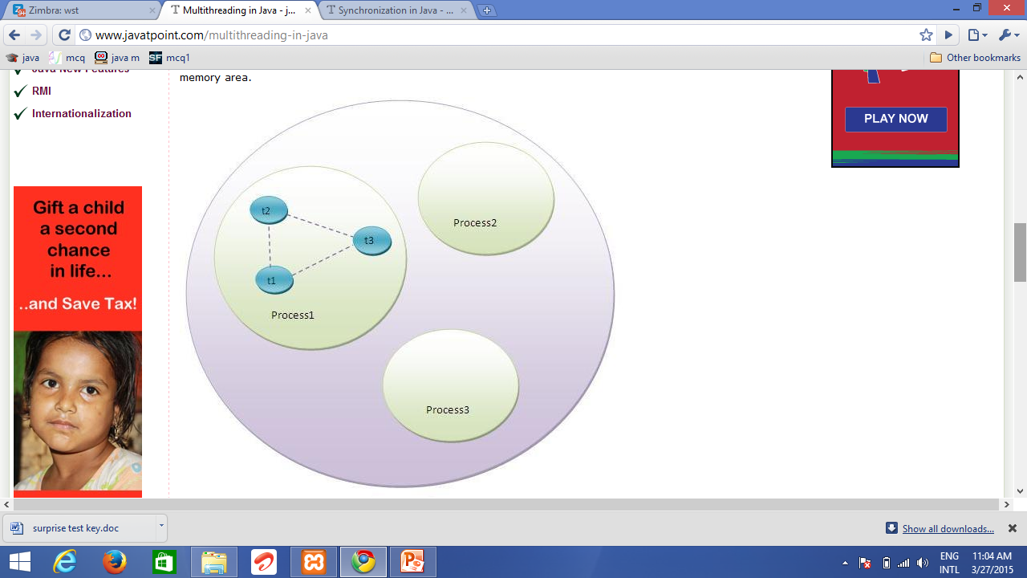

Slide 35
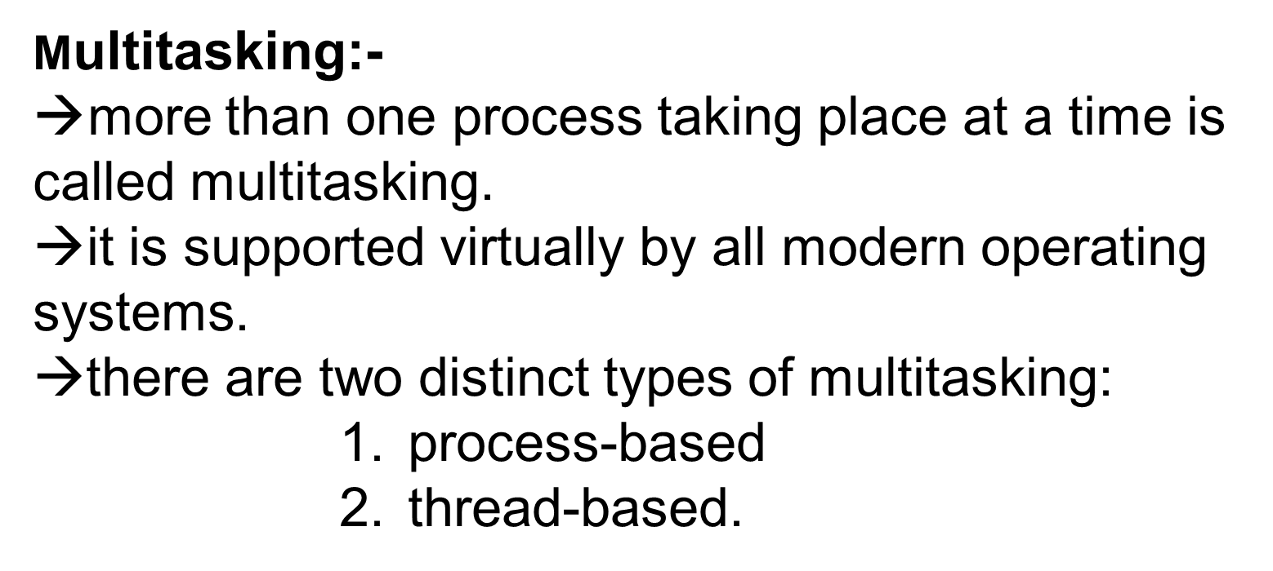

Slide 36
→A process is, in essence, a program that is executing.
→Thus, process-based multitasking is the feature that allows your computer to run two or more programs concurrently.
→For example, process-based multitasking enables you to run the Java compiler at the same time that you are using a text editor.
→In process-based multitasking, a program is the smallest unit of code that can be dispatched by the scheduler.

Slide 37
→In a thread-based multitasking environment, the thread is the smallest unit of dispatchable code.
→This means that a single program can perform two or more tasks simultaneously.
→For instance, a text editor can format text at the same time that it is printing, as long as these two actions are being performed by two separate threads.

Slide 38
→Multitasking threads require less overhead than multitasking processes.
→Processes are heavyweight tasks that require their own separate address spaces.
→Interprocess communication is expensive and limited.
→Context switching from one process to another is also costly.
→Threads, on the other hand, are lightweight(less memory &less process time).
→They share the same address space and cooperatively share the same heavyweight process.
→Interthread communication is inexpensive, and context switching from one thread to the next is low cost.

Slide 39
The Thread Class
and
The Runnable Interface

Slide 40
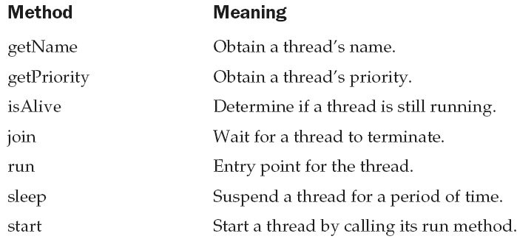
→Java’s multithreading system is built upon the Thread class, its methods, and its companion interface, Runnable.
→To create a new thread, program will either extend Thread or implement the Runnable interface.
→The Thread class defines several methods that help manage threads.

Slide 41
The Main Thread

Slide 42
→When a Java program starts up, one thread begins running immediately.
→This is usually called the main thread of your program, because it is the one that is executed when your program begins.
→The main thread is important for two reasons:
    ■ It is the thread from which other “child” threads will be spawned.
    ■ Often it must be the last thread to finish execution because it performs various shutdown actions.

Slide 43
→Although the main thread is created automatically when program is started, it can be controlled through a Thread object.
→To do so, obtain a reference to it by calling the method currentThread( ), which is a public static member of Thread.
→Its general form is shown here:
static Thread currentThread( )
→This method returns a reference to the thread in which it is called.
→Once we have a reference to the main thread, we can control it just like any other thread.

Slide 44
class CurrentThreadDemo {
public static void main(String args[]) {
Thread t = Thread.currentThread();
System.out.println("Current thread: " + t);
t.setName("My Thread");
System.out.println("After name change: " + t);
try {
for(int n = 5; n > 0; n--) {
System.out.println(n);
Thread.sleep(1000);
}
} catch (InterruptedException e) {
System.out.println("Main thread interrupted");
}}}

Slide 45
OUTPUT:
Current thread: Thread[main,5,main]
After name change: Thread[My Thread,5,main]
5
4
3
2
1

Slide 46
By default, the name of the main thread is main.
Its priority is 5, which is the default value,
main is also the name of the group of threads to which this thread belongs.

Slide 47
Creating a Thread

Slide 48
→We can create a thread by instantiating an object of type Thread.
→Java defines two ways in which this can be accomplished:
    ■ implements the Runnable interface.
    ■ extends the Thread class, itself.

Slide 49
Implementing Runnable

Slide 50
→The easiest way to create a thread is to create a class that implements the Runnable interface.
→To implement Runnable, a class need only implement a single method called run( ), which is declared like this:
        public void run( )
→Inside run( ), we can define the code that constitutes the new thread.
→It is important to understand that run( ) can call other methods, use other classes, and declare variables, just like the main thread can.
→The only difference is that run( ) establishes the entry point for another, concurrent thread of execution within the program.
→This thread will end when run( ) returns.

Slide 51
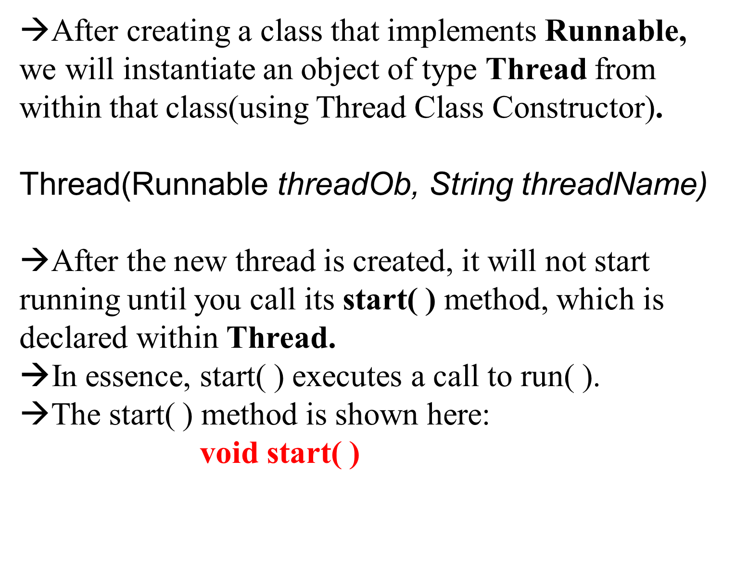

Slide 52
class Multi3 implements Runnable{
public void run(){
System.out.println("thread is running...");
}
public static void main(String args[]){
Multi3 m1=new Multi3();
Thread t1 =new Thread(m1);
t1.start();
}
}

Slide 53
Extending Thread

Slide 54
→The second way to create a thread is to create a new class that extends Thread, and then to create an instance of that class.
→The extending class must override the run( ) method, which is the entry point for the new thread.
→It must also call start( ) to begin execution of the new thread.

Slide 55
class Multi extends Thread{
public void run(){
System.out.println("thread is running...");
}
public static void main(String args[]){
Multi t1=new Multi();
t1.start();
}
}

Slide 56
If you are not extending the Thread class,your class object would not be treated as a thread object. So you need to explicitly create Thread class object.
We are passing the object of your class that implements Runnable so that your class run() method may execute.

Slide 57
Basic Control of Threads
• Test threads:
isAlive()
• Access thread priority:
        getPriority()
        setPriority()
• Put threads on hold:
        Thread.sleep() // static method
        join()
        Thread.yield() // static method

Slide 58
Test threads: isAlive()
→This method is defined by Thread, and its general form is shown here:
    final boolean isAlive( )
→The isAlive( ) method returns true if the thread upon which it is called is still running.
→It returns false otherwise.

Slide 59
Thread Priorities:-
→Thread priorities are used by the thread scheduler to decide when each thread should
be allowed to run.
→In theory, higher-priority threads get more CPU time than lowerpriority threads.
→In practice, the amount of CPU time that a thread gets often depends on several factors besides its priority.

Slide 60
→To set a thread’s priority, use the setPriority( ) method, which is a member of Thread.
final void setPriority(int level)
→The value of level must be within the range MIN_PRIORITY and MAX_PRIORITY.
varies from 1 and 10
→default priority - NORM_PRIORITY, which is currently 5.
→These priorities are defined as final variables within Thread.
→getPriority( ) - To obtain the current priority setting
final int getPriority( )

Slide 61
Put threads on hold:
Thread.sleep() // static method,
join() method waits for this thread to die
Thread.yield() // temporarily pause and allow other threads to execute.

Slide 62
→The sleep( ) method causes the thread from which it is called to suspend execution for the specified period of milliseconds.
→Its general form is shown here:
    static void sleep(long milliseconds) throws InterruptedException
→The number of milliseconds to suspend is specified in milliseconds. This method may throw an InterruptedException.
→The sleep( ) method has a second form, shown next, which allows you to specify the period in terms of milliseconds and nanoseconds:
    static void sleep(long milliseconds, int nanoseconds) throws InterruptedException
→This second form is useful only in environments that allow timing periods as short as nanoseconds.

Slide 63
→While isAlive( ) is occasionally useful, the method that you will more commonly use to wait for a thread to finish is called join( ), shown here:
    final void join( ) throws InterruptedException
→This method waits until the thread on which it is called terminates.
→Its name comes from the concept of the calling thread waiting until the specified thread joins it

Slide 64
Synchronization

Slide 65

→When two or more threads need access to a shared resource, they need some way to ensure that the resource will be used by only one thread at a time.
→The process by which this is achieved is called synchronization.
→Java provides unique, language-level support for it.
→Key to synchronization is the concept of the monitor (also called a semaphore).
→A monitor is an object that is used as a mutually exclusive lock, or mutex.

Slide 66
→Only one thread can own a monitor at a given time.
→When a thread acquires a lock, it is said to have entered the monitor.
→All other threads attempting to enter the locked monitor will be
suspended until the first thread exits the monitor.
→These other threads are said to be waiting for the monitor.
→A thread that owns a monitor can reenter the same monitor if it so desires.
→synchronization can be done in two ways using synchronized keyword
Applying for a method (synchronized Method)
Applying for a Statement (synchronized Block)

Slide 67
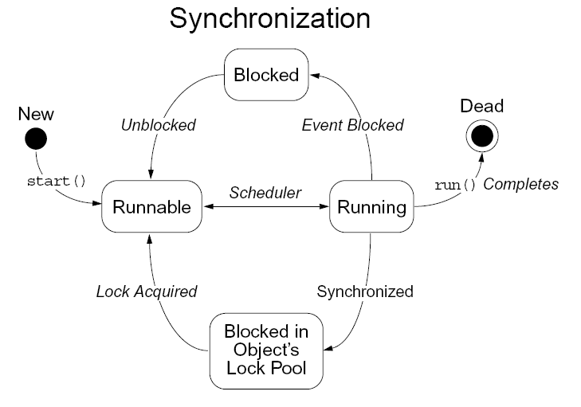

Slide 68
Using Synchronized Methods

Slide 69
class Callme {
void call(String msg) {
System.out.print("[" + msg);
try {
Thread.sleep(1000);
} catch(InterruptedException e) {
System.out.println("Interrupted");
}
System.out.println("]");
}
}

Slide 70
class Caller implements Runnable {
String msg;
Callme target;
Thread t;
public Caller(Callme targ, String s) {
target = targ;
msg = s;
t = new Thread(this);
t.start();
}
public void run() {
target.call(msg);
} }

Slide 71
class Synch {
public static void main(String args[]) {
Callme target = new Callme();
Caller ob1 = new Caller(target, "Hello");
Caller ob2 = new Caller(target, "Synchronized");
Caller ob3 = new Caller(target, "World");
try {
ob1.t.join();
ob2.t.join();
ob3.t.join();
} catch(InterruptedException e) {
System.out.println("Interrupted");
} }

Slide 72
In this program, nothing exists to stop all three threads from calling the same method, on the same object, at the same time. This is known as a race condition, because the three threads are racing each other to complete the method.

Slide 73

Example: Without Using Synchronization
Here is the output produced by this program:
Hello[Synchronized[World]
]
]

Slide 74
With synchronized key word
class Callme {
synchronized void call(String msg) {
}

Slide 75

Example: With Synchronization
OUTPUT:-
[Hello]
[World]
[Synchronized]

Slide 76
The synchronized Statement

Slide 77
class Callme {
void call(String msg) {
System.out.print("[" + msg);
try { Thread.sleep(1000);
} catch (InterruptedException e) {
System.out.println("Interrupted");
}
System.out.println("]");
}}
class Caller implements Runnable {
String msg;

Slide 78
Callme target;
Thread t;
public Caller(Callme targ, String s) {
target = targ;
msg = s;
t = new Thread(this);
t.start();
}
// synchronize calls to call()
public void run() {
synchronized(target) { // synchronized block
target.call(msg);
}}}

Slide 79

Output:-
[Hello]
[World]
[Synchronized]

Slide 80
Interthread Communication

Slide 81
Polling is usually implemented by a loop that is used to check some condition repeatedly.
Once the condition is true, appropriate action is taken.
This wastes CPU time.

Slide 82
To avoid polling, Java includes an elegant interprocess communication mechanism via the wait( ), notify( ), and notifyAll( ) methods.
→These methods are implemented as final methods in Object, so all classes have them.
→All three methods can be called only from within a synchronized context.

Slide 83
→Although conceptually advanced from a computer science perspective, the rules for using these methods are actually
quite simple:
  ■ wait( ) tells the calling thread to give up the monitor and go to sleep until some other thread enters the same monitor and calls notify( ).
  ■ notify( ) wakes up the first thread that called wait( ) on the same object.
  ■ notifyAll( ) wakes up all the threads that called wait( ) on the same object. The highest priority thread will run first.

Slide 84
→These methods are declared within Object, as shown here:
final void wait( ) throws InterruptedException
    final void notify( )
    final void notifyAll( )

Slide 85
class Q {
int n;
boolean valueSet = false;
synchronized int get() {
while(!valueSet)
try {
wait();
} catch(InterruptedException e) {
System.out.println("InterruptedException caught");
}
System.out.println("Got: " + n);
valueSet = false;
notify();
return n;
}

Slide 86
synchronized void put(int n) {
while(valueSet)
try {
wait();
} catch(InterruptedException e) {
System.out.println("InterruptedException caught");
}
this.n = n;
valueSet = true;
System.out.println("Put: " + n);
notify();
}
}

Slide 87
class Producer implements Runnable {
Q q;
Producer(Q q) {
this.q = q;
new Thread(this, "Producer").start();
}
public void run() {
int i = 0;
while(true) {
q.put(i++);
}
}
}

Slide 88
class Consumer implements Runnable {
Q q;
Consumer(Q q) {
this.q = q;
new Thread(this, "Consumer").start();
}
public void run() {
while(true) {
q.get();
}
}
}

Slide 89
class PCFixed {
public static void main(String args[]) {
Q q = new Q();
new Producer(q);
new Consumer(q);
System.out.println("Press Control-C to stop.");
}
}

Slide 90
Example: with Interthread methods
Put: 1
Got: 1
Put: 2
Got: 2
Put: 3
Got: 3
Put: 4
Got: 4
Put: 5
Got: 5

Slide 91
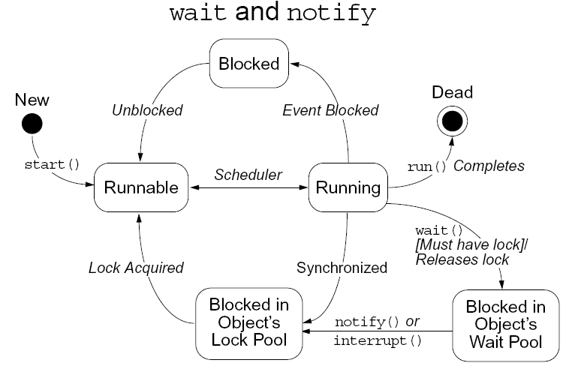

Slide 92
Difference between stop(),suspend() resume()
stop() - terminate the thread execution,
Once a thread is stopped, it cannot be restarted with the start() command.
Can pause the execution of a thread with the sleep() method.
The thread will sleep for a certain period of time and then begin executing when the time limit is reached.
But, this is not ideal if the thread needs to be started when a certain event occurs. In this case, the suspend() method allows a thread to temporarily cease executing. resume() method allows the suspended thread to start again.

Slide 93
Deadlock

Slide 94
→A special type of error that you need to avoid that relates specifically to multitasking is deadlock, which occurs when two threads have a circular dependency on a pair of synchronized objects.
→For example, suppose one thread enters the monitor on object X and another thread enters the monitor on object Y. If the thread in X tries to call any synchronized method on Y, it will block as expected. However, if the thread in Y, in turn, tries to call any synchronized method on X, the thread waits forever, because to
access X, it would have to release its own lock on Y so that the first thread could complete.

Slide 95
→Deadlock is a difficult error to debug for two reasons:
  ■ In general, it occurs only rarely, when the two threads time-slice in just the right way.
  ■ It may involve more than two threads and two synchronized objects. (That is , deadlock can occur through a more convoluted sequence of events than just described.)

Slide 96
class A {
synchronized void foo(B b) {
String name = Thread.currentThread().getName();
System.out.println(name + " entered A.foo");
try {
Thread.sleep(1000);
} catch(Exception e) {
System.out.println("A Interrupted");
}
System.out.println(name + " trying to call B.last()");
b.last();
}
synchronized void last() {
System.out.println("Inside A.last");
}
}

Slide 97
Class B
{
synchronized void bar(A a) {
String name = Thread.currentThread().getName();
System.out.println(name + " entered B.bar");
try {
Thread.sleep(1000);
} catch(Exception e) {
System.out.println("B Interrupted");
}
System.out.println(name + " trying to call A.last()");
a.last();
}
synchronized void last() {
System.out.println("Inside A.last");
}
}

Slide 98
class Deadlock implements Runnable {
A a = new A();
B b = new B();
Deadlock() {
Thread.currentThread().setName("MainThread");
Thread t = new Thread(this, "RacingThread");
t.start();
a.foo(b); // get lock on a in this thread.
System.out.println("Back in main thread");
}
public void run() {
b.bar(a); // get lock on b in other thread.
System.out.println("Back in other thread");
}
public static void main(String args[]) {
new Deadlock();
}
}

Slide 99

Example:- DeadLock.java
OUTPUT:-
MainThread entered A.foo
RacingThread entered B.bar
RacingThread trying to call A.last()
MainThread trying to call B.last()
Because the program has deadlocked, you need to press CTRL-C to end the program.

Slide 100

Thread pool

Slide 101
Java Thread pool represents a group of worker threads that are waiting for the job and reuse many times.
In case of thread pool, a group of fixed size threads are created. A thread from the thread pool is pulled out and assigned a job by the service provider. After completion of the job, thread is contained in the thread pool again.

Slide 102
Advantage of Java Thread Pool
Better performance It saves time because there is no need to create new thread.
Real time usage
It is used in Servlet and JSP where container creates a thread pool to process the request.

Slide 103
A thread pool is represented by an instance of the class ExecutorService. With an ExecutorService, you can submit task that will be completed in the future. Here are the type of thread pools you can create with the Executors class :
Single Thread Executor : A thread pool with only one thread. So all the submitted tasks will be executed sequentially. Method
Executors.newSingleThreadExecutor()

Slide 104
Fixed Thread Pool : A thread pool with a fixed number of threads. If a thread is not available for the task, the task is put in queue waiting for an other task to ends. Method : Executors.newFixedThreadPool()
Scheduled Thread Pool : A thread pool made to schedule future task. Method : Executors.newScheduledThreadPool()
Single Thread Scheduled Pool : A thread pool with only one thread to schedule future task. Method : Executors. newSingleThreadScheduledExecutor()

Slide 105
Cached Thread Pool : A thread pool that creates as many threads it needs to execute the task in parallel. The old available threads will be reused for the new tasks. If a thread is not used during 60 seconds, it will be terminated and removed from the pool. Method : Executors.newCachedThreadPool()

Slide 106
Future and callable
Future allows you to control your threads, checking to see if they're running or not, waiting for results and even interrupting them or rescheduling them.
The Callable interface is similar to Runnable, in that both are designed for classes whose instances are potentially executed by another thread.
A Runnable, however, does not return a result and cannot throw a checked exception.

Slide 107
public String call() throws Exception {
String s="Callable Task Run at “ + System.currentTimeMillis();
return s;
}

Slide 108
Fork and Join
Fork-Join breaks the task at hand into mini-tasks until the mini-task is simple enough that it can be solved without further breakups. It’s like a divide-and-conquer algorithm.

Slide 109
It employs pseudocode
Result solve(Problem problem)
{
if (problem is small)
directly solve problem
else {
split problem into independent parts
fork new subtasks to solve each part
join all subtasks
compose result from subresults
}
}

Slide 110
Annotations

Slide 111
Java Annotation is a tag that represents the metadata i.e. attached with class, interface, methods or fields to indicate some additional information which can be used by java compiler and JVM.
Annotations in java are used to provide additional information, so it is an alternative option for XML and java marker interfaces

Slide 112
Built-In Java Annotations used in java code
@Override
@SuppressWarnings
@Deprecated
Built-In Java Annotations used in other annotations
@Target
@Retention
@Inherited
@Documented

Slide 113
In its simplest form, an annotation looks like the following:
@Entity
The at sign character (@) indicates to the compiler that what follows is an annotation. In the following example, the annotation's name is Override:
@Override void mySuperMethod() { ... }

Slide 114
The annotation can include elements, which can be named or unnamed, and there are values for those elements:
@Author( name = "Benjamin Franklin", date = "3/27/2003" ) class MyClass() { ... }
or
@SuppressWarnings(value = "unchecked") void myMethod() { ... }

Slide 115
If there is just one element named value, then the name can be omitted, as in:
@SuppressWarnings("unchecked") void myMethod() { ... }
It is also possible to use multiple annotations on the same declaration:
  @Author(name = "Jane Doe")
  @EBook class MyClass { ... }

Slide 116
If the annotations have the same type, then this is called a repeating annotation:
@Author(name = "Jane Doe") @Author(name = "John Smith") class MyClass { ... }
Override and SuppressWarnings are predefined Java annotations.
It is also possible to define your own annotation type.
The Author and Ebook annotations in the previous example are custom annotation types.

Slide 117
Annotations are notes in Java programs to instruct the Java compiler to do something. Java provides three standard annotations and four standard meta-annotations.
An annotation type is a special interface type.
An annotation is an instance of an annotation type.
An annotation type has a name and members.
The information contained in an annotation takes the form of key/value pairs.

Slide 118
There can be zero or multiple pairs and each key has a specific type.
It can be a String, int, or other Java types.
Annotation types with no key/value pairs are called marker annotation types.
Those with one key/value pair are referred to single-value annotation types.

Slide 119
There are three annotation types in Java 5: Deprecated, Override, and Suppress Warnings.
There are four other annotation types that are part of the java.lang.annotation package: Documented, Inherited, Retention, and Target.
These four annotation types are used to annotate annotations.

Slide 120
The Annotation Interface
An annotation type is a Java interface.
All annotation types are subinterfaces of the java.lang.annotation.Annotation interface.
It has one method, annotation Type, that returns an java.lang.Class object.
java.lang.Class<? extends Annotation> annotationType()

Slide 121
Using Default Values
Annotation default values is used if no value is specified.
A default value is specified by adding a default clause.
Default value must be of a type compatible with type.

Slide 122
Here is @MyAnnotation rewritten to include default values:
@Retention(RetentionPolicy.RUNTIME) @interface MyAnnotation {
String stringValue() default "defaultString";
int intValue() default 101;
}

Slide 123
This declaration gives a default value of "Testing" to str and 9000 to val.
This means that neither value needs to be specified when @MyAnno is used.
However, either or both can be given values if desired.
Therefore, following are the four ways that @MyAnnotation can be used:

Slide 124
@MyAnnotation() // both str and val default @MyAnnotation(stringValue = "some string") // val defaults
@MyAnnotation(intValue = 100) // str defaults @MyAnnotation(stringValue = "Testing", intValue = 100) // no defaults

Slide 125
Marker Annotations
Marker Annotations are used to mark a declaration.
A marker annotation is a special kind of annotation.
A marker annotation contains no members.
Using isAnnotationPresent( ) to determine if the marker is present.

Slide 126
import java.lang.annotation.Annotation;
import java.lang.annotation.Retention;
import java.lang.annotation.RetentionPolicy;
import java.lang.reflect.Method; @Retention(RetentionPolicy.RUNTIME)
@interface MyAnnotation { }
@MyAnnotation
public class MainClass {
// Annotate a method.
@MyAnnotation()
public static void myMethod() { }
public static void main(String[] arg)
{ try { MainClass ob = new MainClass();
Method m = ob.getClass( ).getMethod("myMethod");
Annotation[] annos = m.getAnnotations();
System.out.println("All annotations for myMeth:");
for(Annotation a : annos)
System.out.println(a); }
catch (Exception exc) { } } }
All annotations for myMeth: @MyAnnotation()

Slide 127
Single-Member Annotations
Single-Member Annotations contains only one member.
Single-Member Annotations allow a shorthand form of specifying the value.
The name of the member must be value.

Slide 128
import java.lang.annotation.Annotation;
import java.lang.annotation.Retention;
import java.lang.annotation.RetentionPolicy;
import java.lang.reflect.Method; @Retention(RetentionPolicy.RUNTIME)
@interface MyAnnotation { int value(); } @MyAnnotation(102)
public class MainClass { // Annotate a method. @MyAnnotation(101)
public static void myMethod() { }
public static void main(String[] arg)
{ try {
MainClass ob = new MainClass();
Method m = ob.getClass( ).getMethod("myMethod");
Annotation[] annos = m.getAnnotations();
System.out.println("All annotations for myMeth:");
for(Annotation a : annos) System.out.println(a); }
catch (Exception exc) { } } }
All annotations for myMeth: @MyAnnotation(value=101)

Slide 129
Built-in Annotations
Java has three built-in annotations:
@Override
@Deprecated
@SuppressWarnings

Slide 130
@Override:
While overriding a method in the child class, we should use this annotation to mark that method.
This makes code readable and avoid maintenance issues, such as: while changing the method signature of parent class, you must change the signature in child classes (where this annotation is being used) otherwise compiler would throw compilation error.
This is difficult to trace when you haven’t used this annotation.

Slide 131
Example
public class MyParentClass {
public void justaMethod() {
System.out.println("Parent class method");
}
}
public class MyChildClass extends MyParentClass {
@Override
public void justaMethod() {
System.out.println("Child class method");
}
}

Slide 132
@Deprecated:
@Deprecated annotation indicates that the marked element (class, method or field) is deprecated and should no longer be used.
The compiler generates a warning whenever a program uses a method, class, or field that has already been marked with the @Deprecated annotation.
When an element is deprecated, it should also be documented using the Javadoc @deprecated tag, as shown in the following example.
Make a note of case difference with @Deprecated and @deprecated.
@deprecated is used for documentation purpose.

Slide 133
Example
/*
* @deprecated
* reason for why it was deprecated
*/
@Deprecated
public void anyMethodHere(){
// Do something
}
Now, whenever any program would use this method, the compiler would generate a warning.

Slide 134
@SuppressWarnings:
This annotation instructs compiler to ignore specific warnings.
For example in the below code, I am calling a deprecated method (lets assume that the method deprecatedMethod() is marked with @Deprecated annotation) so the compiler should generate a warning, however I am using @SuppressWarnings annotation that would suppress that deprecation warning.

Slide 135
Example
@SuppressWarnings("deprecation")
void myMethod() { myObject.deprecatedMethod();
}

Slide 136
Some Restrictions
No annotation can inherit another.
All methods declared by an annotation must be without parameters.
Annotations cannot be generic.
They cannot specify a throws clause.
They must return one of the following:
A simple type, such as int or double, An object of type String or Class An enum type Another annotation type An array of one of the preceding types

