Slide 1
Fairness
In AI model

Slide 2
Fairness
Fairness refers to ensuring that algorithms and models do not discriminate against individuals or groups based on sensitive attributes such as race, gender, or ethnicity.[wikipedia]
Bias and fairness in AI are two sides of the same coin; bias is a result, fairness is an action. Bias is inherently present in the world around us and is where prejudice is put into practice (consciously or unconsciously). Fairness is the absence of prejudice or preference for an individual or group based on their characteristics. For decades, bias in machine learning has been recognized as a potential concern, but it remains a complex and challenging issue for machine learning researchers and engineers when deploying models into production.[azire[

Slide 3
Bias
Bias in machine learning refers to systematic errors that arise during the development and application of ML algorithms, often due to the presence of discriminatory or unfair patterns in data. In these cases, the model perpetuates or amplifies biases or discrimination due to the patterns in the underlying data. When talking about bias, there are two types you should pay attention to: bias in relating to sensitive groups and bias relating to non-sensitive groups.
Sensitive group bias
Non-sensitive Group bias

Slide 4
Sensitive Group Bias-
Sensitive groups in machine learning are groups of individuals who are identified by a specific characteristic that is protected by law or ethics, and may be subject to discrimination or unfair treatment. These characteristics include race, ethnicity, gender, age, religion, disability, sexual orientation, and other personal attributes.
Non-Sensitive Group Bias-
Non-sensitive groups are the features that are not protected attributes. Bias for non-sensitive groups occurs when a model consistently makes errors due to its inability to represent certain aspects of the data accurately. This can happen for various reasons, such as overfitting or underfitting, inappropriate assumptions and lack of diversity in the training data.

Slide 5
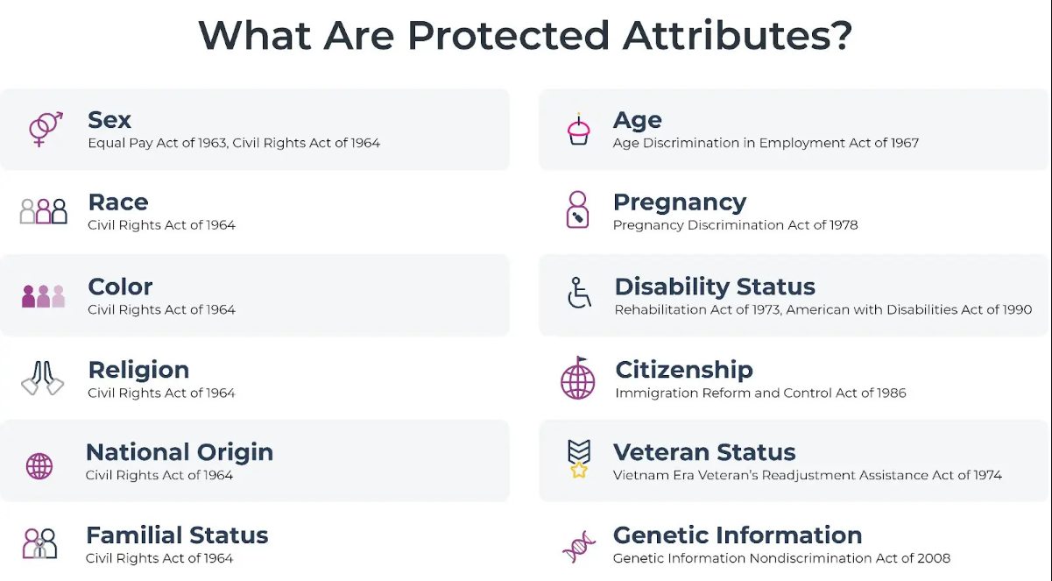

Slide 6
Types of Fairness:
Individual Fairness: Ensures that similar individuals are treated similarly by the model, regardless of their background or characteristics.
Group Fairness: Focuses on ensuring fairness for specific groups, such as racial or gender groups, by avoiding disparate impact or treatment.
Fairness Metrics:
Disparate Impact: Measures the ratio of positive outcomes for different groups, highlighting potential bias.
Equal Opportunity: Ensures that the true positive rate (sensitivity) is equal across different groups.
Statistical Parity: Requires that the probability of a positive outcome is the same for all groups.

Slide 7
Bias Detection and Mitigation:
Bias Detection: Techniques such as statistical tests or fairness-aware metrics can help identify biases in models.
Bias Mitigation: Strategies like re-weighting training examples, modifying the learning objective, or using adversarial techniques can help mitigate biases.
Fairness and Explainability:
Explainable AI (XAI) techniques can help in understanding how and why a model makes certain decisions, which is crucial for identifying and addressing biases.
Ensuring that explanations are provided in a way that is understandable and actionable for users is essential for promoting fairness.

Slide 8
Fairness Trade-offs:
There can be trade-offs between fairness and other desirable properties of a model, such as accuracy or efficiency. For example, reducing bias may lead to a decrease in overall model performance.
Understanding these trade-offs and finding a balance that aligns with the desired outcomes is important in designing fair AI models.
Legal and Ethical Considerations:
Various laws and regulations, such as the General Data Protection Regulation (GDPR) in Europe or the Fair Credit Reporting Act (FCRA) in the United States, govern the use of AI and data in decision-making.
Adhering to these regulations and considering the broader ethical implications of AI are essential for ensuring fair and responsible AI systems.
Human-in-the-Loop:
Incorporating human oversight and intervention in AI systems can help mitigate biases and ensure fairness, especially in critical or high-stakes applications.
Continual Monitoring and Feedback:
Regularly monitoring the performance of AI models, collecting feedback from users, and updating the models based on new data and insights are crucial for maintaining fairness over time.[chat-GPT]

Slide 9
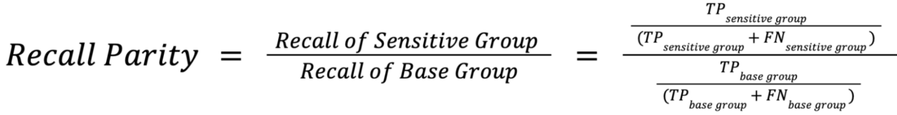
Fairness metrics[azire]
Recall Parity Formula
Recall Parity measures whether the model has equal recall rates across different subgroups. You can interpret this as how “sensitive” the model is for one group compared to another, or the model’s ability to predict true positives correctly.
If the recall parity value is greater than 1, it indicates that one subgroup has a higher recall rate than the other subgroups. This may indicate that the model is biased towards that subgroup, or that the model performs better on that subgroup due to differences in the data distribution or feature importance.
This metric is particularly relevant when the cost of a false negative (i.e., failing to identify a positive instance) is high, such as in medical diagnoses or loan approvals. Use this metric when you want to ensure that the model is not biased in favor of or against certain subgroups.

Slide 10
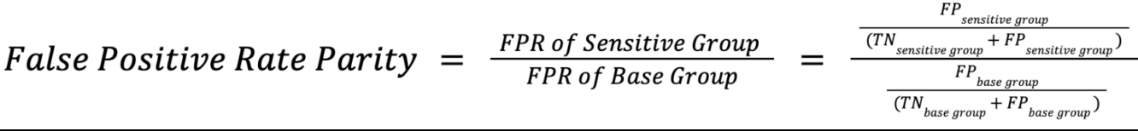
False Positive Rate Parity Formula
False positive rate parity measures whether a model incorrectly predicts the positive class for the sensitive group as compared to the base group. Ideal false positive rate parity is achieved if the false positive rates (the ratio between the number of false positives and the total number of negatives) in the subgroups are close to each other.
If the FPR Parity value is greater than 1, it would mean that the false positive rate is higher for the sensitive group compared to the base group. If the FPR Parity value is less than 1, it would mean that the false positive rate is lower for one subgroup compared to other subgroups.
This metric is particularly relevant when the cost of a false positive (i.e., incorrectly identifying a negative instance as positive) is high, such as in criminal justice or hiring decisions. Use this metric when you want to ensure that the model is not biased in favor of or against certain subgroups.

