Slide 1
A new data structure: dictionary

Slide 2
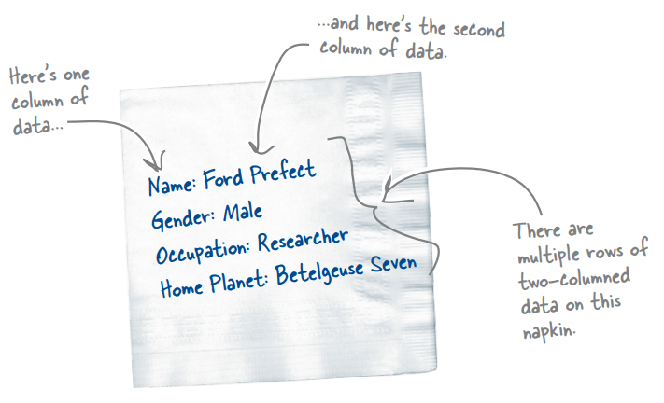
What is dictionary?
A dictionary stores
key / value pairs
Dictionary is unordered

Slide 3
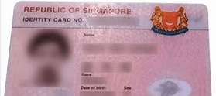
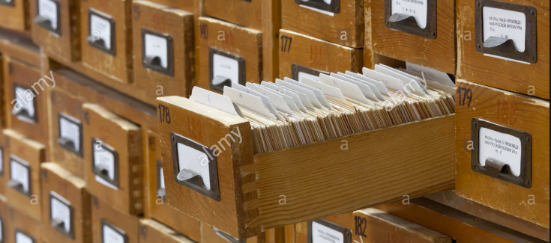
A dictionary stores key / value pairs
Some real-life example:
Example 1)
NRIC – Person
Example 2)
Library card – library book

Slide 4
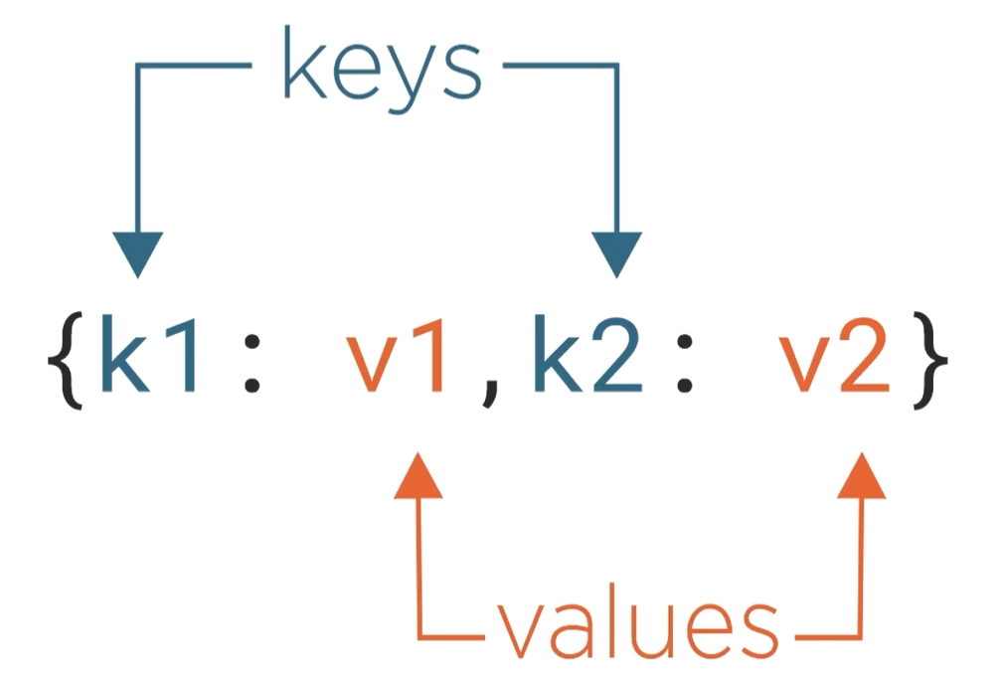
Define a dictionary

Slide 5
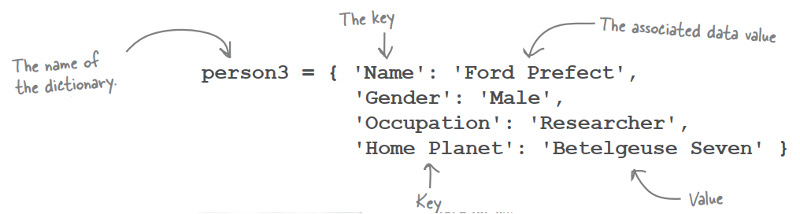
Define a dictionary

Slide 6
