Slide 1

Tree
A non-linear data structure
A hierarchical data structure

Slide 2
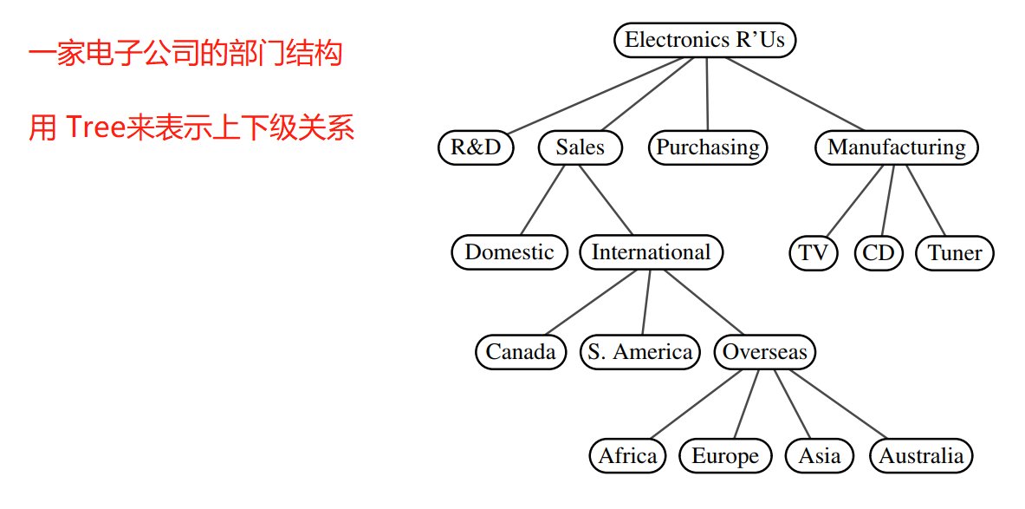
Tree example 1 – a company

Slide 3
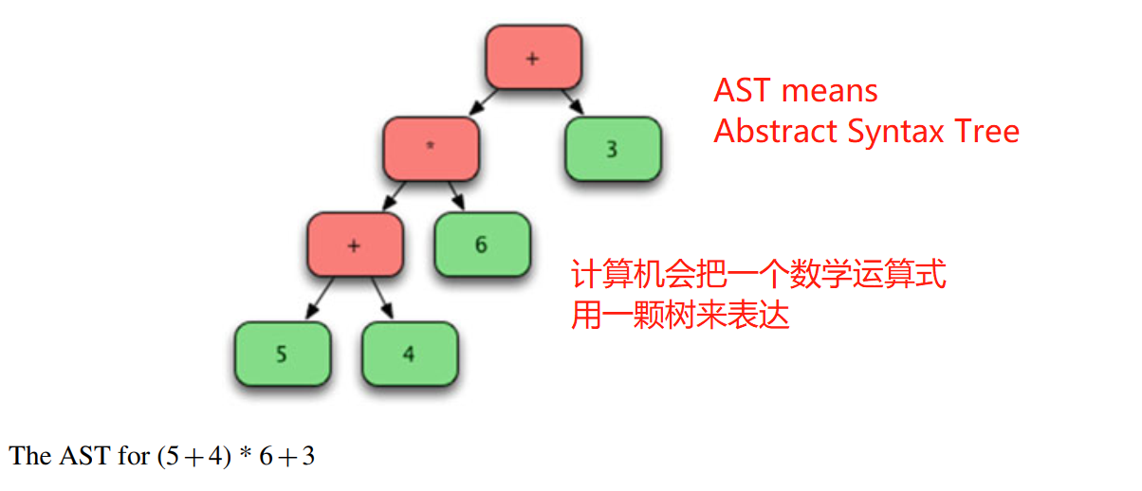
Tree example 2 – a math expression

Slide 4
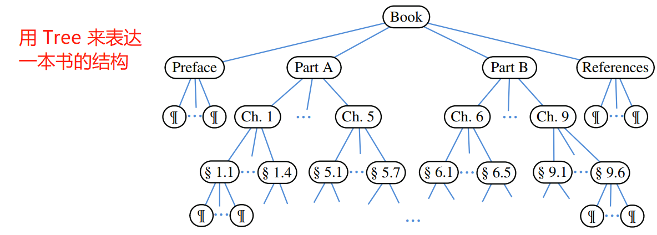
Tree example 3 – a book

Slide 5
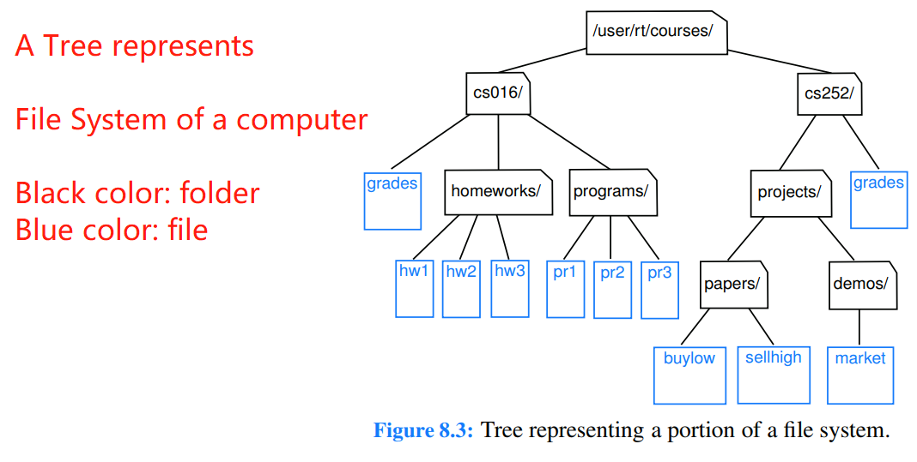
Tree example 4 – File System

Slide 6
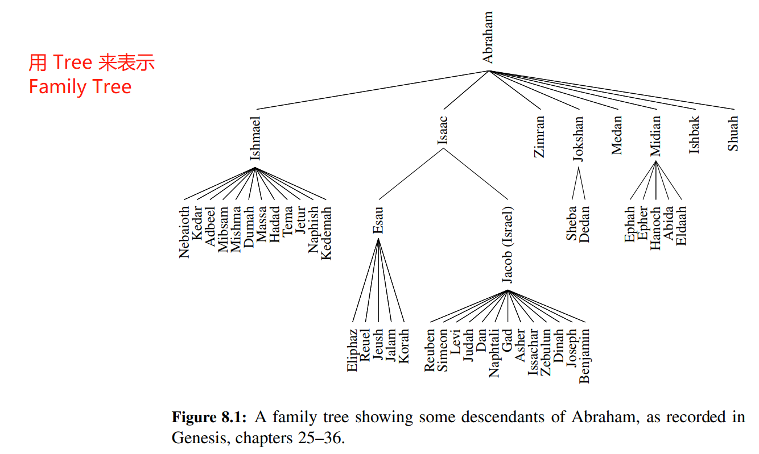
Tree example 5 – a family Tree

Slide 7
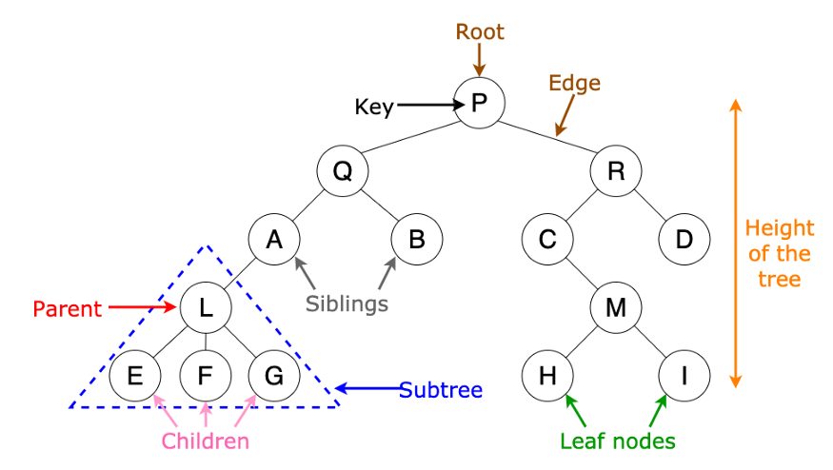
Tree terminology (1)

Slide 8
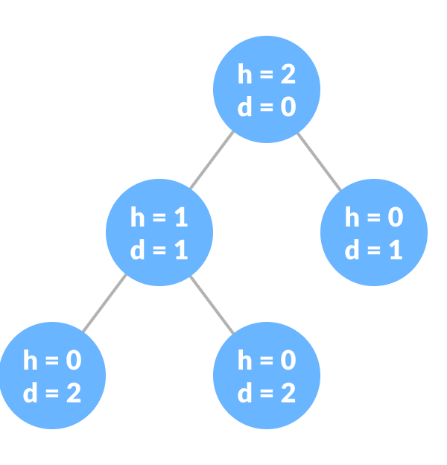
Tree terminology (2) – height & depth
Height of a node:
count from the node to the deepest leaf
Depth of a node:
count from root to the node

Slide 9
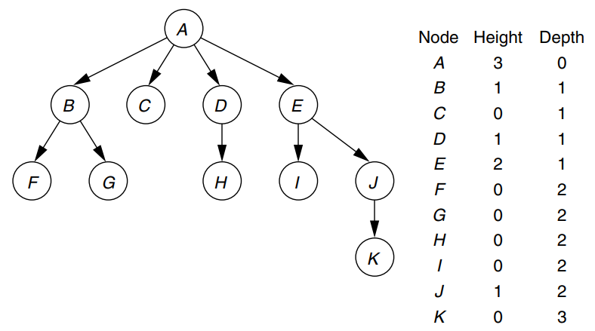
Tree terminology (2) – height & depth

Slide 10
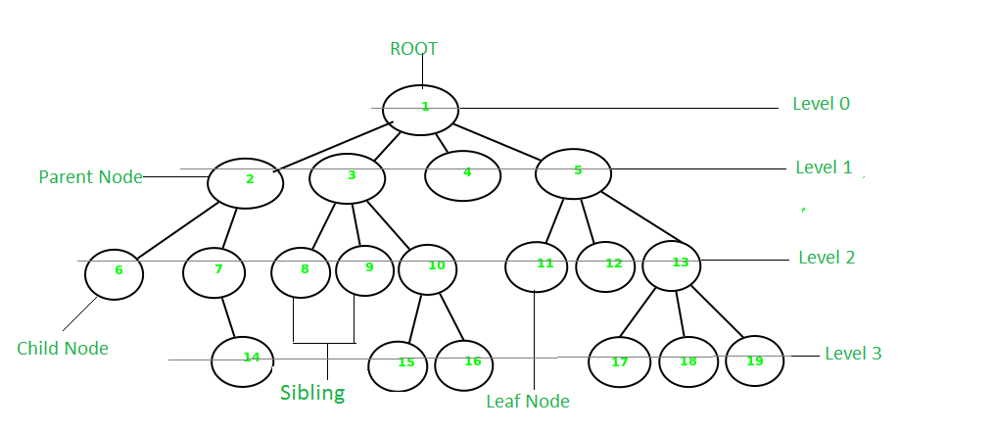
Tree terminology (3)

Slide 11
Tree character
1) Each node has 1 parent node (except root node)
2) Each node has 0 to many children node
3) There exists only 1 path from root node to any node of the Tree

Slide 12
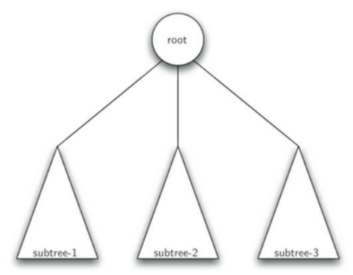
What is Tree?
Recursive Definition:
A tree is
either empty
or a root node + 0 to many subtrees.

Slide 13
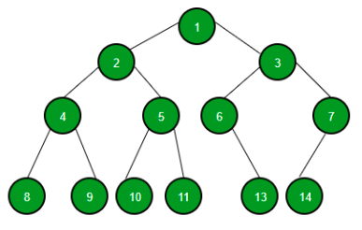
Binary Tree / 二叉树
In a Binary Tree, each node has 0 child, 1 child or 2 children.

Slide 14
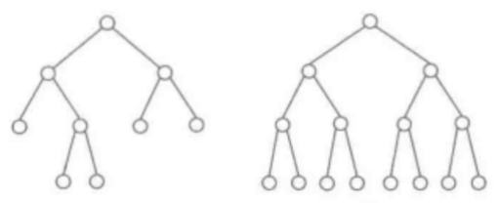
Full Binary Tree / 满二叉树
Internal nodes always have two children.

Slide 15
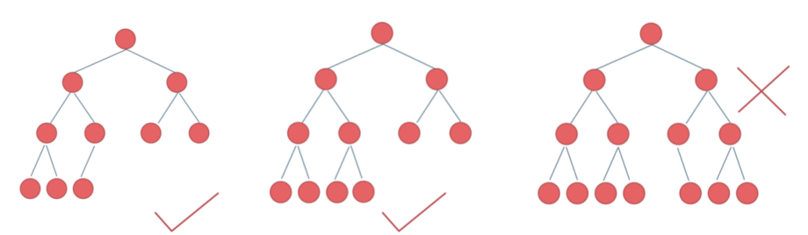
Complete Binary Tree / 完全二叉树
every level, except the deepest, is completely filled.
At the deepest level, all nodes must be as far left as possible.

Slide 16
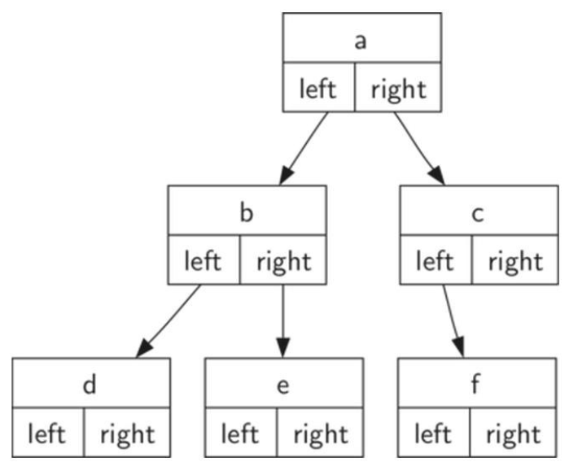
Binary Tree in Python Code
A Binary Tree is composed of nodes
Each node is composed of a key and 2 pointers
The key stores the node data
The 2 pointers point to left child and right child

Slide 17
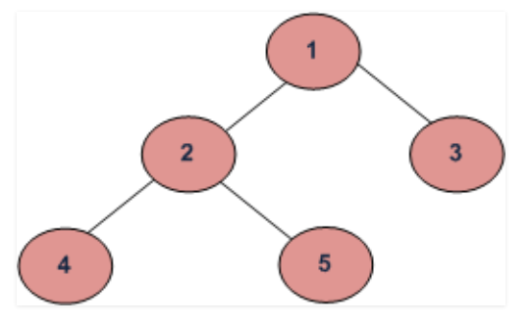
Tree Traversal – Depth First Traversals
Inorder (Left, Root, Right) :
4 2 5 1 3
(b) Preorder (Root, Left, Right) :
1 2 4 5 3
(c) Postorder (Left, Right, Root) :
4 5 2 3 1

Slide 18
Tree Traversal – Depth First Traversals - Inorder
Inorder (Left, Root, Right) : 4 2 5 1 3
Step 1) Traverse the left subtree
Step 2) Visit the root
Step 3) Traverse the right subtree

Slide 19
Tree Traversal – Depth First Traversals - Preorder
Preorder (Root, Left, Right) : 1 2 4 5 3
Step 1) Visit the root
Step 2) Traverse the left subtree
Step 3) Traverse the right subtree

Slide 20
Tree Traversal – Depth First Traversals - Postorder
Postorder (Left, Right, Root) : 4 5 2 3 1
Step 1) Traverse the left subtree
Step 2) Traverse the right subtree
Step 3) Visit the root

