Slide 1
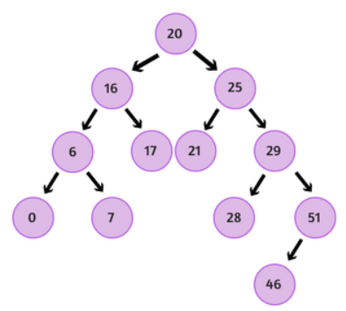
What is Tree Traversal?
It means ‘walking the tree’.
It means, ‘visiting all nodes of the tree’.
What rule shall we follow
to visit all elements of a tree?

Slide 2
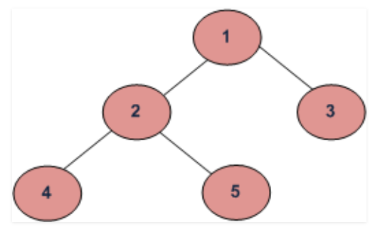
Tree Traversal – Depth First Traversals - Preorder
Preorder (Root, Left, Right) : 1 2 4 5 3
Step 1) Visit the root - 1
Step 2) Traverse the left subtree – 2 4 5
Step 3) Traverse the right subtree - 3

Slide 3
Tree Traversal – Depth First Traversals – Inorder
Inorder (Left, Root, Right) : 4 2 5 1 3
Step 1) Traverse the left subtree – 4 2 5
Step 2) Visit the root - 1
Step 3) Traverse the right subtree - 3

Slide 4
Tree Traversal – Depth First Traversals - Postorder
Postorder (Left, Right, Root) : 4 5 2 3 1
Step 1) Traverse the left subtree – 4 5 2
Step 2) Traverse the right subtree - 3
Step 3) Visit the root - 1

Slide 5
Tree Traversal – Depth First Traversals
Inorder (Left, Root, Right) :
4 2 5 1 3
(b) Preorder (Root, Left, Right) :
1 2 4 5 3
(c) Postorder (Left, Right, Root) :
4 5 2 3 1

