Slide 1
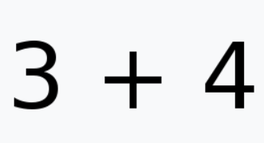
Infix notion – 中序表达式 place operator between operands

Slide 2
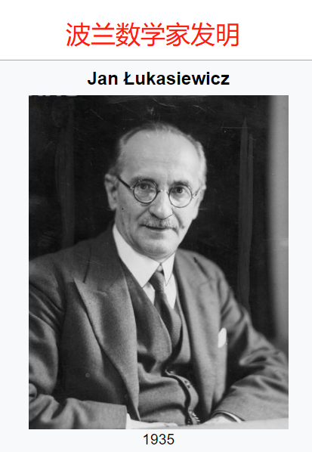
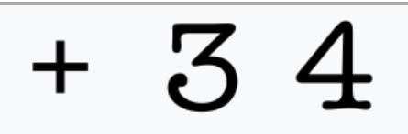
Polish Notation (PN)
operator precedes their operands
prefix notation – 前序表达式 – 1920年发明

Slide 3
Why we need polish notion? – to kill ()
(5 − 6) × 7 => × − 5 6 7
5 − (6 × 7) => − 5 × 6 7
How to convert to Polish Notion?
Let’s hold on for a while

Slide 4
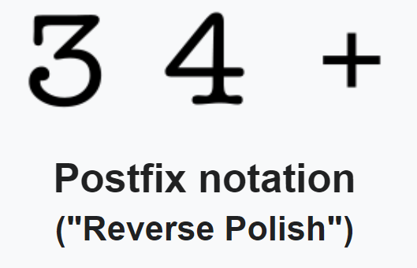
Reverse Polish Notation (RPN)
operators follows their operands
postfix notation – 后序表达式

Slide 5
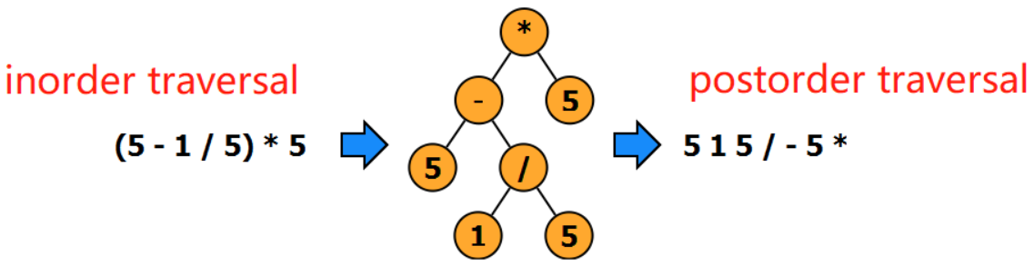
Reverse Polish Notation is Tree PostOrder Traversal
Polish Notion is Tree PreOrder Traversal -> Revisit Page 3

Slide 6
All math calculations in computer use
Reverse Polish Notion (PRN)
Why? Because using stack
Makes things so simple!

