Slide 1
database

Slide 2
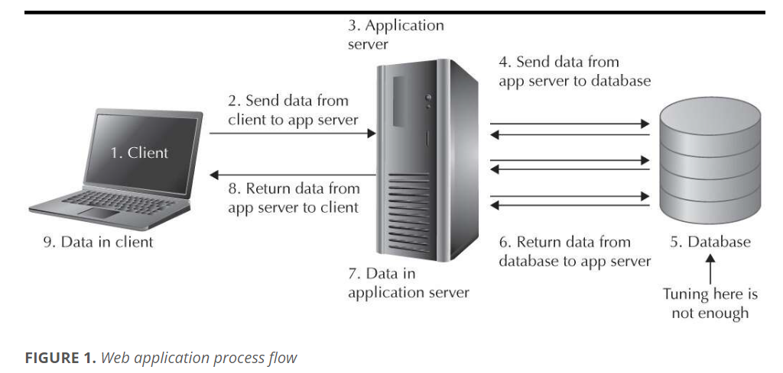
What is database?
Database is where all data are stored.

Slide 3
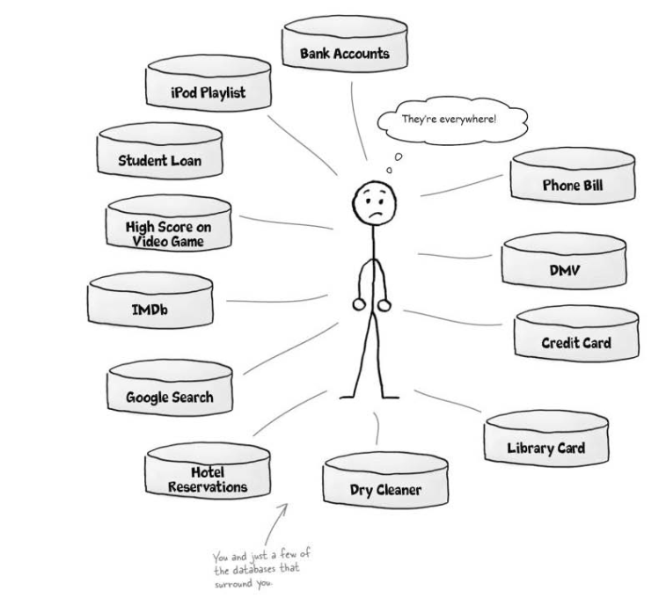
Our life is surrounded by databases

Slide 4
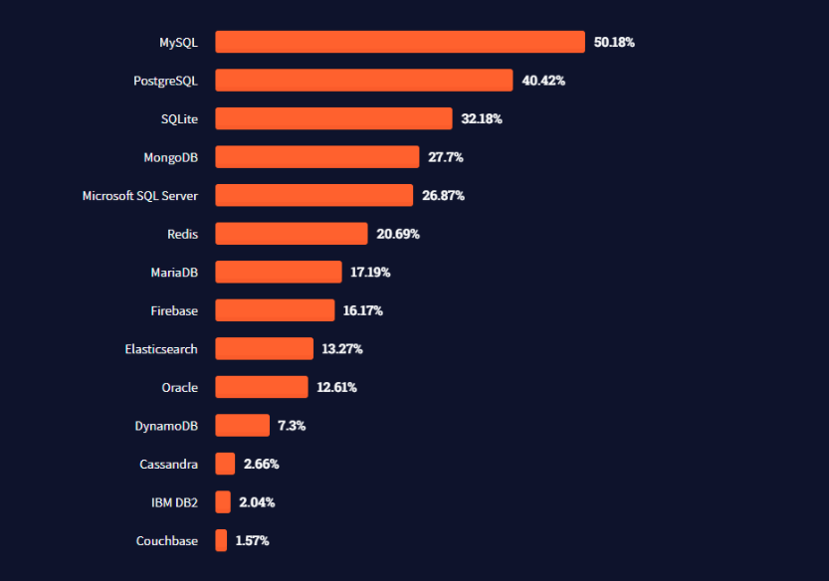
Famous database brand
We are going to use
SQLite database

Slide 5
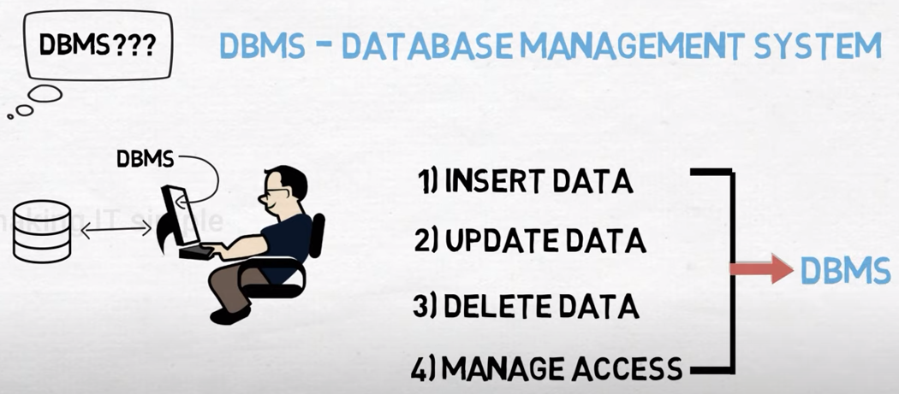
DBMS – DataBase Management System

Slide 6
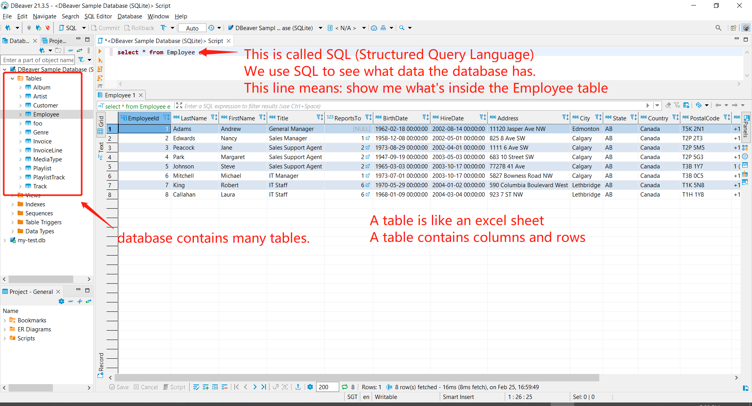
What database looks like?

Slide 7
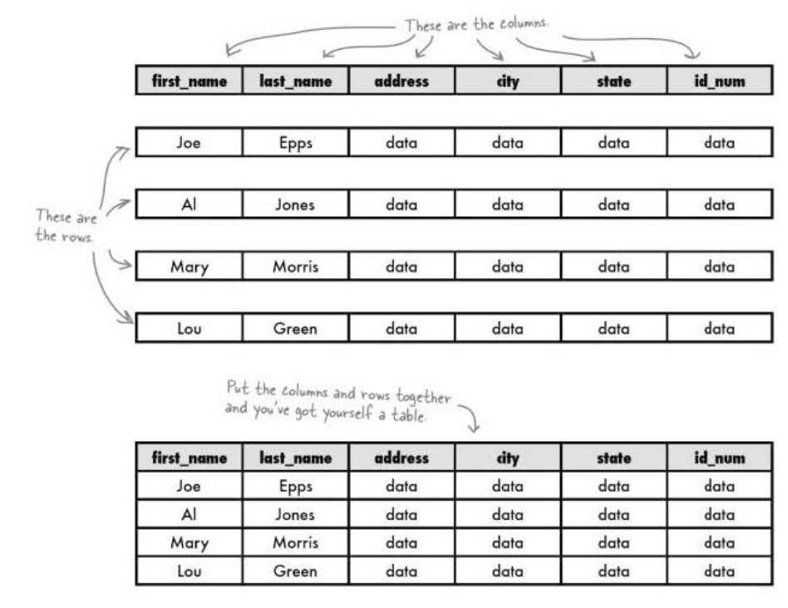
A table has multiple columns and many rows

Slide 8
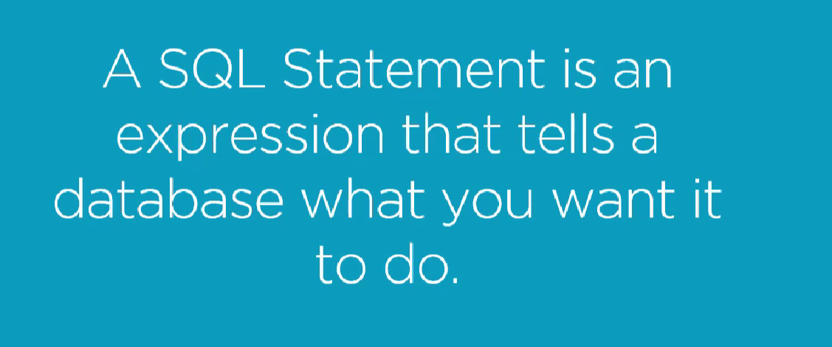
What is SQL (Structured Query Language)?

