Slide 1
trigonometry

Slide 2
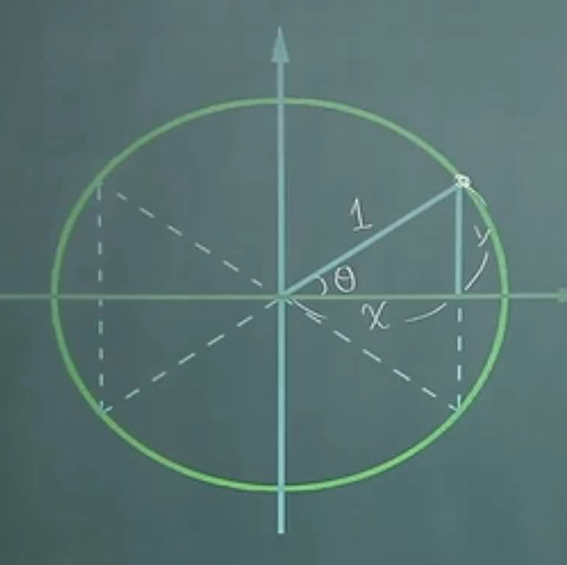
Unit circle
radius = 1
dot A on the circle
The coordinate is (x, y)
hypotenuse = 1
opposite = y
adjacent = x

Slide 3
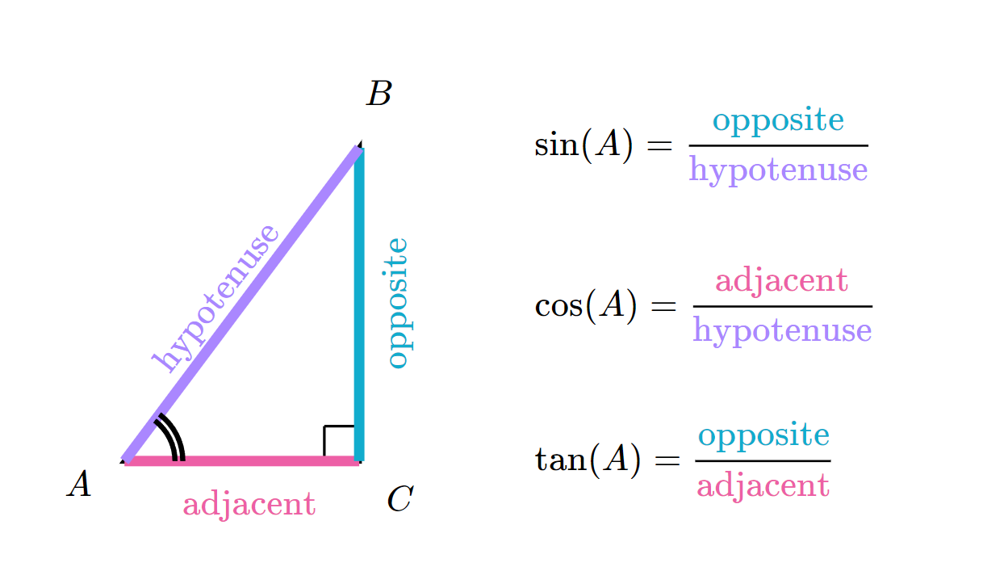

Slide 4
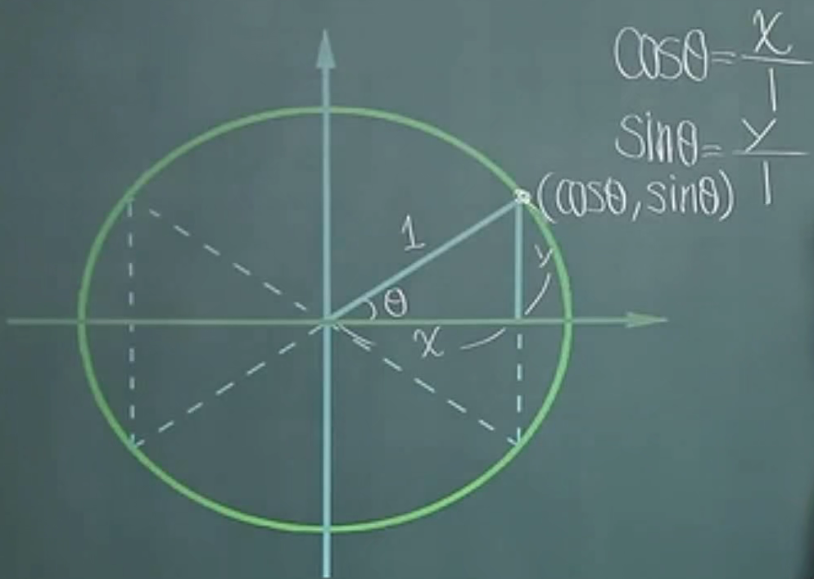
The coordinates of the dot A can be expressed as
(cos(Ɵ), sin(Ɵ))
Because
cos(Ɵ) = x/1
sin(Ɵ) = y/1

Slide 5
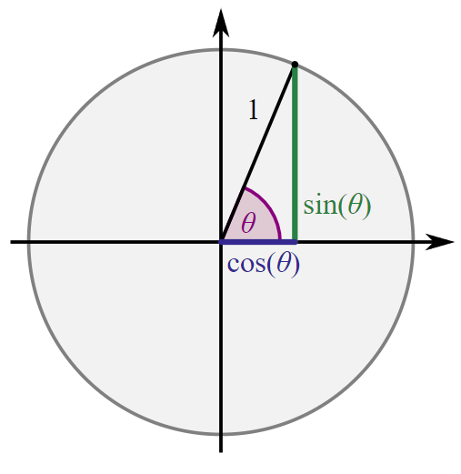

Slide 6
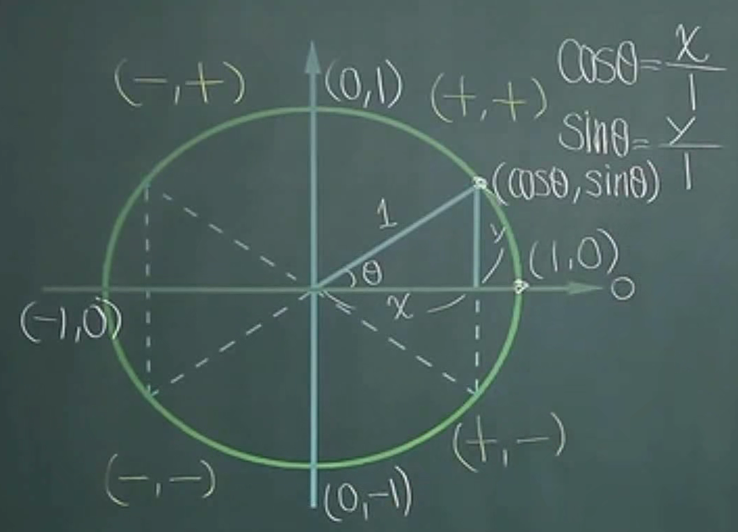
Common values
cos0=1; sin0=0
cos90=0; sin90=1
cos180=-1; sin180=0
cos270=0; sin270=-1
--------------------------------
sin120 = sin60 = √3/2
cos240 = -cos60=-1/2
以180为基准点。1) 看距离180度的大小。2) 看所在象限的正负号。

Slide 7
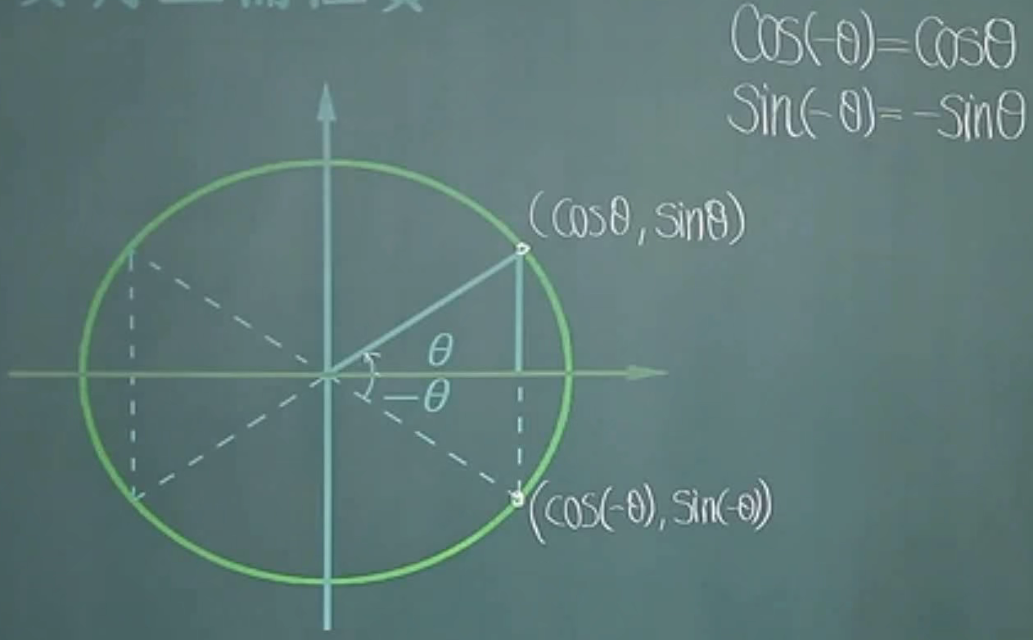
Negative degree

Slide 8
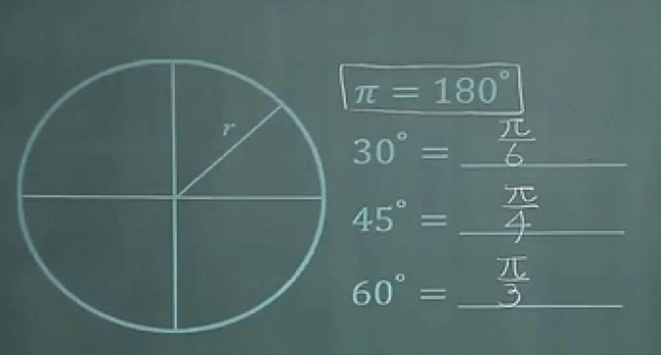
Radians – 弧度

Slide 9
