Slide 1
Internal theory of dict

Slide 2
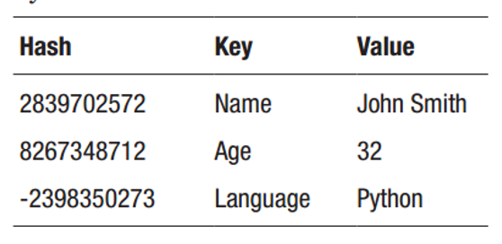
dict / HashMap / unordered_map

Slide 3
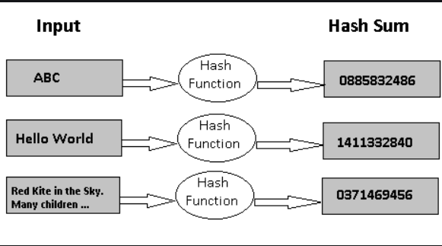
What is hash?

Slide 4
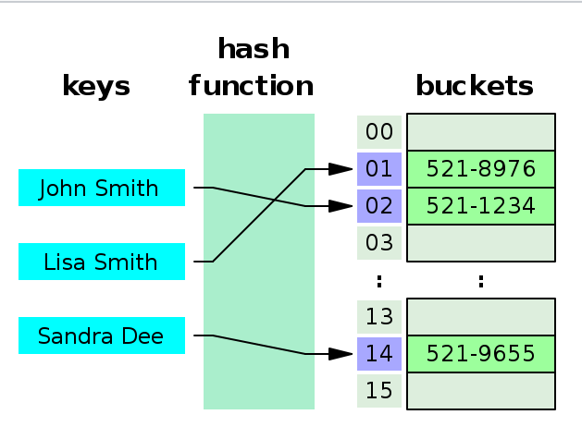
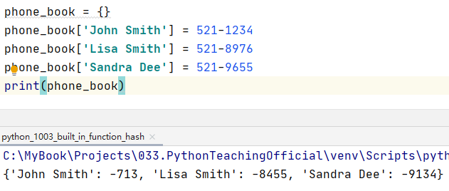
Internal theory of dict / HashMap / Hashtable

Slide 5
插入过程

Slide 6
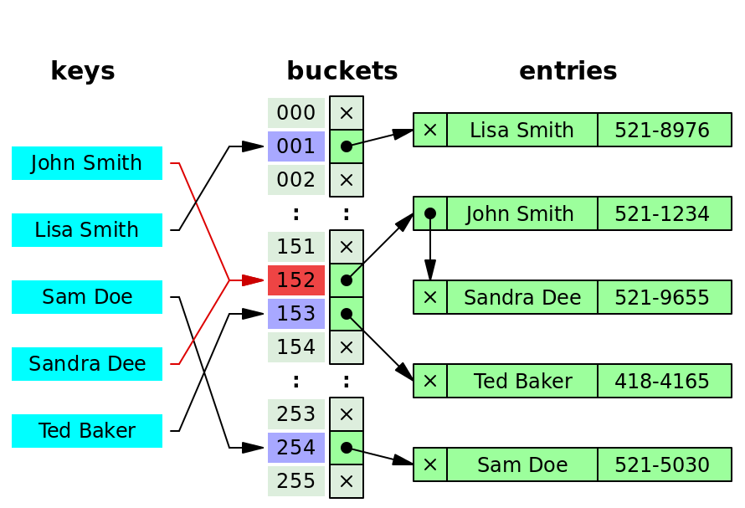
Hash collisions

Slide 7
Hash collision 插入过程

