Slide 1
What is a function in Python?
a block of organized, reusable code.
Functions provide high degree of code reusing.
Python gives you many built-in functions . So far we’ve learnt:
print(“Hello Python”) / abs(-10) / type(var_a) / range(4) / id(var_a)
sum(list) / len(list) / enumerate(list) / max(list) / min(list) / sorted(list)
You can create your own functions - user-defined functions.

Slide 2
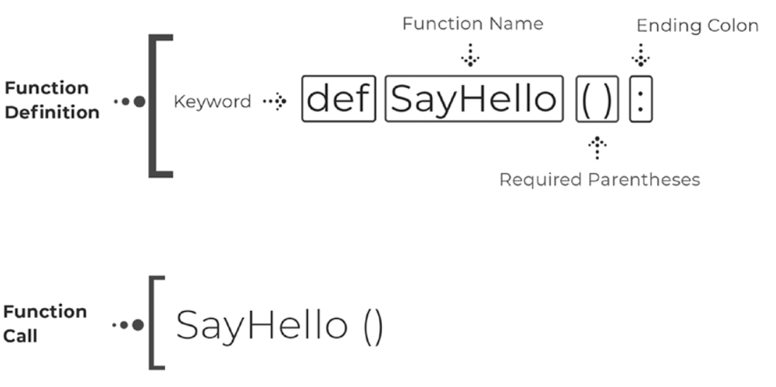
User-defined function involves 2 parts
built-in functions: python defines the function, you call it.
user-defined functions: You define the function, you call it.
Notes:
built

