Slide 1


$weather = $weatherApi->getWeather(‘Paris’, ‘FR’);
echo $weather->getTemperature();
Classe WeatherApi
https://openweathermap.org/api
Cache
Logs

Slide 2

Guzzle 5
$client->sendRequest(…)
Guzzle 6
Composant
Zend-HTTP
ReactPHP
Monolog
$logger->log(…)
cakephp/log
Composant
joomla/log
vespula/log

Slide 3

guzzle5-adapter
Guzzle 5
$client->sendRequest(…)
guzzle6-adapter
Guzzle 6
Composant
zend-adapter
Zend-HTTP
React-adapter
ReactPHP
HTTPlug
Monolog
$logger->log(…)
cakephp/log
Composant
PSR-3
joomla/log
vespula/log
Or one of the 1169 packages available…

Slide 4
Validation
Filesystem
HTTP Client
Console
Serialization
Cache
Log management
Security / User management
I18N/L10N
Database access layer
ORM
Patch management
Result sets / Paginator
Router
Template engine
Form management
Config
Package Manager
Autoloader
Dependency injection container
Event dispatcher

Slide 5
Filesystem
I18N/L10N
Event dispatcher
Serialization
Security / User management
Result sets / Paginator
HTTP Client
Cache
Utils
Mailer
Console
Image manipulation
Log management
Asset management (JS/CSS)
Web
Router
Template engine
Form management
Validation
DB
Database access layer
ORM
Patch management
Core
Package Manager
Autoloader
Dependency injection container
Config

Slide 6
~phpleague/flysystem
PSR-14
Filesystem
I18N/L10N
Event dispatcher
Serialization
beberlei/porpaginas
php-http/httplug
PSR-6
PSR-16
Utils
Security / User management
Result sets / Paginator
HTTP Client
Cache
PSR-7
Mailer
~symfony/console
Image manipulation
Log management
Console
PSR-3
webmozart/puli
Asset management (JS/CSS)
Web
PSR-7
PSR-15
Router
Template engine
Form management
Validation
PSR-17
doctrine/dbal
DB
Database access layer
ORM
Patch management
Composer
PSR-11
Package Manager
Autoloader
Dependency injection container
Core
PSR-4
Config
Voted FIG « standards »
Upcoming FIG « standards »
De-facto standards
Non FIG interfaces
Wildly used packages

Slide 7
Filesystem
I18N/L10N
PSR-14
Event dispatcher
Serialization
php-http/httplug
PSR-6
PSR-16
Utils
Security / User management
Result sets / Paginator
HTTP Client
Cache
PSR-7
Mailer
Console
Image manipulation
Log management
PSR-3
Asset management (JS/CSS)
Web
PSR-7
PSR-15
Router
Template engine
Form management
Validation
PSR-17
DB
Database access layer
ORM
Patch management
Composer
PSR-11
Package Manager
Autoloader
Dependency injection container
Core
PSR-4
Config
Voted FIG « standards »
Upcoming FIG « standards »
De-facto standards
Non FIG interfaces
Wildly used packages

Slide 8
~phpleague/flysystem
PSR-14
Filesystem
I18N/L10N
Event dispatcher
Serialization
beberlei/porpaginas
php-http/httplug
PSR-6
PSR-16
Utils
Security / User management
Result sets / Paginator
HTTP Client
Cache
PSR-7
Mailer
~symfony/console
Image manipulation
Log management
Console
PSR-3
webmozart/puli
Asset management (JS/CSS)
Web
PSR-7
PSR-15
Router
Template engine
Form management
Validation
PSR-17
doctrine/dbal
DB
Database access layer
ORM
Patch management
Composer
PSR-11
Package Manager
Autoloader
Dependency injection container
Core
PSR-4
Config
Voted FIG « standards »
Upcoming FIG « standards »
De-facto standards
Non FIG interfaces
Wildly used packages

Slide 9
~phpleague/flysystem
PSR-14
Filesystem
I18N/L10N
Event dispatcher
Serialization
beberlei/porpaginas
php-http/httplug
PSR-6
PSR-16
Utils
Security / User management
Result sets / Paginator
HTTP Client
Cache
PSR-7
Mailer
~symfony/console
Image manipulation
Log management
Console
PSR-3
webmozart/puli
Asset management (JS/CSS)
Web
PSR-7
PSR-15
Router
Template engine
Form management
Validation
PSR-17
doctrine/dbal
DB
Database access layer
ORM
Patch management
Composer
PSR-11
Package Manager
Autoloader
Dependency injection container
Core
PSR-4
Config
Voted FIG « standards »
Upcoming FIG « standards »
De-facto standards
Non FIG interfaces
Wildly used packages

Slide 10
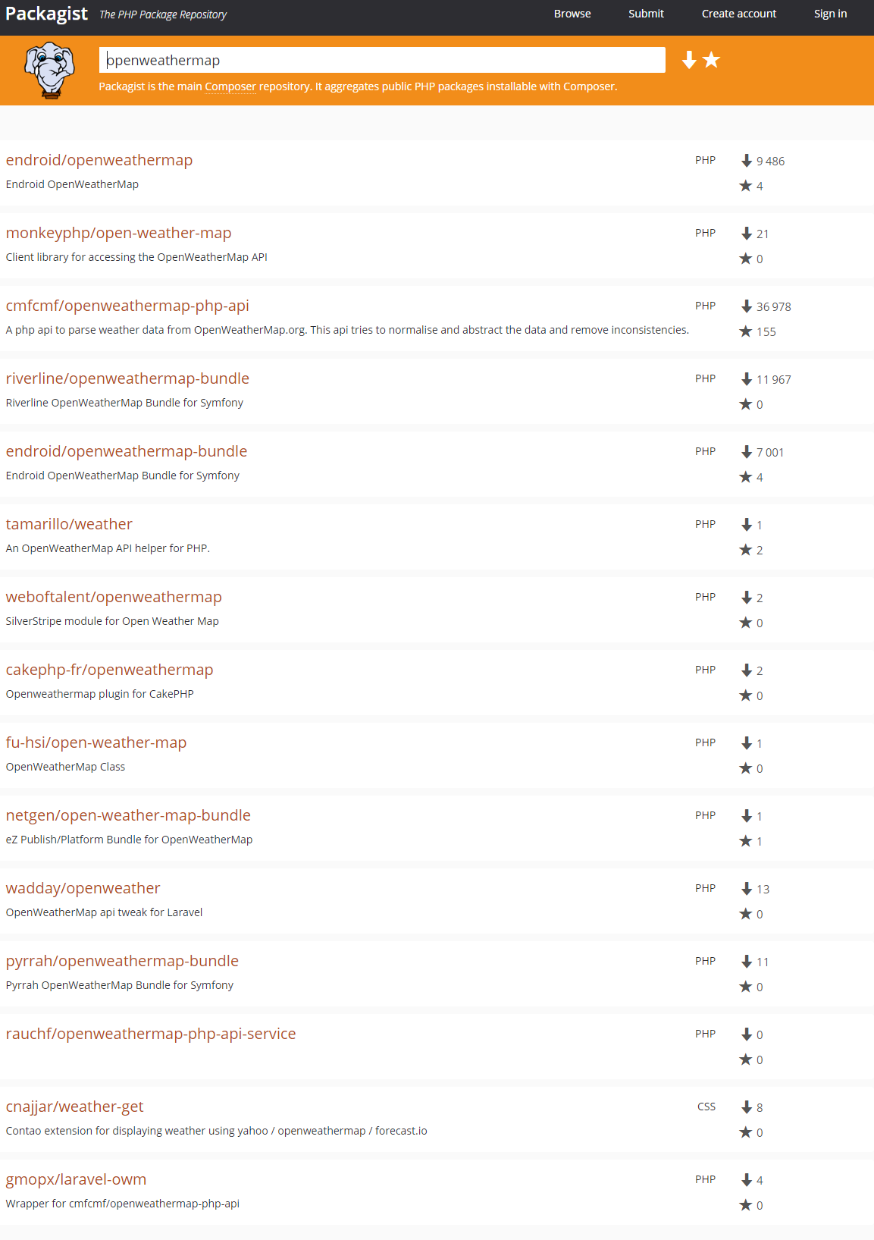
Symfony
Symfony
Silverstripe
Cake-php
Symfony
Laravel
Symfony
Contao
Laravel

Slide 11
$container->get(‘WeatherApi’)
CompositeContainer (aka root container)
MyAppContainer
WeatherApiContainer
YetAnotherContainer
…
WeatherApi
Cache
Log
HTTPClient

Slide 12
$container->get(‘WeatherApi’)
CompositeContainer (aka root container)
MyAppContainer
WeatherApiContainer
YetAnotherContainer
…
Cache
WeatherApi
Log
$container-> get(‘Log’)
HTTPClient
???

Slide 13
$container->get(‘WeatherApi’)
CompositeContainer (aka root container)
MyAppContainer
WeatherApiContainer
YetAnotherContainer
…
Cache
WeatherApi
Log
$weatherApiContainer ->get(‘Log’)
HTTPClient
???

Slide 14
$container->get(‘WeatherApi’)
CompositeContainer (aka root container)
MyAppContainer
WeatherApiContainer
YetAnotherContainer
…
Cache
WeatherApi
Log
$rootContainer ->get(‘Log’)
HTTPClient
« delegate lookup »

Slide 15
$container->get(‘TwigEngine’)
CompositeContainer (aka root container)
MyAppContainer
TwigContainer
ExtensionContainer
TwigEngine
MyTwigExtension
register ?

Slide 16
Symfony
???
logger
WeatherApiServiceProvider
Laravel
WeatherApi
Psr\Log\LoggerInterface

Slide 17
Symfony
logger
Alias
Monolog\Logger
Alias
$container->get(‘Psr\Log\LoggerInterface’)
Psr\Log\LoggerInterface
WeatherApiServiceProvider
Laravel
WeatherApi
Psr\Log\LoggerInterface

Slide 18
l33t/weatherapi-bundle
Symfony
l33t/weatherapi-zf2-module
Zend Framework
l33t/weatherapi-laravel-module
Laravel
l33t/weatherapi-drupal-module
Drupal
l33t/weatherapi-wordpress-module
Wordpress
l33t/weatherapi
l33t/weatherapi-yii-module
Yii
l33t/weatherapi-silex-module
Silex
l33t/weatherapi-mouf-installer
Mouf
l33t/weatherapi-joomla-module
Joomla
l33t/weatherapi-magento-module
Magento
l33t/weatherapi-magento2-module
Magento2

Slide 19
l33t/weatherapi-bundle
Symfony
l33t/weatherapi-zf2-module
Zend Framework
l33t/weatherapi-laravel-module
Laravel
l33t/weatherapi-drupal-module
Drupal
l33t/weatherapi-wordpress-module
Wordpress
l33t/weatherapi
l33t/weatherapi-yii-module
Yii
l33t/weatherapi-silex-module
Silex
l33t/weatherapi-mouf-installer
Mouf
l33t/weatherapi-joomla-module
Joomla
l33t/weatherapi-magento-module
Magento
l33t/weatherapi-magento2-module
Magento2

Slide 20
Symfony
Zend Framework
Laravel
Drupal
Wordpress
l33t/weatherapi
l33t/weatherapi-universal-module
Yii
Silex
Mouf
Joomla
Magento
Magento2

Slide 21
Symfony bridge
Symfony
ZF bridge
Zend Framework
Laravel bridge
Laravel
Silex bridge
Silex
l33t/weatherapi
l33t/weatherapi-universal-module
Mouf bridge
Mouf
PHP-DI
Simplex
Yaco

Slide 22
Symfony bridge
Symfony
ZF bridge
Zend Framework
Laravel bridge
Laravel
Silex bridge
Silex
l33t/weatherapi
l33t/weatherapi-universal-module
Mouf bridge
Mouf
PHP-DI
Simplex
Yaco

Slide 23
Container
MyServiceProvider
Twig_Environement
MyTwigExtension
register?

