Slide 1
Google Play Store Data Analytics
Insights and Visualizations
Prepared by: C.Raj kumar

Slide 2
Introduction
This project analyzes Google Play Store data to uncover insights about app categories, user reviews, installs, and trends. The objective is to guide app developers and marketers in understanding user preferences and improving app performance.

Slide 3
Dataset Overview
The dataset includes information about:
- App Categories
- Ratings and Reviews
- Number of Installs
- Content Rating
- Last Updated Date
Source: Google Play Store Data

Slide 4
Task Breakdown
1. Generate a word cloud for 5-star reviews (Health & Fitness category).
2. Compare average ratings and reviews for top app categories.
3. Visualize global installs using an interactive map.
4. Analyze rating distributions using a violin plot.
5. Plot time series trends for installs by app category.

Slide 5
Methodology
Tools and Libraries Used:
- Python (Pandas, Matplotlib, Plotly, etc.)
- Jupyter Notebook
Steps:
1. Data Preprocessing: Cleaning and filtering data.
2. Data Analysis: Aggregations and visualizations.
3. Insight Generation: Interpreting results for actionable findings.

Slide 6
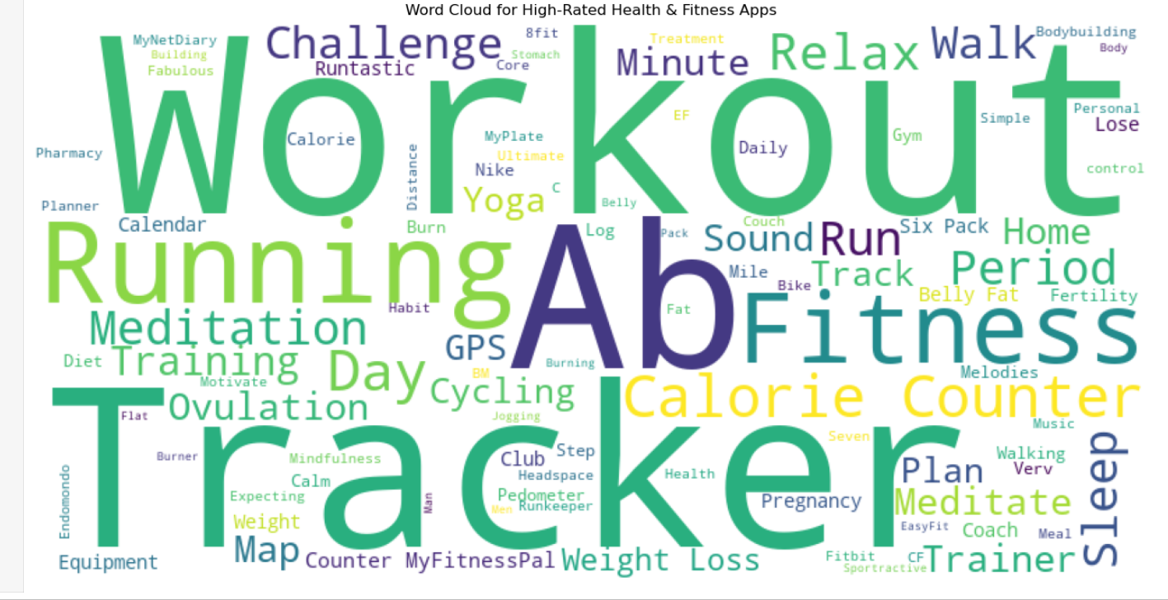
Task 1: Word Cloud for 5-Star Reviews
Analysis details and visualizations will be added here.

Slide 7
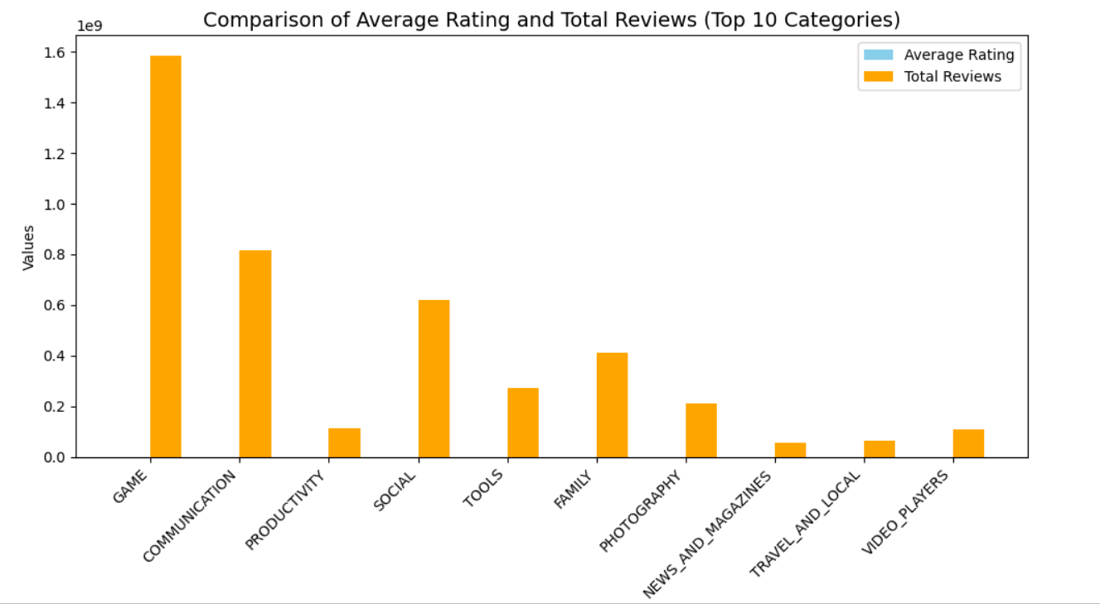
Task 2: Grouped Bar Chart for Ratings and Reviews

Slide 8
Task 3: Choropleth Map for Global Installs
Analysis details and visualizations will be added here.

Slide 9
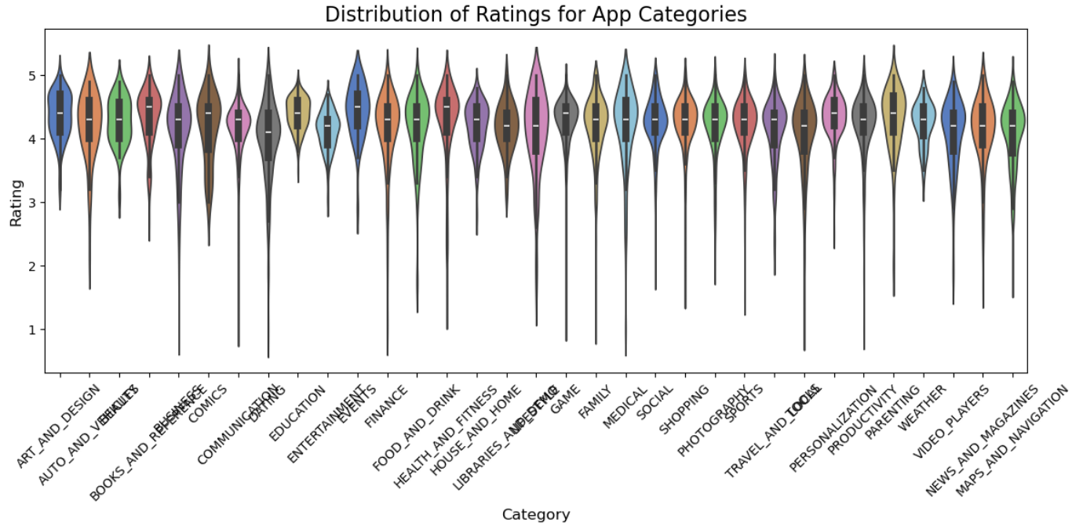
Task 4: Violin Plot for Ratings Distribution
Analysis details and visualizations will be added here.

Slide 10
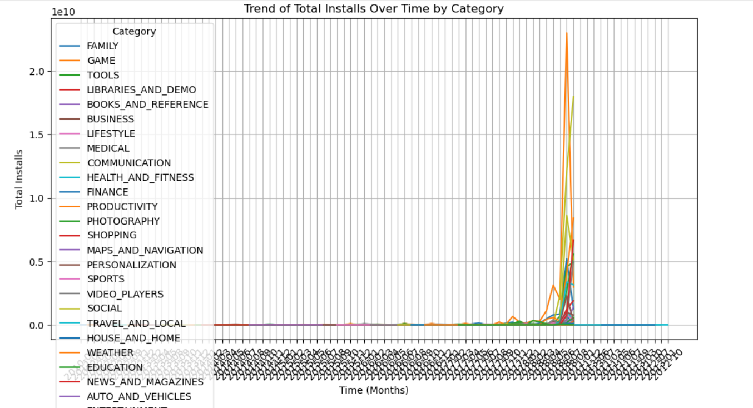
Task 5: Time Series Chart for Install Trends
Analysis details and visualizations will be added here.

Slide 11
Key Insights
- Identified recurring themes in highly-rated reviews.
- Revealed top-performing app categories based on ratings and reviews.
- Highlighted geographical trends in app installs.
- Showcased variability in user ratings across categories.
- Unveiled significant growth periods in app installs.

Slide 12
Conclusion
The analysis provides actionable insights for app developers and marketers:
- Focus on popular categories and regions.
- Improve user satisfaction by addressing recurring feedback themes.
- Optimize app launch strategies to leverage periods of significant growth.

Slide 13
Contact Information
Name: Chakali Raj kumar
Email: chakalirajkumar153@gmail.com
GitHub: https://github.com/thecodingraj/GooglePlayStore-Data-Analysis.git

