Slide 1

N-body Simulation
Parallelization of Physics calculations on GPUs with CUDA
Rahul Banerjee
Technische Universität München
Fakultät für Physik
11 July. 2019

Slide 2
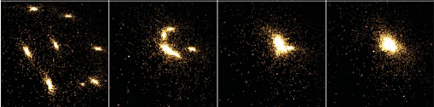
Introduction
Numerically approximates the time evolution of a system of bodies/particles that all interact with one another via a mediating force.
A simple yet highly demonstrative example is an astrophysical simulation where the mutual attraction between bodies is mediated by the gravitational force.

Slide 3

All-Pairs N-body Simulations
Brute force technique to evaluate all pair-wise interactions in a system.
Naive approach and rather straightforward implementation.
O(N²) computational complexity.
Usually used as a close-range approximator and coupled with another, faster method for long-range interactions (Barnes Hut, Fast Multipole Expansion etc).
Given N bodies with an initial position x_{i} and velocity v_{i} for 1 ≤ i ≤ N, the force vector f_{ij} on body i caused by its gravitational attraction to body j is given by the following:

Slide 4

All-Pairs N-body Simulations
Here m_{i} and m_{j} are the masses of bodies i and j, respectively; r_{ij} = x_{j} − x_{i} is the vector from body i to body j; and G is the gravitational constant.
The total force F_{i} on body i, due to its interactions with the other N − 1 bodies, is obtained by summing all interactions:

Slide 5


All-Pairs N-body Simulations
As bodies approach closer to another during the simulation, the gravitational force between them increases rapidly and this could lead to numerical instabilities and overflow/division-by-zero error.
To avoid this, a softening factor ε² > 0 is introduced and the modified equation is:
To obtain acceleration, in order to obtain velocity and position by integration, we divide by the mass.

Slide 6
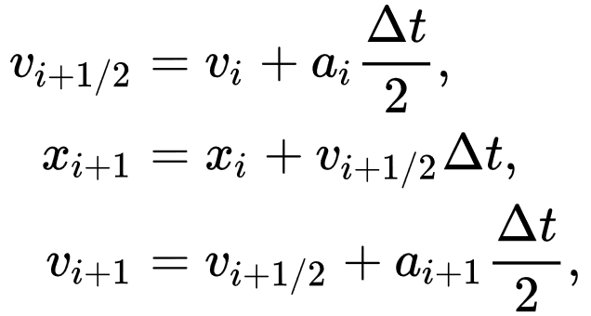
All-Pairs N-body Simulations
Once accelerations are obtained, the velocity and position of each particle is updated using a Leapfrog Integration scheme:
It scales as O(N) complexity and thus, its cost becomes negligible as compared to the problem size as the scale of the problem increases.

Slide 7
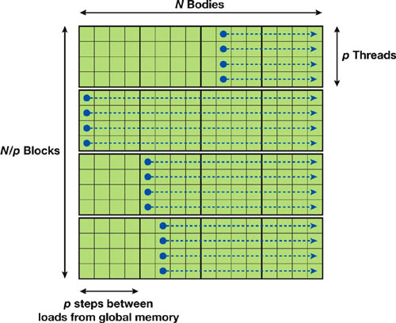
Parallelization
All-pairs algorithm can be represented by an N x N grid where each entry f_{ij} has to be calculated.
Due to a lack of interdependency, a hypothetical parallelism of O(N²) is possible. However, memory and bandwidth restrictions prevents this.

Slide 8
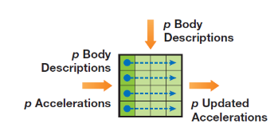
Parallelization – Computational Tile
Computational Tile is a square p x p region in the interaction table.
Load p “own” positions into a local variable (left arrow)
Load p “other” positions into shared memory (top arrow)
Sync threads
Compute p interactions in all threads, sync again and repeat.

Slide 9
Parallelization – Body-Body Force
Interaction between a pair of bodies is entirely serial.
Body descriptions stored in a float4 data type (float4 allows coalesced memory access)
Coalescing allows the storage of data into contiguous memory locations so that they can be accessed by a single or fewer memory access operations.
~20 flops in calculating the body-body force between each pair.

Slide 10
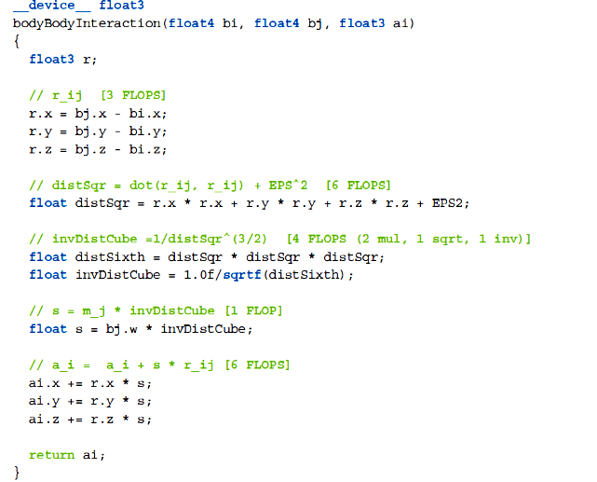
Parallelization – Body-Body Force

Slide 11
Parallelization – Tile Calculation
A tile is evaluated by p threads performing same operation sequence on different data.
p body descriptions are transferred from the device memory to the shared memory provided to each thread block.
Each thread in the block evaluates p successive interactions to get p updated accelerations.

Slide 12
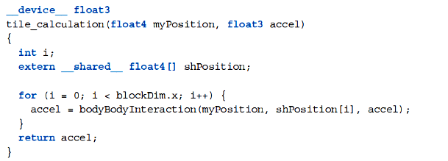
Parallelization – Tile Calculation

Slide 13
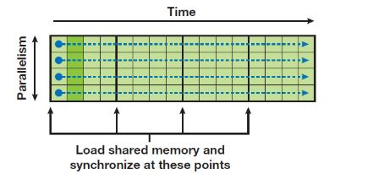
Parallelization – Tiles and Thread Blocks
Thread block is a block of p threads that sequentially executes some number of tiles.
Number of rows should be carefully chosen so that multiple warps can keep the execution pipeline busy.
Before executing a tile, each thread fetches a single body into the shared memory and syncs.
Thus each tile starts with p successive bodies loaded in shared memory.

Slide 14
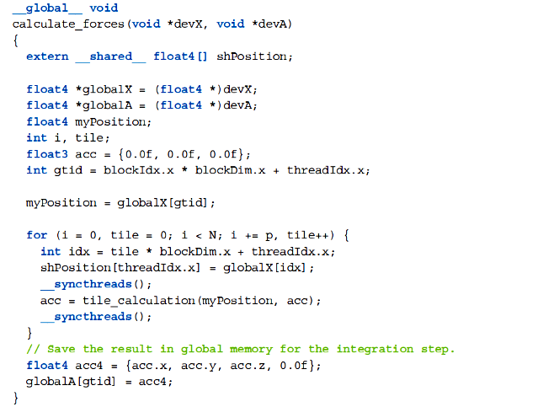
Parallelization – Tiles and Thread Blocks

Slide 15
Parallelization – Grid of Thread Blocks
The kernel we just saw computes the acceleration of p bodies (in p threads) due to their interaction with N bodies in a system.
This kernel is executed on a grid of thread blocks to compute accelerations of all bodies.
Since there are p threads per block (we chose a p x p tile size), and each thread computes details of one body, there are N/p thread blocks.
So a 1D grid of size N/p is defined.
Thus a total of N threads perform N calculations each, giving N² calculations in total.

Slide 16
Parallelization – Further optimizations
Loop Unrolling : A single body-body interaction call replaced by multiple calls to reduce loop overheads.
Block Size : Tile size p, is an important parameter in determining performance. Increasing p reduces memory overheads. Choice of p is restricted by number of multiprocessors in the GPU. The ratio N/p should be at least equal to the number of multiprocessors or else some won’t be utilized.

Slide 17
Demo and Performance Measures
Device 0: "GeForce GTX 1050"
CUDA Driver Version / Runtime Version 10.2 / 10.1
CUDA Capability Major/Minor version number: 6.1
Total amount of global memory: 4042 MBytes (4238737408 bytes)
( 5) Multiprocessors, (128) CUDA Cores/MP: 640 CUDA Cores
GPU Max Clock rate: 1493 MHz (1.49 GHz)
Maximum Texture Dimension Size (x,y,z) 1D=(131072), 2D=(131072, 65536), 3D=(16384, 16384, 16384)
Maximum Layered 1D Texture Size, (num) layers 1D=(32768), 2048 layers
Maximum Layered 2D Texture Size, (num) layers 2D=(32768, 32768), 2048 layers
Total amount of constant memory: 65536 bytes
Total amount of shared memory per block: 49152 bytes
Total number of registers available per block: 65536
Warp size: 32
Maximum number of threads per multiprocessor: 2048
Maximum number of threads per block: 1024
Max dimension size of a thread block (x,y,z): (1024, 1024, 64)
Max dimension size of a grid size (x,y,z): (2147483647, 65535, 65535)

Slide 18
Algorithm – Is there something better than O(N²)
Hierarchical Methods : Recursively divide the space into sub-domains till some criteria reached (low body density for example) using Tree Structures (Octrees, KD Trees etc).
Within the sub-domains, All-Pairs computation is used but for interactions with bodies outside of a sub-domain, far field approximations are used (such as approximating clusters with their centroids).
Typically able to reach O(N log N ).
Example : Barnes-Hut algorithm, Fast-Multipole Expansion.

Slide 19
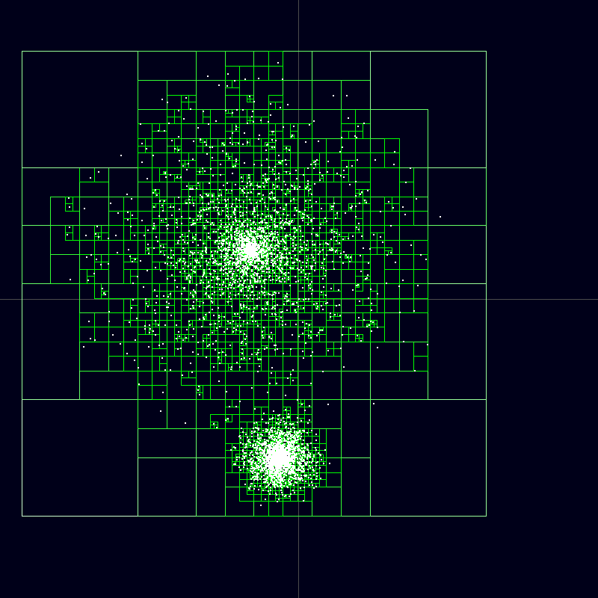
Algorithm – Is there something better than O(N²)

Slide 20
Conclusion
All-Pair N-body simulation is a simple way of simulating many body systems.
It is computationally expensive in sequential programs but can be sped up wherever large scale parallel processing can be made available.
Tiling strategies in the CUDA architecture helps with highly parallelized implementations.
Choice of single/double precision computations also heavily affects performance.

Slide 21
References
CUDA N-Body simulatoins : https://developer.download.nvidia.com/compute/cuda/1.1-Beta/x86_website/projects/nbody/doc/nbody_gems3_ch31.pdf
https://en.wikipedia.org/wiki/N-body_simulation
An Efficient CUDA Implementation of the Tree-Based Barnes Hut n-Body Algorithm
https://iss.oden.utexas.edu/Publications/Papers/burtscher11.pdf

Slide 22
Thank You!!

