Slide 1
ThorBang MQ
erik jonsson THORen michael BANG
ASL Milestone 1

Slide 2
Agenda
Design of System
Summary of Experiments
3h trace
Things Learned

Slide 3
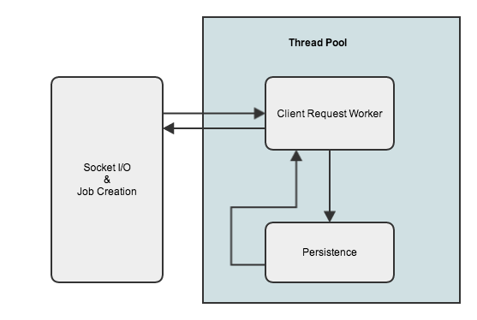
Design of System

Slide 4
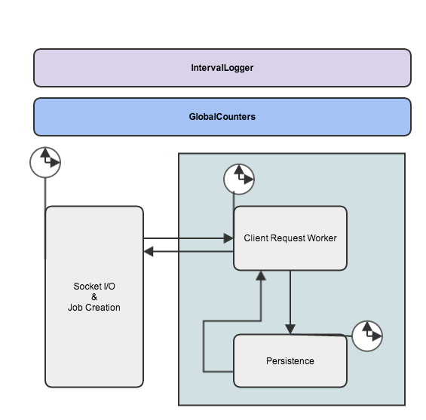

Slide 5
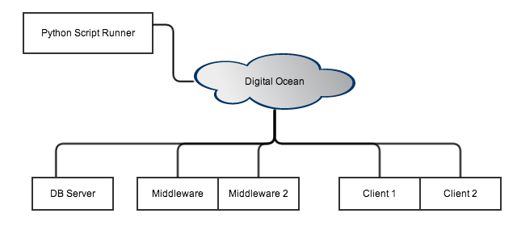
Design of System

Slide 6
Design of System
Produced Log Files
Time since server start
Push Requests
Pop / Peek Requests
Total Requests
Total Think Time in Socket I/O and job creation
Total Think Time in Request Worker
Total Think Time in Persistence-component
593135,1101,1090,2191,47713665384,29913823472,29510444900
594136,1200,1214,2414,47829943204,30080084320,29805427278
System.nanoTime() System.nanoTime()

Slide 7
Summary Of Experiments Conducted
Traces
One 4 hour
Four 2 hour
Tests on
# of Middleware (1 & 10)
# of Worker Threads (30 and 100)
# of DB-connections (30 and 100)
# of Message in DB (0, 200k and 1M)
# of Queues (1,5,10,20,30,50)
Size of message (10B -> 5MB)
Micro Benchmarks
Think Time (500k repeats)
Time to Push
Time to Peek
Time to Pop

Slide 8
Results Of Experiments Conducted
# of queues used simultaneous does not affect performance (as opposed to all msg’s going in 1 queue)

Slide 9
Results Of Experiments Conducted
Database is our bottleneck (~94% of think time)

Slide 10
Results Of Experiments Conducted
Size of message only affects pushing

Slide 11
Results Of Experiments Conducted
50 db-connection better than 5
Performance with 50 threads bounded by db-conns

Slide 12
Results Of Experiments Conducted
Request | Response Time [ms]
Push Message | 1.856 ± 0.018
Peek Queue | 2.3926 ± 0.0018
Pop Queue | 2.997 ± 0.026

Slide 13
4 Hour Trace

Slide 14
4 Hour Trace

Slide 15
Things Learned

