Slide 1
Design
Stateless
Job queuing system
Each message should only be consumed once
Consumption of message = client decides to 'act upon' it

Slide 2
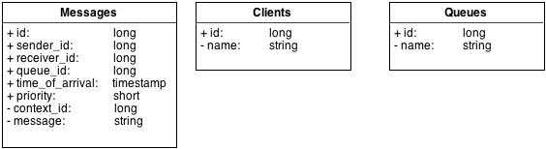
Database schema

Slide 3
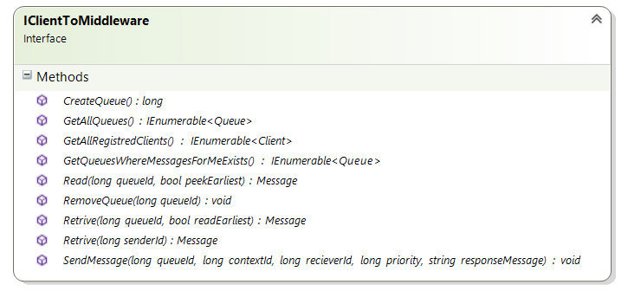

Slide 4
