Slide 1
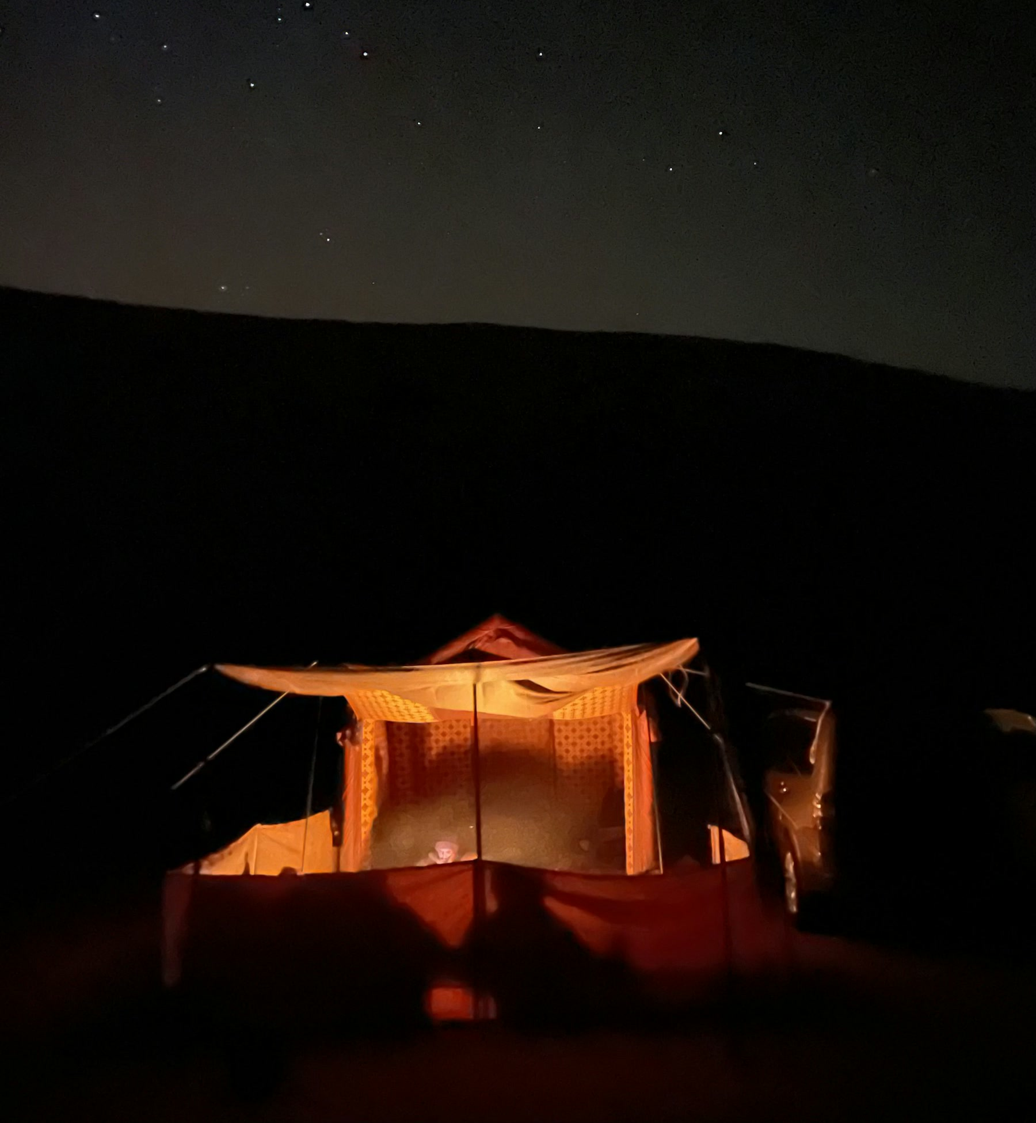
PITCH
STAY A
LITTLE
LONGER.
A product website that sells the EcoFlow RIVER 3 Plus by selling the hours it gives back.
Bluehour Studio · Group X · Geng Quan, Jemond, Ryan, Martin
Notes:
Good morning. We're Bluehour Studio. Our website sells the EcoFlow RIVER 3 Plus portable power station, and our pitch is simple: people don't buy watt-hours, they buy time. Time to stay at the campsite, finish the shoot, or keep the Wi-Fi up when the power trips.

Slide 2
THE OPPORTUNITY: BUYERS ARE READY, LISTINGS DON'T CLOSE
1
MORE OF LIFE HAPPENS AWAY FROM A SOCKET
57M
Campsite operators report fully booked weekends, and 55% of Malaysian professionals prefer hybrid work (The Star, 2023; Standard Insights, 2024).
2
THE CATEGORY IS GROWING FAST
visits a month to Shopee Malaysia, the country's biggest marketplace. Lazada adds about 12M more.
Portable power stations are forecast to grow about 17% a year to 2030 (Grand View Research forecast).
The buyers are already on the marketplaces. Our job is to send them in sure of what to buy.
3
BUT A LISTING CAN'T ANSWER “WILL IT LAST?”
Marketplace pages show watts and vouchers. Our site turns that doubt into a plan, then hands buyers to the store ready to pay.
Source: TMO Group, December 2024 web traffic
Our target: +20% marketplace sales in 3 months, tracked link by link from the site to the store.
Notes:
Here's the opportunity. Shopee Malaysia gets about 57 million visits a month and Lazada about 12 million more, so the buyers are already there. More of life now happens away from a socket: campsite operators report fully booked weekends, and more than half of Malaysian professionals prefer hybrid work. The category is forecast to grow around 17 percent a year. But a marketplace listing is a spec sheet; it can't answer 'will it last my night?'. Our site answers that, then sends people to the store ready to buy. That's how we get to plus 20 percent in three months, and every link is tracked so we can prove it. Sources: TMO Group, December 2024 traffic; The Star, December 2023; Standard Insights 2024 survey; Grand View Research forecast.

Slide 3
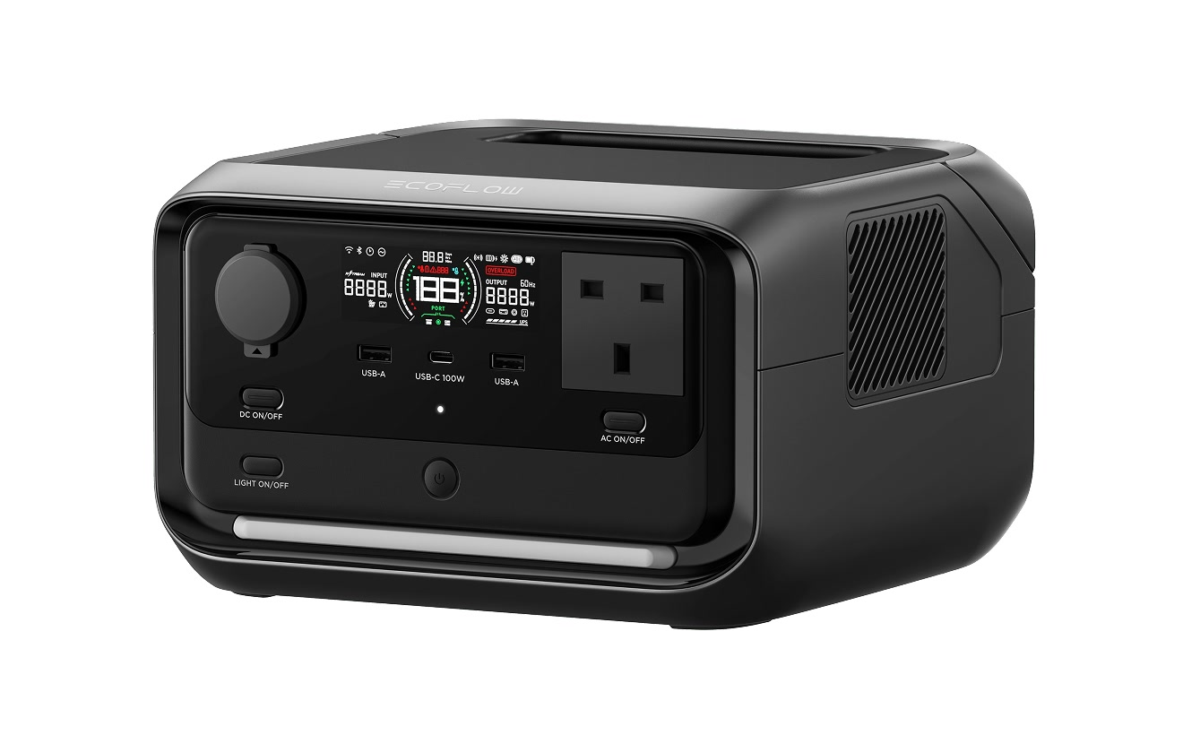
THE PRODUCT IN FIVE NUMBERS
286Wh
600W
LiFePO4 battery, 3,000 cycles
AC output, 1200W X-Boost
<10 ms
60 min
switch-over in a power cut
wall socket to full
4.7 kg
Sources: StorageReview spec table and test (9 ms measured switch-over); EcoFlow product listing.
carry with one hand
Notes:
Here's the product in five numbers. 286 watt-hours, 600 watts, under 10 milliseconds to switch over in a power cut, full in an hour, and 4.7 kilograms. Every number on our site is sourced; an independent test measured the switch-over at 9 milliseconds.

Slide 4
WHAT WE LEARNED BEFORE DESIGNING
FOUR DOUBTS STOP A BUYER
250+
“Will it last my whole night?”
→
Runtime calculator with a plain verdict
campsites across Malaysia, and not all have a power hook-up. Operators report weekends fully booked, some all the way to Hari Raya.
“Which size do I need?”
→
Calculator recommends Plus, Max or Max Plus
“Where is it safe to buy?”
→
An ST-SIRIM label check and authorised-seller links
“Can I take it on a flight?”
→
An honest no, in the FAQ and spec table
Sources: The Straits Times via OpenVan, 2026; The Star, December 2023.
Notes:
Camping in Malaysia is booming: there are more than 250 campsites, many without a power hook-up, and operators report weekends fully booked, some up to Hari Raya. From reviews and forums we found four doubts that stop people buying a power station. Every one of them has a direct answer on the site, including where it's safe to buy: authorised sellers only, and a check for the ST-SIRIM label.

Slide 5
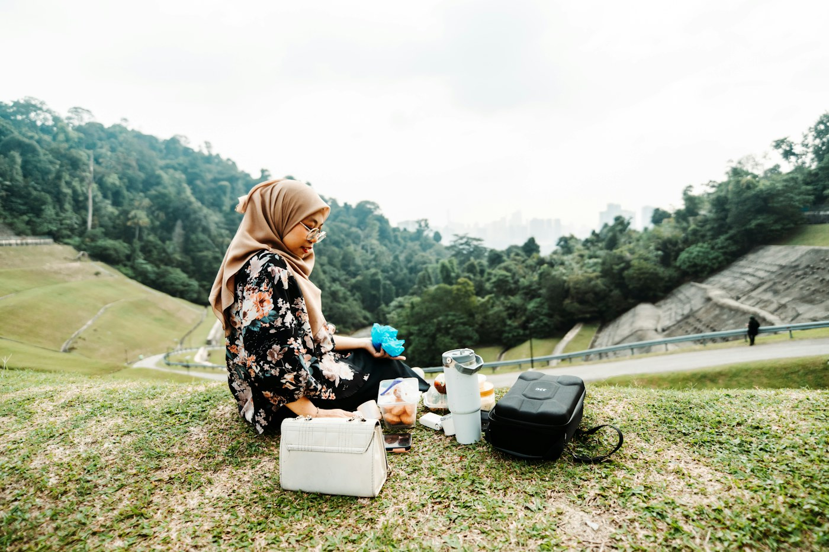
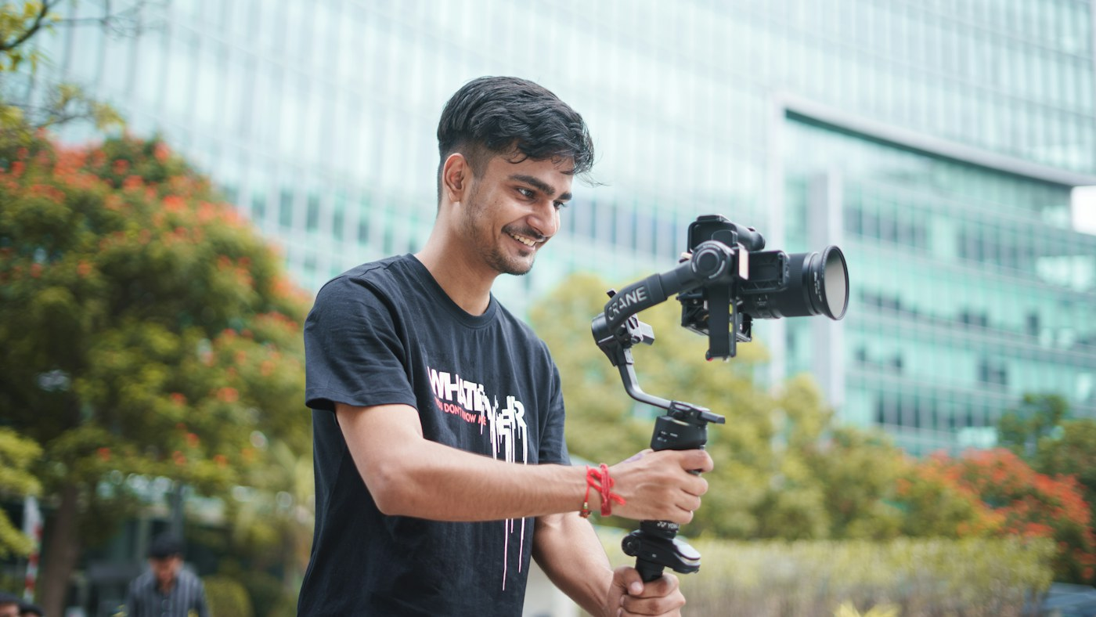

TARGET PERSONAS: WHO WE DESIGNED FOR
PRIMARY · CAMPER, MALAYSIA
THE ON-LOCATION CREATOR
THE HOME-BACKUP PLANNER
Nur Aisyah, 36, Petaling Jaya
Daniel, 27, freelancer
Ravi, 38, works from home
Camps near KL with her young kids. Many of Malaysia's 250+ campsites have no power hook-up, so by 10 pm the tent is hot and the phones are dying.
Shoots golden hour at beaches and parks. Runs out of camera batteries and laptop charge far from a socket.
A tripped breaker drops his router and video calls. Wants it to “just work” without thinking about it.
Wants: a fan all night, lights, charged phones.
Wants: USB-C 100W, light weight, quiet.
Wants: under 10 ms switch-over, set and forget.
Notes:
We built three proto-personas from that research. Our primary is Nur Aisyah, a camper mum in Petaling Jaya, Malaysia, where Lazada and Shopee are both big and many of the 250-plus campsites have no power hook-up. Daniel the creator and Ravi the home-backup planner widen the market to every day of the week. We'd validate these with interviews after launch. Photos: Ainur Iman, Sanket Mishra and Vitaly Gariev on Unsplash (free Unsplash Licence).

Slide 6
WHEN YOU NEED IT, AND WHAT IT CAN RUN
WHEN THE PLUGS RUN OUT
EQUIPMENT | TYPICAL DRAW | ON ONE CHARGE
Wi-Fi router | 12 W | about 20 h
Fan | 25–40 W | 6–10 h
Laptop | 60 W | about 4 h
MEDICAL · CPAP, humidifier off | 10–25 W | 10–24 h
MEDICAL · CPAP, humidifier on | about 53 W | about 4.5 h
MEDICAL · Home oxygen concentrator | 250–350 W | under 1 h
1
POWER CUT OR TRIPPED BREAKER
Takes over in under 10 ms, so the router and the CPAP keep running.
2
CAMPSITE WITH NO HOOK-UP
Lights, a fan and phones through the night, with no fumes or noise.
3
WORKING OR SHOOTING OUTDOORS
USB-C 100W for laptops, plus AC for cameras and lights.
Medical equipment: a CPAP machine can run through a power cut, but an oxygen concentrator draws too much for this size. Always check the device maker's power specs first.
4
STORMS AND PLANNED MAINTENANCE
Charged and waiting, then full again in about an hour.
Estimates: 286 Wh × 85% ≈ 243 Wh ÷ watts. Draws: ResMed AirSense 10 spec; CAIRE Companion 5 spec; typical device ratings.
Notes:
When do you need it? Whenever the plugs run out: a power cut or tripped breaker, a campsite with no hook-up, working or shooting outdoors, storms and planned maintenance. And here's what it can run, using our 243 usable watt-hours. A router for about 20 hours, a fan for 6 to 10. For medical equipment we're honest: a CPAP machine with the humidifier off can run 10 to 24 hours, so it gets someone through a night-time outage, about 4 and a half with the humidifier on. A home oxygen concentrator draws 250 to 350 watts, so it would run under an hour; that needs a bigger system, and we say so. Anyone relying on a medical device should check the maker's specs first. Sources: ResMed AirSense 10 power spec, CAIRE Companion 5 spec.

Slide 7
USER JOURNEY MAP: WHERE THE SITE MEETS NUR AISYAH
DISCOVER
EXPLORE
EVALUATE
DECIDE
AFTER
DOING
Sees a camping reel, or searches “camping power station Malaysia”
Reads the Camping moment and campsite tips
Plans her night in the runtime calculator
Checks where to buy, then taps Lazada
Gets the setup kit, reads battery-care tips
THINKING
“But Malaysia is so hot at night…”
“Is this made for families like us?”
“Will it really last till morning?”
“Is this the official store? Any 11.11 vouchers?”
“How do I look after it?”
OUR ANSWER
Home hero: Stay a little longer
Time-stamped night timeline at the campsite
Verdict, then a pick: Essential, from RM 2,099
ST-SIRIM check + authorised links
Free kit email + Journal guides
Notes:
This is Nur Aisyah's journey. She discovers us through a reel or a search, explores the camping page, and evaluates in the calculator, which is the moment that removes her biggest doubt. Then she decides on the where-to-buy page and goes to Lazada. Afterwards the setup kit and journal keep her coming back.

Slide 8
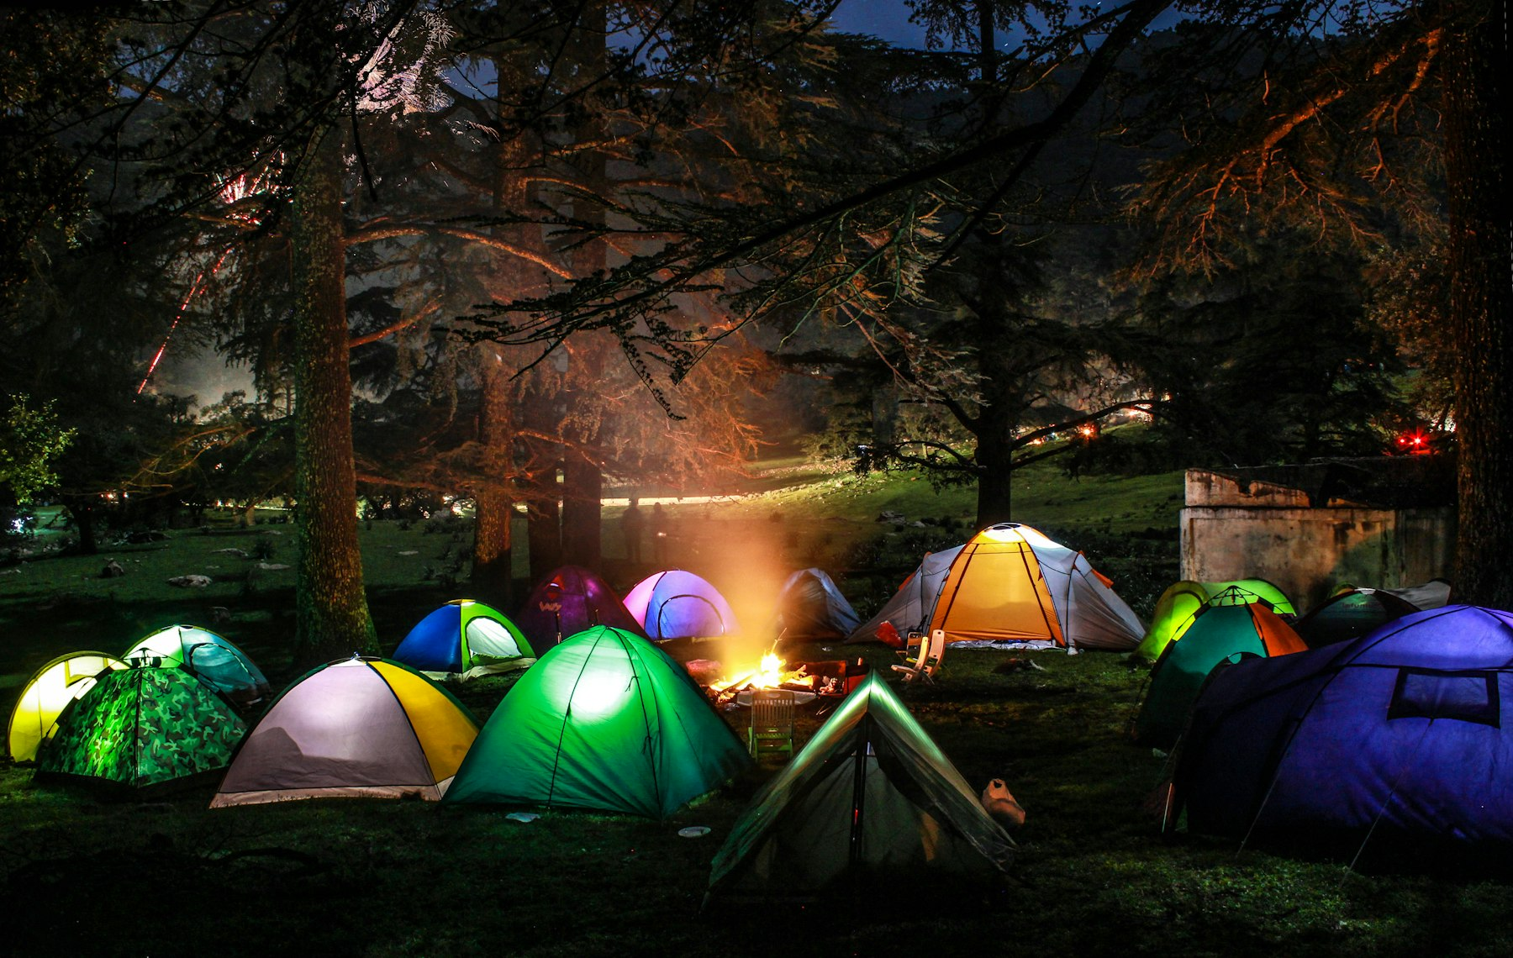
CREATIVE BRIEF CONCEPT
BIG IDEA
Stay a little longer. We sell the extra hours, not the watt-hours.
AUDIENCE
Malaysian families who camp and road-trip, creators who shoot outdoors, and anyone who works from home.
TONE
Warm, local, honest.
PROOF
Sourced specs, battery timelines that add up, and a calculator that shows the working.
BLUEHOUR
ACTION
Plan your night, then buy from an authorised seller on Lazada or Shopee Malaysia.
The hour after sunset, when the light is softest and nobody wants to go home yet.
Bluehour Studio · River 3 Plus website pitch
Notes:
Our creative concept is Bluehour: the hour after sunset when nobody wants to go home. The big idea is 'Stay a little longer'. The audience is Malaysian: families who camp and road-trip, creators and people who work from home. Our tone is warm, local and honest.

Slide 9
THEME: DUSK COLOURS, ONE LOUD SIGNAL
#101214
#FF6B1A
#1E3A5F
#F3F4F5
#B4460A
TRAIL BLACK
SIGNAL ORANGE
DUSK BLUE
FOG
ORANGE INK
Header, footer, night bands. The dark of the campsite.
Every action: Shop now, Buy, Get the kit. Like a lantern.
Tints photo overlays toward blue hour.
Quiet backgrounds for specs and tables.
Orange text on white, at 5.5:1 contrast.
Why: orange is used only for actions, so the next step is always obvious. Black and dusk blue carry the night-time mood, and every text colour pair passes WCAG AA contrast.
Notes:
Our theme is dusk. Trail black and dusk blue carry the night mood. Signal orange is used only for actions, like a lantern in the dark, so the next step is always obvious. Every text colour pair passes accessibility contrast.

Slide 10
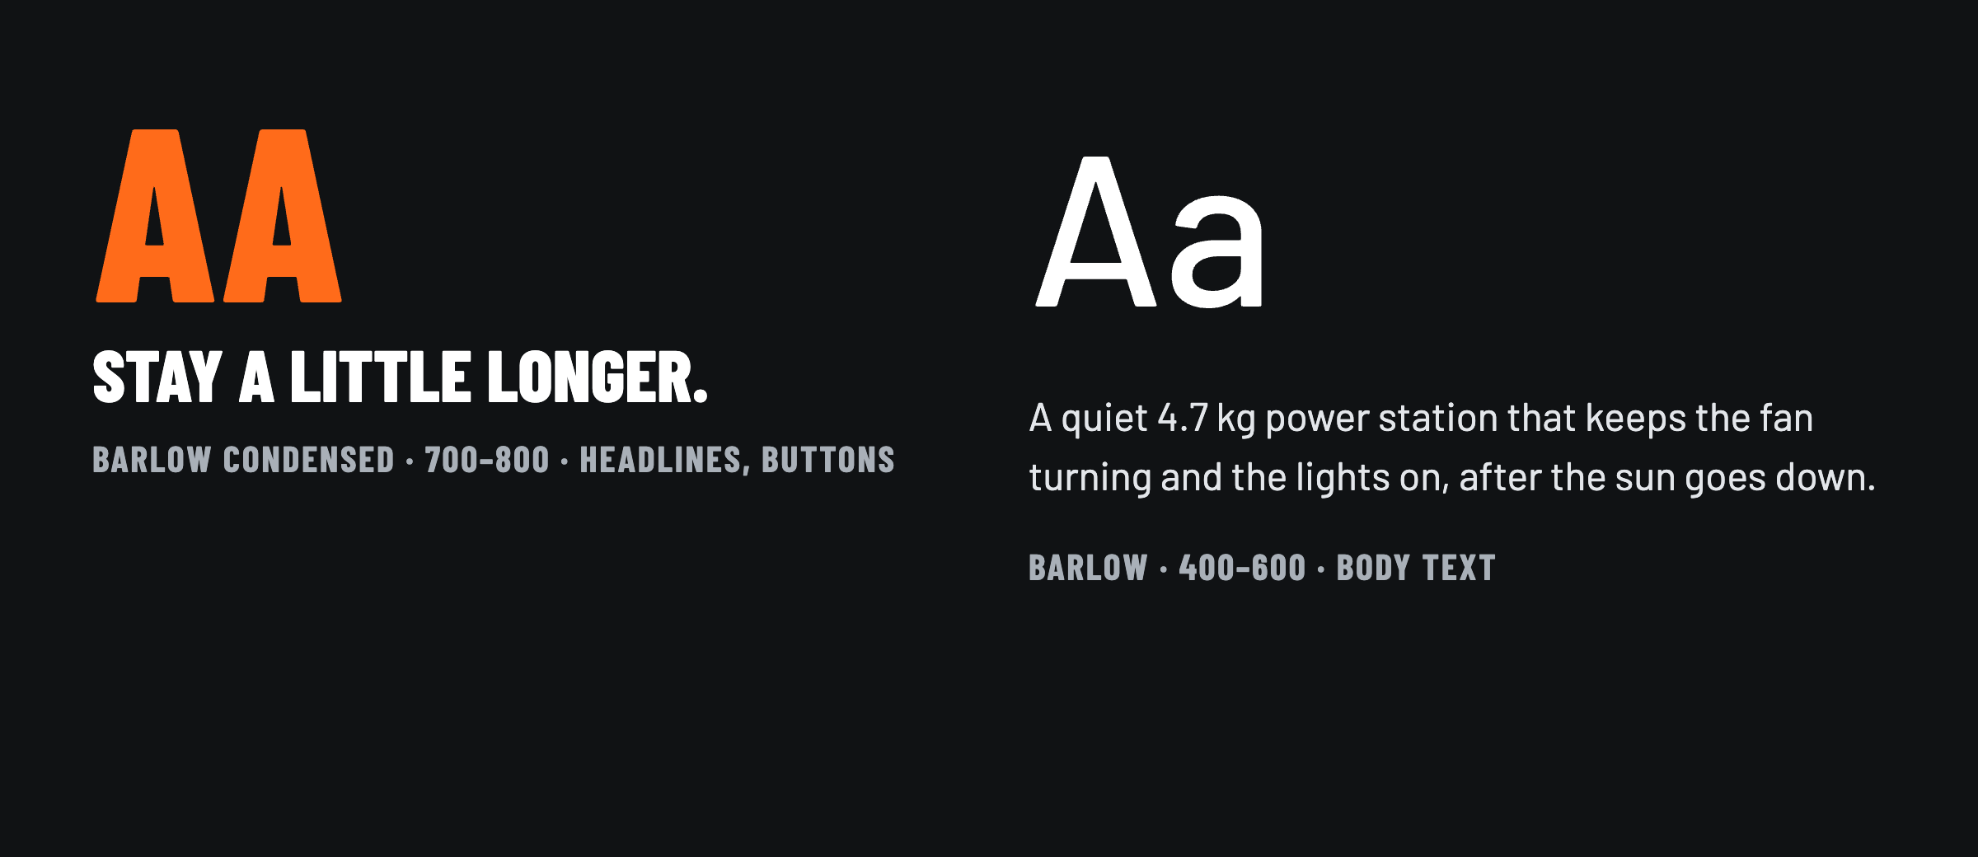
FONTS: BARLOW CONDENSED + BARLOW
BARLOW CONDENSED
Bold uppercase headlines with the feel of outdoor-gear signage. Narrow, so big statements fit on a phone screen.
BARLOW
Same family for body text: friendly, very readable at small sizes, and with clear numbers for specs.
FREE AND SELF-HOSTED
One type family, two widths: a strong headline voice and calm, readable body text, without the clash of two unrelated fonts.
Open-source (SIL licence) and stored with the site, so pages load fast with no Google request.
Notes:
We chose one type family in two widths. Barlow Condensed gives bold, outdoor-signage headlines that fit on a phone. Barlow keeps body text and spec numbers easy to read. Both are free and stored with the site, so nothing extra loads from Google.

Slide 11
SITEMAP: 14 PAGES, THREE CLICKS TO ANY ANSWER
HOME
RIVER 3 PLUS
SPECS
MOMENTS
RUNTIME CALCULATOR
JOURNAL
SUPPORT & FAQ
WHERE TO BUY
GET THE KIT (FORM)
TRUST AND SERVICES
CAMPING
REVIEWS
CARE, RENTALS & TRADE-IN
WORK ANYWHERE
IN THE FOOTER
HOME BACKUP
TEAM
PRIVACY POLICY (PDPA)
404 PAGE
Orange = conversion pages that hand off to the store or capture a lead. Blue = the decision tool.
Notes:
Here's the sitemap. Fourteen pages, all within three clicks of home. The three Moments pages speak to our three personas. The runtime calculator is the decision tool, and the two orange pages are where we convert: where to buy, and the lead form. Two newer pages build trust and revenue: sample reviews, and our proposed care, rentals and trade-in services.

Slide 12
PAGES BREAKDOWN: EVERY PAGE HAS ONE JOB
PAGE | JOB | WHAT'S ON IT
Home | Hook | Stay a little longer, moment tiles, spec strip
River 3 Plus | Persuade | Features as benefits, gallery, sticky buy bar
Specs | Reassure | Every number, River 3 vs Plus vs a rival, ST-SIRIM seal
Camping | Persona 1 | Hulu Langat night timeline, road trips, campsite tips
Work anywhere | Persona 2 | Shoot-day power budget for creators
Home backup | Persona 3 | Power-cut scenarios, what stays on
Runtime calculator | Decide | Plan your night, verdict, a pick with price and Buy button
Journal | SEO content | Buying guides: camping, blackouts, generator, CPAP
Support & FAQ | Objections | Kettle, flights, warranty, FAQ schema
Where to buy | Convert | Price, Lazada / Shopee Malaysia, ST-SIRIM check
Get the kit | Lead form | Malaysia PDPA consent, optional deal alerts
Team | Credits | Group, members, photo credits
Reviews | Trust | Real marketplace ratings, #StayALittleLonger contest
Care, rentals, trade-in | Grow revenue | Proposed care, rentals, trade-in, gifts, referrals
Notes:
Every page has one job in the journey. The three moment pages each serve a persona, the calculator decides, and two pages convert. Reviews builds trust, and the services page tests new revenue. Privacy and the 404 page sit outside the fourteen.

Slide 13
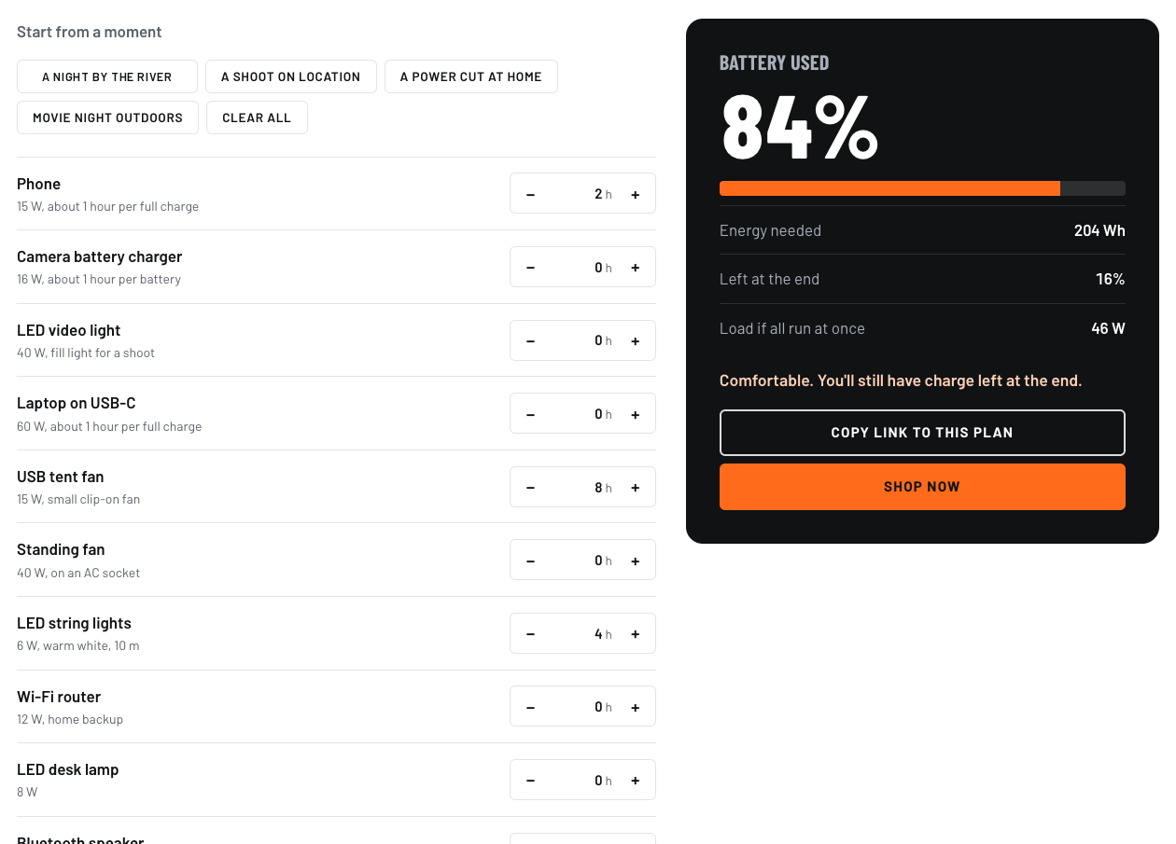
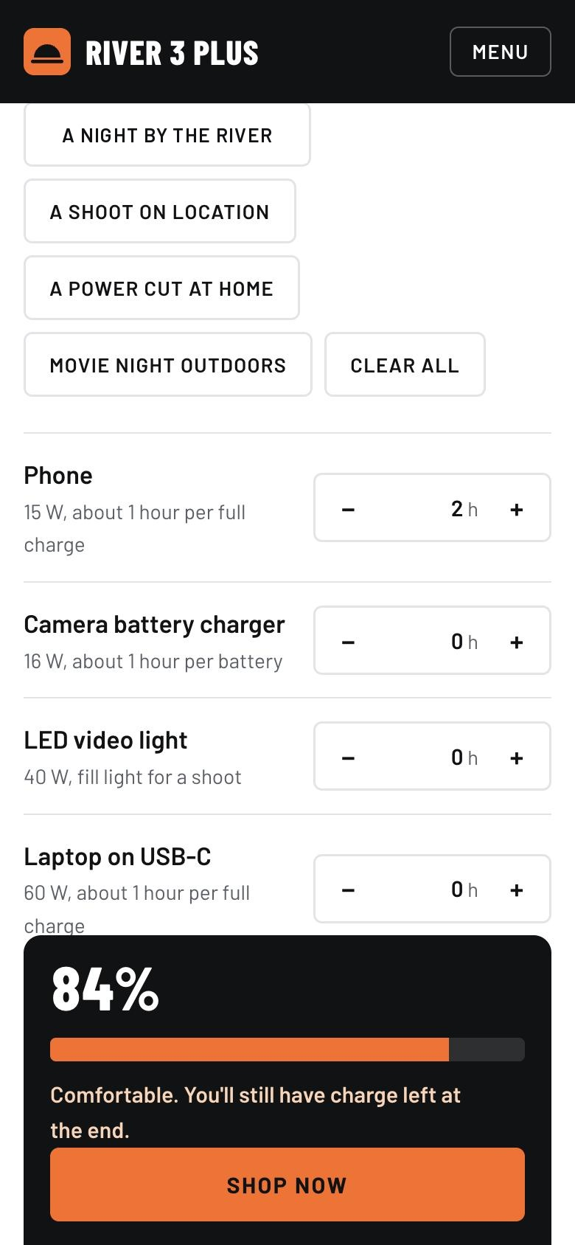
THE FEATURE THAT CLOSES THE SALE
1
PLAN YOUR NIGHT
Pick a moment or set hours; see % of one charge used.
2
A VERDICT AND A PICK
Then “Essential: River 3 Plus, from RM 2,099” and a Buy button.
3
SHARE THE PLAN
The link saves your plan, ready to send to family.
Also on the site: a model comparison, an ST-SIRIM safety seal, real buyer ratings and a sticky Shop now bar on phones.
Notes:
The runtime calculator is our strongest selling tool, and now it ends with a pick. Nur Aisyah picks 'A night by the river', sees 84 percent used and the verdict 'Comfortable', and then the answer: 'Essential: River 3 Plus, from RM 2,099', with a Buy on Lazada button. If her plan needs more, it recommends the extra-battery kit instead. A fun tool becomes a sales tool. She can still share the plan as a link, and on a phone the pick stays pinned to the bottom of the screen.

Slide 14
SEO: ANSWER THE QUESTIONS BUYERS SEARCH
TARGET KEYWORD | PAGE
portable power station Malaysia | Home, River 3 Plus
EcoFlow River 3 Plus specs | Specs
best power station for camping Malaysia | Camping, Journal
power for outdoor photo shoots | Work anywhere
keep Wi-Fi on during a blackout | Home backup, Journal
how long will a power station last | Runtime calculator
where to buy River 3 Plus Malaysia | Where to buy
EcoFlow River 3 Plus review | Reviews
power station rental Klang Valley | Care, rentals and trade-in
ON EVERY PAGE
Unique title under 60 characters and meta description
One H1, logical headings, alt text on every image
Canonical URL and social-preview tags
Structured data: Product, FAQ, Breadcrumbs
sitemap.xml and robots.txt
Fast and mobile-first: local fonts and photos
Journal guides as fresh, linkable content
Keywords come from buyer questions. After launch we check real volumes in Google Search Console and Keyword Planner.
Notes:
For SEO, each page targets the question a buyer actually types, from 'portable power station Malaysia' to 'best power station for camping in Malaysia'. Four new journal guides target buyers close to purchase: the best power station for camping, keeping Wi-Fi on in a blackout, River 3 Plus versus a generator, and whether a power station can run a CPAP. Every page has a short title, description, headings, alt text and structured data, plus a sitemap. After launch we'd confirm volumes in Search Console.

Slide 15
WEBSITE MARKETING STRATEGY: 3 MONTHS, 3 SALE PEAKS
MONTH 1 · NOV
MONTH 2 · DEC
MONTH 3 · JAN
LAUNCH FOR 11.11
12.12 AND SCHOOL HOLIDAYS
BACK TO WORK
Site live, sitemap submitted to Google
Reels: “One river night in Hulu Langat, one charge”
TikTok proof test: a tent fan all night, what’s left at dawn
Free Stay Longer Kit builds the deal-alert list
TikTok Shop affiliates and micro-influencers, paid per sale
Deal-alert email on 12.12
Retarget calculator users
Event-kit rentals for year-end kenduri and family days
Home-backup angle: monsoon outages and work-from-home
New journal guide plus search ads on top keywords
Runtime charts shared in camping, 4x4 and photo Facebook groups
Review the data and shift budget
Every channel points to the site, and the site points to Lazada and Shopee with tracked (UTM) links.
Notes:
Our three-month plan rides three sale peaks: 11.11, 12.12 with the school holidays, and back-to-work in January, which is also monsoon season on the east coast, so the home-backup story lands then. Short TikTok proof tests show a tent fan running all night and what's left by morning. TikTok Shop affiliate creators earn per sale, so they're motivated to sell. In January we share the runtime chart in Malaysian camping, 4x4 and photography Facebook groups, where a helpful chart works better than an ad. Every link to the store is tracked so we can prove what worked.

Slide 16
REVENUE STREAMS BEYOND THE FIRST SALE
STREAM (PROPOSED) | HOW IT GROWS SALES | WHAT WE MEASURE
Stay Longer Care | A protection plan for drops, rain and battery health, up to 5 years. Lowers the risk of a big buy and earns on every unit. | Share of orders that add Care
Rentals | Weekend, event and kenduri kits. Try before you buy: the rental fee is deducted if they buy within 30 days. | Renters who go on to buy
Stall plans (B2B) | Monthly plans with battery swaps for pasar malam stalls, food trucks and event crews replacing noisy gensets. | Active plans, monthly churn
Bundles | Solar panel, extra battery or road-trip kit at checkout raises the order value. | Share of bundle orders
Trade-in | A value set on the day you buy, towards a bigger EcoFlow station, brings owners back in 2–3 years. | Trade-ins redeemed
All five are shown on the site as proposed services, with no prices, and "Register interest" collects demand first. The marketplace sale stays the main +20% lever; these add trial, confidence and repeat buyers.
Notes:
Beyond the first sale, we propose five revenue streams. They're on the site as proposed services, with no prices. Stay Longer Care is a protection plan that covers drops, rain and battery health for up to five years. Rentals let hesitant buyers try it for a camping weekend, an outdoor kenduri or an event, and the fee comes back as a voucher if they buy. For business, monthly stall plans with battery swaps replace noisy, smelly gensets at pasar malam stalls and food trucks. Bundles lift the order value, and trade-in brings owners back for a bigger station in two to three years. The marketplace sale stays our main plus-20 lever; these add trial, confidence and repeat buyers.

Slide 17
MAKING IT EASIER TO SAY YES
CHANGE ON THE SITE | WHY IT SELLS | WHERE
A dated price | “From RM 2,099 · checked 12 Nov” near every Buy button. Seeing the price first brings people closer to buying. | Product, home, where to buy
The calculator picks | After the devices, it says which kit to buy, with the price and a Buy button. | Runtime calculator
Model comparison | River 3 vs River 3 Plus vs a rival 300W station, so visitors compare on our page instead of leaving. | Tech specs
Less risk | 2-year warranty and the ST-SIRIM safety seal beside the buy buttons. | Product, specs, where to buy
Rent first (proposed) | Rent it for a weekend; the fee is deducted if they buy. | Product, calculator, services
Always a Shop now | A sticky bar on phones, and a smaller cookie banner that no longer hides the opening screen. | Every page on phones
Gift, not discount (proposed) | Free LED lights or a USB fan; a referral voucher for the friend and the referrer. | Services
Prices come from EcoFlow Malaysia and are dated, because marketplace prices and vouchers change. Sample reviews were removed: the site now links to real marketplace ratings instead.
Notes:
Feedback told us the site taught people well but didn't close. So we made it easier to say yes. Every buy button now shows a dated price, from RM 2,099 at EcoFlow Malaysia, because people who see the price before they click are much closer to buying. The calculator ends with a pick and a buy button. A comparison with River 3 and a rival 300W station keeps comparers on our page. The 2-year warranty and the ST-SIRIM seal sit beside the buy buttons, and you can propose renting first with the fee deducted. On phones, a Shop now bar is always on screen. Referrals reward both sides: the friend gets a voucher, and so does the person who referred them, which gives them a reason to share. We also removed our sample reviews: fake-looking reviews hurt trust more than none, so we link to real marketplace ratings.

Slide 18
NEW BUYERS THE SITE NOW SPEAKS TO
AUDIENCE | THE PITCH | HOW WE REACH THEM
Night-market and food-truck sellers | Quiet, no fumes, safe near customers; recharging costs under RM 1 a night. | Stall plans with battery swaps
Home medical users | An honest CPAP guide: about 10–24 hours with the humidifier off; not for oxygen concentrators. | Journal guide, home backup
Event, wedding and film crews, site offices | Several units, one invoice, priority support. | Business package
Flood-prone towns | Charged and ready before the monsoon. | Group orders with residents and NGOs
Campers who want to try first | Rent on the spot at partner campsites, then scan a QR code to buy. | Partner campsites, roadshows
Our top three: the night-market angle, monthly instalments at checkout, and units at partner campsites. Each reaches a buyer the old site didn’t speak to, or removes a reason to say “not yet”. All offers here are proposals.
Notes:
The site now speaks to buyers it ignored before. Night-market and food-truck sellers get a quiet, fume-free alternative to a genset that costs under a ringgit a night to recharge. Families with CPAP machines get an honest guide. Event crews and site offices get a business package. Flood-prone towns can order together before the monsoon. If we had to pick three, it's the night-market angle, monthly instalments, and units at partner campsites, because each either reaches a new buyer or removes a reason to say not yet.

Slide 19
HOW WE PROVE THE +20%
VISITS
Search Console, analytics (opt-in)
CALCULATOR PLANS
Plans made, links shared
KIT SIGN-UPS
Deal-alert list growth
STORE CLICKS
UTM-tagged Lazada / Shopee clicks
ORDERS
Seller Centre, vs previous 3 months
Example: if the store sold 100 units in Aug–Oct, the target is 120 in Nov–Jan. We check weekly and move budget to the channels whose links convert.
Notes:
We measure the whole funnel: visits, calculator plans, kit sign-ups, tracked clicks to the store, and finally orders in the seller centre, compared with the three months before. For example, 100 units before means a target of 120. We check weekly and move budget to what converts. For the new services we'd add two numbers: how many orders add Stay Longer Care, and how many renters go on to buy.

Slide 20
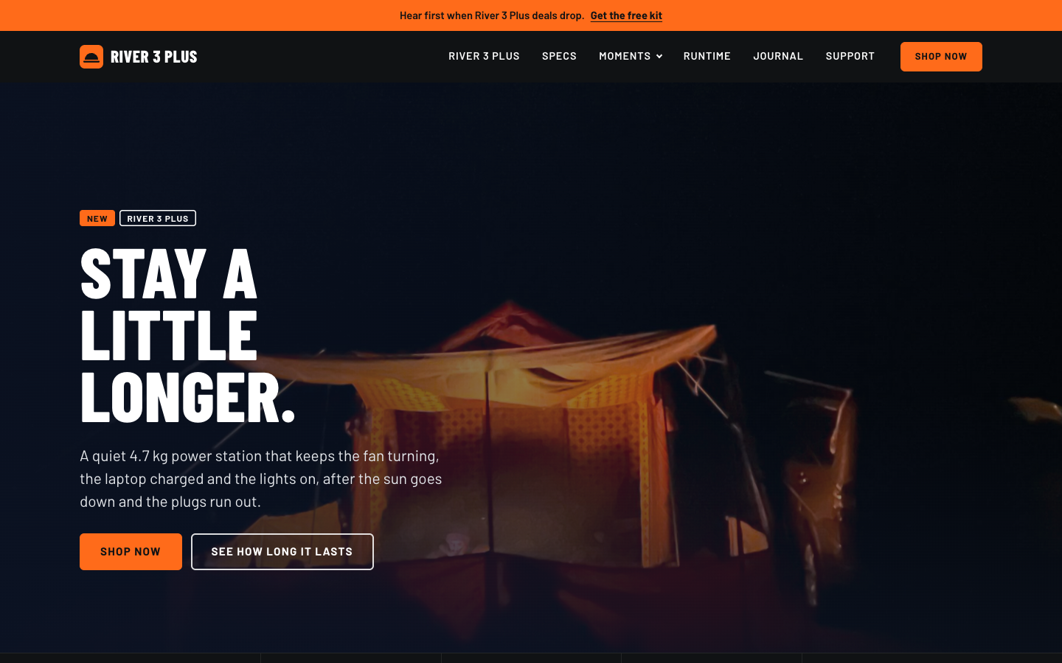
STAY A
LITTLE
LONGER.
Thank you. Questions?
See it live: thecpinsiders.github.io/CS2024-Project-Website
Bluehour Studio · Group X · Geng Quan, Jemond, Ryan, Martin
Notes:
To sum up: we sell the hours, not the watt-hours, answer every buying doubt on the site, and hand buyers to the official store with tracked links so the 20 percent is measurable. The site is live at this address. Thank you, we're happy to take questions.

