Slide 1



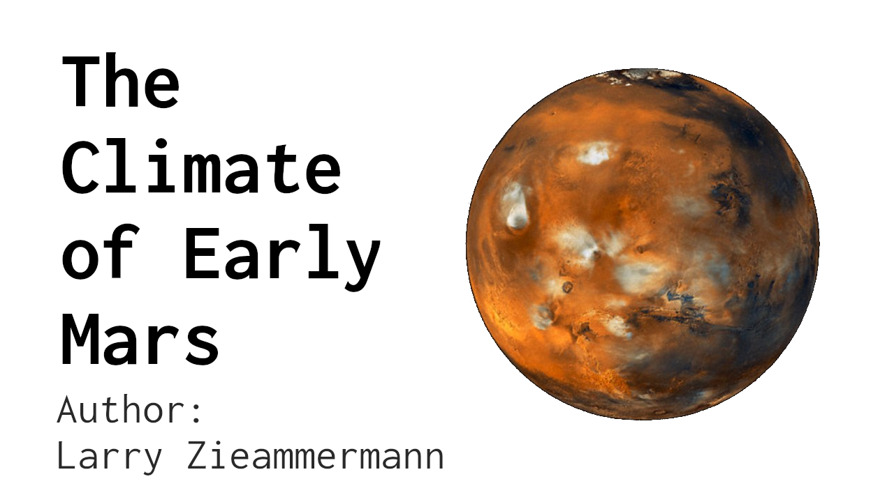









HNRS 190: Math and Climate
Research Projects
Instructor: Erik Van Vleck
Seminar Assitant: Sagindyk Urazayev
The University of Kansas, Lawrence, KS
Illustrations and covers made in GIMP.
Presentation made in LibreOffice.
Poster Template provided by KU Brand Center.

