Slide 1

CONCURRENT AND REAL TIME PROGRAMMING
Lecturers:
Prof. Gabriele Manduchi
Prof. Andrea Rigoni Garola
- 20/2/2024 -
Notes:
Buongiorno a tutti,
This is my presentation for the final project of this course

Slide 2
Topic 4: Producer - Consumer Flow Control
Student: Nguyen Tho The Cuong – 2106235
Notes:
My topic is the topic fourth, which is called Producer - Consumer Flow Control

Slide 3
OUTLINE
1
Introduction and System Design
2
Flow Control Algorithm
3
Metrics Monitoring
4
Results
5
Conclusion
Notes:
My presentation would have 5 parts…

Slide 4
01
Introduction and
System Design
Notes:
Let’s begin with the first part which is introduction and System Design for the problem

Slide 5
Introduction and System Design
4. Producer - (single) consumer program with dynamic message rate adjustment. The consumer shall consume messages at a given rate, that is, with a given delay simulating the consumed message usage. An actor (task or process) separate from producer and consumer shall periodically check the message queue length and if the length is below a given threshold, it will increase the production rate. Otherwise (i.e. the message length is above the given threshold), it will decrease the production rate.
Notes:
This is the content of the topic

Slide 6
Introduction and System Design
4. Producer - (single) consumer program with dynamic message rate adjustment. The consumer shall consume messages at a given rate, that is, with a given delay simulating the consumed message usage. An actor (task or process) separate from producer and consumer shall periodically check the message queue length and if the length is below a given threshold, it will increase the production rate. Otherwise (i.e. the message length is above the given threshold), it will decrease the production rate.
1. Producer
Consumer
Orchestrator
Synchronization
2. Rate Control
3. Visualization
Notes:
Based on the content of the topics, there are three main issues I have to deal with:
First,... Second,... and Third… Additionally, the third issue is outside the scope of the topic however it plays an important role as we will see later

Slide 7
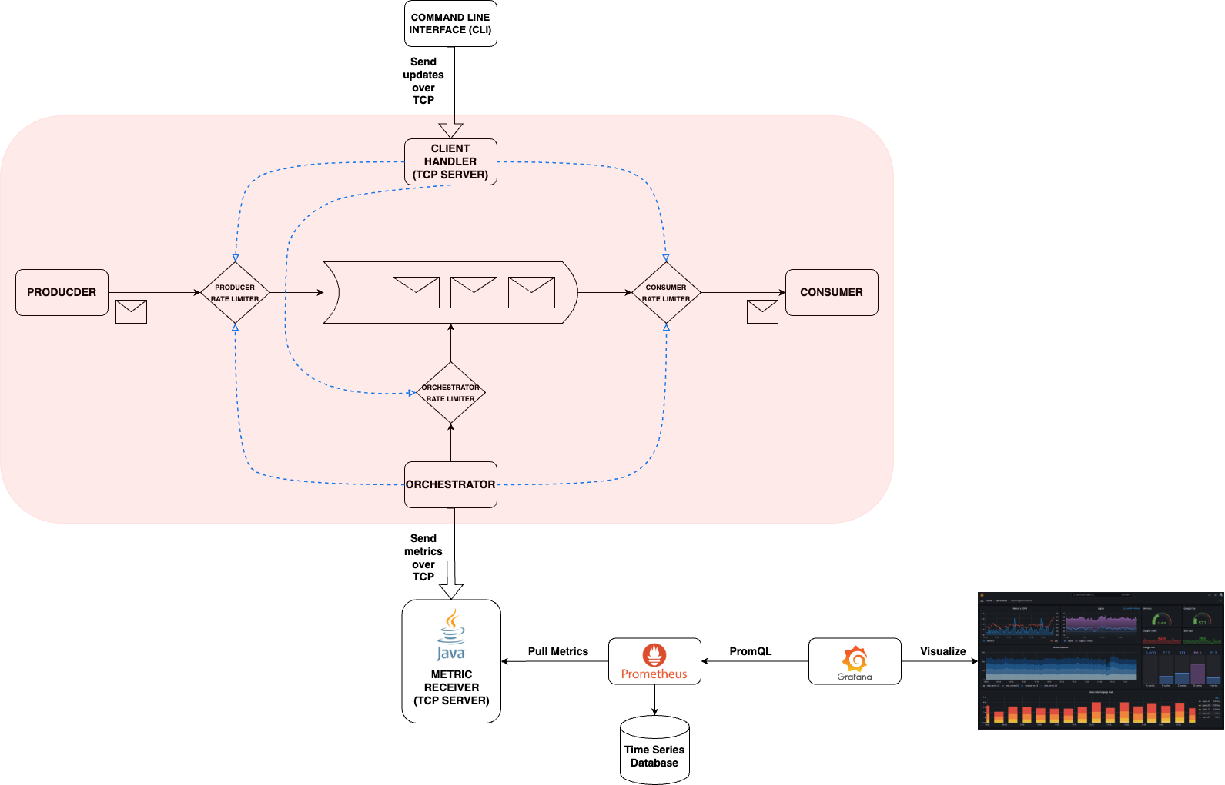
Introduction and System Design
Full Design
Notes:
This is the full design of my implementation:
The main part is Producer - Consumer - Orchestrator model

Slide 8
Introduction and System Design
Full Design
Outside the scope of the task
Notes:
This part is supplemented

Slide 9
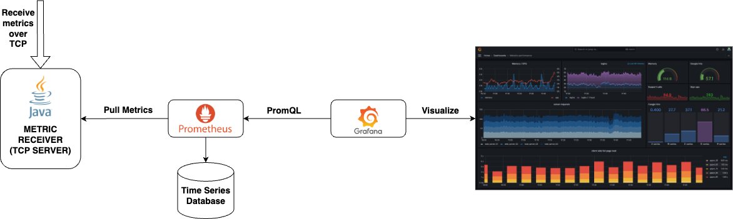
Introduction and System Design
Outside the scope of the task:
Notes:
Let’s take a look at this supplemented part

Slide 10
Introduction and System Design
Outside the scope of the task:
3. Visualization
Notes:
It is for the sake of visualization

Slide 11
Introduction and System Design
Outside the scope of the task:
Java supports Prometheus Client
3. Visualization
Notes:
Specifically, I used Java as a TCP server to receive metrics from my main application because it supports Prometheus Client

Slide 12
Introduction and System Design
Outside the scope of the task:
Metrics information is stored with the timestamp at which it was recorded
Java supports Prometheus Client
3. Visualization
Notes:
And Prometheus is a software used for recording the metrics and saved the metrics into a time series database

Slide 13
Introduction and System Design
Outside the scope of the task:
Metrics information is stored with the timestamp at which it was recorded
Grafana enables to query, visualize and explore metrics wherever they are stored
Java supports Prometheus Client
3. Visualization
Notes:
Finally, Grafana is a software used to visualize our metrics

Slide 14
Introduction and System Design
Full Design
Outside the scope of the task
Notes:
Comeback to our full design,

Slide 15
Introduction and System Design
Full Design
Our main task
Outside the scope of the task
Notes:
Let’s consider our main task which is shown here:

Slide 16
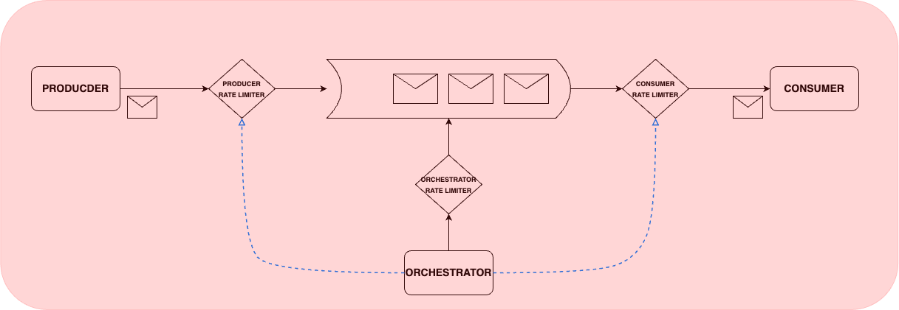
Introduction and System Design
Solution for the task:
1. Producer
Consumer
Orchestrator
Synchronization
2. Rate Control
Notes:
As I mentioned, we have two main issues:

Slide 17

Introduction and System Design
Solution for the task:
1. Producer
Consumer
Orchestrator
Synchronization
…
2. Rate Control
…
Notes:
How to deal with these issues…

Slide 18
Introduction and System Design
Solution for the task:
1. Producer
Consumer
Orchestrator
Synchronization
Semaphore
3-Thread model
Rate Limiter
2. Rate Control
Notes:
My solution is to use semaphore for synchronization and to use Rate Limiter to control the rates

Slide 19
Introduction and System Design
Solution for the task:
1. Producer
Consumer
Orchestrator
Synchronization
Semaphore
3-Thread model
Rate Limiter
2. Rate Control
Token Bucket Algorithm
Notes:
Additionally, regarding to Rate Limiter, I adopt a common algorithm which is Token Bucket Algorithm

Slide 20
02
Flow Control Algorithm
Notes:
Let’s now dive deeper into the Flow Control Algorithm

Slide 21
Flow Control Algorithm
Idea: Token Bucket Algorithm
Input: Assign a limiting rate
Output: Allow a number of permits per one unit of time (e.g. per second)
Notes:
As I mentioned, the idea is Token Bucket Algorithm

Slide 22
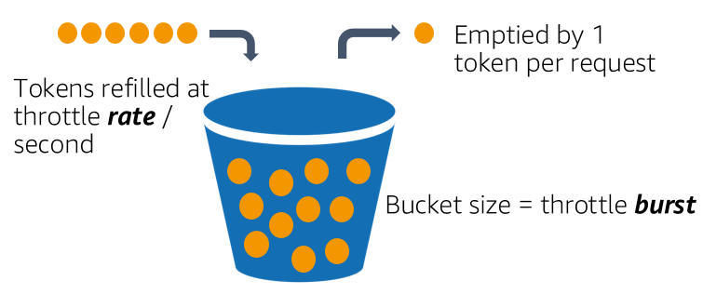
Flow Control Algorithm
Idea: Token Bucket Algorithm
Input: Assign a limiting rate
Output: Allow a number of permits per one unit of time (e.g. per second)
Notes:
It can me imagined as this figure, the bucket has a size. Tokens are refilled at an assigned rate. Each request will decrease the number of tokens in the bucket.
So, the bucket size will define the limiting rate of requests

Slide 23
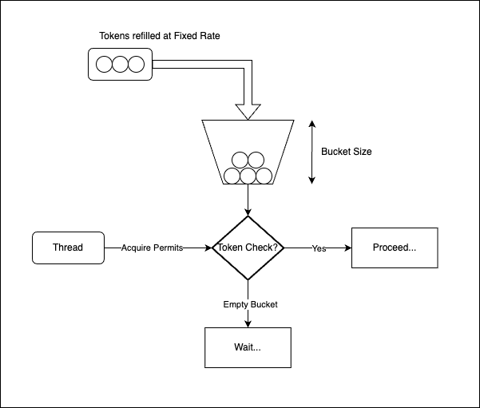
Flow Control Algorithm
Idea: Token Bucket Algorithm
Input: Assign a limiting rate
Output: Allow a number of permits per one unit of time (e.g. per second)
Notes:
And this is the figure for the usage of the Rate Limiter

Slide 24
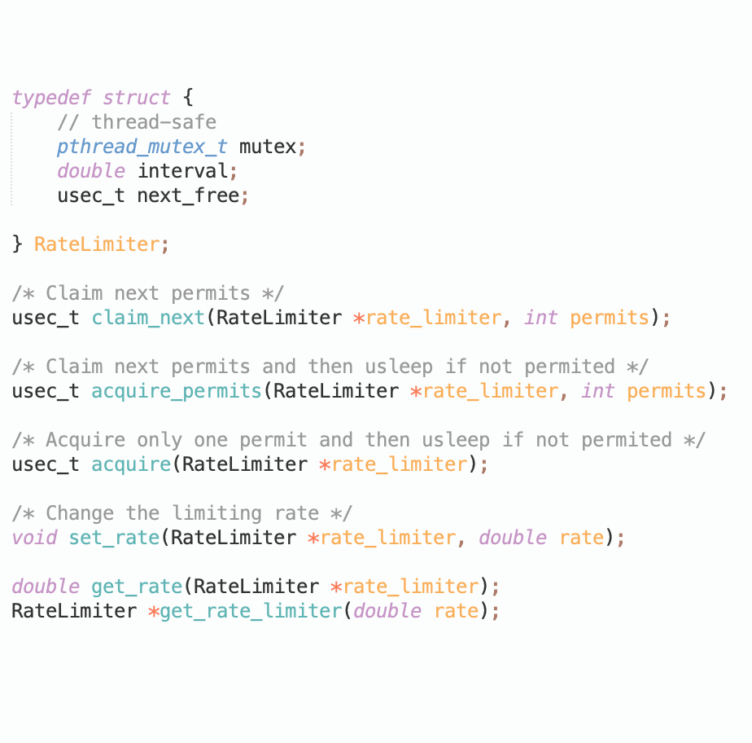
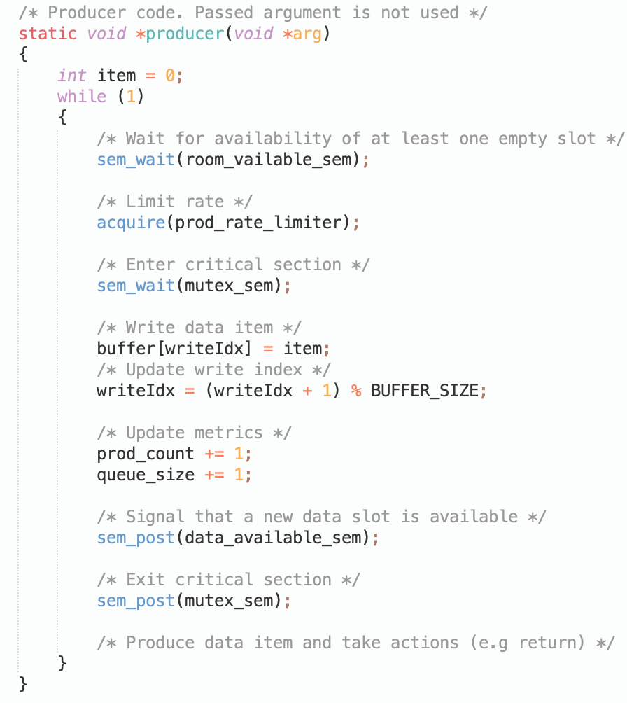
Flow Control Algorithm
Implementation and Usage of Rate Limiter
Notes:
Let’s take a look at the actual implementation, here is my declaration of all functions of Rate Limiter object, and the producer code used to show the usage of
the Rate Limiter object

Slide 25
Flow Control Algorithm
Implementation and Usage of Rate Limiter
Notes:
Most important function is acquire

Slide 26
Flow Control Algorithm
Implementation and Usage of Rate Limiter
Notes:
It is used before entering the critical sections to enqueue new items

Slide 27
Flow Control Algorithm
Implementation and Usage of Rate Limiter
Blocked if not permitted
Notes:
It would be blocked if at this instant, the producer’s rate exceeds the limiting rate of producer

Slide 28
Flow Control Algorithm
Implementation and Usage of Rate Limiter
Blocked if not permitted
Notes:
Additionally, in order to control the flow and visualize metrics, we need to update metrics here

Slide 29
Flow Control Algorithm
Implementation and Usage of Rate Limiter
Blocked if not permitted
Update accumulated count of enqueued items and the current queue size
Notes:
These metrics are the number of enqueued items so far up to this current instant, and the current queue size which is used to compare with the threshold

Slide 30
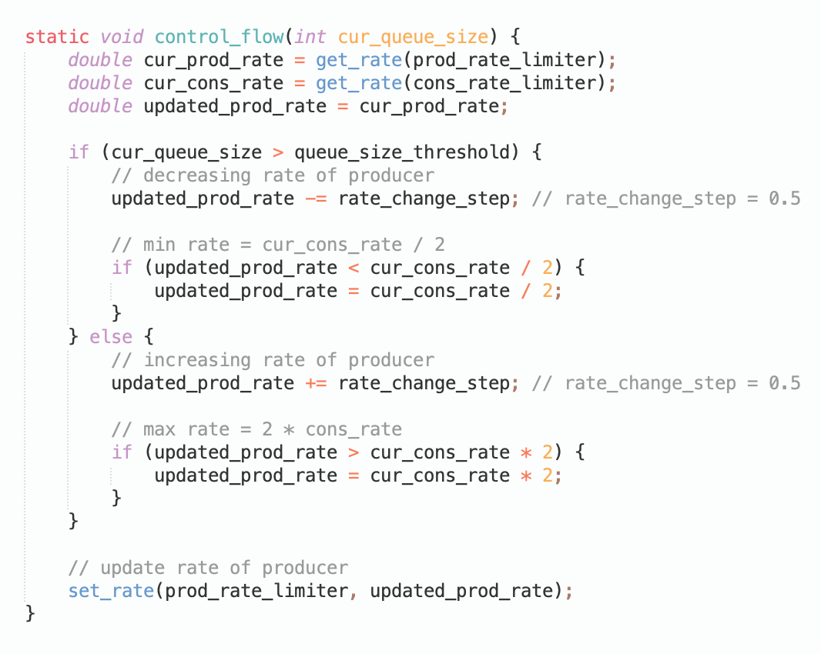
Flow Control Algorithm
Regulate the rate of Producer
Notes:
And to regulate the rate of producer, we do simple things.
Decrease the rate when current queue size is greater than the threshold and increase otherwise
After that, we need to set a new rate value to the Producer Rate Limiter object

Slide 31
Flow Control Algorithm
Regulate the rate of Producer
Decrease rate
Notes:
And to regulate the rate of producer, we do simple things.
Decrease the rate when current queue size is greater than the threshold and increase otherwise
After that, we need to set a new rate value to the Producer Rate Limiter object

Slide 32
Flow Control Algorithm
Regulate the rate of Producer
Decrease rate
Increase rate
Notes:
And to regulate the rate of producer, we do simple things.
Decrease the rate when current queue size is greater than the threshold and increase otherwise
After that, we need to set a new rate value to the Producer Rate Limiter object

Slide 33
Flow Control Algorithm
Regulate the rate of Producer
Decrease rate
Increase rate
Apply new rate
Notes:
And to regulate the rate of producer, we do simple things.
Decrease the rate when current queue size is greater than the threshold and increase otherwise
After that, we need to set a new rate value to the Producer Rate Limiter object

Slide 34
03
Metrics Monitoring

Slide 35
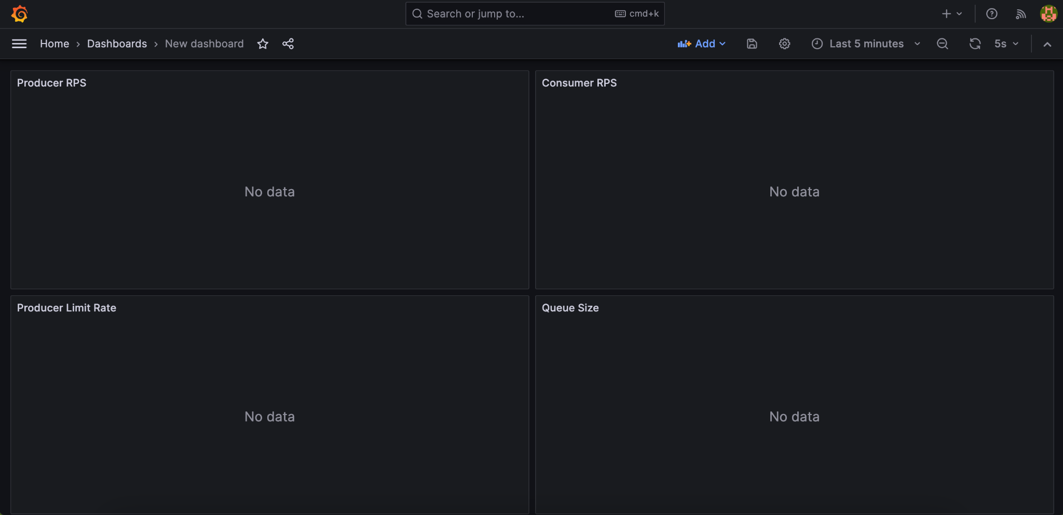
Metrics Monitoring
At the instant t
Notes:
The Orchestrator can take a snapshot of metrics at an instant, and then we can visualize those metrics

Slide 36
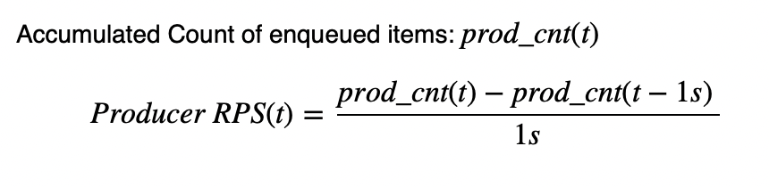
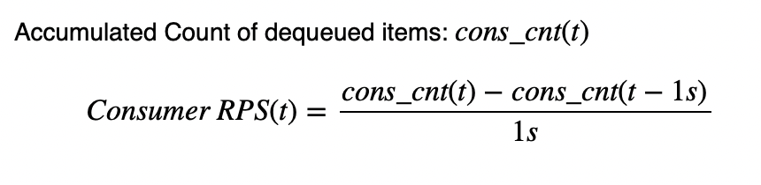
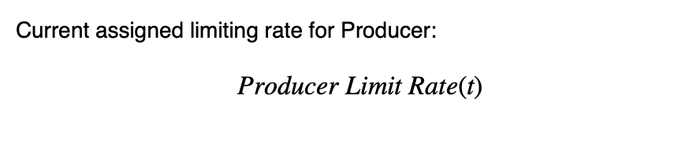
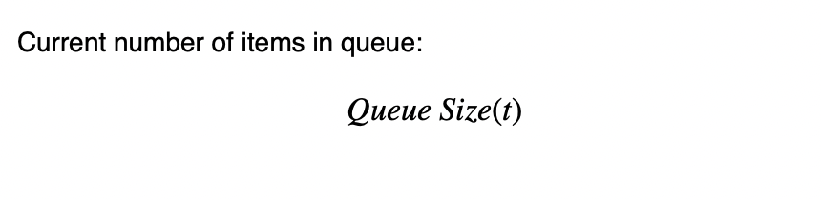
Metrics Monitoring
At the instant t
Notes:
Here I have four important metrics,
Producer actual rate, Consumer actual rate, Producer Limit Rate which is the assigned value for Producer Rate Limiter
And finally the queue size. These metrics which changed according to time

Slide 37
Metrics Monitoring
At the instant t
Compare the actual rate with the assigned rate
Notes:
Why I have these two metrics, the purpose is to compare the actual rate and the assigned rate

Slide 38
04
Results
Notes:
Next, let’s evaluate my results

Slide 39
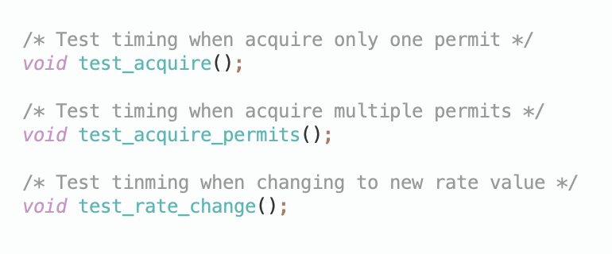
Results
Rate Limiter Unit Testing
Notes:
Firstly, Unit Testing the Rate Limiter, what about the accuracy of it

Slide 40
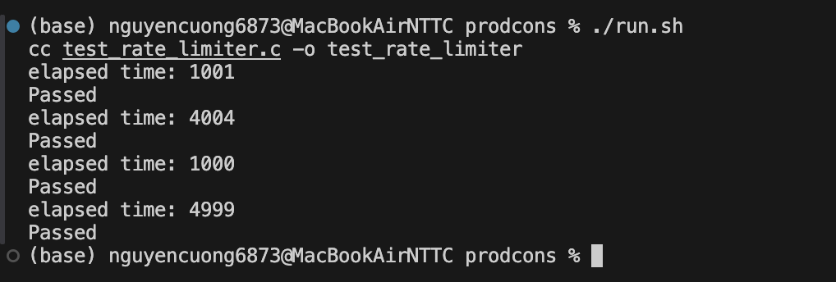
Results
Rate Limiter Unit Testing
Notes:
This is the results of my test cases

Slide 41
Results
Rate Limiter Unit Testing
Compare with…
Notes:
These values here would make sense when I compare to the test results of

Slide 42

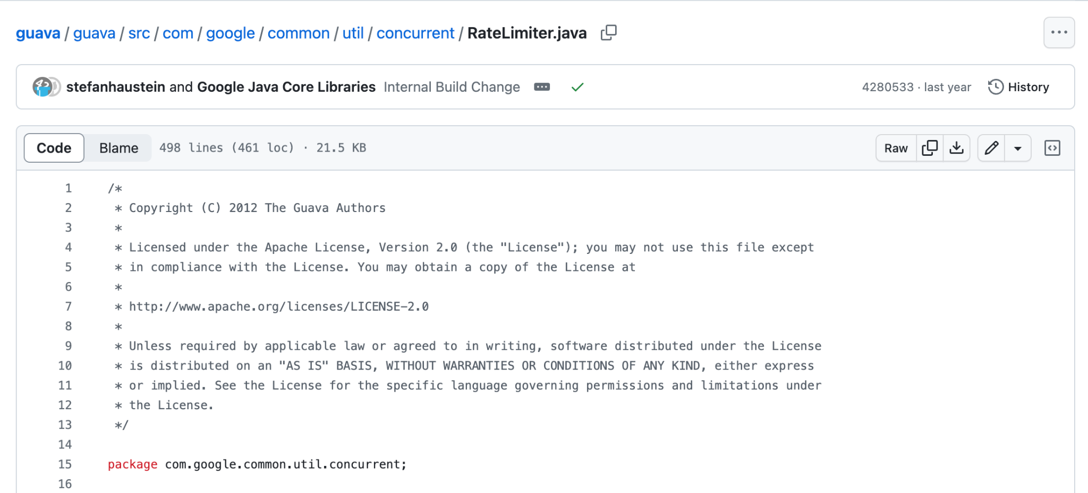
Results
Rate Limiter Unit Testing
Compare with…
Notes:
These values here would make sense when I compare to the test results of a common Java Library which support Rate Limiter object which is also implemented the Token Bucket Algorithm

Slide 43
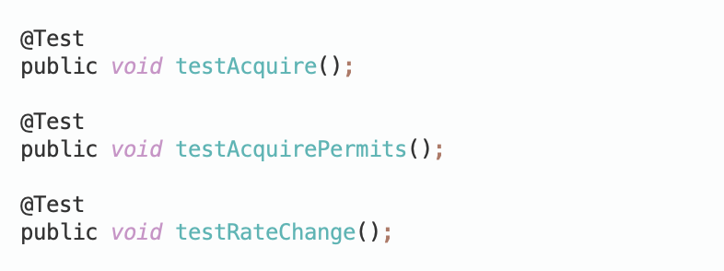
Results
Rate Limiter Unit Testing
Compare with…
Notes:
I wrote the same test cases in Java for these functionalities,

Slide 44
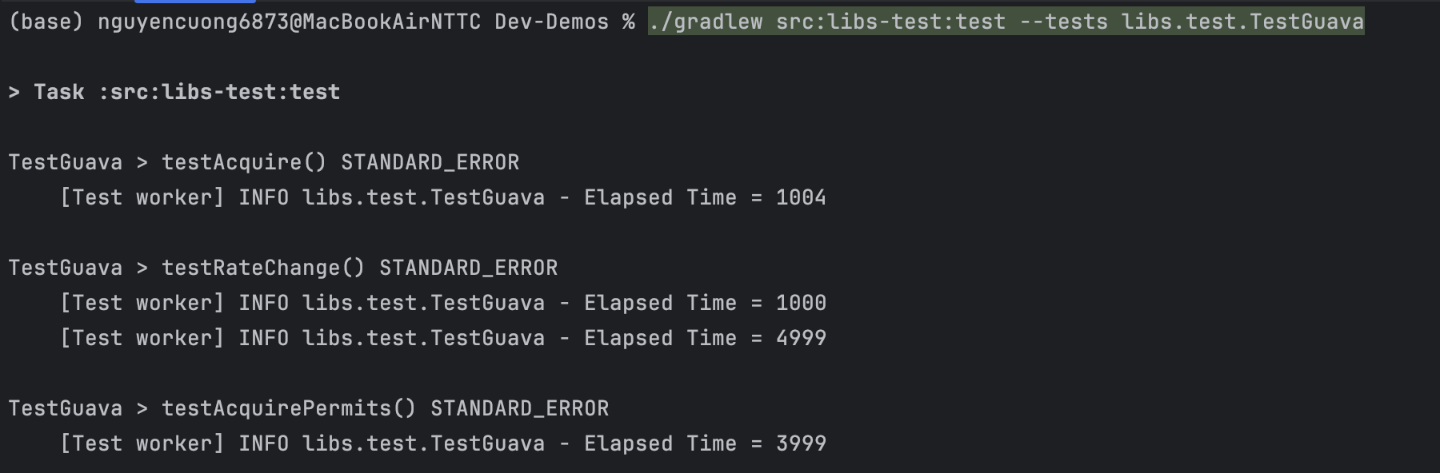
Results
Rate Limiter Unit Testing
Compare with…
Notes:
And here is the result, we can see the similarity in the figures

Slide 45
Results
Rate Limiter Unit Testing
Compare with…
TOLERANCE < 10 milliseconds with rate = no. permits / second
Compare this test results to the the results of testing Rate Limiter from the popular Google Guava Java Library, the TOLERANCE is almost similar
Notes:
And my evaluation is that …

Slide 46

Results
Metrics Visualization
http://localhost:3000/d/f82217e3-90ef-4aa4-a108-492b21bb8839/new-dashboard?orgId=1&refresh=5s&from=now-5m&to=now
Notes:
Now, lets see the most interesting part of my project, I will show the demo

Slide 47
05
Conclusion
Notes:
Finally, this is the conclusion of my presentation

Slide 48
Conclusion

Slide 49
Conclusion
Conclusion 01
Using semaphore and Rate Limiter to control flow in the Producer - Consumer - Orchestrator model

Slide 50
Conclusion
Conclusion 01
Conclusion 02
Using semaphore and Rate Limiter to control flow in the Producer - Consumer - Orchestrator model
Using Token Bucket Algorithm for Rate Limiter implementation

Slide 51
Conclusion
Conclusion 01
Conclusion 02
Conclusion 03
Using semaphore and Rate Limiter to control flow in the Producer - Consumer - Orchestrator model
Using Token Bucket Algorithm for Rate Limiter implementation
Using Prometheus and Grafana for the purpose of visualization with the support of Java Client Library

