Slide 1



Employee.jet
An Employee Engagement Platform
By
Nerd Herd

Slide 2
Employee Engagement Platform
Introduction
Hierarchy Structure
Employee.jet
Tracking
and
Setting Goals
Employee
Feedback
Insights
Timeline
Incentivized
Coins

Slide 3

Introduction
This platform is designed to increase employee performance and engagement by collecting regular feedback from the employee, optimizing their work schedules, incentivizing their performances, managing their daily and weekly tasks, and optimizing their meeting schedules.
3

Slide 4
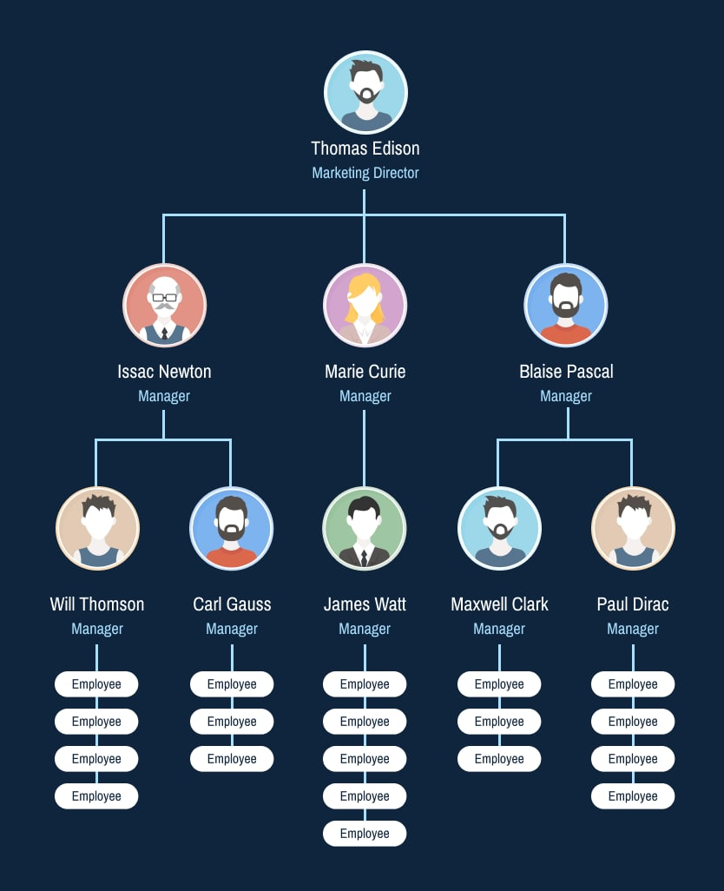
Hierarchy Structure
This shows the hierarchical structure of an organization which we would be taking as an example and seeding our database according to these relations
All the extra privileges(like adding more members to the team, setting project goals for the team, analyzing the feedback from the team) will be provided only to non-leaf members of the organization.

Slide 5
Employee Feedback
Let your employees know their voices matter
Reward employees who complete a survey with coins to incentivize participation
Will include anonymous participation
We will be keeping our survey short and user-friendly with a variety of questions such as
Was the behavior of the manager up to the standards? (This will be sent to someone directly above the manager in our hierarchy structure)
Was team coordination up to the expectations?
Was work distributed evenly?
Ease of communication with the team and manager
Was the deadline sufficient?
All data is recorded and analyzed for the manager to use in optimizing team efforts. The manager will be able to view the detailed results of each survey, including average ratings and percentages except the feedback about him.

Slide 6

Insights
Track, measure and compare engagement and interactions insights
For each project, we’ll show top engaging members to encourage others towards a healthy competition
It will show detailed ratings by project managers on different aspects such as ‘Fluency in required Tech’,
‘Finished on Deadline’, ‘Team Collaboration’, ‘Eagerness to Learn’
It will show the number of leaves
It will show a work-day streak to encourage employees to be regular
It will show the person on the team with the maximum streak
It will show incentivized coins(about them in later slides)

Slide 7
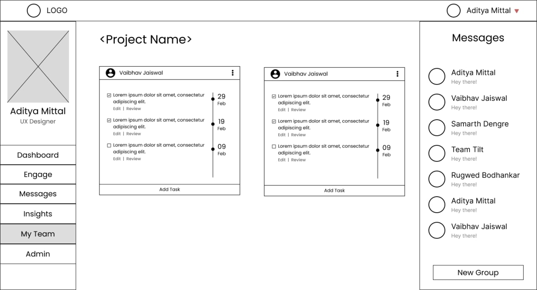
Tracking and Setting Goals
The project manager will be able to set up project goals for each member of the team, and each team member will be able to view their respective tasks and mark them completed when done. This list cannot be modified by the leaf nodes of the hierarchy structure, they will only be able to view it and tick it.

Slide 8
Incentivized Coins
We are creating the scheme of incentivizing coins so as to encourage the employees to increase their participation in feedback, challenges, and quizzes
Feedback:-
We’ll keep our feedback simple and user-friendly with questions that take a short amount of an employee’s time multiple choice, star rating, and slider scale.
All data is recorded and analyzed to optimize the organization’s efforts. Admin can view the detailed results of each survey, including average ratings and percentages.
Quizzes:-
We’ll make our quizzes fun and inject healthy competition by adding timers and leaderboards.
Send the right quiz to the right people. Choose between sending to specific people, groups, your entire organization, and segments.
Challenges:-
In the constant battle with turnover and employee disengagement, employee health and loyalty are valuable resources. So we will encourage our employees to participate in fun and healthy challenges.
Some challenges include- Walking challenge, Habit-Building Challenge, Nutrition Challenge, etc
The members of the organization can redeem their incentivized coins in various manners, such as goodies, trips, etc.

Slide 9
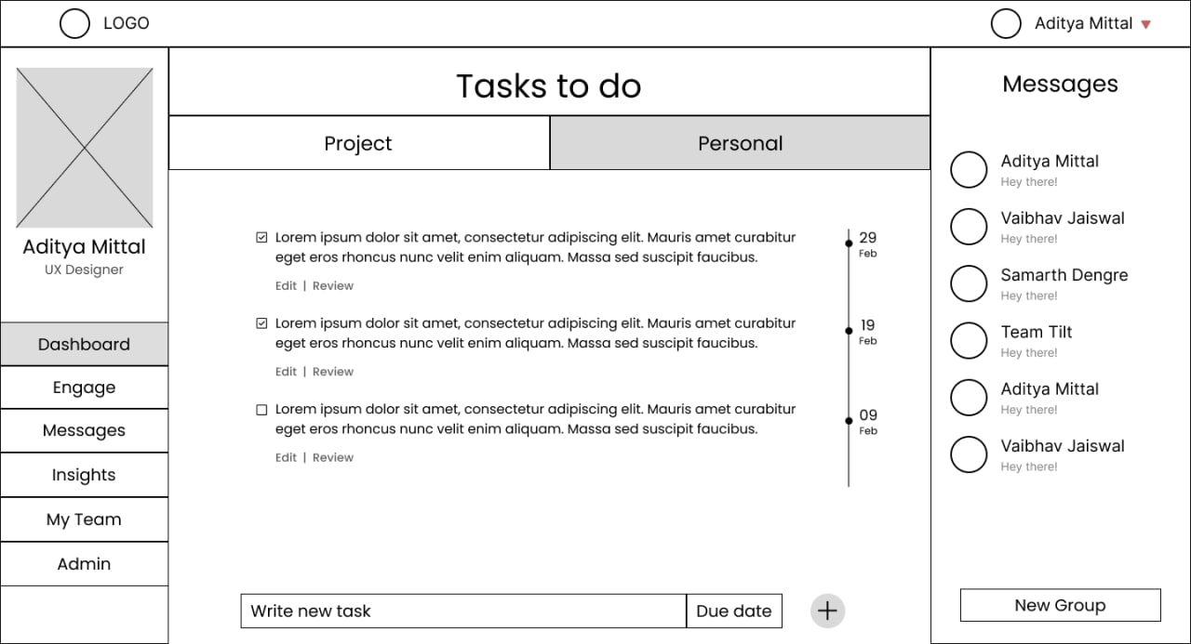

Slide 10
Timeline
Creating the ‘Incentivization’ page and logic.
Creating the ‘My Team’ page for the employees and managers to set the team tasks
Collecting the sample data of an organization to seed the databases and understanding the working of an organization
Implementing the Admin page which would allow the authenticated personnel to view and update the database
Creating the ‘Insights’ Page to show specific details like their previous ratings, performances, etc.
1st Stage
2nd Stage
3rd Stage
4th Stage
5th Stage
6th Stage
7th Stage
8th Stage
9th Stage
Creating the Welcome page, Sign-in page, Admin Page
Creating a dashboard to show the basic info like ongoing projects, messages, personal details, feedback forms, challenges, quizzes, etc
Creating the feedback, quizzes, and challenges pages.
Creating the ‘Messaging’ functionality for employees.

Slide 11




Thank you
Team- Nerd Herd
-Aditya Mittal (UI/UX designer)
-Rugwed Bodhankar(Front-End Developer)
-Samarth Dengre (Back-End Developer)
-Vaibhav Jaiswal (Back-End Developer)

