Slide 1






CHAT BOT
Presented By:
Ashutosh Sagar 21/10/JC/006
Harshita Chourasiya 21/10/JC/035

Slide 2





ABOUT US
HISTORY
TABLE OF CONTENTS
INTRODUCTION
TYPES OF CHAT BOT

Slide 3




ARCHITECTURE
APPLICATIONS
TABLE OF CONTENTS
HOW DOES CHATBOT WORKS
CODE

Slide 4

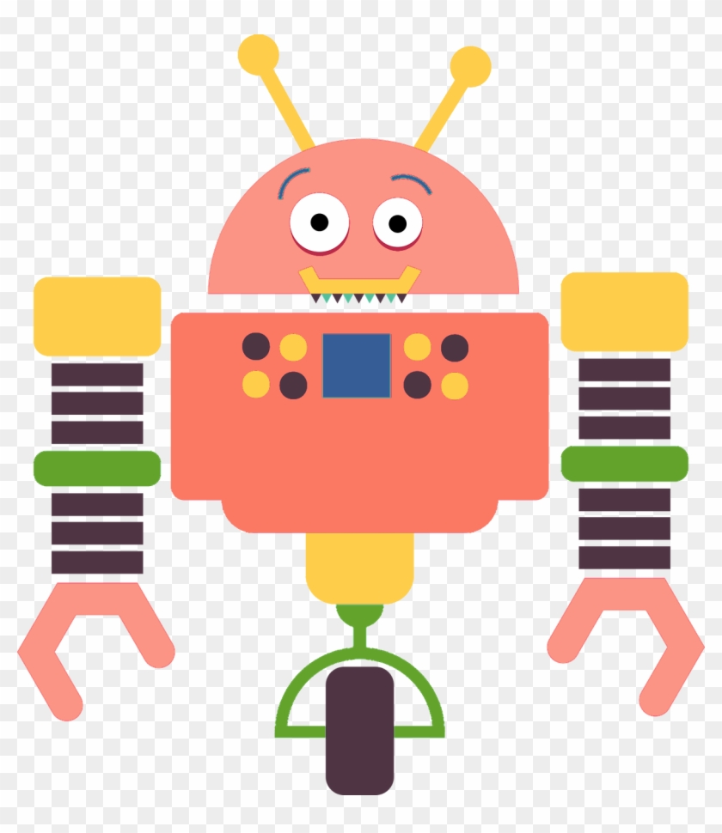
“We are no longer teaching people how to communicate with system. We are teaching systems to communicate with people.”

Slide 5


CHATBOT
A chatbot is a computer program that simulates and processes human conversation (either written or spoken), allowing humans to interact with digital devices as if they were communicating with a real person.

Slide 6
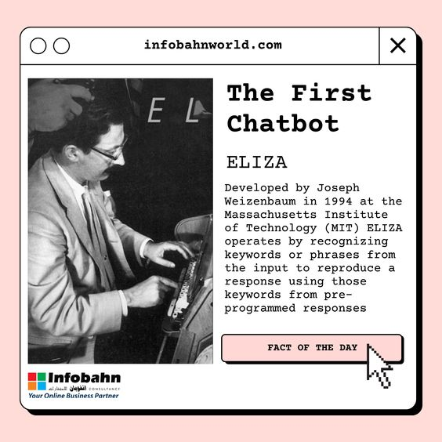
HISTORY

Slide 7

ELIZA-(1966)
HISTORY
PARRY-(1972)
ALICE-(1995)
SMARTER CHILD (2001)

Slide 8
SIRI-(2010)
GOOGLE NOW (2012)
HISTORY
CORTANA (2014)
ALEXA-(2015)

Slide 9

TYPES OF CHATBOT
TEXT BASED
VOICE BASED

Slide 10
TWIN APPROACH
RULE BASED CHATBOT
SELF LEARNING CHATBOT

Slide 11
HELPDESK ASSISTANT
HOME ASSISTANT
APPLICATIONS
EMAIL DISTRIBUTER
OPERATIONS ASSISTANT
PHONE ASSISTANT
ENTERTAINMENT ASSISTANT

Slide 12
CORPUS
CHAT WINDOW (FOR USER INTERACTION)
NLP MODEL
ARCHITECTURE
INTERFACE
APPLICATION DB

Slide 13

HOW DOES A CHATBOT WORK
CORPUS
A corpus is a large and structured set of machine-readable texts that have been produced in a natural communicative setting.
Without Corpus it is impossible for chatbot to learn and reply something useful to the user.

Slide 14
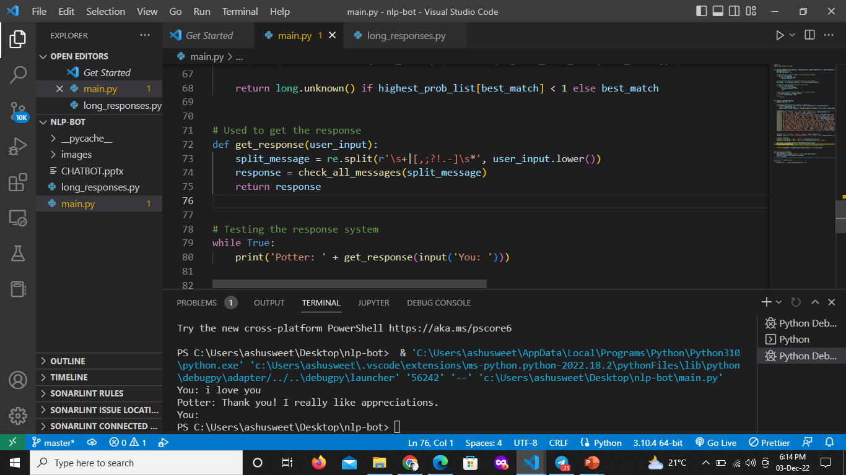
PREPROCESSING THE DATA
All the data coming as an input should be converted to lower case.
HOW DOES A CHATBOT WORK

Slide 15
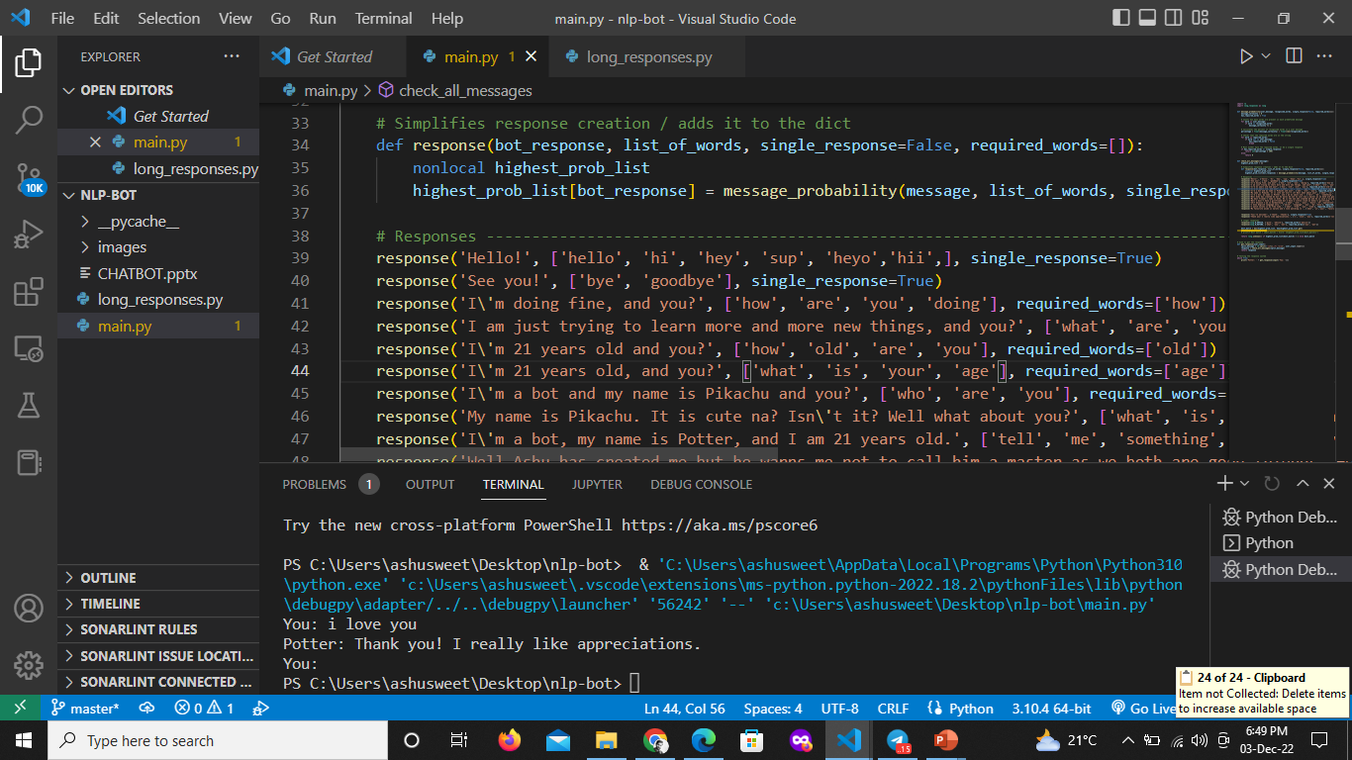
TOKENIZATION
Tokenization is the structural process of converting a sentence into individual collection of words.
HOW DOES A CHATBOT WORK

Slide 16
STEMMING
Stemming is a process of finding similarities between words with the same root words.
HOW DOES A CHATBOT WORK

Slide 17
GRAPHIC USER INTERFACE
Tkinter is the standard GUI library for Python. Python when combined with Tkinter provides a fast and easy way to create GUI applications. Tkinter provides a powerful object-oriented interface to the Tk GUI toolkit.
TKINTER

Slide 18
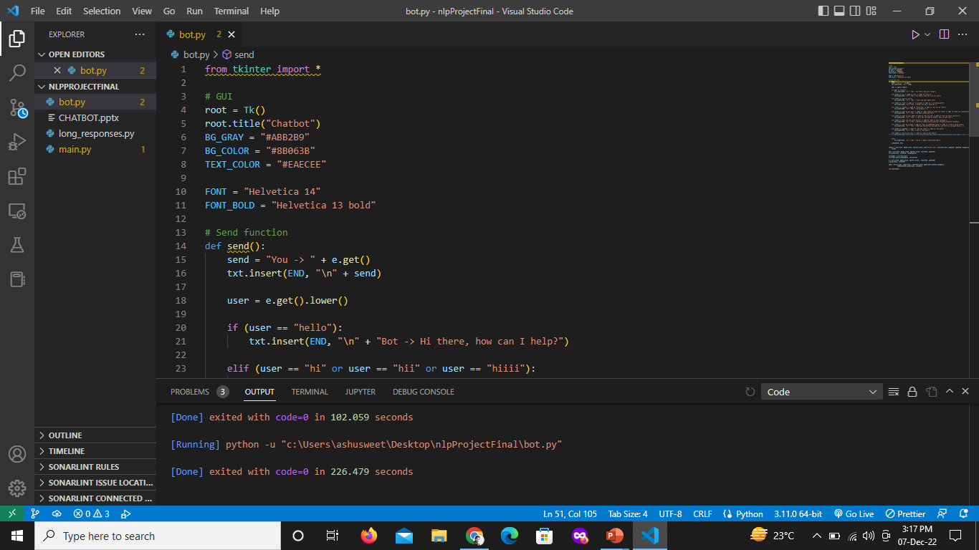
GUI
CODES

Slide 19
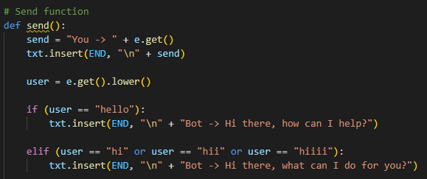
GUI
CODES

Slide 20
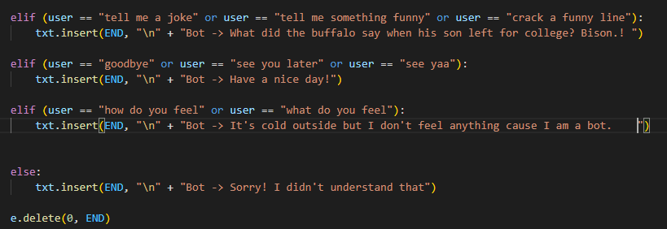
GUI
CODES

Slide 21
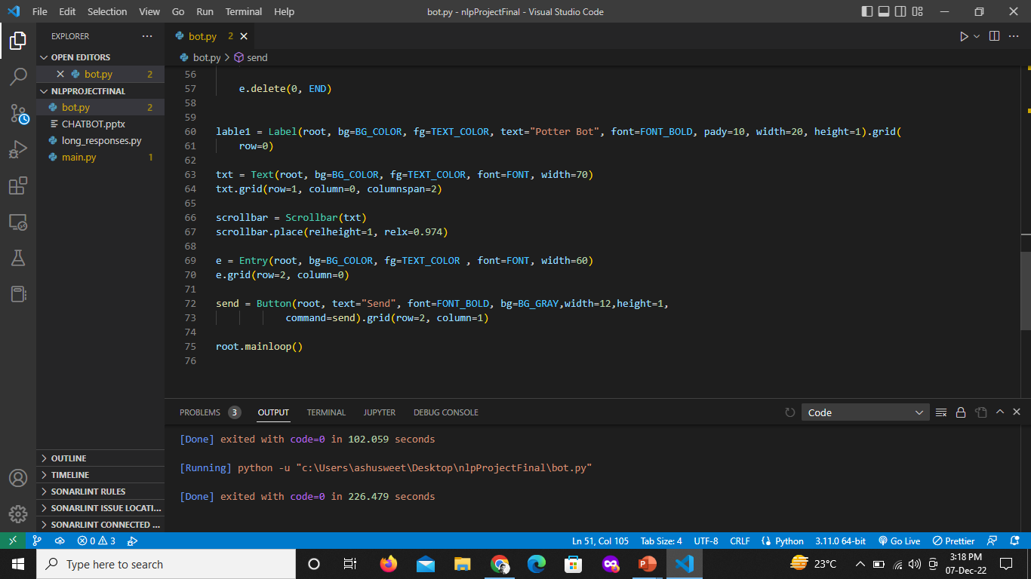
GUI
CODES

Slide 22
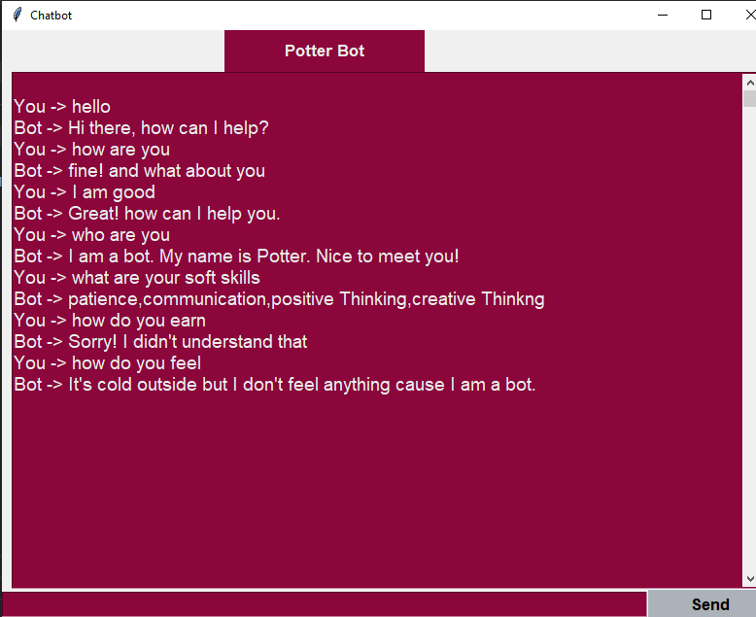

OUTPUT
CODES

Slide 23

THANK YOU

