Slide 1
Business Case: E-tailor Hub
By Nurul Najihah Khairul Najmy, Siti Hajar Borhanuddin, Nur Dhiya Alyani Raduan, Siti Salbiah Azmi, Abdul Rahman Ahmad Dahlan

Slide 2
Table of contents
01
04
02
05
03
06
Pain & Gains of our customers
Uniques
Solutions - Product and Services
Competition
Business Model
Summary

Slide 3

Background information
E-tailor Hub is a business model that provides handmade clothing while also serving as a marketplace for used clothing. Customers have the options to purchase from our sellers through the E-tailor Hub mobile application that is available for iOs and android users.
E-Tailor Hub

Slide 4
01
Pain & Gains of our customers

Slide 5

The problem that our customers are facing (pains)
Loss of jobs
Low income
Unemployment
Underemployment
Fabric Waste
Lack of sustainable consumption in the fashion industry

Slide 6
Solution for our customers
Problem (gains)
An online platform (mobile application) that enables the B40 tailors to sell handmade clothing.
This platform also allows other sellers to market their used clothing to a wide audience.
We also provide upskilling and reskilling training courses to the B40 tailors.
Provide sustainable fashion as every piece of clothing is booked before sewing & promotes reusing old pieces of clothing.

Slide 7
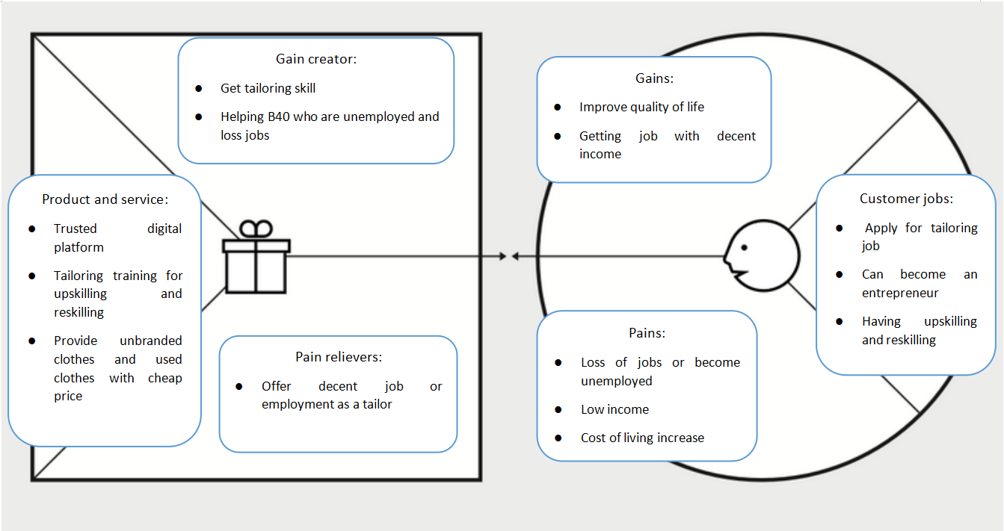
Value Proposition for tailor (B40)

Slide 8
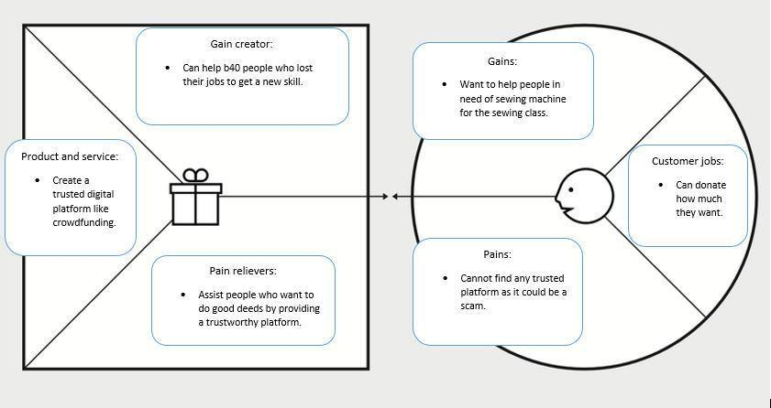
Value Proposition for Customer (M40 & T20)

Slide 9
How many customers need this problem solved - market size?
Have you validated that customers will pay to have it solved?
B40 (tailor) - consists of 40% of Malaysian citizens
M40 and T20 (consumers) - 60% of the Malaysian Citizens
Sellers: Open to all B40, M40 and T20 groups
We researched and prepared some literature review regarding the market of our business
We also conducted a survey to obtain the opinions of the public

Slide 10
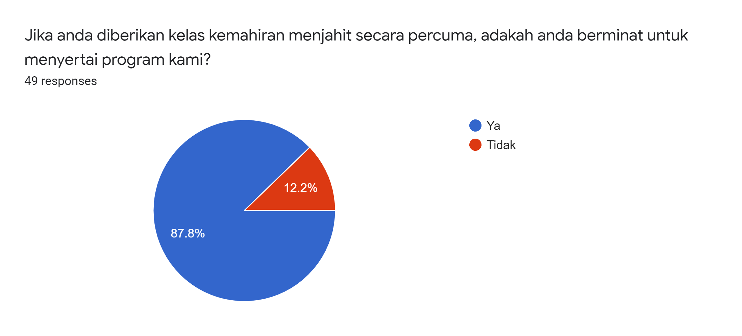

Slide 11
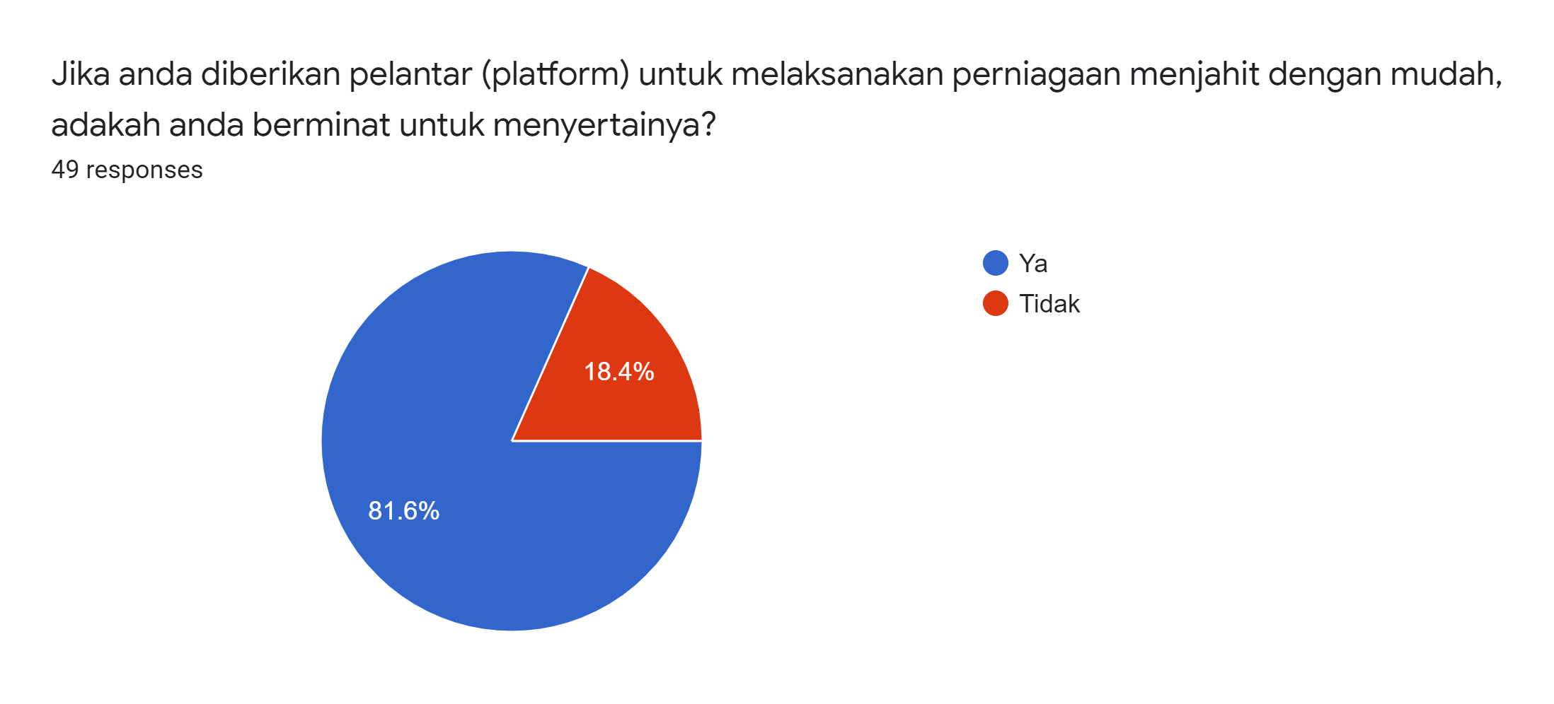

Slide 12
02
Solutions -
Product and Services

Slide 13
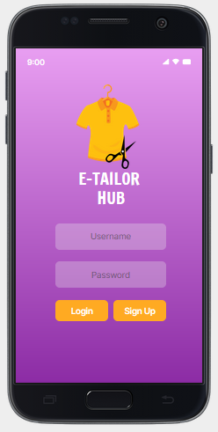
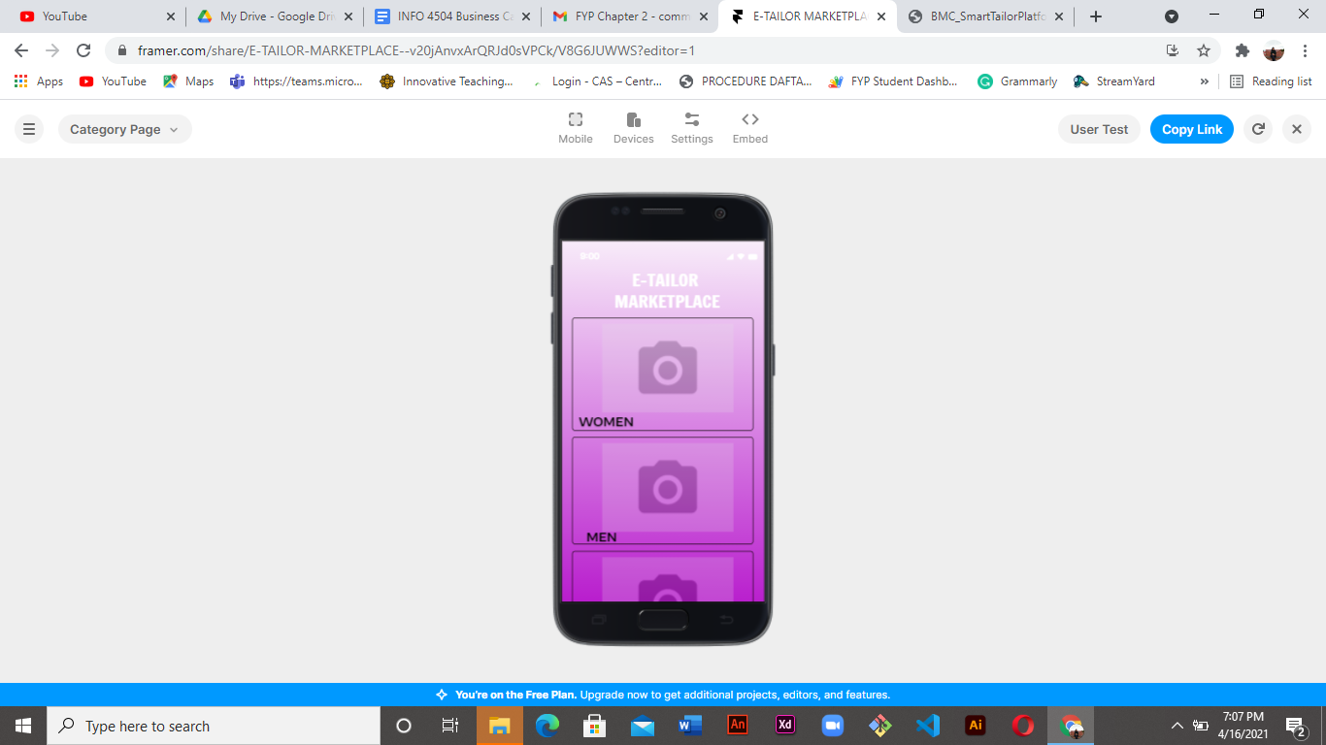
Login interface
Product category interface

Slide 14
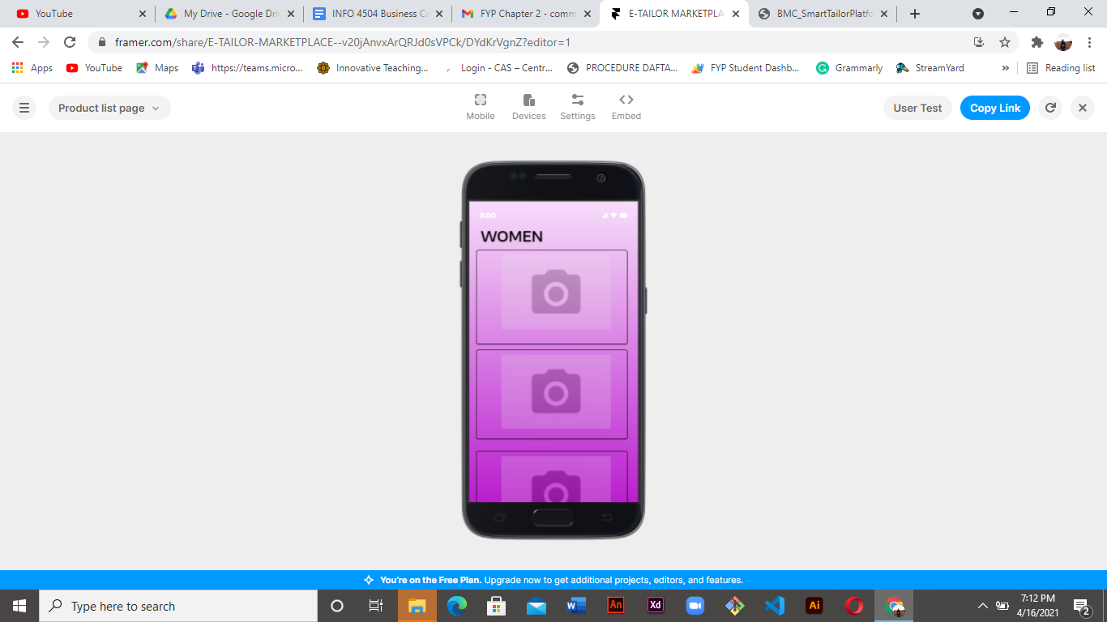
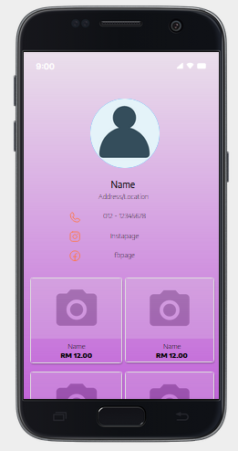
Product list interface
Seller Store

Slide 15
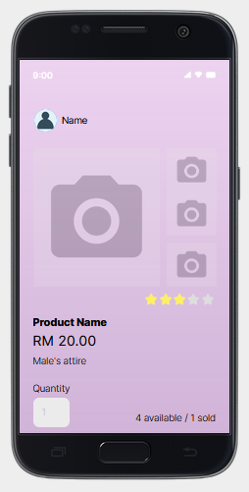
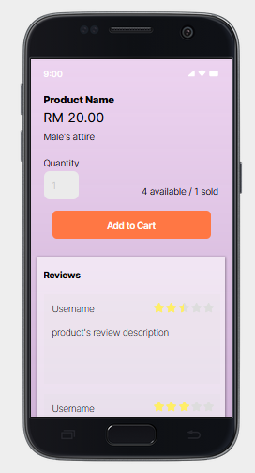
Product description

Slide 16
 | Our Product (E-Tailor Hub) | Customers Benefits
Consumers | Uniqueness of customized design for the clothes based on the consumer's request. Wide range of clothing selection that is affordable. | Can purchase new or preloved clothings from the sellers Can contact and order custom design from the tailors.
Seller/Tailors | job opportunities platform for tailor/sellers to reach consumers. | Can create and market their own products. Able to generate income from sales.

Slide 17
Opportunities provided for the customers:
Providing job opportunities for the B40 group with upskilling and reskilling and help them become an entrepreneur in tailoring business.
Fast and sufficient delivery services
Affordable price

Slide 18
03
Business Model

Slide 19
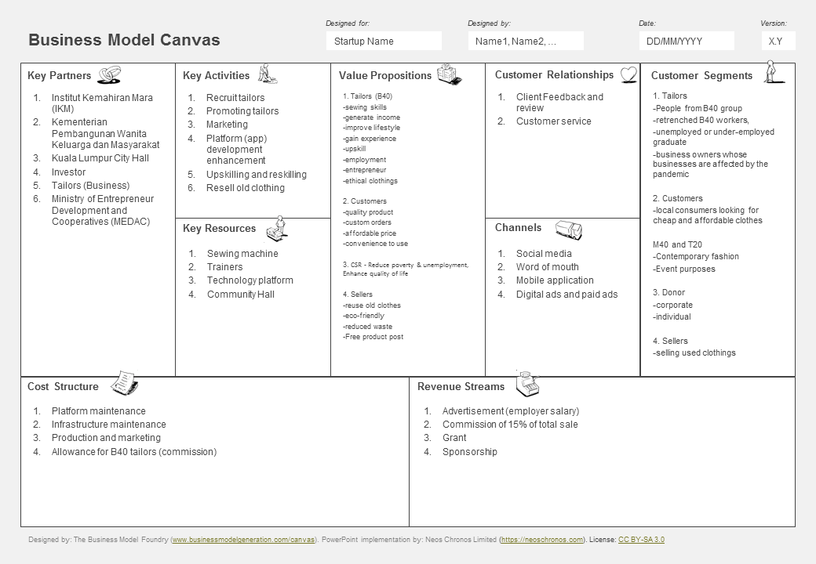

Slide 20
REVENUE STREAM
OPPORTUNITIES FOR GROWTH
SCALING BEYOND CURRENT SCOPE
Commissions
Advertisements
Grant
Sponsorships
Availability of demands
Critical need for employment
Leveraging other talents of service professionals
Remote assistance for quick fixing

Slide 21



CHANNEL
Social Media
Word of Mouth
Mobile application
Digital Ads and Paid Ads

Slide 22
04
Unique Values

Slide 23
What’s Unique
High quality clothing pieces
Upskilling and reskilling for the b40 group
Platforms that sellers and buyers can get various types of tailored, new, and used clothes.
Fair and ethical fashion

Slide 24
05
Competition

Slide 25
Our Competitors
Etsy - An online marketplace where artists can sell one-of-a-kind, handmade pieces to consumers all over the world. It is to allow vendors to sell their handmade crafts and earn a living while also allowing customers to buy one-of-a-kind products.
Wish - An ecommerce marketplace that allows users to shop for a variety of items, ranging from clothes to electronics. majority of the products sold are unbranded and sold directly to customers by a variety of small businesses
thredUP - an online consignment and thrift shop where customers can buy and sell high-quality second-hand clothing, handbag, accessories and shoes.
Redbubble - an online platform that sells print-on-demand items based on artwork submitted by artists and they can promote their art digitally using Redbubble.
MUD Jeans - a circular jeans brand applying a circular production model. Customers can lease or buy MUD jeans, and when customers no longer want to wear them, they can return the jeans to have them recycled into new denim products.

Slide 26
Competitive Landscape
PRODUCT
FEATURES
ETSY
WISH
THREDUP
REDBUBBLE
MUD JEANS
E-TAILOR HUB
Sell unbranded products
Seller can create shop in app
Provide job opportunities for B40
Sell used items.
Customer can order custom order

Slide 27
05
Summary

Slide 28
Summary
The conceptual digital platform business model offers value propositions and benefits to various customer segments such as tailors, customers, donors and sellers
The business model is focused on sustainable consumption, aligned to the Sustainable Development Goals (SDG).
The next step is to develop a business plan after reducing business risks and uncertainties after validating the business model process.

Slide 29

Thank You For Watching!

