Slide 1
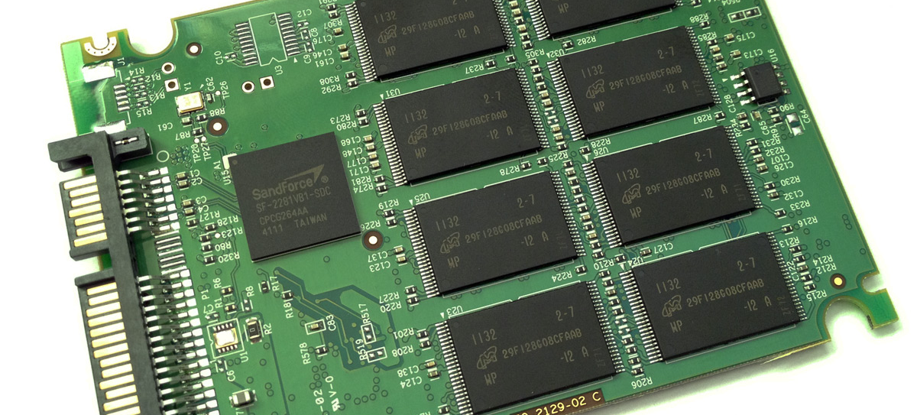
Nand Flash Memory
22i-1552_22i-1612_22-1668

Slide 2


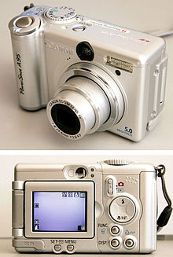
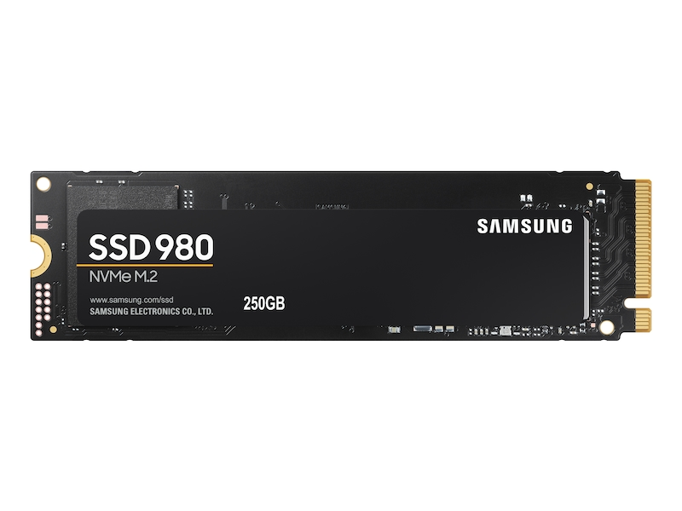
Introduction to Nand Flash Memory
It is a nonvolatile storage that doesnot require power to store data.
It is portable storage.
It can be found in MP3 players, digital cameras, USB flash drives and solid-state drives (SSD).

Slide 3

Let’s look at the block diagram for nand flash

Slide 4
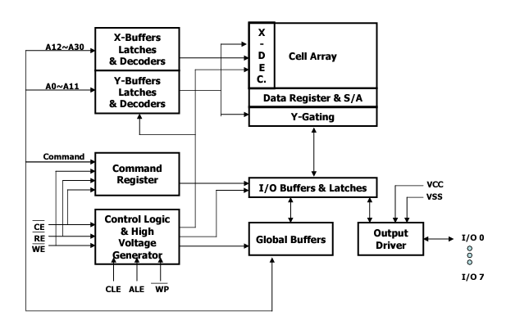

Slide 5

How does it function ?

Slide 6
Nand flash saves data as blocks and relies on electric circuits to store data.
When power is detached a metal-oxide semiconductor will provide an extra charge to the memory cell, keeping the data.

Slide 7
Flash Memory Structure
It is a type of electronically erasable programable read only memory (EEPROM) chip.
Grid structure with columns and rows.
Each intersection has two transistors: floating gate and control gate.
Notes:
Flash Memory Structure:
Flash memory is a type of EEPROM (Electrically Erasable Programmable Read-Only Memory) chip, featuring a grid structure composed of columns and rows.
At the intersections of the grid, there are two essential transistors: the floating gate and the control gate.

Slide 8
Flash Memory Structure
Floating Gate Transistors: The basic building block of NAND Flash memory is the floating gate transistor. Each memory cell consists of a MOSFET (Metal-Oxide-Semiconductor Field-Effect Transistor) with a floating gate and a control gate.
Insulating Layer: The floating gate is surrounded by an insulating layer, typically made of silicon dioxide. This insulating layer isolates the charge stored in the floating gate from the rest of the transistor.

Slide 9
Memory Cell States
Control gate link = digital value 1 (erased bit).
Fowler-Nordheim tunneling required to program bit to digital value 0.
Notes:
A digital value of 1 (erased bit) is achieved when the control gate establishes a link.
To program the bit to a digital value of 0, Fowler-Nordheim tunneling is necessary.

Slide 10
Programming Process
Tunneling alters electron placement in the floating gate.
Signal voltage sent along column line.
Charge drained to ground, pushing electrons across oxide layer.
Alters charge on oxide layer, creating a barrier between floating and control gates.
Below threshold voltage, cell's value becomes digital 0.
Notes:
Tunneling modifies the placement of electrons in the floating gate.
A signal voltage is transmitted along the column line.
Charge is drained to the ground, pushing electrons across the oxide layer.
The alteration of charge on the oxide layer forms a barrier between the floating and control gates.
Once the charge drops below the threshold voltage, the cell's value becomes digital 0.

Slide 11

Reading Data
Sensing Threshold Voltage: To read data from a memory cell, a voltage is applied to the control gate, and the threshold voltage is measured. The threshold voltage reflects the charge state of the floating gate. By comparing the threshold voltage to predefined levels, the memory controller can determine the stored data.

Slide 12
Erasing Process
Higher-voltage charge applied to return cell to digital 1.
Stops tunneling and restores charge to the floating gate.
Notes:
A higher-voltage charge is applied to revert the cell to a digital value of 1.
This stops tunneling and restores charge to the floating gate.
Block Erase: Unlike writing, erasing in NAND Flash memory occurs at the block level. To erase a block, a higher voltage is applied to the entire block, removing the electrons from the floating gates within that block.
Block Size: Since erasing happens at the block level, modifying data in a block requires copying valid data to a new block and then erasing the entire old block. This process is one reason for wear leveling strategies to distribute write and erase cycles evenly across the memory cells.

Slide 13
Non-Volatile Nature
Cells retain charged or drained states even without external power.
NAND flash memory is non-volatile.
Notes:
Even without external power, cells retain their charged or drained states.
NAND flash memory is characterized by its non-volatile nature.

Slide 14
Memory Wear Out
Charging and tunneling processes are destructive.
Limited program/erase cycles before breakdown.
Concept of memory wear-out or wear.
Notes:
How long it lasts basically ?
Generally speaking it lasts from between 10,000-100,000 write/erase cycles.
he charging and tunneling processes are inherently destructive.
There's a limited number of program/erase cycles before the cell may break down.
This limitation is referred to as memory wear-out or wear.

Slide 15

Comparison With NOR Flash Memory

Slide 16
Cost Efficiency
NAND flash memory is generally more cost-effective to manufacture compared to NOR flash.
Larger storage capacities can be achieved at a lower cost with NAND technology, making it suitable for mass storage applications.

Slide 17
Density and Capacity
NAND flash offers higher storage density and capacity than NOR flash.
NAND allows for the creation of high-capacity storage devices such as USB drives, SSDs (Solid State Drives), and memory cards.

Slide 18
Read & Write Speeds
NAND flash provides faster read and write speeds compared to NOR flash.
NAND is commonly used in applications where rapid data access and transfer rates are essential, such as in SSDs.

Slide 19
Page Based Programming
NAND flash operates on a page-based programming model, allowing data to be written or read in larger chunks.
This page-based structure contributes to faster write speeds and efficient data storage.

Slide 20
Erase Speed
NAND flash memory has faster erase speeds compared to NOR flash.
Quick erase times are crucial for applications that require frequent data updates or modifications.

Slide 21
Sequential Access
NAND flash is optimized for sequential data access.
Applications that benefit from streaming large amounts of data, like video playback or file storage, find NAND flash more suitable.

Slide 22
Compact Form Factor
NAND flash memory is available in compact form factors, making it suitable for space-constrained devices.
It is commonly used in mobile devices, cameras, and other consumer electronics.

Slide 23

Reliable in reading
NAND flash memory tends to be more reliable for read operations.
Although both NOR and NAND can wear out over time, NAND flash is often preferred for read-centric applications.

Slide 24

Parallelism
NAND flash memory supports parallelism, allowing multiple memory pages to be programmed or read simultaneously.
This parallelism enhances overall data throughput in NAND-based storage systems.

Slide 25

While NAND flash has these advantages, it's important to note that NOR flash memory has its own strengths, such as faster random-access times and better suitability for code storage in embedded systems. The choice between NAND and NOR depends on the specific requirements of the application.

Slide 26

Thank You!

