Slide 1
GPU-Optimised Semantic Segmentation of
Mesopotamian Tell Sites
Profiler Adaptive Data staging
MSc High Performance Computing | University of Luxembourg
Thesis Meeting | 9th June 2026
Nabeel Ahsan

Slide 2
Overview
Data for training (Bing_1k dataset)
MA-Net
DeepLabV3+
SegFormer
Trainable parameters
Model size (MB)
IoU
Epochs
Batch size
CPU time (s)
GPU time (ms)
17.2 Million
68
68
21
32
4.512
644.360
3.7 Million
15
67
34
32
3.922
416.305
26.7 Million
106
35.9
46
32
4.639
830.446
GAP

Slide 3
Why DataLoading Matters on HPC
Profiler Findings
GPU starvation detected: with num_workers=0, V100 sits idle between batches
Shared filesystem pressure: thousands of small image/mask files cause high metadata overhead on Iris GPFS
Static configuration: num_workers, prefetch_factor, pin_memory are set once and never adapt to the actual bottleneck
Tile inference is deterministic: future data access is predictable, enabling proactive prefetching
Research Question
Can a profiler-adaptive DataLoader that combines bottleneck classification, tar-shard staging, and predictive prefetching improve GPU utilisation and tile throughput for large-scale satellite-image segmentation on HPC systems?
When does the DataLoader become the bottleneck on Iris GPFS?
Do tar shards reduce many-small-file overhead?
Does predictive scratch staging outperform fixed WebDataset streaming?
Can prefetch depth be auto-tuned from measured timings?
pin_memory=True stores DataLoader batches in page-locked CPU memory, allowing faster and potentially asynchronous CPU-to-GPU transfer. In PADS-Loader, it is selected when profiling shows that host-to-device transfer contributes significantly to batch time.
Prefetch_factor: How far ahead the DataLoader prepares future data before the GPU actually needs it.

Slide 4
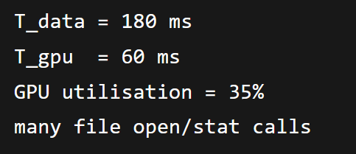
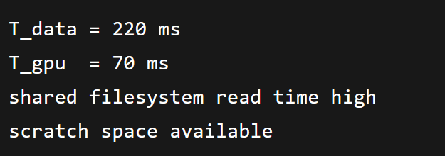
PADS-Loader: Proposed Method
Profiler-Adaptive Data Staging for PyTorch segmentation on HPC
1. WARM-UP
PROFILING
50-100 batches
2. BOTTLENECK
CLASSIFICATION
I/O, decode, H2D, compute
3. POLICY
SELECTION
loose / shard / stage
4. PREDICTIVE
STAGING
shard prefetch to scratch
Profiler Signals Measured
T_data time waiting for next batch
T_decode image/mask decode + transforms
T_h2d CPU-to-GPU transfer time
T_gpu model forward/backward time
GPU utilisation + DataLoader queue fullness
Shard size Whether the next tar shard can be staged efficiently
Scratch Availability: Whether node-local scratch has enough space
Example
Policy: Shard
Policy: Stage

Slide 5
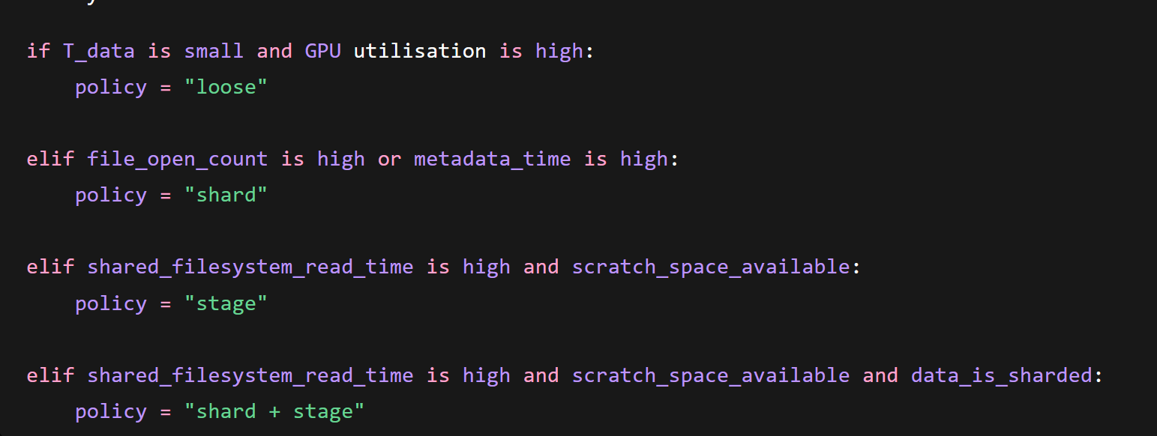
Bottleneck Classification & Adaptive Policy
Policy Action Best when
Policy | What it does | Best when
Loose | Reads individual image/mask files directly | Simple baseline, small/local dataset
Shard | Reads samples from tar archives | Many-small-file overhead is the problem
Stage | Copies future shards to node-local scratch before use | Shared filesystem latency is the problem

Slide 6
Bottleneck Classification & Adaptive Policy
Detected Bottleneck PADS-Loader Action
T_data low, T_gpu high, GPU utilisation high
Loose
Many open/stat/read calls, high metadata overhead
Shard
Shared filesystem read latency high, scratch available
Stage
Many-small-file overhead + slow shared FS
Shard + stage
T_decode dominates
Increase workers / cache decoded samples
Policies are not mutually exclusive — e.g. scratch staging + increased workers may both be active when filesystem I/O and decode are co-bottlenecks

Slide 7
Evaluation Plan
Comparison Methods
Baseline PyTorch DataLoader (loose files, default settings)
Tuned PyTorch DataLoader (best num_workers, pin_memory, prefetch)
WebDataset (fixed tar-shard streaming, no adaptation)
Scratch Baseline (copy loose files to node-local scratch manually)
PADS-Loader (proposed) adaptive staging + predictive prefetch

Slide 8
References
[1] Svogor et al., “Profiling and Improving the PyTorch Dataloader for High-Latency Storage,” arXiv, 2022. Base paper
[2] Aizman et al., “High Performance I/O for Large Scale Deep Learning,” arXiv, 2020. Tar
[3] Dryden et al., “Clairvoyant Prefetching for Distributed Machine Learning I/O,” SC, 2021. Predictive staging
[4] Kuchnik et al., “Plumber: Diagnosing and Removing Performance Bottlenecks in Machine Learning Data Pipelines,” MLSys, 2022. (bottleneck classification)
[5] Leclerc et al., “FFCV: Accelerating Training by Removing Data Bottlenecks,” CVPR, 2023.

Slide 9
Project Timeline
Expected timeline
Period
Dates
Task
Wks 1–4
Mar 1 – Mar 28
HPC setup, dataset preparation & QGIS pipeline
TIMELINE
Wks 5–8
Apr 1 – Apr 25
MA-Net baseline (reproducing Casini et al. 2023) + intro & background drafting
Wks 9–12
Apr 28 – May 23
DeepLabV3+, SegFormer + methods drafting
Wks 13–16
May 26 – Jun 20
Profiler-driven HPC inference optimisation + results drafting
Wks 17–19
Jun 23 – Jul 11
Comparative evaluation; full-region inference benchmark + discussion drafting
Wks 20–24
Jul 14 – Aug 15
Thesis revision, consolidation & submission

