Slide 1

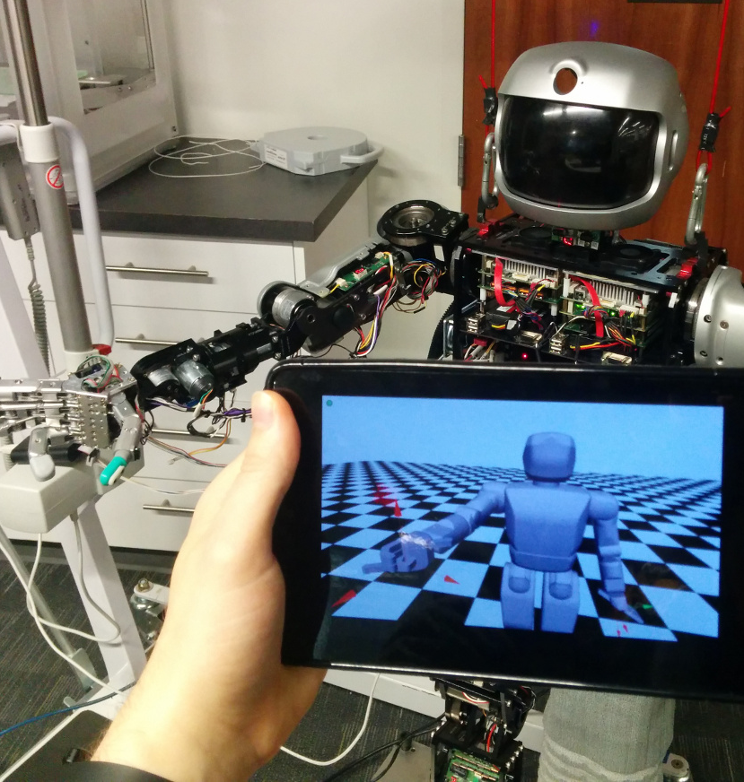
A lightweight, cross-platform, multiuser robot visualization using the cloud
William Hilton¹, Daniel M. Lofaro²
and Youngmoo Kim¹
¹Drexel University ²George Mason University
Cloud based robot monitoring
Runs through a standard browser
No third-party software required
Supported/Tested Systems: Mobile - Android and iOS; Computer - Mac, Linux, Windows Cloud - Public and Private
Monitor in Browser

