Slide 1
SCONTINENT TECH
Akash Prathap(2343073)
Company Guide
Sushma ck
HR
SCONTINENT TECH
Faculty Guide
Dr. Krishna Presannakumar
Assistant Professor
CHRIST (deemed to be University

Slide 2
About the Company
The company is a technology-driven organization focused on web development and digital solutions.
It specializes in designing and developing responsive, user-friendly websites and web applications for clients across different domains.
The company works with modern web technologies such as HTML, CSS and JavaScript to deliver solutions.
Emphasis is placed on clean UI/UX design, performance optimization, and secure coding practices.
The organization follows an agile development approach, encouraging collaboration, regular feedback, and continuous improvement

Slide 3
About the Project
Student ERP is a local-first web app for managing students in an aviation training workflow.
It centralizes attendance, fee tracking, and role-based access for staff and students.
Includes Excel sync with attendance_master.xlsm and receipt upload handling.
Built with FastAPI, SQLite, and a lightweight HTML/CSS/JS frontend.
Deployed with Cloudflare Pages Functions and D1 for a free-tier production setup.
Designed to be responsive, user-friendly, and maintainable.

Slide 4
Project Progress
Gathered requirements from training-institute workflows (attendance, fees, roles).
Designed database schema and API endpoints.
Implemented backend with FastAPI and SQLite.
Built frontend dashboards for staff and students.
Added attendance sync with Excel and date-wise views.
Implemented fee recording, receipts, and balance views.
Integrated payment flow and invoice generation.
Tested flows, fixed bugs, and optimized UX.
Optimized code for better performance and readability.

Slide 5
Learnings from the Project/Internship
Learned to design REST APIs and align them with frontend flows.
Practiced schema design and data integrity in SQLite.
Implemented file uploads and invoice generation.
Handled session expiry and role-based access control.
Gained experience integrating payments and receipts.
Improved debugging and QA across UI and API.
Deployed a full-stack app on Cloudflare Pages.
Improved understanding of UI/UX principles and user-centric design.

Slide 6
Problem Statement
Training institutes often rely on Excel for attendance and fee tracking, which is error-prone and hard to audit.
Staff need a fast way to record attendance, generate receipts, and track balances.
Students need transparent access to their own attendance and fee status.
A lightweight, role-based web app is needed to centralize data and improve efficiency.
Websites also need responsive design to function properly across devices such as desktops, tablets, and smartphones.

Slide 7
Literature Review / Background Study
Local-first web apps with a single SQLite database can simplify small-institute workflows.
FastAPI enables quick development of clean REST endpoints for internal tools.
Role-based access control improves privacy for student data.
Lightweight HTML/CSS/JS frontends can deliver responsive dashboards without heavy frameworks.
Cloudflare Pages Functions and D1 provide a low-cost deployment path.
Research in user experience (UX) shows that websites with dynamic content and automated assistance systems increase user satisfaction and interaction.

Slide 8
Objectives
Build a student management portal tailored for aviation training institutes.
Provide role-based dashboards for staff and students.
Enable daily attendance recording and date-wise views.
Support fee recording, receipt uploads, and balance tracking.
Sync attendance with existing Excel workflows.
Deploy the app for easy access and maintenance.

Slide 9
Methodology / Approach
Requirement analysis and workflow mapping from existing Excel processes.
System design for entities: students, attendance, fees, receipts, payments.
Backend development with FastAPI endpoints and SQLite schema.
Frontend UI with responsive HTML/CSS/JS dashboards.
Integration of Excel sync and payment flow.
Testing, debugging, and iterative UX improvements.

Slide 10
Technical Implementation
FastAPI backend with REST endpoints for students, attendance, and fees.
SQLite database for local-first storage.
Attendance sync read/write with attendance_master.xlsm.
Receipt upload handling and invoice PDF generation.
Razorpay payment flow for student payments.
Cloudflare Pages Functions + D1 for deployment.

Slide 11
Testing & Validation
Manual testing of attendance and fee workflows.
Validated session expiry behavior and role-based access.
Tested Excel sync accuracy and date formats.
Checked receipt uploads and invoice downloads.
Verified payment flow and gateway status.
Ran backend tests with pytest.

Slide 12
Results & Performance Analysis
Staff can record attendance and fees quickly from the dashboard.
Students can view their own attendance and balances.
Excel sync keeps legacy workflows intact.
Receipts and invoices are available for auditing.
The system performs reliably for small-institute usage.
Website remained responsive across different devices.

Slide 13
Challenges Faced & Solutions
Challenge: Keeping Excel sync consistent with database entries. Solution: Defined a strict date format and two-way sync flow.
Challenge: Handling file uploads and invoice generation. Solution: Stored receipt files and generated PDFs per fee entry.
Challenge: Secure access per student. Solution: Implemented role-based session checks.
Challenge: Payment integration complexity. Solution: Implemented Razorpay order and verification endpoints.

Slide 14
Business Impact
Reduced manual effort in attendance and fee management.
Improved transparency for students and staff.
Centralized data for faster reporting and audits.
Enabled low-cost deployment for small institutes.
Responsive design made the web app accessible across multiple devices.

Slide 15
Future Enhancements
Add stronger authentication with hashed passwords.
Move to persistent sessions or JWT.
Tighten CORS and HTTPS enforcement for production.
Add reporting and analytics dashboards.
Expand to mobile-friendly workflows.

Slide 16
Code Flow: Payment Gateway Integration
Implementation of Razorpay order creation for fee payments:
def create_razorpay_order(payload, request): user = _get_current_user(request) if not (RAZORPAY_KEY_ID and RAZORPAY_KEY_SECRET): raise HTTPException(status_code=503, detail="Razorpay not configured") student_id = payload.student_id or user["user"] conn = get_connection() info = _student_financials(conn, student_id) conn.close() amount_paise = int(round(amount_inr * 100)) receipt = f"fee-{student_id}-{int(time.time())}" order = _create_razorpay_order( amount_paise=amount_paise, receipt=receipt, notes={"student_id": student_id, "course": info["student"]["course"]} ) return order

Slide 17
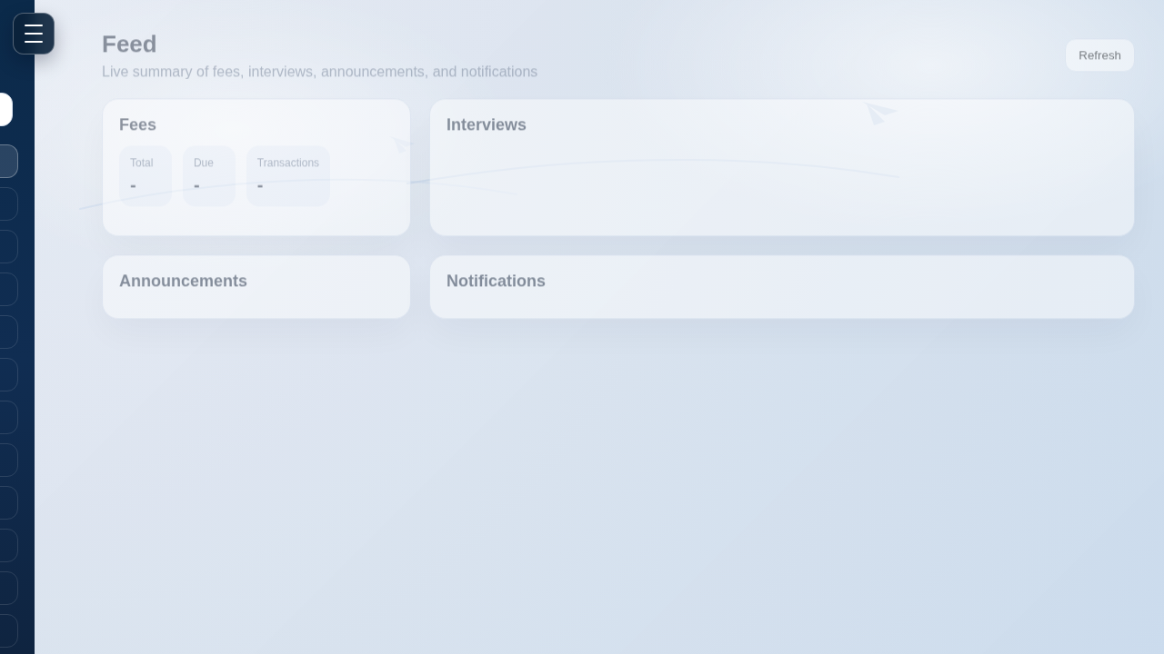
System Output: Staff Dashboard

Slide 18

System Output: Student Dashboard

Slide 19
Thank you

