Slide 1

Power BI
@powerbidaysNL @powerbidays
#PowerBIDays
Like a Pro!
@TheDataAbides
Notes:
To use this title animation slide with a new image simply 1) move the top semi-transparent shape to the side, 2) delete placeholder image, 3) click on the picture icon to add a new picture, 4) Move semi-transparent shape back to original position, 5) Update text on slide.

Slide 2

Empower everyone with the tools to be a data hero
“It’s really quick for someone with no, or little, experience or technical background to pick up the tools and start creating things—which changes how they do their own job.”
Simon O
Digital Factory Product Manager
+
Data Storyteller
Power BI Website

Slide 3
The plan for this hour
1
2
3
4
5
Who’s who
Case, What,
Why
Background
Solutions
Questions

Slide 4
Who’s who
1
Who am I?,
Who do I think you are?

Slide 5

Arno Coppens
1 – Who’s Who: Me at Work
/ Working at OGD since 2015 in various roles.
/ Roles
Data platform architect/technical lead @ Data Office
/ Fun fact
In a previous life I was a Policy maker

Slide 6

1 – Who’s Who: Me not at Work
Community
Enthusiastic follower of various Dutch, Belgian, and other data community events.
Regular at Benni’s virtual bardataminds evenings
Tinkerer
Always looking to make things better
... or at least the way I want them to be ...
Hiker
Proud catdad who loves to take the kitties hiking in the forest

Slide 7

1 – Who’s Who: You
Who are you?
Do-er of things and
aspiring (citizen-)developer
What do you know?
Only just joining the Power BI party (Like her➜➜)
What do you have?
Nothing serious yet
Up to
Piles of BI Xes
(X =stuff I built because someone made me do it)

Slide 8
Case, What & Why
2
What scenario are we talking about,
what is a ‘pro’-developer workflow,
and why would you want one

Slide 9
2 – Case, What & Why: Case
Case
Who can help you get a good workflow?
1
2
3
4
5
You are the power(bi)-user for your department;
all their power bi are belong to you
If people are happy other departments will also know where to find you.
YOU build it,
YOU maintain it.
Budgets are tight, so you are largely on your own.
You need some help to up and running and get them right.
2 names keep coming up; Babs and James

Slide 10
2 – Case, What & Why: Babs
Role
Something with computers
Very friendly.
Power BI Experience
About 3 years.
Portfolio
About 8 datasets and 32 reports
Babs

Slide 11
2 – Case, What & Why: James
Role
Something in the finance dept.
Very helpful
Power BI Experience
About 4 years.
Go-to PBI fixer in the dept.
Portfolio
About 40-odd reports and datasets
Various versions of various files are used by different teams and people.
James

Slide 12

2 – Case, What & Why: The Count
Show of hands, who will you ask for help?
James
#
Babs
#

Slide 13

2 – Case, What & Why: What & Why
“What’s ‘Pro’, precious?”
What do I mean with a ‘pro’ or developer workflow?
Version control
Know what changes
Controlled up (or down)grade
Source control
Know how things get into production
Maintainability
Reuse, Reduce, Recycle.
Build once, break everywhere, fix once.

Slide 14

2 – Case, What & Why: Overview/Analysis
The Good
The Bad
The Ugly
Empowering and engaging people with their data
=
More recognition of the importance, problems, potential, and value of their data
Updates galore, time will solve most problems.
From Excel hell to Power BI purgatory
Power Desktop encourages/does not discourage bad habits
Fixes/workaround are available, just not necessarily evident or intuitive

Slide 15
2 – Case, What & Why: The Count
Show of hands, who will you ask for help?
James
#
Babs
#

Slide 16
Background
3
The building blocks of Power BI,
Which options do we have for which issues

Slide 17




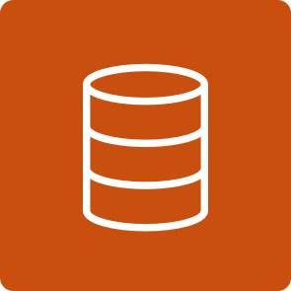



3 – Background: The building blocks
The power BI service
⮦ A Pipeline manages a workspace across dev/test/prod environments (kind of)⮧
⮦ A workspace may contain any of ⮧
A dashboard may consume 0 or more reports ⭢ | A dataset may consume 0 or more dataflows ⭢ ⮦A dataset may supply 0 or more reports ⮧ |  | ⭠ A dataflow may supply 0 or more datasets ⭯ A dataflow may supply 0 or more dataflows ⭯ ! Data flow management is not quite there yet, but coming
 | ⮤ A report must consume exactly 1 ⮥ ⭠A report may supply 0 or more
⮤ An app must publish at least 1 of ⮥
Big thanks to @MarcLelijveld for collecting the icons on Github

Slide 18
3 – Background : The building blocks
Artifact | Availability: [Online,Both] | Official API: [No,ReadOnly,ReadUpdate,ReadWrite] | URL Power BI REST APIs
Pipeline | Online | No | -
Workspace | Online | ReadWrite | Groups
Dataflow | Online | ReadUpdate | Dataflows
Dataset | Both | ReadWrite | Datasets
Report | Both | ReadWrite | Reports
Dashboard | Online | ReadOnly | Dashboards
App | Online | ReadOnly | Apps

Slide 19
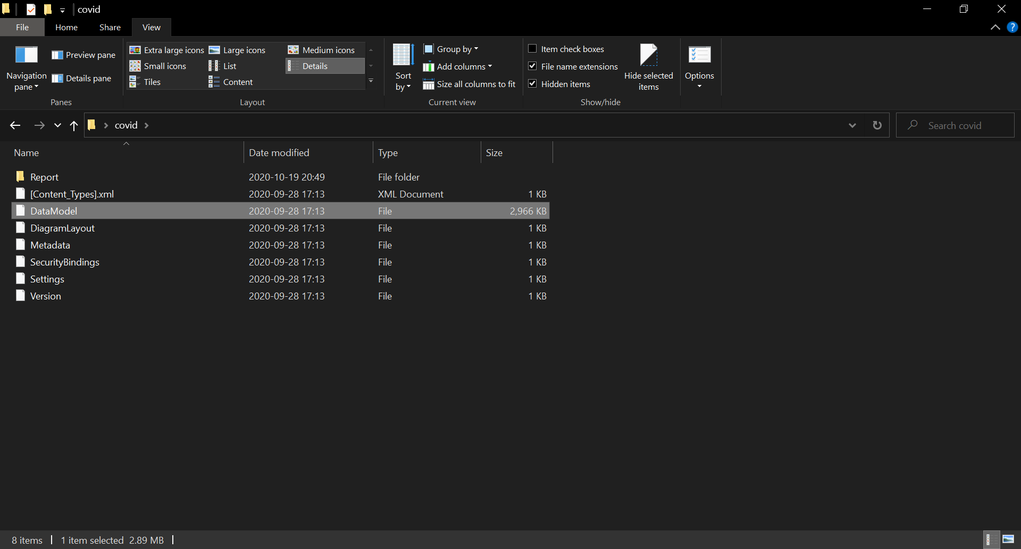
3 – Background: The building blocks
A .pbi(x/t) file consists of 2 main components:
A dataset [DataModel, or DataModelSchema]
A report component

Slide 20
Solutions
4
Which options do we have for which issues

Slide 21

4 - Solutions: Functional separation
How
Use online power BI datasets as a source for your ‘thin’ reports,
or Use the hotswap external tool to connect to a local .pbix file open in another instance of Power Desktop if you want to develop them together.
Advantage
Better maintainability/scalability
Why
Reuse transformation logic
Reduce the total number of datamodels
Build once, break everywhere, fix once
Always keep datasets and reports in separate .pbix files

Slide 22
File separation (and hotswap)
4 - Solutions: Functional separation
Demo
If we skipped the demo: | Vid-Reid Havens | Vid-Melissa Coates | Vid-Guy in a Cube | Blog-SQLServerBI | Vid-Hot Swap connections external tool

Slide 23
4 - Solutions: OneDrive/SharePoint Sync
How
Import file from OneDrive/SharePoint
(Optionally link the location to the workspace)
Advantage
[Partial] Source Control
[Partial] Deployment automation
Why
No need to manually publish after setting up the initial import.
Manual publish still possible
No automated deployment across environments
Should be possible with Power Automate (with approvals!)
Sync files automatically from OneDrive/SharePoint to Power BI

Slide 24
SharePoint import/synchronization
4 - Solutions: SharePoint Sync
Demo
If we skipped the demo: | Vid-Paul Turley | Blog-SQLServerBI | Blog-BIInsight

Slide 25
4 - Solutions: SharePoint file versioning
How
Create Document Library, or a folder in OneDrive.
Advantage
[Partial] Version Control
Why
Easily restore earlier versions
No changelog
Store your .pbix/t files in OneDrive/SharePoint to leverage the file versioning capabilities

Slide 26
OneDrive/SharePoint file versioning
4 - Solutions: SharePoint versioning
Demo
If we skipped the demo: | Vid-Paul Turley | Blog-SQLServerBI | Blog-BIInsight

Slide 27

4 – Solutions: Deployment Pipelines
How
Assign the workspaces to a premium capacity.
Create the pipelines and start using them.
Advantage
[Partial] Source Control
Why
You can partially know how things get into your production environments
No built-in prd security
If you have Power BI Premium in some form or other; use the Deployment pipelines.

Slide 28
Deployment Pipelines (with PPU)
4 – Solutions: Deployment Pipelines
Demo
If we skipped the demo: | Vid-MS Power BI | Vid-Guy in a Cube | Blog-Data-marc

Slide 29
4 – Solutions: Power BI Version Control with Power Platform
How
? Haven’t had a chance to play with it yet,
but it sure looks like it’s worth a try!
Advantage
[Partial] Source Control
[Partial] Deployment automation
Why
Some people have been thinking for you, wanting to help.
- Still in BETA, not feature complete yet - May require admin support for installation/configuration.
Power BI Version Control Solution @ Powerbi.tips

Slide 30

Questions ?
5
Contact or follow me at:
LinkedIn
Twitter
Very much still Work In Progress:
Site/Blog
GitHub

Slide 31
Useful links to more links
6
Blogs (& articles)
Paul Turley’s SQL Server Blog: Doing Power BI the right way | Power BI Expert Resources | P
Kratos BI: Data Gods (kratosbi.com) | DAX Guide
PowerBI.Tips | SQLBI
Power BI Blog (Microsoft)
Communities
Power BI Days
dataMinds (BE) | Power BI Gebruikersgroep » Dutch PUG (pbig.nl)
#Dataweekender | DataSaturdays

