Slide 1

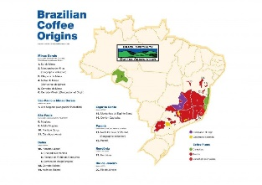
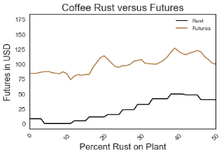
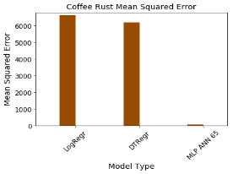
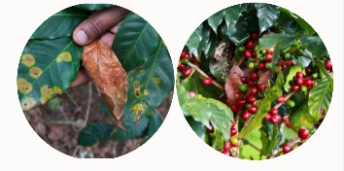
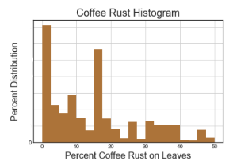
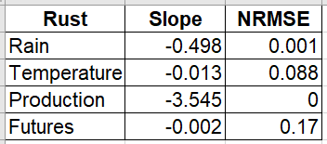
Using Neural Networks to Predict Coffee Rust
Laura H. Kahn, lkahn@Indiana.edu
Indiana University School of Informatics, Computing and Engineering
Problem
Conclusion
Can Artificial Neural Networks Predict Coffee Rust?
Artificial neural networks can be used to predict weekly coffee Rust percentages in a Humid Subtropical coffee-growing region.
Understanding and quantifying this relationship can impact the livelihood of 120 million people that rely on the coffee supply chain.
Coffee is the second most valuable agricultural commodity, second only to oil. Coffee rust disease causes production losses of over $1 billion annually and affects up to 120 million people worldwide.
Neural networks can predict weekly coffee rust percentages at a country level using Temperature, Rainfall, Rust, Production and Futures covariates.
Methods
Results
Artificial Neural Networks (ANNs)
MLP ANN Mean Squared Error (MSE) = 54.41
Logistic Regression MSE = 6619.78
Decision Tree Regression MSE = 6179.33
Artificial neural network methods work best as a tool for predicting coffee rust when compared to other methods.
The model can be used in other coffee growing regions with a Humid subtropical Köppen-Geiger climate.
A multi-layer perceptron (MLP) ANN with 5 layers, 6 neurons, and a hyperbolic tangent activation function was chosen to compensate for the imprecise dataset’s non-linearity.
Data Acquisition & Exploration
Over 1500 weekly observations of Temperature, Rainfall, Production, and Futures data from Minas Gerais, Brazil from January 1993 - July 2018 were used to predict coffee rust.
Matplotlib and Seaborn libraries were used to explore the relationship between the covariates.

