Slide 1

AI for social good
AAAI Fall Symposium
Laura Kahn Benjamin Ortiz Ulloa Viveca Pavon-Harr Onur Savas November 8, 2019
@AccentureFed
Notes:
Imagine a tool augmented by AI that considers users at the core of its design, development and deployment. Imagine a tool that improves human decision-making in emergency situations by getting the right information to the right people at the right time.
Hello! I’m Laura Kahn and along with my teammates Benjamin Ortiz, Viveca Pavon and Onur Savas from Accenture Federal Services, I would like to talk about our emergency route management tool.

Slide 2
AI can make the world better
Notes:
Applied Intelligence (AI) has great potential to solve challenging problems, including those with humanitarian impact. We believe an emergency management tool, if designed, developed, and deployed thoughtfully, can be very valuable for humanitarian relief and logistics efforts, and can improve resiliency to emergencies, save lives and minimize loss.

Slide 3
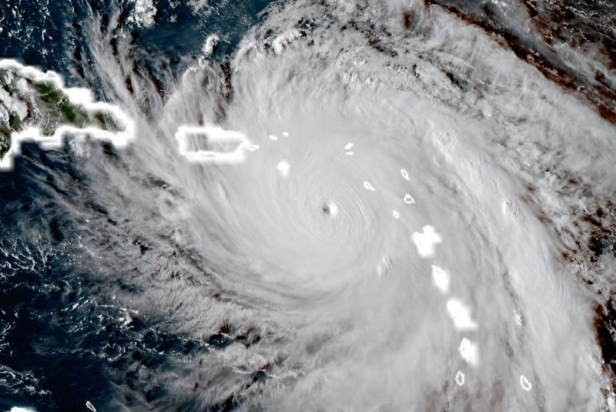
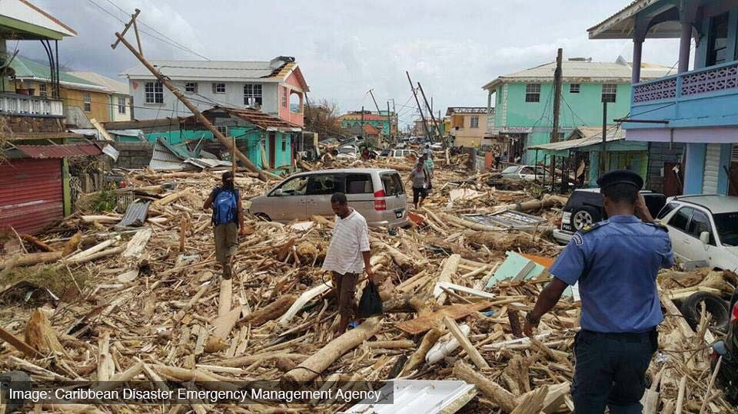
Notes:
During the Atlantic Hurricane season of 2017, 10 out of 17 named storms developed into hurricanes. Hurricane Maria was the first ever category five hurricane on record to hit the Caribbean island of Dominica and made landfall September 19, 2017. With maximum wind speeds of 175 mph (280 km/h), Hurricane Maria killed thirty-one people, severely injured many more, and caused major infrastructure damage; some parts of the island are still being rebuilt nearly two years after the hurricane.

Slide 4
What research has already been done?
Notes:
Before I begin talking about our tool, it’s important to know what prior research has been done.

Slide 5
Prior research
WHO
Hilljegerdes & Augustijn-Beckers: shortest walking distance to shelters prior to a hurricane
Campos & Bandeira: Road network capacity based on vehicle traffic volume
Shekhar: capacity-constrained route planner for earliest arrival time
Kim: route planning to minimize computational cost in a major urban area in the US
Massey – patent application for an emergency communication system
→ No one focuses on how to deploy the route-planning algorithms so that a user receives timely and actionable information.
@AccentureFed
Notes:
Several researchers use agent-based modeling and the Dijkstra algorithm to calculate the shortest walking distance to shelters during the evacuation phase of a hurricane.
Campos & Bandeira have calculated road network capacity based on the number of vehicles anticipated during an evacuation.
Shekhar used a capacity-constrained route planner for evacuees to arrive at a shelter the earliest.
Kim’s research aims to minimize the computational cost for evacuation planning in a major urban area.
Massey’s patent application shows an emergency communication system with a database and a web interface for providing disaster information.
However, none of the research to date focuses on how to apply and communicate the route planning algorithmic research to a user to improve their decision-making.

Slide 6
AI Tools improve decision-making
Notes:
For countries that are vulnerable to natural hazards such as Dominica and other Caribbean islands, we recommend implementing our emergency management tool to minimize human loss. Our team believes that AI tools such as ours can improve decision-making in critical situations.

Slide 7
motivation
WHAT
Knowing how to travel along routes to safety improves decision-making capabilities of humans and increases a population’s resilience to natural hazards.
WHY
Prior research describes AI algorithms for route planning but do not include a user-friendly interface.
HOW
We combine AI machine learning algorithms with a user-centered design framework for visualizing natural hazard evacuation route "what if" scenarios in Roseau, Dominica.
@AccentureFed
Notes:
Our tool uses machine learning algorithms to optimize and communicate route evacuations. The route information supports how a user is assessing risk prior to, during and after an emergency. The information also reduces how long it takes a user to decide to take a route by visually presenting the information. Our tool can be used in other contexts when the need arises for people to move from a starting point to somewhere else due to unforeseen circumstances.
We show how our tool might work in the capital city of Roseau, Dominica, which houses about 20% of the island’s population.

Slide 8
Design improves ai Tools
@AccentureFed
Notes:
As Dr. Brenda Laurel, a pioneer in developing virtual reality technology says, "Design isn't finished until somebody is using it." User-centered design principles influence our tool’s technical requirements.

Slide 9
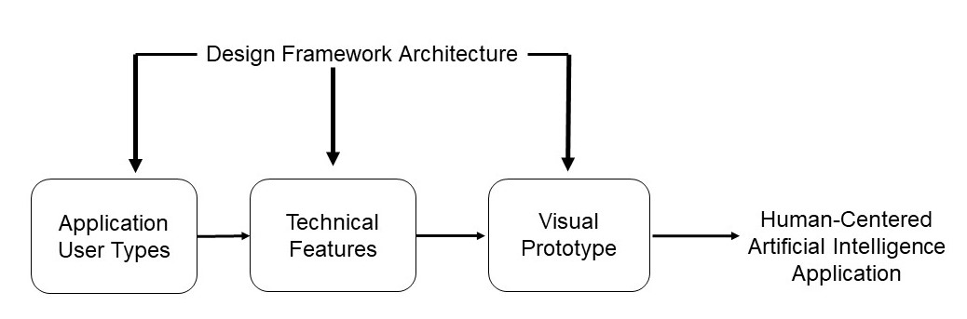
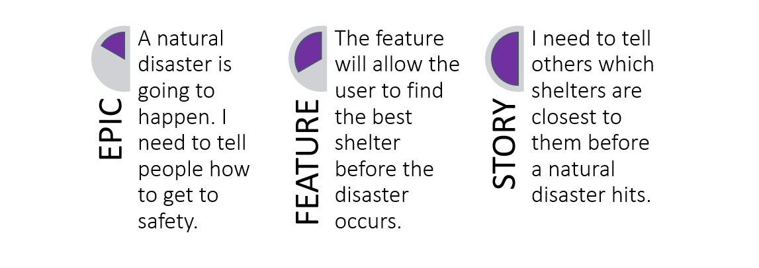
A “Useable” AI Tool considers the Human in its design
@AccentureFed
Notes:
Our User-Centered Design framework has the following architecture: User Types, Technical Features and a Visual display. The framework drives technical requirements for the emergency management tool.
We created an epic, feature and story for one type of user – the Decision Maker (a local/government official responsible for emergency communication and response). The epic, feature and story articulate the journey a user experiences when interacting with the tool and is important for improving usability. The epic describes how a user might express the problem they want to solve; the feature describes how the user might solve the problem and the story is the action the user takes to solve that problem.

Slide 10
Encoded data is another key component
@AccentureFed
Notes:
PAUSE

Slide 11
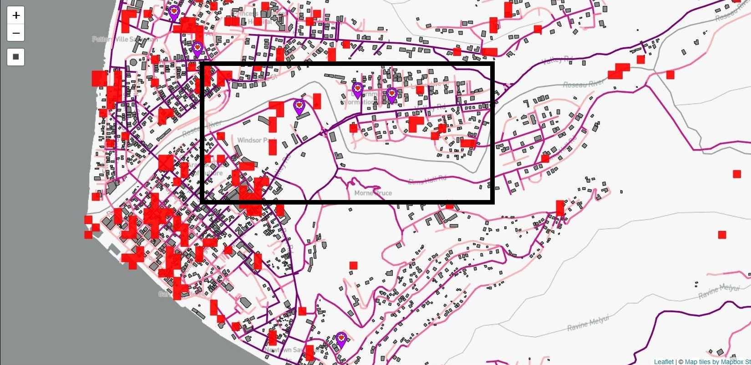
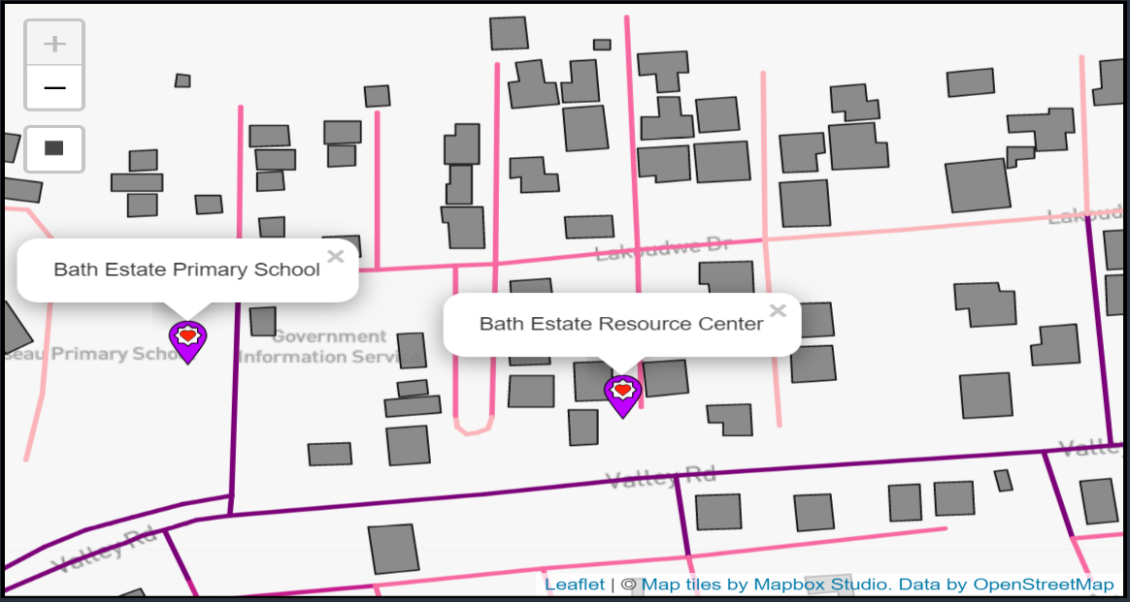
encoded heterogeneous data communicates effectively
@AccentureFed
Notes:
We transformed publicly available geospatial data from Open Street Maps and the Caribbean Handbook on Risk Information.
The image on the left shows how roads and buildings in the capital city of Roseau, Dominica are encoded using several open source R libraries, including OSM, SF and Raster (https://cran.r-project.org/web/packages/raster/raster.pdf).
The picture on the right is a closeup view of the Bath estate neighborhood of Roseau, specifically the area where the box is drawn on the left-hand image. Determining the flow of people from an origination point to a different destination using a road network is a key component of our emergency management tool. We represent roads in the neighborhood as a directed graph network using the Dodgr R library. The intersection of two roads in the network is encoded with a line and is referred to as a junction or node. A segment of the road is also visually encoded and referred to as an edge. Buildings on the map are assumed to be residential buildings. A purple leaflet symbol on the map encodes the shelters – Bath Estate Primary School and Bath Estate Resource Center. These shelters were randomly taken from a list of previous hurricane evacuation shelters and are added to the map according to latitude and longitude.
The dark purple color shows that Valley Road is a primary road with a high network weight. A high network weight means it is most connected to other roads in the network. The dark pink color highlights that Lakoudwe Drive is a secondary road with a lower weight than Valley Road. The light pink roads not named on the map represent other tertiary roads with the lowest network weight.

Slide 12
Augmented AI powers the tool
@AccentureFed
Notes:
PAUSE

Slide 13
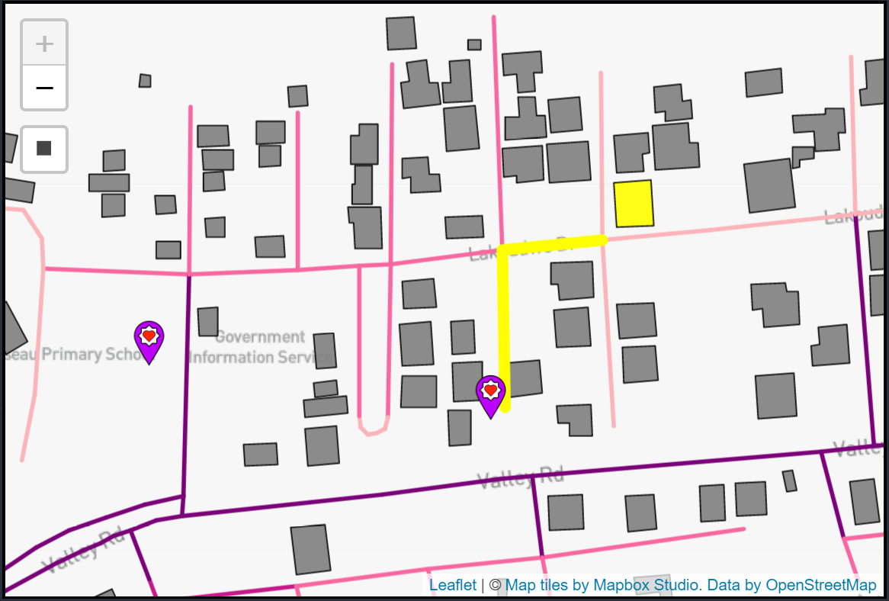
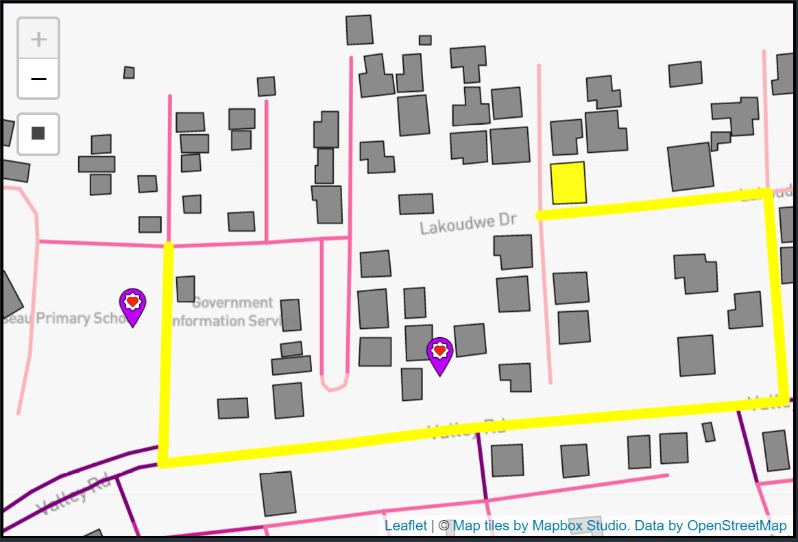
AI helps find optimal evacuation routes
@AccentureFed
Notes:
Now let’s see how the tool works by looking at the image on the left side. During the hurricane evacuation phase, the Decision Maker selects their yellow origination point on the map with a click. The evacuation route is calculated with the Dijkstra algorithm from a starting point to the nearest available shelter.
The information can help the user decide to exit the origination building on the Lakoudwe Drive side, follow the yellow evacuation route by proceeding west, and then going south to Valley Road arriving at the Bath Estate Resource Center shelter.
On the right, we see a backup evacuation route scenario. The backup evacuation route accounts for that road's inaccessibility issues that occurred during the hurricane. In this example, Lakoudwe Drive and the Bath Estate Resource Center shelter have been destroyed. Starting from the same origination point, the tool shows the user to exit on the Lakoudwe Drive side of the building, follow the evacuation route by proceeding east, then south to Valley Road, east on Valley Road and travel north until they reach the alternate Bath Estate Primary School shelter.

Slide 14
What’s next?
@AccentureFed
Notes:
PAUSE

Slide 15
This is just the beginning
OTHER USER TYPE
MAP UPDATES
USER INTERFACE
OFFLINE
@AccentureFed
Notes:
Future work on the tool include applying design improvements for another User Type - the Evacuee. The Evacuee might have slightly different usability and technical requirements. There are also challenges of how the map information is updated so that the information is timely and accurate.
Further usability studies may reveal other additional features that would be helpful for both user types such as word instructions in multiple languages. Furthermore, there are common infrastructure challenges such as lack of electricity and Internet that will affect successful implementation of the tool at scale. The next iteration of a visual tool might include additional offline features that could be used in the event of these common infrastructure challenges.
We also feel our work could be used for a variety of other use cases specific to other types of natural hazard or emergency situations where people are forced away from their homes and must travel along a road to a different destination.
Applied Intelligence is being used to solve complex problems in both the corporate and private sectors. We propose using AI for social good with an emphasis on combining the algorithmic power with user-centered design for an easy-to-use and deploy emergency management tool.

Slide 16
AI can improve humanitarian logistics
@AccentureFed
Notes:
Our use of AI for social good is one example of how technology can continue to help people with humanitarian logistics, and how machines can be used in times of great need to augment human decision-making capabilities.
Our emergency management tool is the first to combine the heterogeneous data layers in the manner previously described and maximizes the usefulness of the AI algorithms by using a design framework to drive technical requirements. Our tool communicates the best evacuation route with a user-friendly interface. We believe our tool has the potential to significantly change preparation and response to emergencies as part of a broader humanitarian logistics plan.

Slide 17
AI for social good
Questions?
@AccentureFed
Notes:
Thanks for your attention. Please let me know if you have any questions.

