Slide 1

Modeling hybrid human-artificial intelligence cooperation: a call center customer service Case study
IEEE Workshop on human-in-the-loop methods
Laura H. Kahn, onur savas, adamma Morrison, Kelsey a. Shaffer, lila Zapata | Accenture federal services

Slide 2
agenda
Intro
Problem
Approach
Conclusion

Slide 3
Introduction
Assumptions of Human Machine Teaming

Slide 4
False Dichotomy

Slide 5
Organic human-ai cooperation

Slide 6










Human in the loop Hybrid
Trade-offs between
Cost
Accuracy
Customer service metrics
Human-in-the loop
Call center metrics
+
Simulation techniques
(Monte Carlo)

Slide 7
Background/Prior Work Sheridan and Verplank’s 10 Levels of Automation
Automation Level | Description
1 | The computer offers no assistance, human must do it all
2 | The computer offers a complete set of action alternatives, and
3 | Narrows the selection down to a few
4 | Suggests one, and
5 | Executes one suggestion if the human approves, or
6 | Allows the human a restricted time to veto before automatic execution, or
7 | Executes automatically, then necessarily informs human, or
8 | Informs human after execution only if human asks, or
9 | Informs human after execution if it, the computer, decides to
10 | The computer decides everything and acts autonomously, ignoring the human

Slide 8
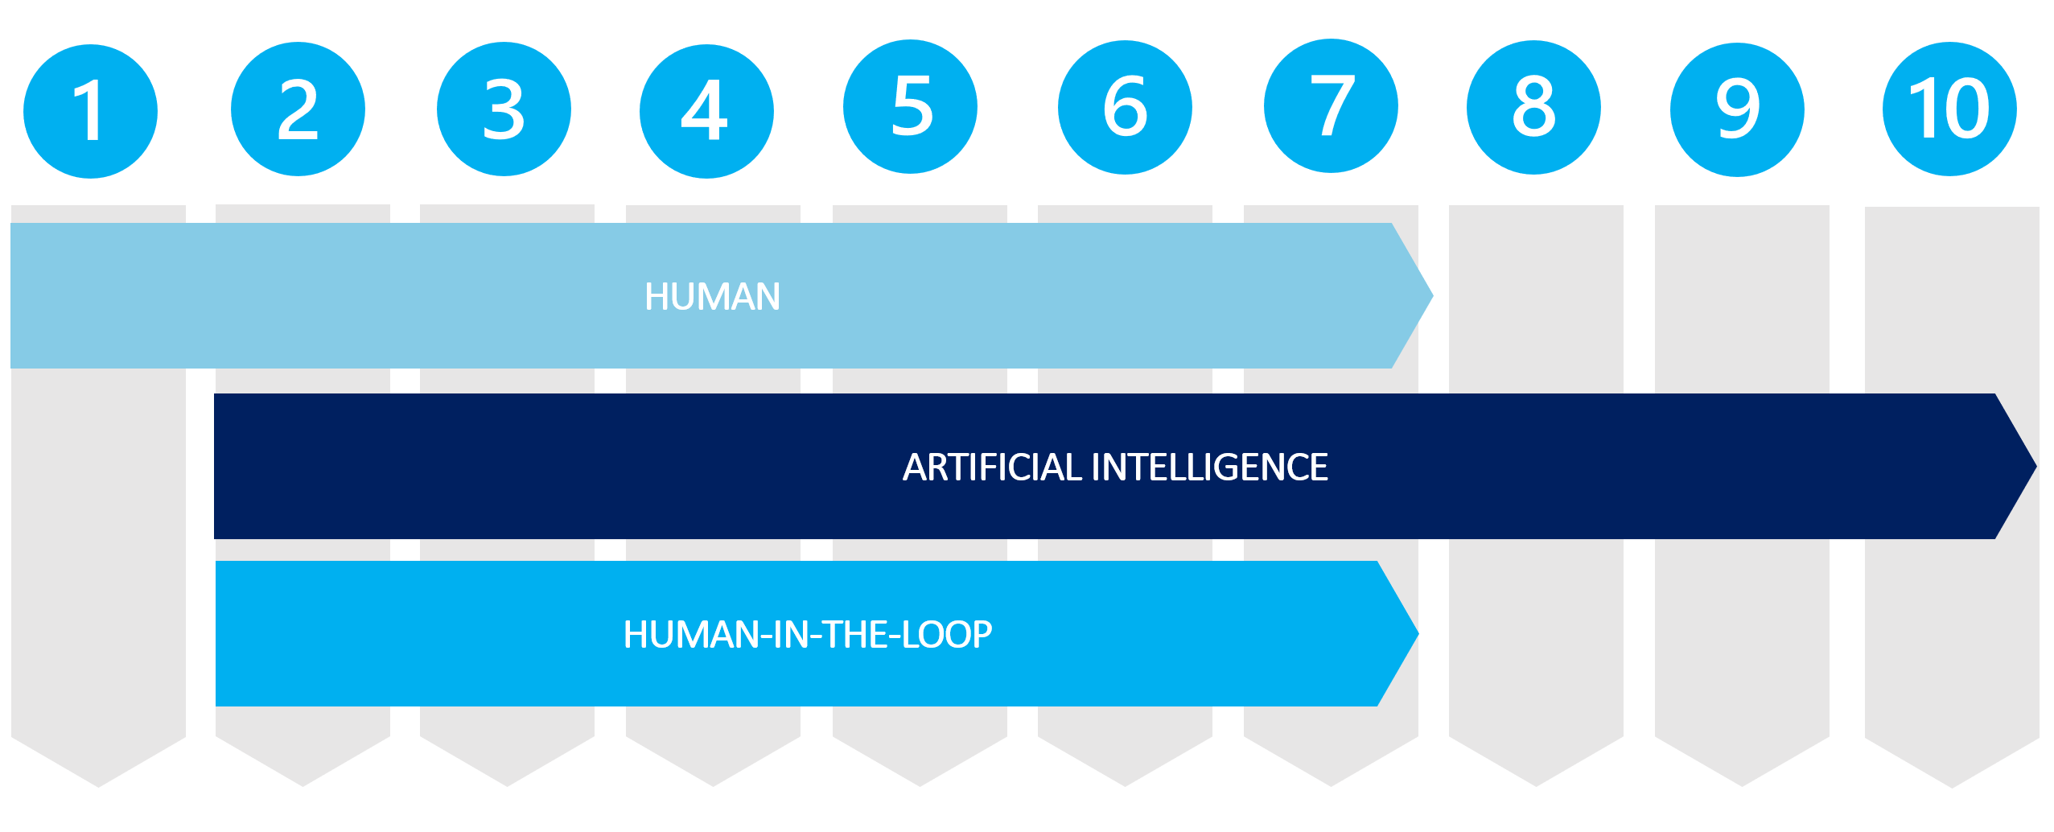
Method: human + machine autonomy levels

Slide 9
The 3 scenarios
Scenario 1 | Scenario 2 | Scenario 3
All human workers (Level 1) | All AI workers (Level 10) | Human in the Loop (Levels 2-7)

Slide 10
Method: human + machine as digital twins

Slide 11
call center Processing
Incoming call center questions of various complexities

Slide 12

Question accuracy
(a)
+
Average handle time
(aht)

Slide 13
 | AI Agent Cost
Cost to Answer a Question | 90% less than a senior human agent (human agent cost w/ experience level 2, hec2)
Hourly rate estimate | 95% less than a junior human agent (human agent cost w/ experience level 1, hec1)
he1 and he2, human with experience level 1 and experience level 2 respectively In our simulation, hec1 < hec2 due to less experience costing less

Slide 14
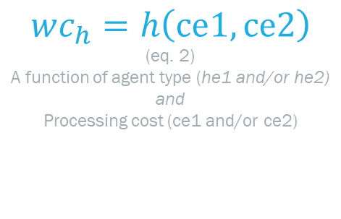
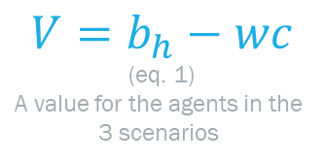
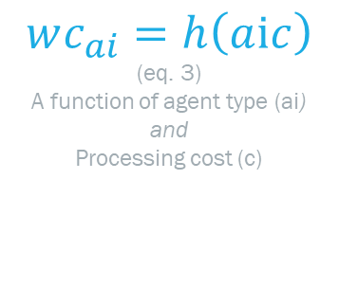
$$V=b_{h}−wc$$
(eq. 1)
A value for the agents in the
3 scenarios
$$wc_{h}=h\left(cⅇ1,cⅇ2\right)$$
(eq. 2)
A function of agent type (he1 and/or he2)
and
Processing cost (ce1 and/or ce2)
$$wc_{ai}=h\left(aⅈc\right)$$
(eq. 3)
A function of agent type (ai)
and
Processing cost (c)
 | Definition
P | Probability value
q | Incoming question
d | Difficulty (easy, medium, or hard)
t | Question arrival time
b | Benefit (percent of the questions answered correctly)
wc | Weighted cost (a function of agent type (he1, he2, or ai) and Processing cost (ce1, ce2, or c))
V | Value for the agents in the 3 scenarios
In this instance, the probability value, p, follows a random distribution of difficulty d

Slide 15
3 million experiments
1,000,000x
1,000,000x
1,000,000x
Scenario | b (%) | wc ($) | V ($)
1 | 93 | 132 | 40
2 | 75 | 0.08 | 75
3 | 80 | 0.42 | 80
Notes:
The table below has the benefit, weighted cost, and value for each scenario.
The scenario with the highest value was the hybrid human-AI agent

Slide 16
Challenges
Variables are directional
Including other types of human preferences and organizational structures

Slide 17
Conclusion
Real-world system
What-if scenarios
Symbiotic framework

Slide 18
The end
A special thanks to Domenico Amodeo, for his knowledge of simulation-related topics.
Feel free to reach out to anyone on the team for further questions.

Slide 19





MEET OUR TEAM
Tim Irvine
Laura Kahn
Onur Savas
Adamma Morrison
Data Scientist Specialist laura.kahn@accenturefederal.com
Principal Data Scientist @
Intelligent Automation, Inc. LinkedIn
Data Science Lead adamma.y.morrison@accenturefederal.com
Kelsey A. Shaffer
Lila Zapata
Data Scientist
kelsey.a.shaffer@accenturefederal.com
Data Scientist lila.m.zapata@accenturefederal.com
Notes:
Thanks for your attention!

