Slide 1

DATA ANALYST PORTFOLIO
Zepto Data
Analysis
RAJ SINGH
DATA ANALYST
Turning product data into pricing, value & inventory intelligence.
Explore → Clean
Standardize → Analyze
Prioritize → Explain
MYSQL
SQL ANALYTICS
BUSINESS INSIGHTS
Portfolio Project
01

Slide 2
01 • PROJECT OVERVIEW
The problem I set out to solve
Use SQL to turn a grocery product catalog into decision-ready analysis.
BUSINESS CONTEXT
PROJECT OUTPUT
A quick-commerce catalog creates everyday questions around:
One analytical story
✓
Which categories carry the deepest assortment?
Raw data
✓
Where are discounts strongest or weakest?
↓
Validated metrics
✓
Which products offer better normalized value?
↓
✓
Where is inventory exposure concentrated?
Business insights
↓
✓
Which categories combine pricing pressure with stockout risk?
Strategic lens
SQL + Business Thinking
02

Slide 3
02 • DATA
A compact dataset with multiple analytical lenses
3,723
14
9
2
Final records
Categories
Core columns
Exact duplicate rows
FIELD MAP
Product
Pricing
SKU • name • category
MRP • selling price • discount %
Inventory
Attributes
available quantity • stock status
weight • quantity
03

Slide 4
02 • APPROACH
Five moves from raw data to insight
01
02
03
04
05
EXPLORE
CLEAN
STANDARDIZE
ANALYZE
PRIORITIZE
Structure & distributions
Nulls, duplicates, invalids
Paise → ₹
Price, value, inventory
Benchmarks & segments
The key design choice: clean first, then build every insight on standardized metrics.
04

Slide 5
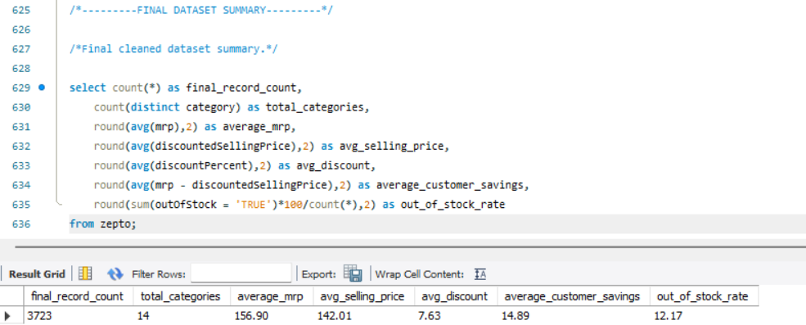
03 • EXECUTIVE VIEW
Seven numbers frame the entire project
3,723
14
₹156.90
₹142.01
Final records
Categories
Avg MRP
Avg selling price
7.63%
₹14.89
12.17%
Avg discount
Avg customer savings
OOS rate
Evidence
05

Slide 6
03 • DATA QUALITY
Before the insight, I validated the inputs
✓
NULL checks
✓
Duplicate rows
Validated completeness
2 exact duplicates detected
✓
Price validity
✓
Weight & quantity
Checked zero / invalid price values
Checked non-positive values
✓
Stock representation
✓
Discount logic
Validated TRUE / FALSE status
Checked percentage field before analysis
Result: a reproducible foundation for every downstream metric.
06

Slide 7
03 • TRANSFORMATION
One small transformation made the analysis business-ready
SOURCE
TRANSFORM
OUTPUT
Paise
÷ 100
₹
Raw price unit
Paise → Rupees
Human-readable pricing
Cleaner reporting
Comparable metrics
Business-ready units
07

Slide 8
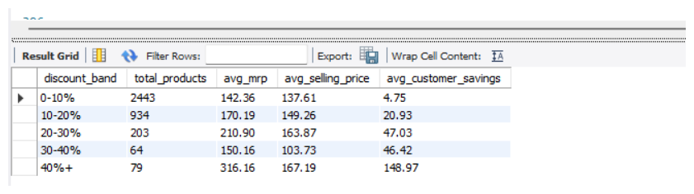
04 • PRICING
Discount depth changes the customer savings story
PRODUCT COUNT
0–10%
2443
40%+ band
Average customer savings reaches ₹148.97.
10–20%
934
20–30%
203
20–30% band
Average customer savings is ₹47.03.
30–40%
64
0–10% band
40%+
79
Largest volume: 2,443 products.
08

Slide 9
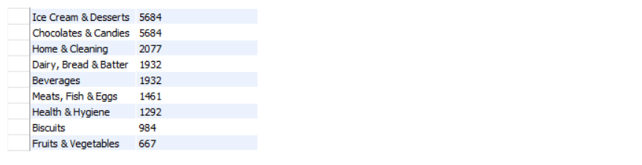
04 • PRICING
Where total customer savings accumulate
TOTAL CUSTOMER SAVINGS
Cooking Essentials
₹8072
Munchies
₹8072
TOP RESULT
Personal Care
₹5954
₹8,072
Paan Corner
₹5954
Cooking Essentials
Packaged Food
₹5684
Munchies matches this total.
Ice Cream & Desserts
₹5684
Customer value lens
Chocolates & Candies
₹5684
Home & Cleaning
₹2077
Dairy, Bread & Batter
₹1932
Beverages
₹1932
09

Slide 10
05 • VALUE
Normalize the price before comparing products
Fruits & Vegetables
₹25.34
WHY ₹ / 100g?
Biscuits
₹35.62
Pack size can distort a simple price comparison.
Dairy, Bread & Batter
₹40.86
Beverages
₹40.86
The normalized measure gives a more comparable value lens across different weights.
Meats, Fish & Eggs
₹49.06
Packaged Food
₹61.22
Ice Cream & Desserts
₹61.22
Lowest category avg
Chocolates & Candies
₹61.22
Fruits & Vegetables
Cooking Essentials
₹83.62
₹25.34 / 100g
Munchies
₹83.62
10

Slide 11
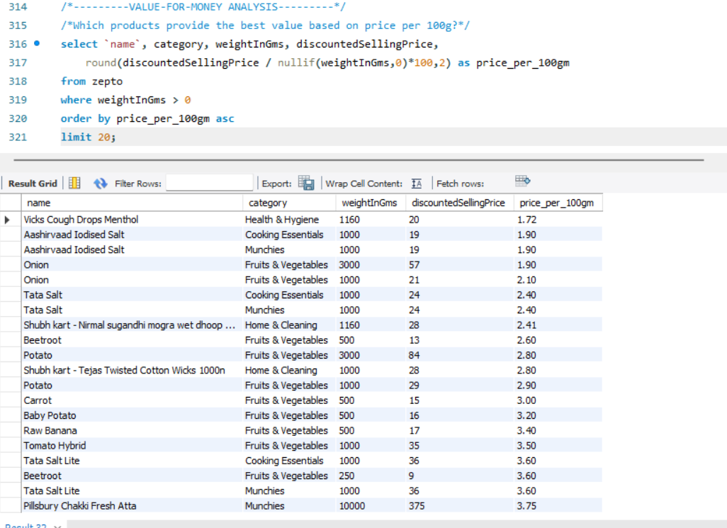
05 • VALUE
Product-level value leaders
LOWEST SHOWN
₹1.72
per 100g
Vicks Cough Drops Menthol
The supplied result ranks products by normalized selling price.
Value-for-money
11

Slide 12
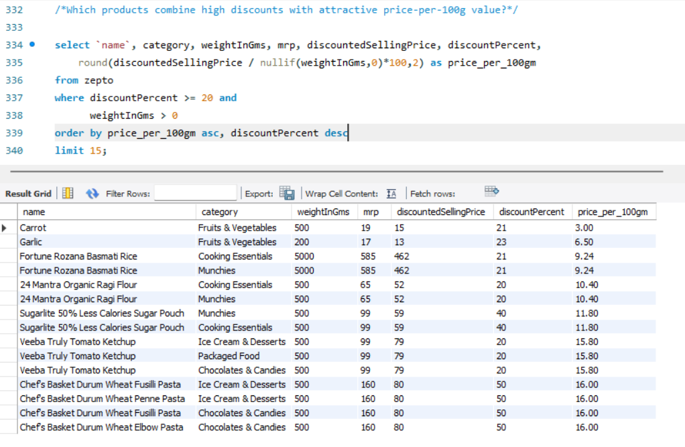
05 • VALUE
Combine discount intensity with normalized value
FILTERED RESULT
≥ 20%
discount
Carrot
₹3.00 / 100g
21% discount
Dual-value lens
12

Slide 13
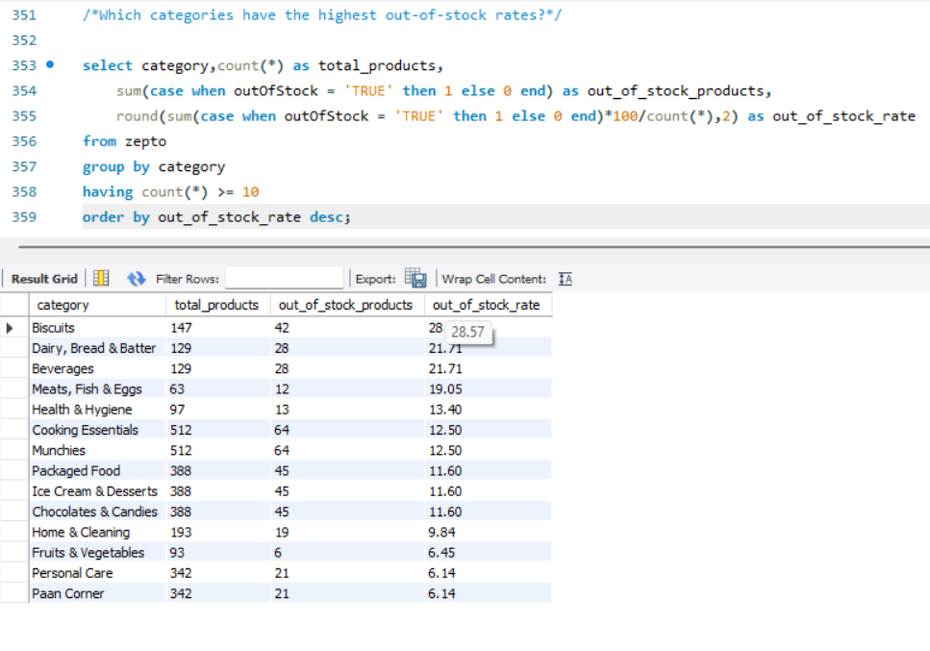
06 • INVENTORY
Availability varies sharply by category
Biscuits
28.57%
HIGHEST SHOWN
Dairy, Bread & Batter
21.71%
28.57%
Beverages
21.71%
Biscuits
Meats, Fish & Eggs
19.05%
Dairy, Bread & Batter and Beverages are both shown at 21.71%.
Health & Hygiene
13.40%
Cooking Essentials
12.50%
Stockout focus
Munchies
12.50%
Packaged Food
11.60%
13

Slide 14
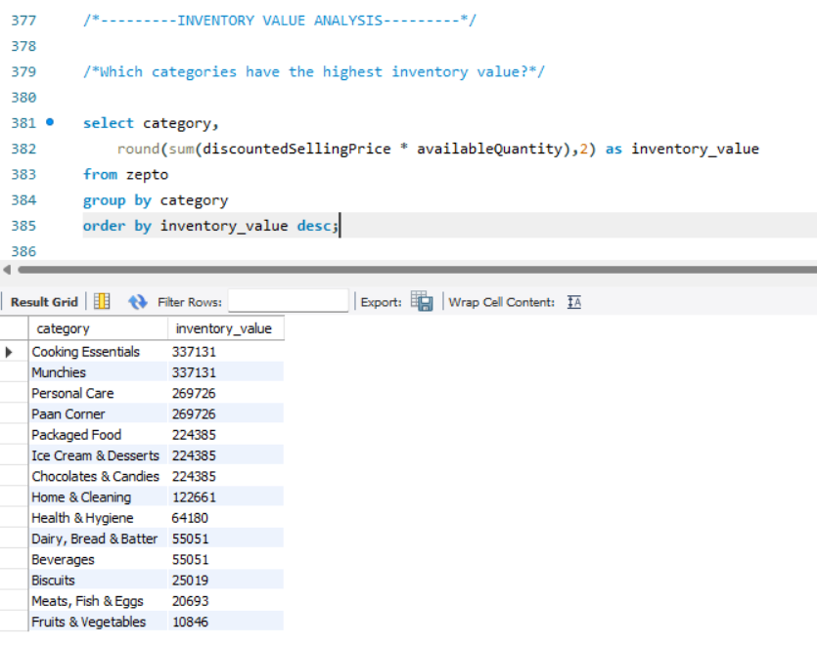
06 • INVENTORY
Inventory value shows where capital is tied up
Cooking Essentials
₹337,131
TOP CATEGORY VALUE
Munchies
₹337,31
₹337,131
Personal Care
₹269,726
Cooking Essentials
Paan Corner
₹269,726
Munchies also shows ₹337,131.
Packaged Food
₹224,385
Inventory value = discounted selling price × available quantity in the supplied SQL.
Ice Cream & Desserts
₹224,385
Not sales revenue
Chocolates & Candies
₹224,385
Home & Cleaning
₹122,661
14

Slide 15
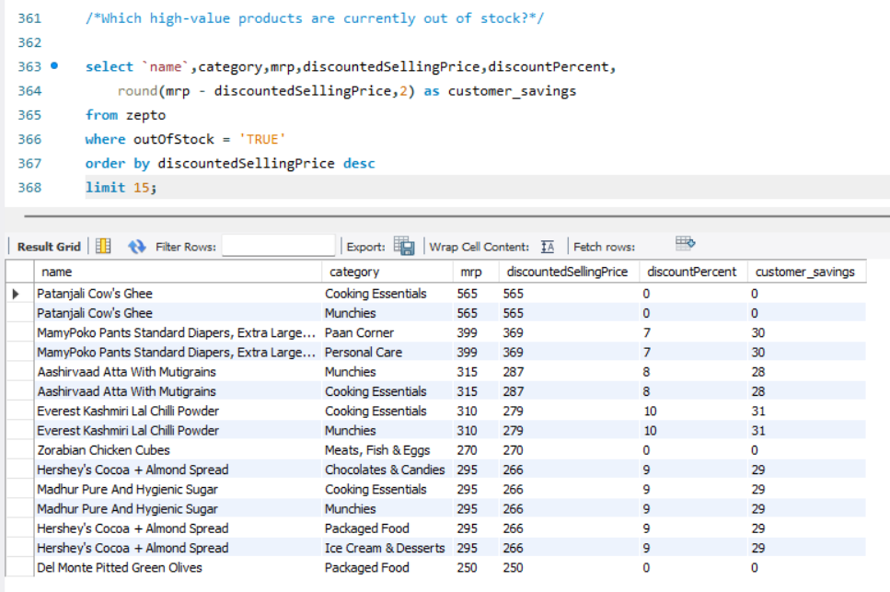
06 • INVENTORY
A risk view: expensive products that are unavailable
WHAT I WOULD REVIEW
1
Selling price
2
Customer savings
3
Category
4
Stock status
Priority inventory review
15

Slide 16
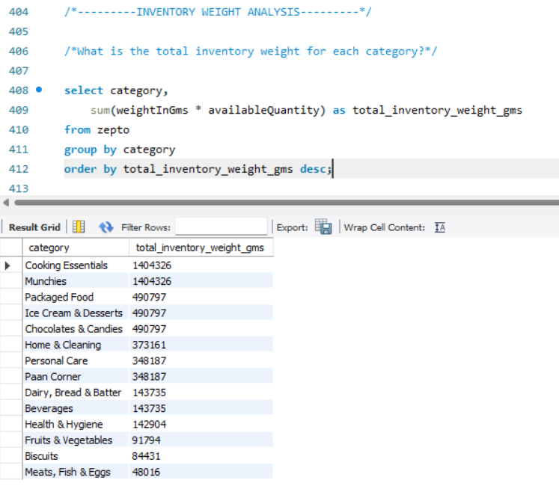
06 • INVENTORY
Weight segmentation adds a physical inventory lens
LOW < 1kg • MEDIUM 1–5kg • BULK ≥ 5kg
NOTABLE
Beverages
Cooking Essentials
Biscuits
417 low • 72 medium • 23 bulk
Chocolates & Candies
Munchies shows the same segment counts in the supplied output.
Cooking Essentials
Dairy, Bread & Batter
Fruits & Vegetables
Physical assortment
Health & Hygiene
Home & Cleaning
16

Slide 17
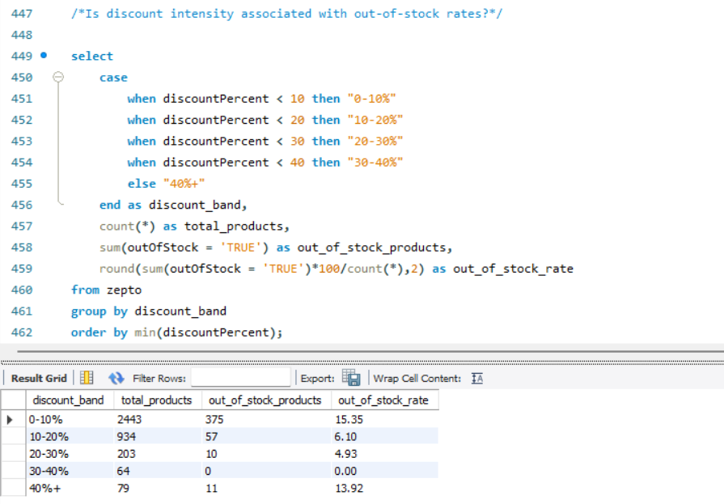
07 • ADVANCED
Discount intensity does not move linearly with OOS rate
0–10%
10–20%
20–30%
30–40%
40%+
2,443
934
203
64
79
products
products
products
products
products
15.35%
6.10%
4.93%
0.00%
13.92%
OOS rate
OOS rate
OOS rate
OOS rate
OOS rate
₹4.75
₹20.93
₹47.03
₹46.42
₹148.97
avg savings
avg savings
avg savings
avg savings
avg savings
17

Slide 18
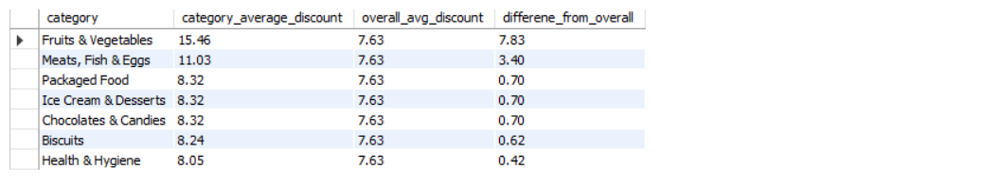
07 • BENCHMARKING
Which categories sit above the platform discount average?
Overall average discount: 7.63%
Fruits & Vegetables
+7.83 pp
HIGHEST GAP
Meats, Fish & Eggs
+3.40 pp
+7.83 pp
Packaged Food
+0.70 pp
Fruits & Vegetables
Ice Cream & Desserts
+0.70 pp
Meats, Fish & Eggs follows at +3.40 pp.
Chocolates & Candies
+0.70 pp
The remaining above-average categories are visible in the supplied SQL output.
Biscuits
+0.62 pp
Health & Hygiene
+0.42 pp
Category vs platform
Cooking Essentials
-0.45 pp
18

Slide 19
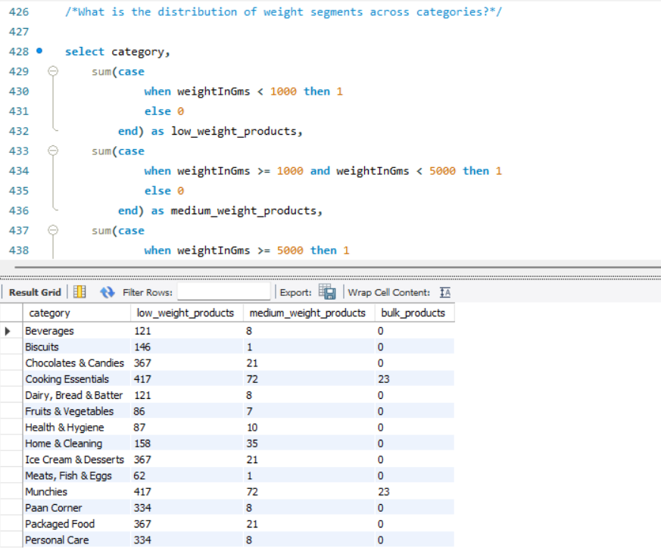
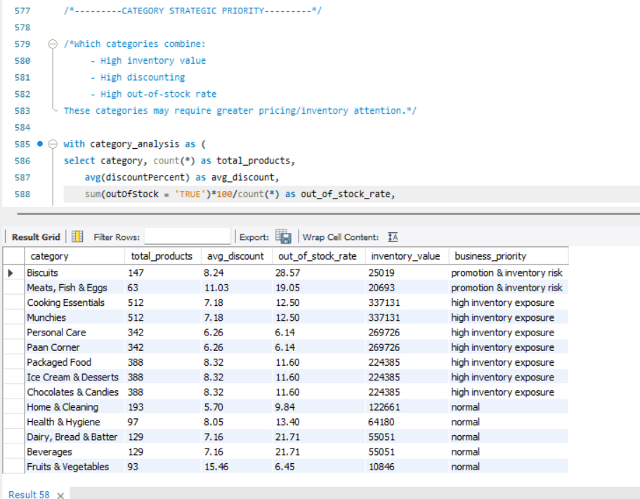
08 • STRATEGY
Combine metrics instead of reading them in isolation
CROSS-METRIC FILTER
Above-average discount
AND
Above-average OOS rate
3 categories returned
STRATEGIC PRIORITY OUTPUT
Promotion + inventory risk
• Meats, Fish & Eggs
Biscuits • Meats, Fish & Eggs
Several other categories are classified as high inventory exposure in the supplied result.
• Biscuits
• Health & Hygiene
19

Slide 20
09 • SKILLS
What the project demonstrates technically
CASE WHEN
GROUP BY
CTEs
SQL
SQL
SQL
Classification & business logic
Category-level aggregation
Readable multi-step logic
Subqueries
Window functions
Conditional aggregation
SQL
SQL
SQL
Nested business calculations
Rank & compare
KPI rates & counts
Analytical SQL • not just data retrieval
20

Slide 21
10 • TAKEAWAYS
From query outputs to business questions
Pricing
Value
Discount bands reveal how savings change with promotional depth.
₹/100g creates a fairer comparison across pack sizes.
Inventory
Strategy
OOS and inventory value reveal different types of exposure.
Cross-metric filters create focused review lists.
The portfolio story: SQL → evidence → interpretation → action.
21

Slide 22
RAJ SINGH
Data Analyst • SQL Analytics
PROJECT FOCUS
Pricing
Customer Value
Inventory
Category Strategy
I designed and developed this Zepto analysis project to demonstrate practical SQL, data quality discipline and business-oriented thinking.
MySQL
Power BI
Python
Excel
Thank You
Zepto SQL Portfolio Project
22

