Slide 1
Online Change Point Detection in Sensor Signal
Binesh Kumar

Slide 2
Approach
Change point detection (CPD) aims to locate abrupt property changes in time series data, I used TadGAN, an unsupervised anomaly detection approach built on Generative Adversarial Networks (GANs).
To capture the temporal correlations of time series distributions, TadGAN uses LSTM Recurrent Neural Networks as base models for Generators and Critics. TadGAN is trained with cycle consistency loss to allow for effective time-series data reconstruction.
Deliverable
Implementation of CPD using TadGAN in Python
Online implementation using Simulated dataset & toy sensor reading

Slide 3
Evaluation Methodology
Working demo of the algorithm with greater than 75% accuracy and should be able to detect changes in signal amplitude ( >2%)
Measure and report the noise tolerance

Slide 4
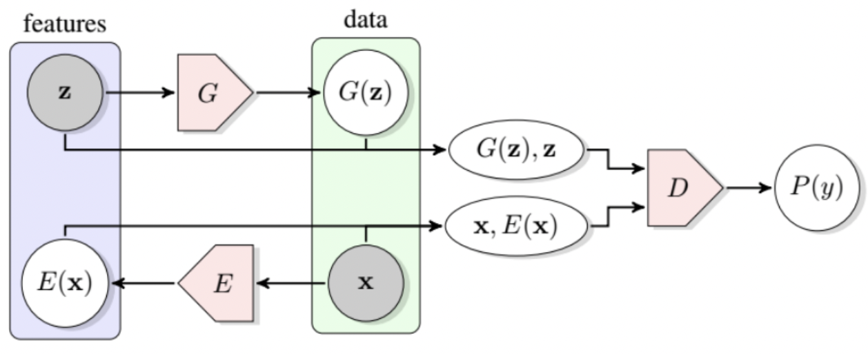
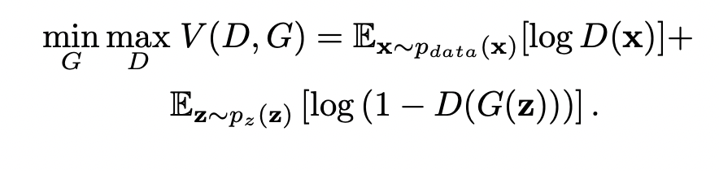
Deep Generative Approaches
Unsupervised Learning
Unsupervised approaches requires only non-faulty data, since their operating principle is the detection of occurrences that deviate from normal
One-class support vector machine is a commonly used fault detection method among connected IOT equipment
Our study focused on Deep generative models for unsupervised fault detection
GANs for Anomaly
GANs are a framework for the estimation of generative models via an adversarial process in which two models, a discriminator D and a generator G, are trained simultaneously
The generator G aim is to capture the data distribution, while the discriminator D estimates the probability that a sample came from the training data rather than G
Training a GAN on normal samples, makes the generator learn the manifold X of normal sample , when an anomalous sample is presented, the generator generates non-anomalous sample there by increasing the reconstruction error
MAIN Conference | Fault Detection in Medical Devices | November2021 | Confidential, for Internal Use Only
Notes:
Then we looked at the unsupervised learning techniques – where we labels are not required, and we can train the algorithm of normal datasets which are relatively easily available.
OCSVN is a very widely used framework and there are a lot of research papers around the use of OSVMS in fault classification of industrial equipments
We focused our benchmarking on Deep generative models because of it huge adoption and success in data generation
First generative model which we looked at is GAN, known for realistic fake image generation.
GANs achieve this level of realism by pairing a generator, which learns to produce the target output, with a discriminator, which learns to distinguish true data from the output of the generator. The generator tries to fool the discriminator, and the discriminator tries to keep from being fooled
D(x) is the discriminator's estimate of the probability that real data instance x is real. D(G(z)) is the discriminator's estimate of the probability that a fake instance is real.The formula derives from the cross-entropy between the real and generated distributions. The original GAN paper notes that the above minimax loss function can cause the GAN to get stuck in the early stages of GAN training when the discriminator's job is very easy
We used a modified version of GAN with a Wasserstein Loss function
Training a GAN on normal samples, makes the generator learn the manifold X of normal sample , when an anomalous sample is presented, the generator generates non-anomalous sample there by increasing the reconstruction error

Slide 5
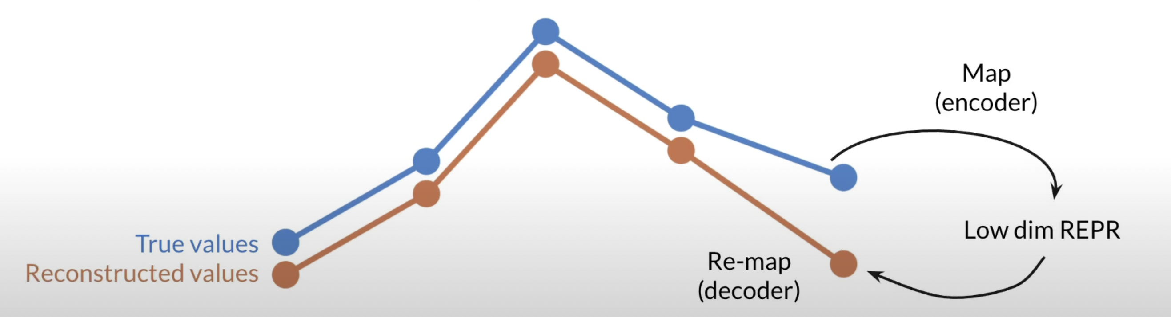
TadGAN
Reconstruction based methods learn a model to capture the latent structure of the given time series data and reconstructs the data using their latent representations
Assumption is that anomalies will be lost when they are mapped to low dimensional space
Source: TadGAN, MIT Orion

Slide 6
TadGAN Pipeline
Preprocessing
Impute Missing Value
Modeling
GAN with Sequential Layer
Postprocessing
Minmax Scaler
Rolling Window Sequencing
Error Calculation based on Reconstruction Error & Critic Score
Window Reconstruction
Visual Interrogation
Model metrics

Slide 7
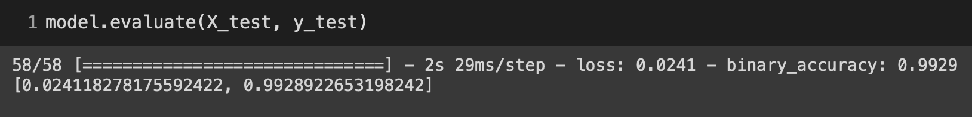
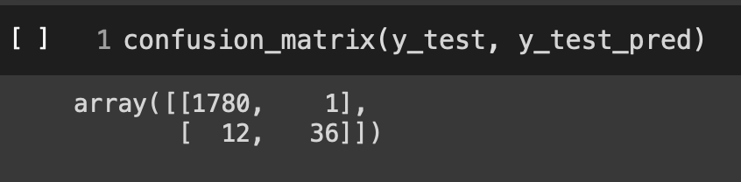
Detector
Accuracy
Confusion Matrix

