Slide 1

Blogging:
Lessons I Learned the Hard Way
Jason Romans
Notes:
NOTE:
To change the image on this slide, select the picture and delete it. Then click the Pictures icon in the placeholder to insert your own image.

Slide 2























Day of Data Baton Rouge 2026
Thank You, Sponsors!

Slide 3


Slide 4




The Outline
1. Personal
2. Hosting
3. Topics
4. Benefits
5. Conclusion

Slide 5
The Outline
1. Personal
2. Hosting
3. Topics
4. Benefits
5. Conclusion

Slide 6
Did you know?
I worked with:
  SQL Server Integration Services
  BIML
  SQL Server Analysis Services Tabular

Slide 7
Know yourself
I Researched Linux distributions
  Time not spent learning Linux
We are tech people
Want to research and optimize
Don’t need the perfect plan
  Guy(s) in the Cube

Slide 8
Syntax Highlighting
How much DAX am I writing?
What if most of my examples are screenshots?

Slide 9
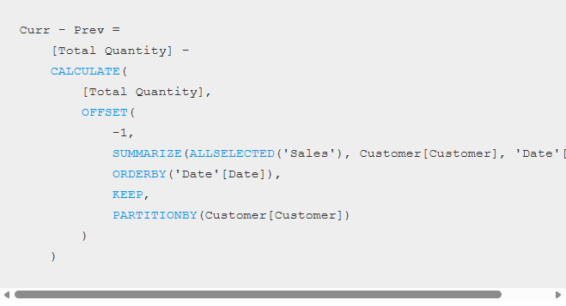
PBIDAX.WORDPRESS.COM

Slide 10
Theme (UI)
Doesn’t matter if the pages are blank
People may read on mobile

Slide 11
The Outline
1. Personal
2. Hosting
3. Topics
4. Benefits
5. Conclusion

Slide 12
Hosting
Managing infrastructure
Time you could be Writing
Blogging about blog platforms is not best for a Power BI career

Slide 13
Self-Hosting vs. Service
Do you want to manage your own infrastructure?
Some people who write the most content use:
  WordPress.com
  Hashnode (fabric.guru)
LinkedIn
  I prefer to promote external blog posts

Slide 14
Publish on Another Site
Monetary
Editing
Promotion
Examples
  Simple Talk
  T-SQL Tuesday
    https://tsqltuesday.com/

Slide 15
Custom Domain
Domain allows you to move platforms
Buy Domain
  Porkbun
  Prefer set price versus promo

Slide 16
What did they use for that blog?
I have looked 3 times this week alone

Slide 17
The Outline
1. Personal
2. Hosting
3. Topics
4. Benefits
5. Conclusion

Slide 18
Topics
What issue did you solve
You have a different voice
What are you learning

Slide 19
Tracking Topics
Method to track potential topics
Word file on OneDrive with each topic
Word file with the topic as the title
  Put bullet points
Notes or Reminder on Phone
Simple Talk Link in Resources

Slide 20
The Outline
1. Personal
2. Hosting
3. Topics
4. Benefits
5. Conclusion

Slide 21
Benefits: Community & Career
Community Recognition
Career Opportunities

Slide 22
Benefits: You Learn the Most
Learn the topic
  Same applies to:
    Speaking
    Tech Editing
Improve communication skills

Slide 23
Rough Edges
Human-generated content will stand out
Don’t refine away all the rough edges

Slide 24
Same Rules, Any Medium
Podcasts, video, newsletters — same principles
Pick the medium you’ll actually keep doing

Slide 25
The Outline
1. Personal
2. Hosting
3. Topics
4. Benefits
5. Conclusion

Slide 26
Inspired by Hamilton
Talk less, Write More
Not about talking less at conferences — it’s about talking less into the air.
Or talk endlessly — just write about it too.

Slide 27

WRITE!!!
or RECORD

Slide 28
Resources
Simple Talk
  https://www.red-gate.com/simple-talk/
WordPress.com
  https://wordpress.com/
Idea Tracking
  https://www.red-gate.com/simple-talk/opinion/editorials/dont-let-that-idea-get-away/
Habits
  https://stevekamb.com/the-unfortunate-uplifting-truth-about-creating-healthy-habits

Slide 29


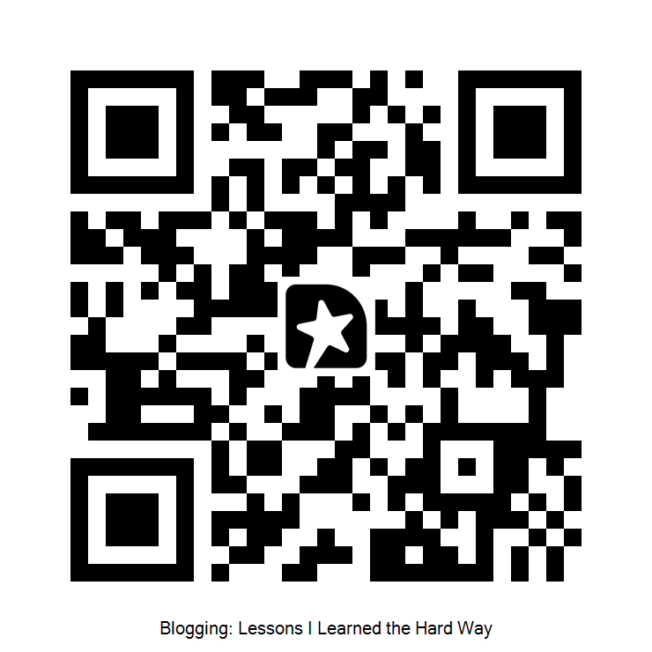
Thank You
Jason Romans
thedaxshepherd@gmail.com
linkedin.com/in/jasonromans
www.thedaxshepherd.com
Slides
Session Evaluation

