Slide 1




FREE TOOLS FOR DATA PROFESSIONALS
THE DATA
PROFESSIONAL'S
TODAY'S TOOLCHAIN
Capture
Obsidian
Visualize
Excalidraw
POWER TOOLKIT
Execute
VS Code
Optimize
PowerToys
Four free tools to capture, visualize, execute, and optimize your workflow.
No vendor pitches.
Just practical workflow wins.
Jason Romans | Day of Data 2026 | Albany

Slide 2


Slide 3






Thank You to Our Sponsors!
Global Sponsors
Platinum Sponsor
Silver Sponsors
Bronze Sponsor

Slide 4

TAKE THIS WITH YOU
DOWNLOAD THIS
PRESENTATION
All slides, resources, and demo files available:
THE DAX SHEPHERD
thedaxshepherd.com/presentations
The Data Professional's Power Toolkit

Slide 5

Standing on the
Shoulders of Giants
Grateful for the people who share their knowledge, encourage us, answer questions, and help the rest of us learn faster.
Photo credit: Unknown Author, CC BY-ND
The Data Professional's Power Toolkit

Slide 6
SESSION ROADMAP
1. Intro
Why these four, and why together
1
2
3
4
5
6
Intro
Obsidian
Excalidraw
VS Code
PowerToys
Wrap-Up
NOW
1. Intro
Next: Obsidian
Why these four, and why together
The Data Professional's Power Toolkit

Slide 7
SESSION ROADMAP
2. Obsidian
Capture notes, links, and ideas
1
2
3
4
5
6
Intro
Obsidian
Excalidraw
VS Code
PowerToys
Wrap-Up
NOW
2. Obsidian
Next: Excalidraw
Capture notes, links, and ideas
The Data Professional's Power Toolkit

Slide 8
SESSION ROADMAP
3. Excalidraw
Visualize systems and workflows
1
2
3
4
5
6
Intro
Obsidian
Excalidraw
VS Code
PowerToys
Wrap-Up
NOW
3. Excalidraw
Next: VS Code
Visualize systems and workflows
The Data Professional's Power Toolkit

Slide 9
SESSION ROADMAP
4. VS Code
One editor for code, data, and diagrams
1
2
3
4
5
6
Intro
Obsidian
Excalidraw
VS Code
PowerToys
Wrap-Up
NOW
4. VS Code
Next: PowerToys
One editor for code, data, and diagrams
The Data Professional's Power Toolkit

Slide 10
SESSION ROADMAP
5. PowerToys
Optimize everyday Windows workflows
1
2
3
4
5
6
Intro
Obsidian
Excalidraw
VS Code
PowerToys
Wrap-Up
NOW
5. PowerToys
Next: Wrap-Up
Optimize everyday Windows workflows
The Data Professional's Power Toolkit

Slide 11
SESSION ROADMAP
6. Wrap-Up
Bring the toolkit together
1
2
3
4
5
6
Intro
Obsidian
Excalidraw
VS Code
PowerToys
Wrap-Up
NOW
6. Wrap-Up
Bring the toolkit together
The Data Professional's Power Toolkit

Slide 12
SESSION ROADMAP
1. Intro
Why these four, and why together
1
2
3
4
5
6
Intro
Obsidian
Excalidraw
VS Code
PowerToys
Wrap-Up
NOW
1. Intro
Next: Obsidian
Why these four, and why together

Slide 13
All Four Tools Are Free
Obsidian
FREE
Excalidraw
FREE
Optional: Sync $4/mo, Publish $8/mo
Optional: Excalidraw+ $7/mo for cloud & collab
VS Code
FREE
PowerToys
FREE
No paid tier — fully free, forever.
No paid tier — fully free, forever.

Slide 14
Bring Your Own Installer
Tool | winget | choco | brew
Obsidian | Obsidian.Obsidian | obsidian | obsidian
Excalidraw | web app — no install | web app | web app
VS Code | Microsoft.VisualStudioCode | vscode | visual-studio-code
PowerToys | Microsoft.PowerToys | powertoys | Windows only
Already have a package manager? You’re one command away.

Slide 15
Yes, We Need to Talk About AI
Tool | AI Superpower | How
Obsidian | Copilot plugin | Copilot plugin + local LLM support
Excalidraw | AI diagram generation | Generate diagrams from text descriptions
VS Code | GitHub Copilot | Copilot + Copilot Chat built right in
PowerToys | Advanced Paste | AI-powered clipboard transforms – local or cloud model
The tools were great before AI. They’re better with it.

Slide 16
Every Tool is Extensible
Tool | Extension Model | Example
Obsidian | Plugins | Dataview, Calendar, Excalidraw
Excalidraw | Libraries | Pre-built data & architecture icon sets
VS Code | Extensions | Rainbow CSV, Jupyter, Python, Excalidraw
PowerToys | Modules | Enable only what you need
Start with the defaults. Extend to fit your workflow.

Slide 17
The workflow
Capture
Visualize
Execute
Optimize
Obsidian
Excalidraw
VS Code
PowerToys
Everything you know, searchable
Make ideas concrete
Where the work happens
Sharpen the system
Four tools, one loop — capture ideas, sketch them, build them, refine the workflow.

Slide 18
One keystroke to rule them all
Obsidian
Excalidraw
VS Code
PowerToys Run
Ctrl / Cmd + P
Ctrl / Cmd + /
Ctrl / Cmd + Shift + P
Alt + Space
Open command palette
Open command palette
Open command palette
Search anything, anywhere
One muscle — one keystroke, search anything, jump anywhere.

Slide 19
SESSION ROADMAP
2. Obsidian
Capture notes, links, and ideas
1
2
3
4
5
6
Intro
Obsidian
Excalidraw
VS Code
PowerToys
Wrap-Up
NOW
2. Obsidian
Next: Excalidraw
Capture notes, links, and ideas

Slide 20

01 · CAPTURE
OBSIDIAN
Capture notes, links, and ideas in one flexible knowledge base.
https://obsidian.md/
WHAT YOU'LL SEE
Fallout-themed vault · Dataview · Canvas · Templates & plugins

Slide 21
Don’t pick a tool — pick a habit
Beware the trap: spending more time choosing than using
Your notes should serve your work, not become the work
If you have a system that works — keep using it.

Slide 22
Why Obsidian?
Your second brain for technical knowledge
Plain-text files you actually own — no vendor lock-in, open with any editor forever
Bidirectional links build a knowledge graph — see how ideas connect across your whole vault
Dataview turns your notes into a queryable database — filter and aggregate frontmatter like a spreadsheet

Slide 23
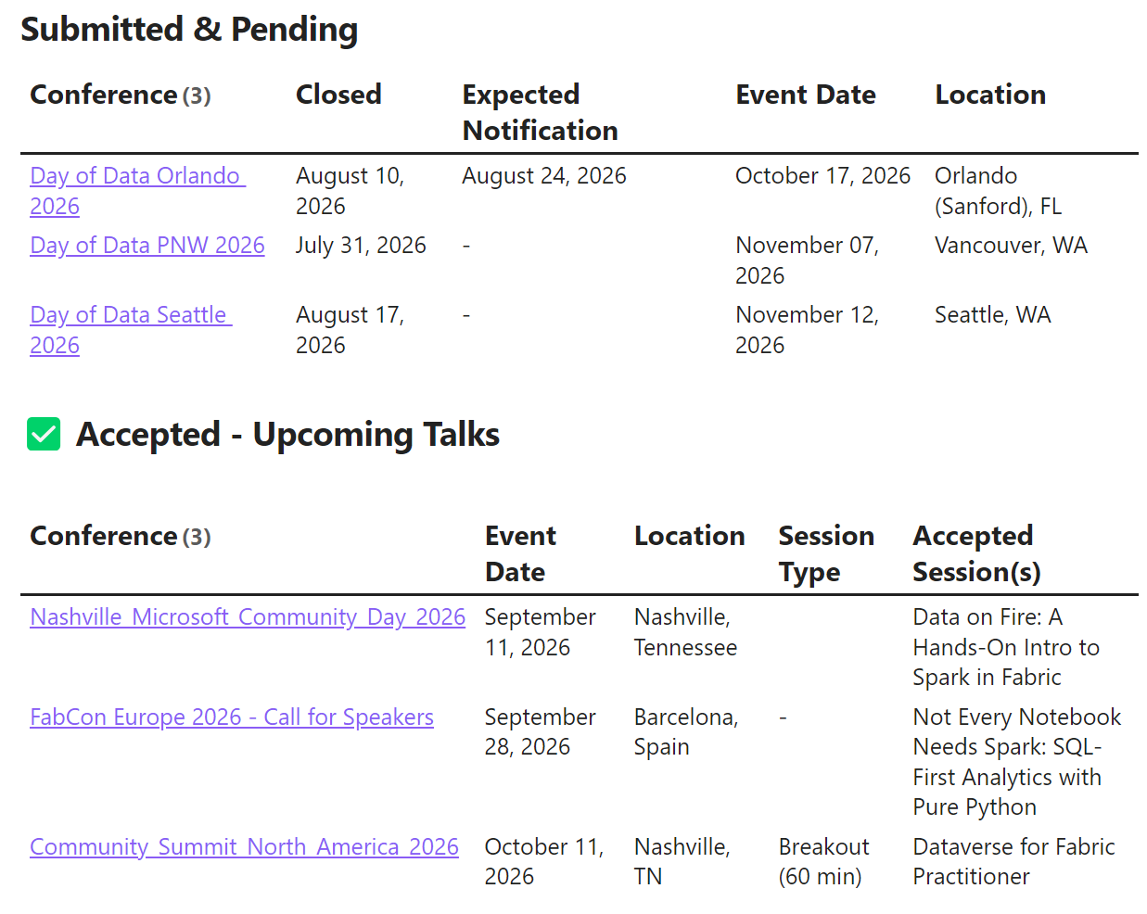
Conference Tracker
A live Dataview query against my conference YAML frontmatter — no spreadsheet required.

Slide 24
01 · CAPTURE · DEMO
Obsidian — Demo
Let’s walk the vault.

Slide 25
SESSION ROADMAP
3. Excalidraw
Visualize systems and workflows
1
2
3
4
5
6
Intro
Obsidian
Excalidraw
VS Code
PowerToys
Wrap-Up
NOW
3. Excalidraw
Next: VS Code
Visualize systems and workflows

Slide 26

02 · VISUALIZE
EXCALIDRAW
Visualize systems and workflows quickly without presentation friction.
https://excalidraw.com/
WHAT YOU'LL SEE
AWS architecture · Microsoft Fabric diagram · a fun Fallout sketch

Slide 27
Why Excalidraw?
Diagrams at the speed of thought
— no UI friction, just sketch and ship
One-click icon libraries for any stack
— AWS, Azure, flowcharts, and more
Embeds directly inside Obsidian
— diagrams live right beside your notes

Slide 28

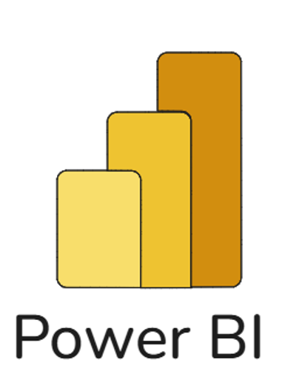
Hand Drawn
Excalidraw
Original

Slide 29
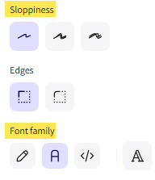
Shape Properties
Quirk: Can’t set sloppiness as a default
Workaround: Draw shapes, then Ctrl+A → adjust all at once

Slide 30
02 · VISUALIZE · DEMO
Excalidraw — Demo
Let’s sketch something out.

Slide 31
SESSION ROADMAP
4. VS Code
One editor for code, data, and diagrams
1
2
3
4
5
6
Intro
Obsidian
Excalidraw
VS Code
PowerToys
Wrap-Up
NOW
4. VS Code
Next: PowerToys
One editor for code, data, and diagrams

Slide 32

04 · VS CODE
VS CODE (Visual Studio Code)
The editor many data pros already use — for code, data, and diagrams.
https://code.visualstudio.com/
WHAT YOU'LL SEE
SQL on a Docker database · Jupyter notebook · Excalidraw diagrams

Slide 33
Why VS Code?
Free, cross-platform, 50,000+ extensions
— runs on Windows, Mac, and Linux
Built for data work out of the box
— Jupyter notebooks, Rainbow CSV, Python, and SQL all-in-one
GitHub Copilot as your AI pair programmer
— context-aware completions for code and text

Slide 34
VS Code — Demo
Let’s pop open the editor.

Slide 35
SESSION ROADMAP
5. PowerToys
Optimize everyday Windows workflows
1
2
3
4
5
6
Intro
Obsidian
Excalidraw
VS Code
PowerToys
Wrap-Up
NOW
5. PowerToys
Next: Wrap-Up
Optimize everyday Windows workflows

Slide 36
05 · POWERTOYS
POWERTOYS
Optimize everyday Windows workflows with fast keyboard-driven utilities.
learn.microsoft.com/windows/powertoys/
WHAT YOU'LL SEE
FancyZones · Command Palette · Color Picker · Advanced Paste · ZoomIt

Slide 37
Why PowerToys?
Free & official — Microsoft-maintained, open source on GitHub
Modular — turn on only what you need; each utility runs independently
Keyboard-first — every utility has a hotkey, fits muscle memory
Power-user features Windows doesn't ship — window tiling, clipboard transforms, bulk rename, color picker
Constantly evolving — new utilities added regularly; community-driven
Note: some toys have been renamed or absorbed into Windows — e.g., Text Extractor now lives in Snipping Tool.

Slide 38
Try One Thing
You don’t need to use all 20+ utilities.
Find the one that solves your most annoying daily problem.
Open PowerToys → pick it from the left menu → enable it.
For many of us it started with ZoomIt

Slide 39
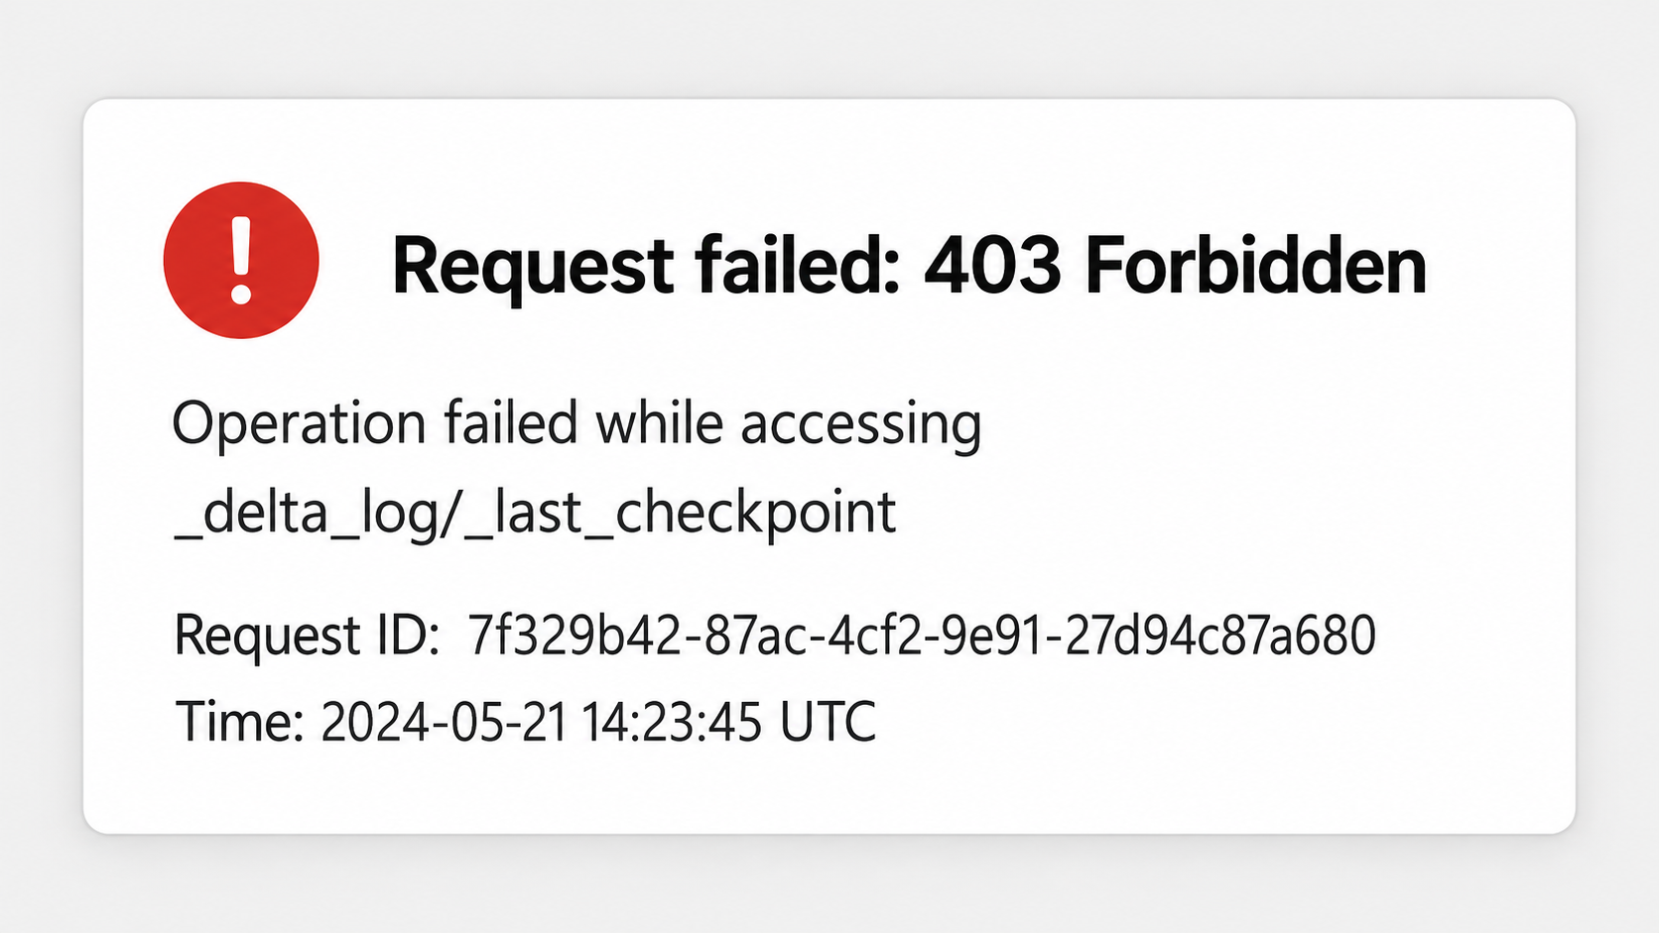
Live Demo – What could go wrong?

Slide 40
POWERTOYS
All PowerToys utilities
Launchers & quick actions
Windows & layout
Advanced Paste Paste clipboard into other formats — AI transforms available.
Always On Top Pin a window above the rest of the desktop.
DEMO
Command Not Found Suggest WinGet packages for failed commands.
Crop And Lock Create a live cropped or thumbnail window.
Command Palette Launch commands, apps, and tools quickly.
FancyZones Snap windows into custom layouts fast.
DEMO
DEMO
PowerToys Run
Fast launcher for apps, files, and plugins.
Peek Preview file content without opening apps.
DEPRECATED
Quick Accent Type accented characters without changing layout.
Shortcut Guide Show available Windows shortcuts in context.
Screen Ruler Measure pixels on screen with edge detection.
Workspaces Launch saved app sets into arranged positions.
Text Extractor
OCR text from anywhere on screen.
Light Switch Auto-switch between light and dark themes.
DEPRECATED

Slide 41
POWERTOYS
All PowerToys utilities
Files & content
System & input
Color Picker Grab color values from any pixel.
Awake Keep the PC awake without changing settings.
DEMO
File Explorer add-ons Preview more file types inside Explorer.
Environment Variables Manage environment variable profiles.
File Locksmith See which process is locking a file.
Keyboard Manager Remap keys and create custom shortcuts.
Hosts File Editor Edit hosts entries with a safer UI.
Mouse utilities Find, highlight, or crosshair your cursor.
Image Resizer Resize images from the Explorer menu.
Mouse Without Borders Use one keyboard and mouse across PCs.
New+ Create files and folders from templates.
Registry Preview Preview and edit .reg files visually.
PowerRename Bulk rename with search, replace, and regex.
ZoomIt Zoom, annotate, and record during demos.
DEMO

Slide 42
POWERTOYS
Newest additions
New in v0.100
Shortcut Guide
Rebuilt from scratch — a side pane that detects the active app and shows its shortcuts.
Command Palette: Extension Gallery
Browse, install, update, and remove extensions without leaving Command Palette.
Command Palette: multi-monitor Dock
Each display gets its own Dock config, plus pinnable CPU, GPU, and battery metrics.
PowerToys ships new utilities every month — v0.100 landed June 10, 2026; current release is v0.100.2.

Slide 43
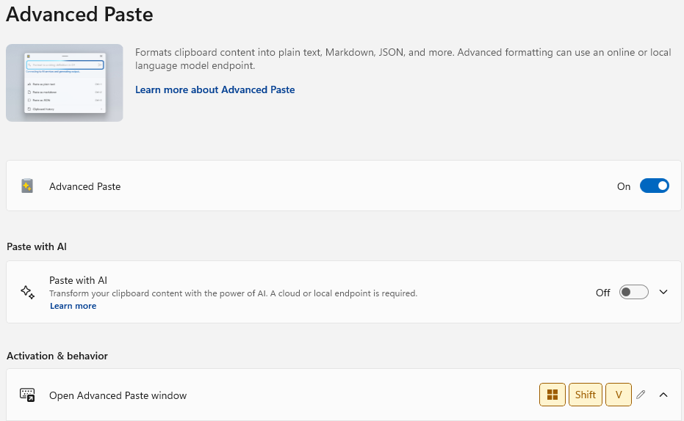
Options

Slide 44
Why these picks — daily drivers
Command Palette — universal entry point. One hotkey replaces hunting through Start menus and folders.
FancyZones — fills the biggest gap in Windows itself. Snap Layouts can't touch multi-monitor or custom grids.
Advanced Paste — shows the modern PowerToys: AI-assisted, format-aware, replaces ad-hoc scripts.
Notes:
Why I picked these three (presenter notes):
• Command Palette — biggest daily-driver impact; you'll use it within an hour of installing.
• FancyZones — most visible "wow" for the audience; the demo lands instantly.
• Advanced Paste — proves PowerToys isn't just legacy tweaks; it's still evolving.

Slide 45
Why these picks — specialist tools
Color Picker — saves designers, devs, and slide-builders from screenshot-then-eyedropper workflows.
ZoomIt — purpose-built for presenting and teaching. Zoom, annotate, and record without third-party software.
Notes:
Why these picks — specialist (presenter notes):
• Color Picker — small tool, outsized payoff; niche use case that everyone secretly needs.
• ZoomIt — meta-relevant for this audience; I'm using it during this talk.

Slide 46
PowerToys — Demo
Let’s supercharge Windows.

Slide 47
SESSION ROADMAP
6. Wrap-Up
Bring the toolkit together
1
2
3
4
5
6
Intro
Obsidian
Excalidraw
VS Code
PowerToys
Wrap-Up
NOW
6. Wrap-Up
Bring the toolkit together

Slide 48
Pick one. Start today.
Pick one tool today.
Build a habit this week.
Share it with your team.

Slide 49
Go Deeper
Tool | Documentation | Learn More
Obsidian | help.obsidian.md | “Linking Your Thinking” — Nick Milo on YouTube How to Take Smart Notes in Obsidian — Josh Duffney
Excalidraw | docs.excalidraw.com | Zsolt Viczián's YouTube channel Excalidraw+ blog (plus.excalidraw.com/blog)
VS Code | code.visualstudio.com/docs | Official VS Code YouTube channel VS Code Tips & Tricks (in official docs)
PowerToys | learn.microsoft.com/windows/powertoys | github.com/microsoft/PowerToys Scott Hanselman's PowerToys videos on YouTube
Each tool has a community worth joining — start with the official docs.

Slide 50


Slides
Session Evaluation
THANK YOU
Jason Romans
thedaxshepherd@gmail.com linkedin.com/in/jasonromans www.thedaxshepherd.com

