Slide 1

DUCKDB 101
FROM DESKTOP
TO NOTEBOOK
Fast, local analytics with SQL — then take it into notebooks and data workflows.
Day of Data 2026 | Albany
Jason Romans | The DAX Shepherd
NO SERVER. NO SETUP. JUST SQL.
1
Desktop
2
SQL
3
Notebook
4
Fabric
start local
query files
repeatable workflow
cloud notebook workflow
DuckDB 101: From Desktop to Notebook

Slide 2


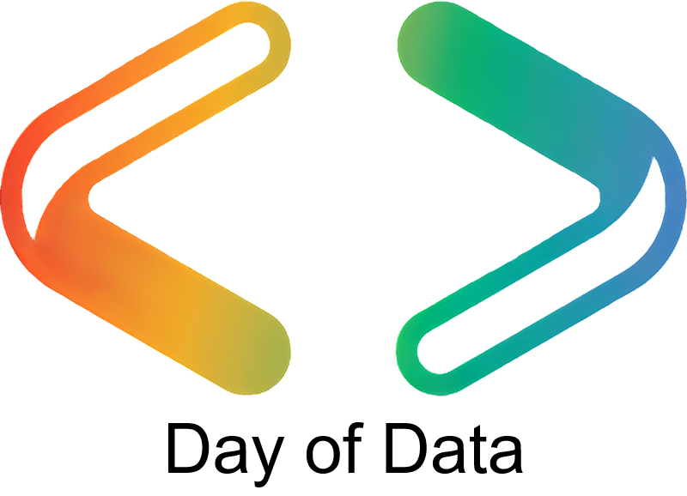
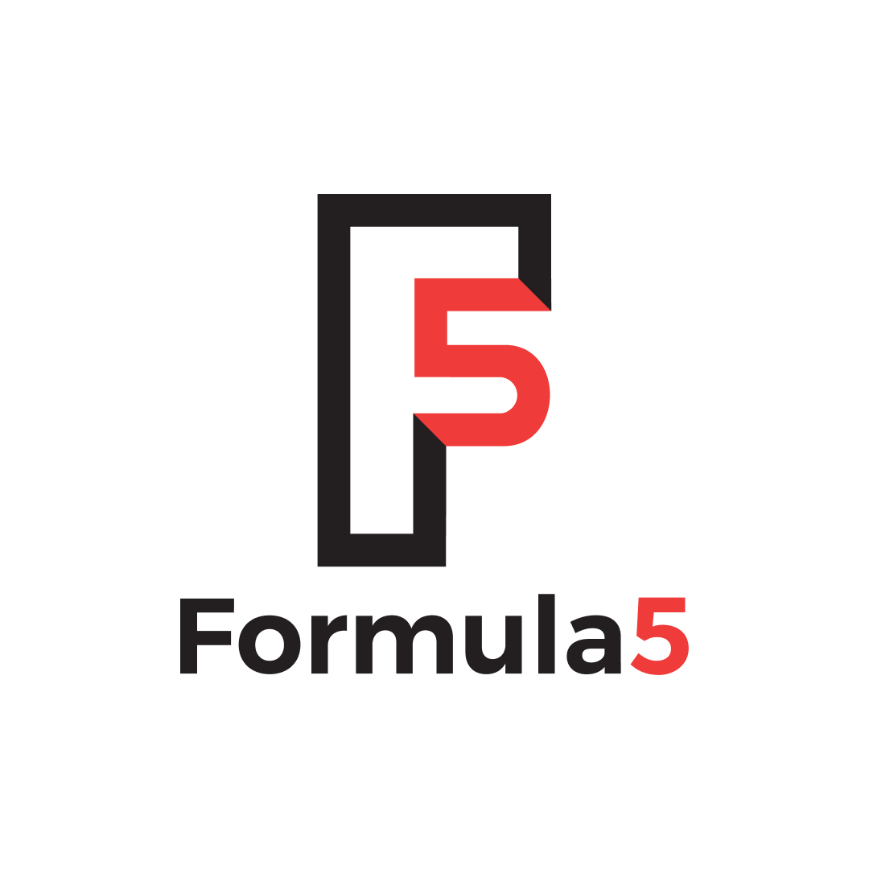


Thank You to Our Sponsors!
Global Sponsors
Platinum Sponsor
Silver Sponsors
Bronze Sponsor

Slide 3
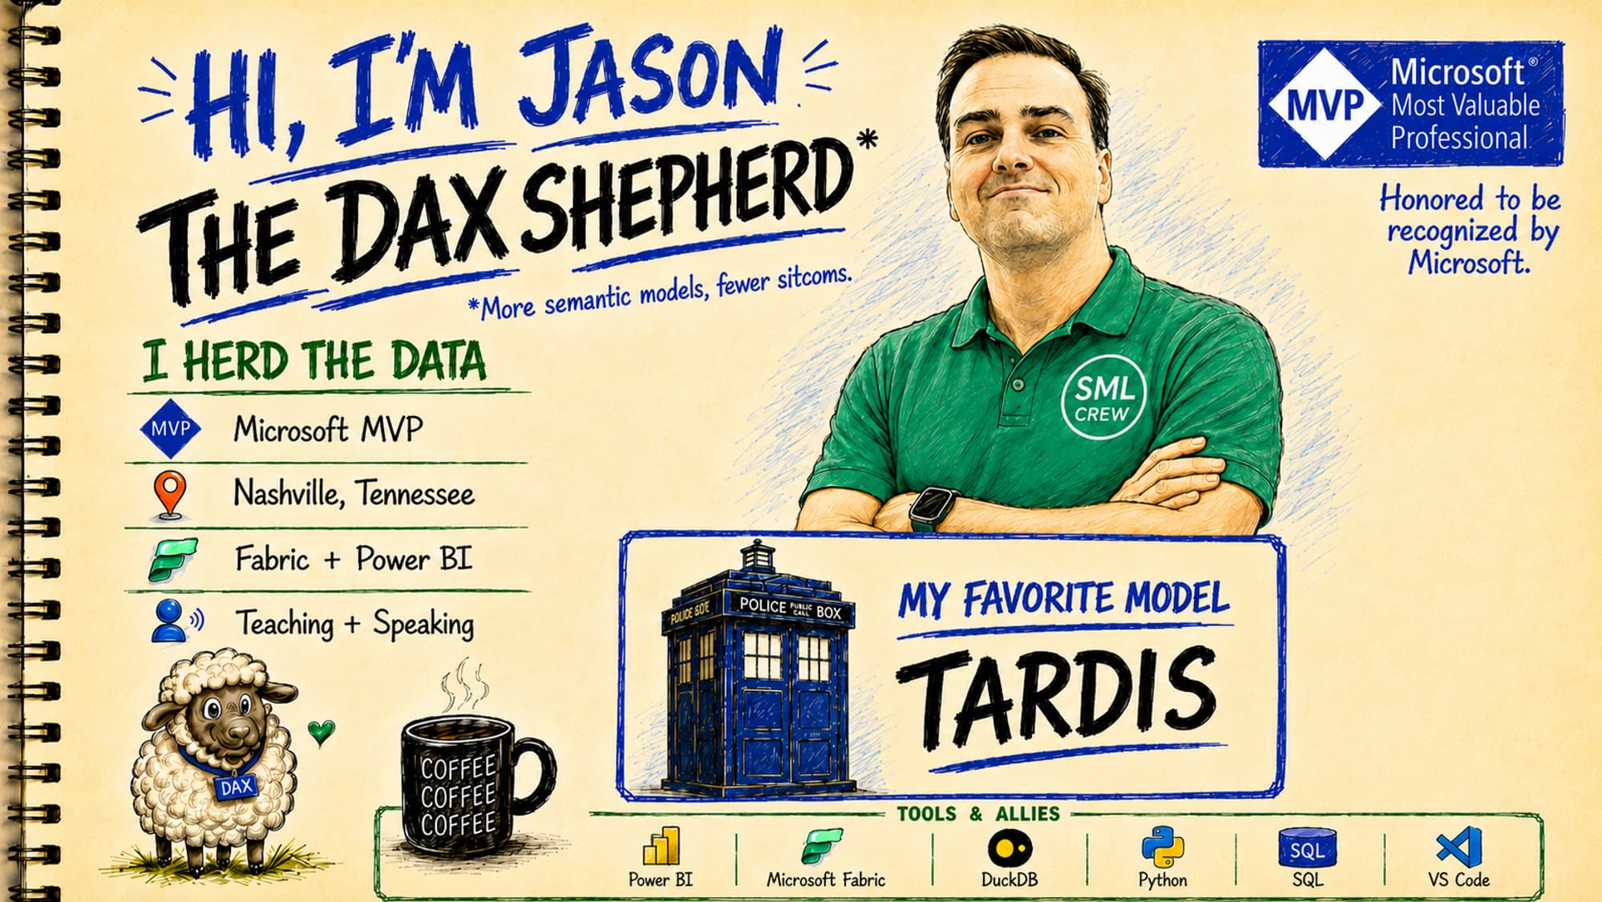

Slide 4

TAKE THIS WITH YOU
DOWNLOAD THIS
PRESENTATION
All slides, resources, and demo files available:
THE DAX SHEPHERD
thedaxshepherd.com/presentations
DuckDB 101: From Desktop to Notebook

Slide 5

Standing on the
Shoulders of Giants
Grateful for the people who share their knowledge, encourage us, answer questions, and help the rest of us learn faster.
Photo credit: Unknown Author, CC BY-ND
DuckDB 101: From Desktop to Notebook

Slide 6
SESSION ROADMAP
1. Intro
What DuckDB is and why it matters
1
2
3
4
5
Intro
Desktop
Notebook
Fabric
Wrap-Up
NOW
1. Intro
Next: Desktop
What DuckDB is and why it matters
DuckDB 101: From Desktop to Notebook

Slide 7
SESSION ROADMAP
2. Desktop
Running DuckDB locally — CLI and GUI
1
2
3
4
5
Intro
Desktop
Notebook
Fabric
Wrap-Up
NOW
2. Desktop
Next: Notebook
Running DuckDB locally — CLI and GUI
DuckDB 101: From Desktop to Notebook

Slide 8
SESSION ROADMAP
3. Notebook
Interactive querying in VS Code
1
2
3
4
5
Intro
Desktop
Notebook
Fabric
Wrap-Up
NOW
3. Notebook
Next: Fabric
Interactive querying in VS Code
DuckDB 101: From Desktop to Notebook

Slide 9
SESSION ROADMAP
4. Fabric
Fabric Notebook — plus a note on Power BI
1
2
3
4
5
Intro
Desktop
Notebook
Fabric
Wrap-Up
NOW
4. Fabric
Next: Wrap-Up
Fabric Notebook — plus a note on Power BI
DuckDB 101: From Desktop to Notebook

Slide 10
SESSION ROADMAP
5. Wrap-Up
Takeaways and what's next
1
2
3
4
5
Intro
Desktop
Notebook
Fabric
Wrap-Up
NOW
5. Wrap-Up
Thanks!
Takeaways and what's next
DuckDB 101: From Desktop to Notebook

Slide 11
SESSION ROADMAP
1. Intro
What DuckDB is and why it matters
1
2
3
4
5
Intro
Desktop
Notebook
Fabric
Wrap-Up
NOW
1. Intro
Next: Desktop
What DuckDB is and why it matters
DuckDB 101: From Desktop to Notebook

Slide 12
What is DuckDB?
The first mental model: an analytical database that runs inside your process.
SQLite is embedded for apps.
DuckDB is embedded for analytics.
In-process
Runs in your app, Python process, notebook, or command-line session. No separate database server is required for the core workflow.
Analytical SQL
Optimized for OLAP-style questions: filtering, grouping, joining, scanning columns, and reading data files.
File-native
Can query files like CSV and Parquet directly, which makes it great for exploration and lightweight ETL.
Notes:
Keep this high-level. The goal is not internals; it is why a data professional should care. DuckDB lets you work where the data already is.

Slide 13
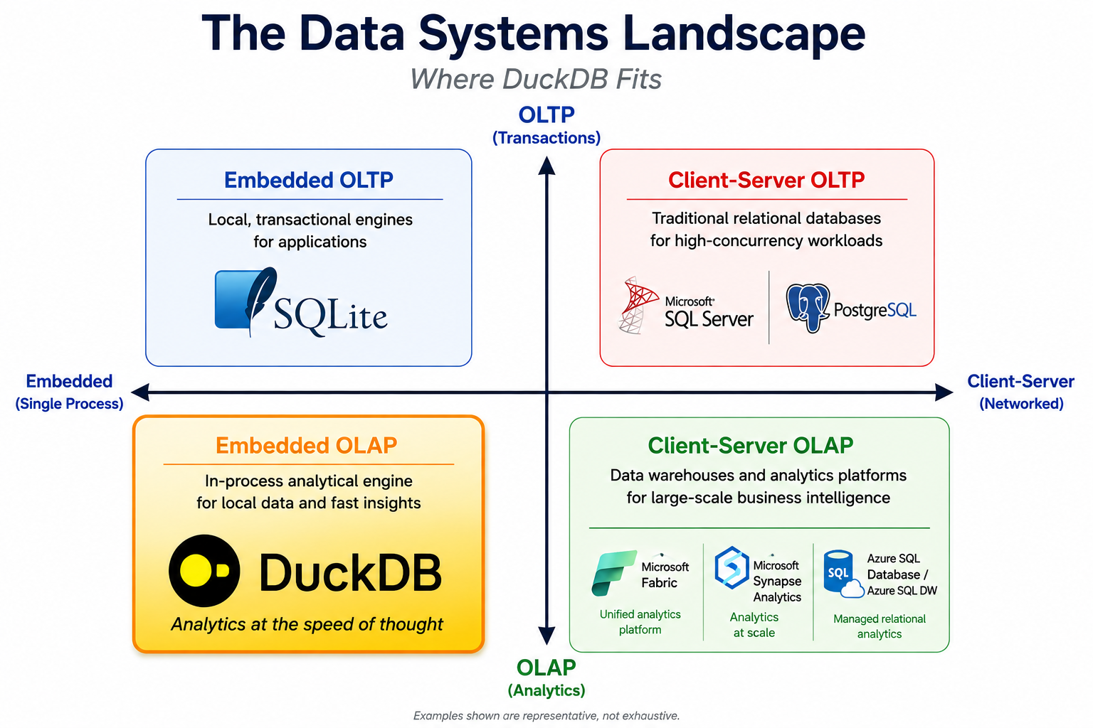
Notes:
This slide builds credibility. We are not selling DuckDB as a silver bullet. We are defining the lane.

Slide 14
The Problem DuckDB Solves
Before DuckDB, running SQL on files meant spinning up infrastructure. Here’s what changed.
Before DuckDB
With DuckDB
Same SQL you already know
Need a server to run SQL
Pandas loads the full dataset into memory
Polar – not SQL
Spark requires a cluster
SQLite is row-oriented, not OLAP
Moving data just to query it is slow
Run SQL on CSV, Parquet, JSON in place
Out-of-core execution for larger-than-RAM data
Often faster than Spark on one machine
One pip install
Query files where they live: local, S3, OneLake
Window functions, CTEs, PIVOT, UNPIVOT, ASOF joins
No new query language to learn
Works in CLI, Python, Jupyter, and Fabric notebooks
Use DuckDB before the big engine, not instead of thinking.

Slide 15
Who is DuckDB for?
A local analytics engine for people who need fast answers without a platform ceremony.
💻
Data analysts exploring files locally
🧪
Engineers prototyping transformations
CSV, Parquet, Excel exports, one-off downloads, vendor extracts.
Test ETL logic locally before deciding whether it belongs in Spark, dbt, a warehouse, or Fabric.
🐍
Python users who still want SQL
🎤
Speakers, teachers, and demo builders
Stay in SQL instead of fighting pandas or polars syntax — drop into a DataFrame only when you need to.
Small setup surface area. Great for repeatable demos and hands-on sessions.
Not just a database.
A shortcut to answers.
Notes:
Tie this to the audience. Data professionals usually have files, SQL skills, Python curiosity, and limited patience for setup.

Slide 16
Who is it not for?
DuckDB is powerful, but the best tool is still situational.
Not your high-concurrency OLTP app
Not a replacement for your warehouse
Not a magic replacement for Spark
If you need many users writing transactions all day, reach for Postgres, SQL Server, or another operational database.
Central security, governance, shared semantic models, concurrency, and BI serving still matter.
DuckDB is single-node; Spark is built for clusters. When data outgrows one machine, Spark is still the big engine.
Use DuckDB before the big engine, not instead of thinking.
Notes:
This slide builds credibility. We are not selling DuckDB as a silver bullet. We are defining the lane.

Slide 17
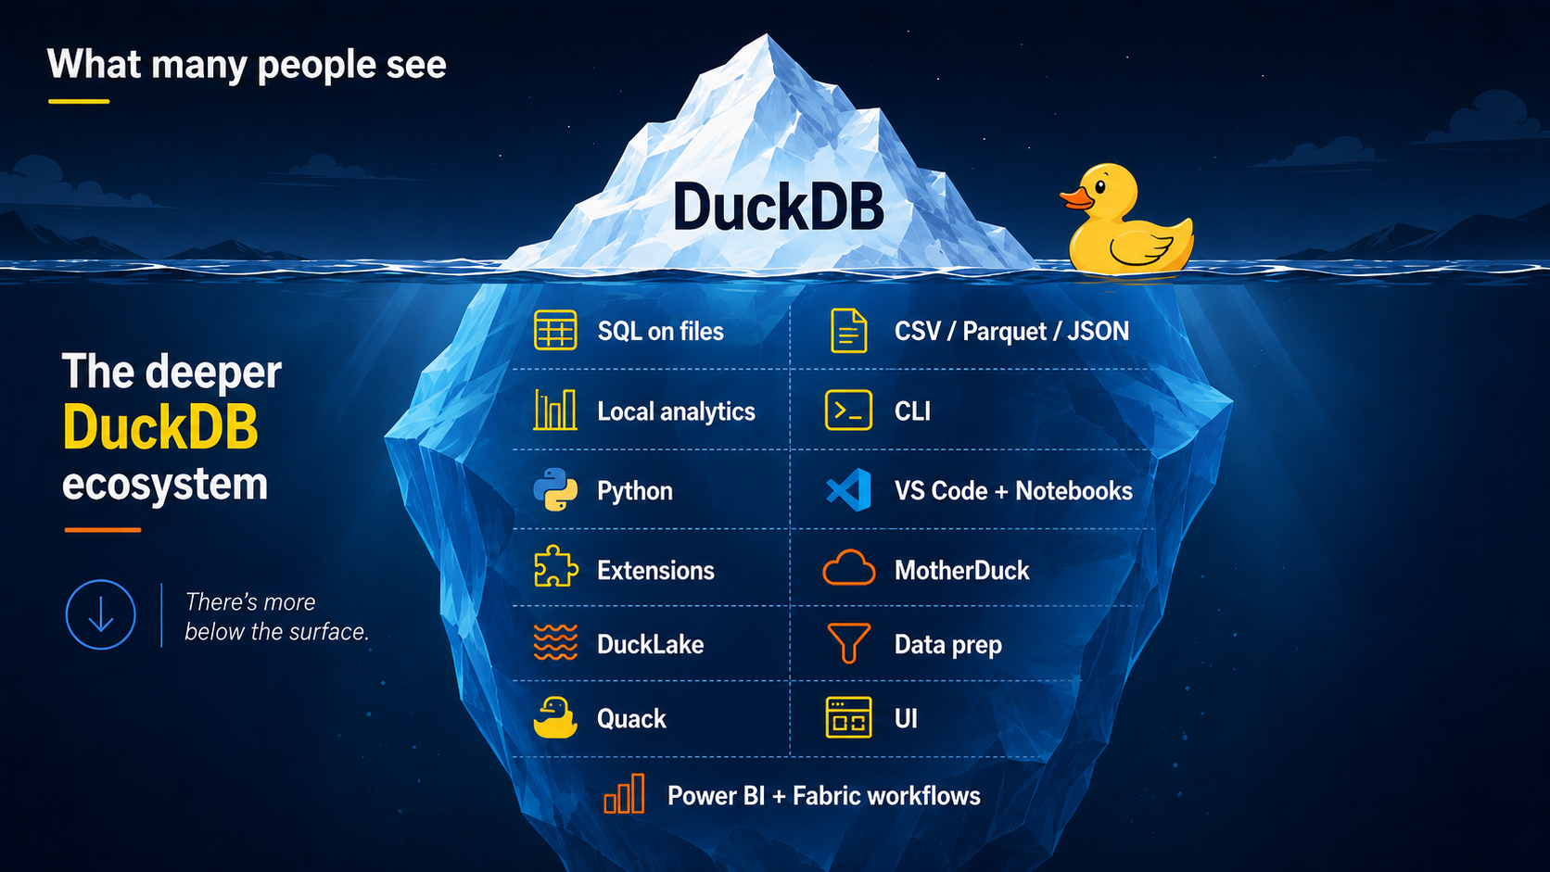
Notes:
This slide builds credibility. We are not selling DuckDB as a silver bullet. We are defining the lane.

Slide 18
Why DuckDB belongs in your toolkit
1
2
3
Local & free
Reads files directly
Scales with your workflow
Runs on your machine. No server, no install ceremony, no licensing. One binary, instant SQL.
Query CSV, Parquet, and JSON in place. The 671 MB flights dataset with 6.8M rows Excel can't open? DuckDB scans it in seconds.
Same SQL works in CLI, Python, Jupyter, and Fabric notebooks. Learn once, use everywhere.
SQL ✓
SQL ✓
SQL ✓

Slide 19
Why should a Power BI person care?
1
2
3
Inspect before import
Prototype locally
Bridge to Fabric
Look at large CSV and Parquet files before bringing them into Power BI.
Profile files that Excel or Power Query may struggle with.
Test SQL transformation logic on your laptop before you commit to a model, pipeline, or warehouse pattern.
Convert raw files into cleaner Parquet.
Use VS Code notebooks for repeatable local analysis.
Carry the same exploration pattern forward into Fabric workflows.

Slide 20
DuckDB vs. Power Query
Different tools for different moments in the data workflow.
Use DuckDB when...
Use Power Query when...
Data is too large for Power Query
You want SQL over CSV or Parquet
Profiling files before import
Prototyping ETL logic locally
Exporting clean Parquet for downstream
Loading data into a Power BI model
M transforms and Power BI dataflows
Governed refresh in Power BI Service
Building reports without code
Team-managed semantic models
DuckDB is for exploration and prep. Power Query is for the model.

Slide 21
Where DuckDB fits for Power BI people
Power BI + Fabric lens
Use it before Power BI/Fabric to inspect, shape, and hand off files — not as another platform to manage.
Raw files
DuckDB
Clean output
Power BI / Fabric
→
→
→
CSV / Parquet / JSON
local SQL engine
Parquet + validated SQL
model, report, or notebook
The practical pattern
DuckDB is the small engine you reach for when files are messy, too big for comfort, or need a quick repeatable check.
1
Before import
2
During exploration
3
Before handoff
Profile large CSV/Parquet files before they become a Power Query problem.
Use SQL + Python in a local VS Code notebook; uv keeps it repeatable.
Export clean Parquet or validated logic, then hand off to Power BI or Fabric.
Demo path: Local DuckDB → Files as Tables → VS Code Notebook → Power BI + Fabric

Slide 22
Where would you use DuckDB?
A lightweight analytics engine for local exploration, files, notebooks, and the Microsoft data stack.
Local DuckDB
Files as Tables
Start with a local engine
Open DuckDB from the CLI, an in-memory database, or a small .duckdb file. No server or cluster needed.
Query data where it already lives
Use SQL directly against CSV, Parquet, JSON, and folders before deciding what to import or convert.
VS Code Notebook
Power BI + Fabric
Make exploration repeatable
Use Jupyter in VS Code with uv so SQL, Python, charts, and documentation live in the same local workflow.
Bridge back to the Microsoft stack
Run DuckDB in Fabric Python notebooks: read Lakehouse files, do light SQL transforms, skip Spark when you don't need it.
The mental model
Start local, query files, then move the pattern into notebooks and Fabric.

Slide 23
SESSION ROADMAP
2. Desktop
Running DuckDB locally — CLI and GUI
1
2
3
4
5
Intro
Desktop
Notebook
Fabric
Wrap-Up
NOW
2. Desktop
Next: Notebook
Running DuckDB locally — CLI and GUI
DuckDB 101: From Desktop to Notebook

Slide 24
Install, launch, and run your first query
WINDOWS · MAC · LINUX
# Windows
winget install DuckDB.cli
# Mac
brew install duckdb
⚠ WATCH OUT
Exit thrashing
`quit` and `exit` don't work. DuckDB uses dot-commands for shell control:
.exit or .quit
.help
.databases
.tables
LAUNCH
duckdb
FIRST QUERY
SELECT 'DuckDB is running' AS demo;
-- Don't forget the semicolon!
Don't forget the semicolon!

Slide 25
Query files directly — no loading required
🦆 ✈️
flights_2023.csv — 671 MB, 6.8M rows
Excel can't open it. DuckDB scans it in seconds — straight from the file.
SELECT FROM A CSV
SELECT * FROM 'flights_2023.csv' LIMIT 10;
No CREATE TABLE. No import. Just point at the file.
DESCRIBE THE SCHEMA
DESCRIBE SELECT * FROM 'flights_2023.csv';
Inspect columns and types without loading data.
SUMMARIZE EVERYTHING
SUMMARIZE SELECT * FROM 'flights_2023.csv';
Stats for every column in one command — DuckDB's secret weapon.

Slide 26
Same SQL, three interfaces
CLI for speed → Python script for repeatability → Notebook for exploration. One uv environment owns it all.
STEP 1
STEP 2
STEP 3
CLI
Python (uv)
Notebook
Pure SQL.
Fastest path to first query.
Project owns its environment.
No pip drift.
Same kernel, interactive.
VS Code or Jupyter.
duckdb
SELECT * FROM 'flights_2023.csv';
uv init
uv add duckdb pandas
uv run python main.py
uv add jupyter ipykernel
code .
The notebook isn't a different system — it's another interface to the same environment.

Slide 27
DuckDB Extensions
Install with INSTALL extension_name; LOAD extension_name; — or let DuckDB auto-load on first use.
excel
Read .xlsx files directly. SELECT * FROM 'my_file.xlsx' just works — no conversion needed.
httpfs
Query files over HTTP/S and S3 — no download step. Essential for remote data.
delta / iceberg
Native Delta Lake and Apache Iceberg table support. Read lakehouse tables without Spark.
azure
Azure Blob Storage, ADLS, and OneLake — query Fabric files with the same SQL.
spatial
Geometry types, spatial joins, and PostGIS-compatible functions for geospatial analysis.

Slide 28
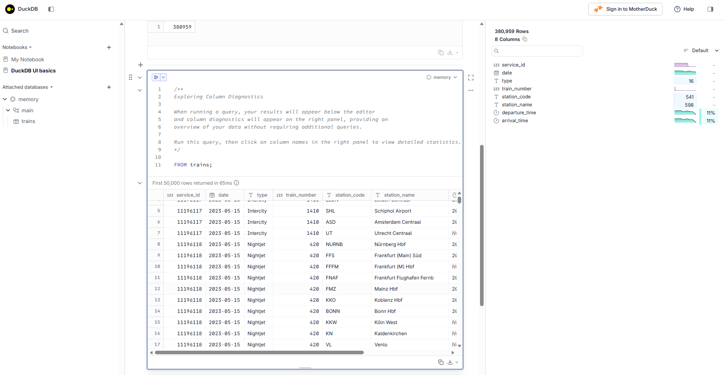
DuckDB’s Built-in UI
duckdb --ui — opens at localhost:4213. Runs fully local; your data never leaves the machine.

Slide 29
DEMO TIME
Desktop

Slide 30
SESSION ROADMAP
3. Notebook
Interactive querying in VS Code
1
2
3
4
5
Intro
Desktop
Notebook
Fabric
Wrap-Up
NOW
3. Notebook
Next: Fabric
Interactive querying in VS Code
DuckDB 101: From Desktop to Notebook

Slide 31
Why notebooks?
A notebook is not a new system. It is another interface to the same environment.
Scripts are great for
Notebooks are great for
Repeatable, automated execution
Clean, version-controlled logic
Production pipelines and scheduled jobs
Reproducible runs from a known state
Step-by-step exploration of files and data
Teaching, demos, and live walkthroughs
Visible results next to the SQL that made them
Quick iteration when shape and intent are still evolving
Same environment. Same DuckDB. Different interaction model.
Notes:
This is the Part 2 transition. Emphasize that we are not throwing away the project setup.

Slide 32
DEMO TIME
Notebook

Slide 33
SESSION ROADMAP
4. Fabric
Fabric Notebook — plus a note on Power BI
1
2
3
4
5
Intro
Desktop
Notebook
Fabric
Wrap-Up
NOW
4. Fabric
Next: Wrap-Up
Fabric Notebook — plus a note on Power BI
DuckDB 101: From Desktop to Notebook

Slide 34
Power BI + DuckDB
Use DuckDB before the model — not necessarily as the model’s live source.
Power BI pattern
Raw files
DuckDB
Clean output
Power BI
DuckDB is usually most valuable as a prep, profiling, and validation tool before Power BI imports the data.
CSV / JSON / Parquet
inspect • profile • reshape
Parquet + validated SQL
import • model • report
Inspect large CSV / Parquet files
Prototype SQL transformations locally
Export cleaner, typed Parquet
Connection options exist, but they are not the main 101 path
Possible via ODBC + MotherDuck Power Query connector — works, but not the main 101 path.
Practical message: DuckDB before Power BI.

Slide 35
Same notebook, different runtime
When you move the notebook into Microsoft Fabric, the SQL stays. Three things change.
✓ STAYS THE SAME
→ WHAT CHANGES
• DuckDB SQL syntax
• Python code
• Query patterns
• Notebook structure
• Your mental model
Environment
uv (you own it) → Fabric runtime
Data paths
../data/flights/*.csv → /lakehouse/default/Files/
Install
uv add duckdb → pre-installed in Fabric
DECISION POINT
Reach for DuckDB when:
Reach for Spark when:
Quick SQL exploration · Small to medium data · Inspecting files · Avoiding Spark startup
Data is large · Workloads need to scale · Production pipelines · Distributed processing

Slide 36
Fabric + DuckDB
Use the smallest engine that can safely do the job.
In Fabric, DuckDB fits naturally in a Pure Python notebook when you want quick single-node SQL over files.
Pure Python notebook + DuckDB
Spark notebook
Good when the task is local-ish and exploratory:
Use when the workload needs distributed scale:
Inspect files in OneLake / Lakehouse Files
Run quick SQL over CSV or Parquet
Prototype transformation logic
Avoid starting Spark for small-to-medium work
Very large data or heavy joins
Production pipelines
Spark ecosystem features
Distributed processing across the cluster
Capacity angle: lower-overhead exploration.
Decision point: do I actually need Spark?
Same idea, new path: read_parquet('/lakehouse/default/Files/flights_2023.parquet')

Slide 37
DuckDB vs Spark in Fabric
Choose the engine based on the workload, not the logo.
Use DuckDB when...
Use Spark when...
Quick SQL exploration
Small-to-medium files
Notebook-first investigation
Avoiding Spark startup for tiny jobs
File inspection and prototypes
Large/distributed workloads
Production pipelines
Lakehouse table processing
Scale-out transformations
Operationalized data engineering
DuckDB is the pocketknife. Spark is the workshop.
Notes:
This is important for the Microsoft/Fabric audience. DuckDB helps you get more from capacity by not using the big engine for every small task.

Slide 38
DEMO TIME
Fabric

Slide 39
SESSION ROADMAP
5. Wrap-Up
Takeaways and what's next
1
2
3
4
5
Intro
Desktop
Notebook
Fabric
Wrap-Up
NOW
5. Wrap-Up
Thanks!
Takeaways and what's next
DuckDB 101: From Desktop to Notebook

Slide 40
A practical use-case ladder
DuckDB often starts as exploration, then becomes a repeatable step.
Explore
What is in this file?
read_csv_auto / read_parquet
Profile
What are the shapes, nulls, and weird values?
COUNT, GROUP BY, DESCRIBE
Transform
Can I clean or reshape this quickly?
CREATE TABLE AS SELECT
Export
Can I hand off a better format?
COPY TO Parquet
Prototype
Does this ETL logic work before production?
Python + SQL + tests
Notes:
This shows progression. The same tool can be a scratchpad and a durable step.

Slide 41
Official DuckDB Resources
Start here: official docs, official sites, and free learning offers.
OFFICIAL
OFFICIAL DOCS
CLOUD + LEARNING
DuckDB
DuckDB Documentation
MotherDuck
Main project site, docs, installation, guides, SQL reference, and client APIs.
The source of truth for installation, CLI, SQL, CSV/Parquet, Python, and extensions.
Cloud analytics built around DuckDB, plus practical articles, videos, and learning resources.
https://duckdb.org
https://duckdb.org/docs/current/
https://motherduck.com
FREE BOOK OFFER
FREE EARLY ACCESS / PREVIEW
DuckDB in Action
DuckLake: The Definitive Guide
Free PDF from MotherDuck. Good practical next step after this 101 session.
O’Reilly early release sponsored by MotherDuck. Chapters are released as they become available.
motherduck.com/duckdb-book-brief
motherduck.com/lp/ducklake-lakehouse-table-format-book-full
Keep the first resource slide boring on purpose: official docs, official project, and current free offers.
DuckDB 101: From Desktop to Notebook

Slide 42
Go Beyond
Books, videos, and community resources when you want more than the docs.
Books
DuckDB: Up and Running
DuckDB in Action
DuckLake: The Definitive Guide
O’Reilly
Manning / free PDF via MotherDuck
O’Reilly Early Release
Good for a structured walk-through of DuckDB concepts and hands-on usage.
Practical book for learning DuckDB from ingestion through analytics workflows.
Preview / early access. Best after DuckDB basics when you want lakehouse table-format context.
Video + community
VIDEO
LEARNING PATH
COMMUNITY
MotherDuck YouTube
Luke Barousse
GitHub + DuckDB Community
Product walkthroughs, livestreams, DuckDB ecosystem videos, and DuckLake content.
Beginner-friendly SQL learning using DuckDB and MotherDuck in practical examples.
Source code, issues, discussions, extension ecosystem, and community links.
https://www.youtube.com/@MotherDuckDB
https://www.youtube.com/@datawithluke
https://duckdb.org/community
Suggested path: docs first → free DuckDB in Action PDF → videos/community → O’Reilly books as you go deeper.
DuckDB 101: From Desktop to Notebook

Slide 43




THANK YOU
Jason Romans
thedaxshepherd@gmail.com
linkedin.com/in/jasonromans
www.thedaxshepherd.com
Slides
Session Evaluation

