Slide 1


Unlocking the Power of TMDL: Enhancing Power BI Development
Jason Romans
SQL Saturday Atlanta 2026 • AI & BI
March 2026

Slide 2



Jason
Romans
Cloud Data & Integration Developer
📍 Nashville, TN, USA
🛠️ Began Career as a SQL Server DBA
➡️ Transitioned to Microsoft BI Stack
📦 Data Engineering to Data Modeling
The DAX Shepherd
@sql_jar
jason-r-sql-jar
https://thedaxshepherd.com/
Notes:
Peter

Slide 3

Standing on the Shoulders of Giants
This Photo by Unknown Author is licensed under CC BY-ND
Grateful for the people who share their knowledge, encourage us, answer questions, and help the rest of us learn faster.

Slide 4
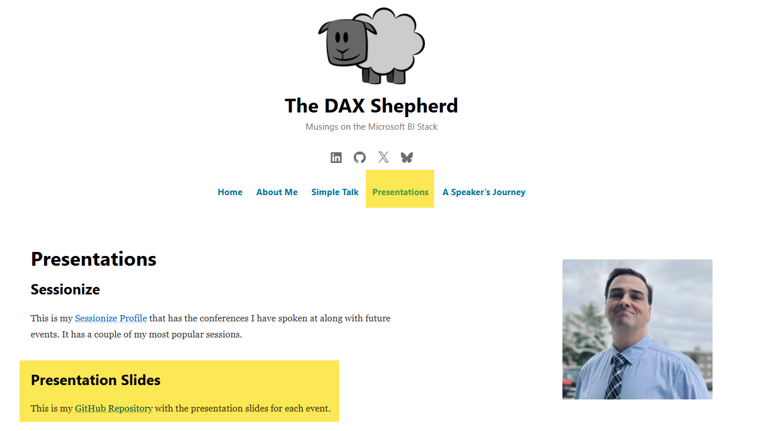
DOWNLOAD THIS PRESENTATION
All slides, resources, and demo files available:
The DAX Shepherd
thedaxshepherd.com/presentations
[Screenshot: Blog homepage
showing 'Presentations' navigation]

Slide 5















Thank You To Our Sponsors
For Making SQL Saturday Possible!
SQL Saturday Atlanta 2026 • AI & BI
2
Notes:
[Sources]
- Conference title, event date, and location are based on the official SQL Saturday Atlanta 2026 event page: https://sqlsaturday.com/2026-03-21-sqlsaturday1127/
- Color palette is derived from the user-provided logo image in this conversation.

Slide 6
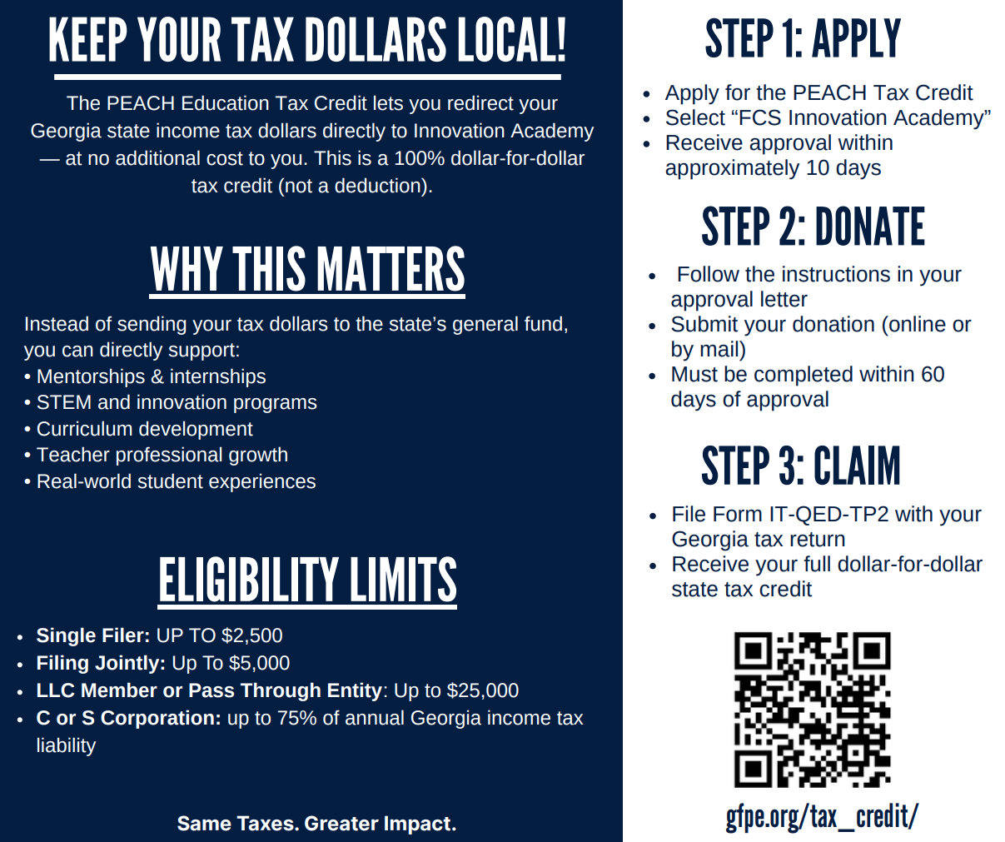

A Very Special Thank You To Our Community Partner
Innovation Academy!
Please Support Via Tax Credit Eligible Donation That Goes DIRECTLY To Innovation Academy
SQL Saturday Atlanta 2026 • AI & BI
2
Notes:
[Sources]
- Conference title, event date, and location are based on the official SQL Saturday Atlanta 2026 event page: https://sqlsaturday.com/2026-03-21-sqlsaturday1127/
- Color palette is derived from the user-provided logo image in this conversation.

Slide 7

Lunch Hour Sponsor Sessions
DBA Survival Kit: Redgate Monitor + Toolbelt
by Chris Reyes
Stop Firefighting: Build a Semantic Layer Ready for AI by Anouk Gorris
Microsoft SQL and AMD
in the Era of AI
by Bob Ward
Sponsor Session Attendees Can Win A $50 Amazon Gift Card Each
Two Raffle Gift Cards Per Session
SQL Saturday Atlanta 2026 • AI & BI
2
Notes:
[Sources]
- Conference title, event date, and location are based on the official SQL Saturday Atlanta 2026 event page: https://sqlsaturday.com/2026-03-21-sqlsaturday1127/
- Color palette is derived from the user-provided logo image in this conversation.

Slide 8
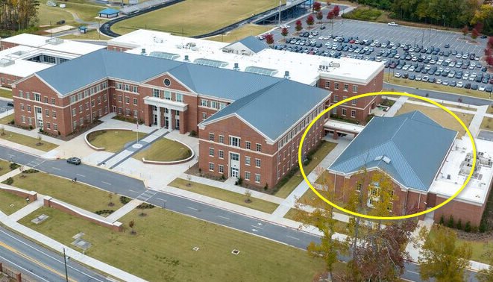
SQL Saturday Atlanta Closing Ceremony
5PM In The Auditorium
Must Be Present To Win Raffle Prizes
SQL Saturday Atlanta 2026 • AI & BI
2
Notes:
[Sources]
- Conference title, event date, and location are based on the official SQL Saturday Atlanta 2026 event page: https://sqlsaturday.com/2026-03-21-sqlsaturday1127/
- Color palette is derived from the user-provided logo image in this conversation.

Slide 9



The TMDL Journey
1. What is TMDL
2. PBIP & TMDL
3. TMDL View
4. External Tools
5. Conclusion

Slide 10
The TMDL Journey
1. What is TMDL
2. PBIP & TMDL
3. TMDL View
4. External Tools
5. Conclusion

Slide 11
In the Beginning…
SQL Server Analysis Services Tabular
  Single BIM File
  Tabular Model Scripting Language (TMSL)
      JSON Format
Creator of Tabular Editor - Daniel Otykier
  TE started as a glorified JSON editor

Slide 12
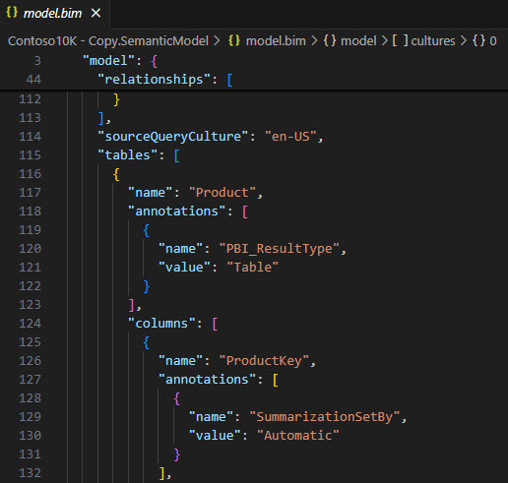
Sample Model.Bim File

Slide 13
Issues with a Single Large BIM File
Difficult to comprehend
  Too much text is focused on delimiters {}, ()
Single, large file - harder to collaborate with others
Power BI and Fabric are advancing toward complete version control across all assets
  Does it exist if it is not in source control?

Slide 14
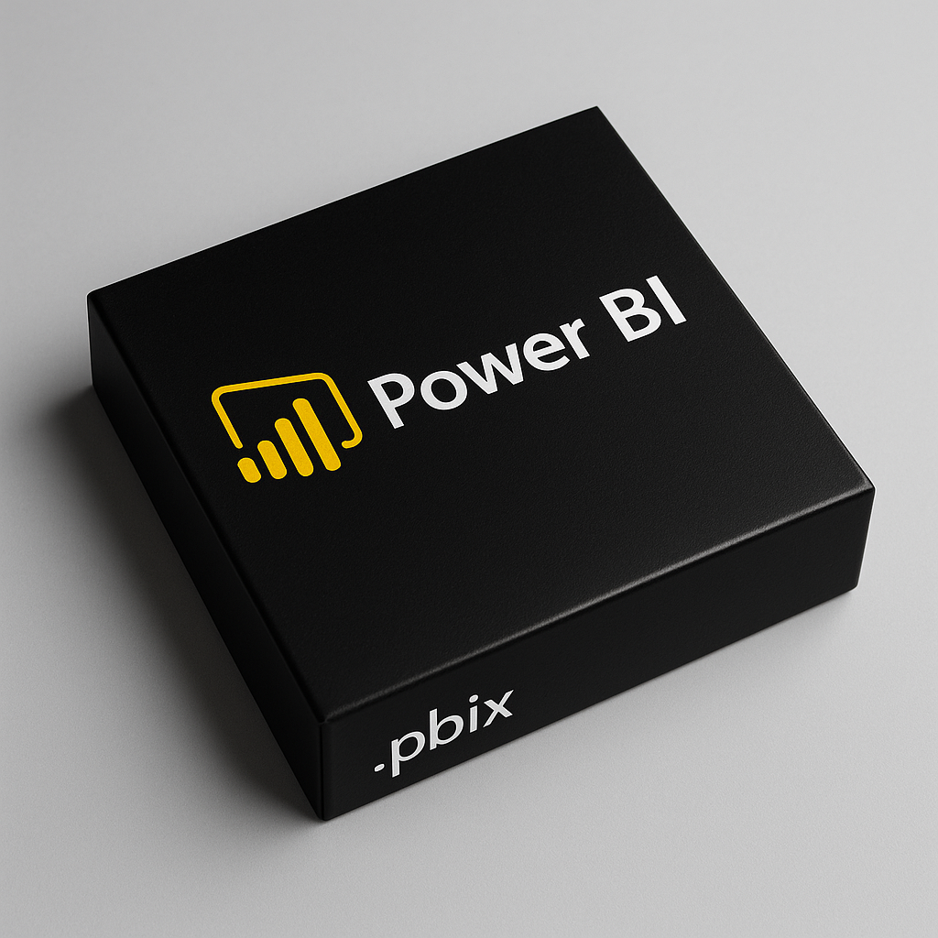
Power BI PBIX File
In some ways a step backwards

Slide 15
Power BI Developer Mode
Store PBIX as a Project Folder
  PBIP
Enhanced Format for Semantic Model
  TMDL
Enhanced Format for Reports
  PBIR

Slide 16

What’s in a Name
TMDL
Tabular
Model
Definition
Language

Slide 17
Key Points
Ease of reading – similar to YAML
Folder structure – separate files for each table, perspective, role, and culture
  Increases collaboration
Minimal delimiters
AI-ready: plain text = Copilot-friendly

Slide 18
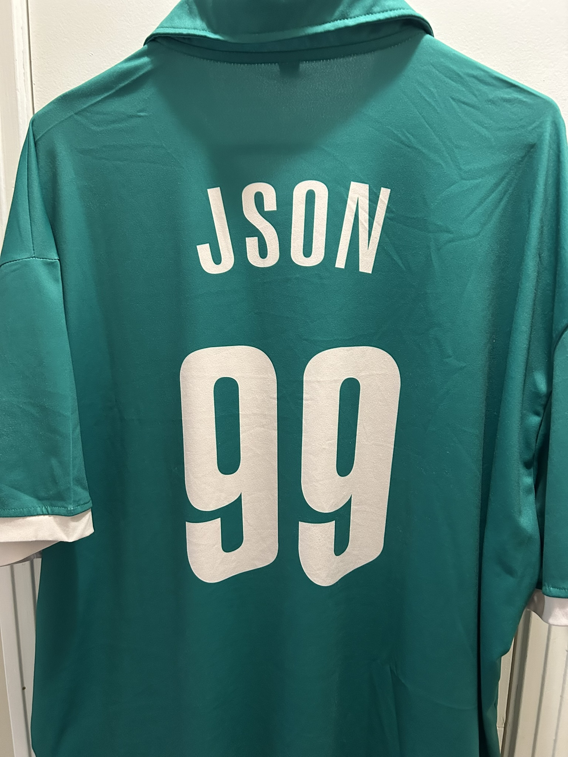
This is not in JSON format.
What it is not
WWW.smlcrew.com

Slide 19
TMDL Credit
Mathias Thierbach
  Microsoft MVP
  pbi-tools
Community involvement

Slide 20
Dual Purpose
1. Definition Language
2. Scripting Language

Slide 21
Unlocking the Power of TMDL
With code:
  Create Date Table
  Turn on or off features
    Auto Date/Time
    Discourage Implicit Measures
  Quickly Create Objects
  Move object between Projects
  Make mass changes quickly

Slide 22
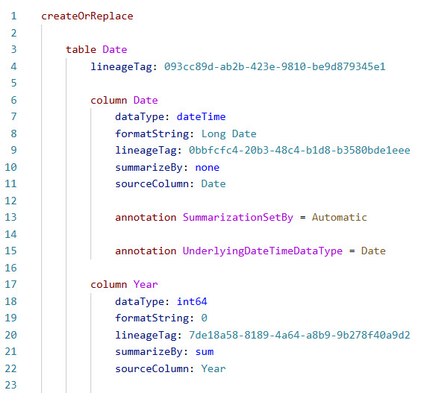
Example of TMDL

Slide 23
Quick TMDL Primer
Whitespace for indenting
Hierarchy
  Table
    Column
      Properties
    Measure
      Properties

Slide 24
More TMDL
Triple slash (///) syntax
  Description – good for documentation
    For example /// Table Description

Slide 25
Best Way to Learn Syntax
Create Object in GUI
  Script out object
View snippets

Slide 26
The TMDL Journey
1. What is TMDL
2. PBIP & TMDL
3. TMDL View
4. External Tools
5. Conclusion

Slide 27
TMDL in Power BI Desktop
Related but independent
Power BI Project (.pbip)
  Store semantic model in TMDL format
TMDL View
  Can be used with PBIX files

Slide 28
Breaking News – Read All About it
September 2025 Power BI Released
  TMDL View is GA
  Power BI September 2025 Feature Summary

Slide 29
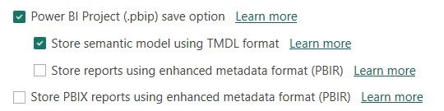
Preview Options - Power BI Project

Slide 30
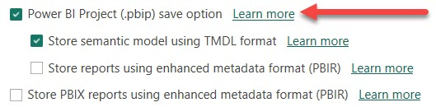
Learn More

Slide 31
TMDL in Power BI Desktop
1.Power BI Project (.pbip)
  Store semantic model in TMDL format

Slide 32
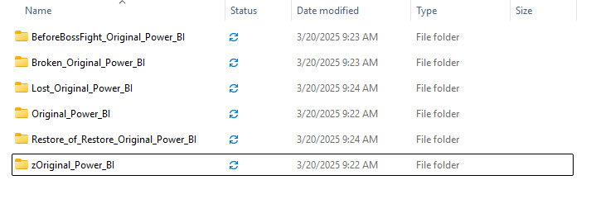
Folder Renaming is NOT Version Control

Slide 33

Visual Studio Code Demo

Slide 34
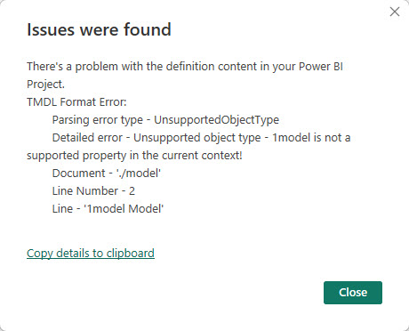
Power BI – TMDL Issue

Slide 35
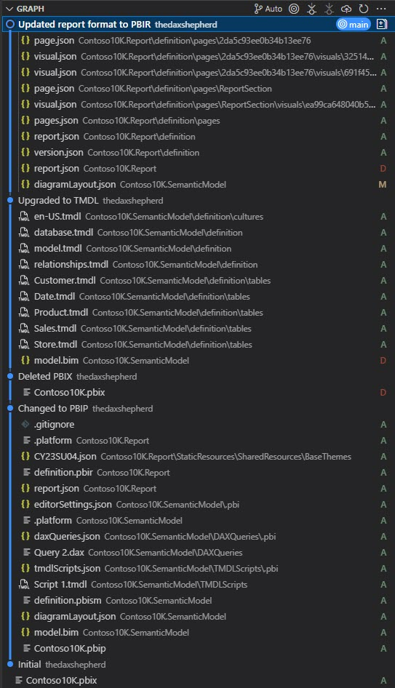
Git Changes
From PBIX to PBIP

Slide 36
The TMDL Journey
1. What is TMDL
2. PBIP & TMDL
3. TMDL View
4. External Tools
5. Conclusion

Slide 37
TMDL in Power BI Desktop
2.TMDL View
  Can be used with PBIX files

Slide 38
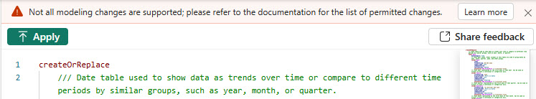
Warning
Learn More: https://learn.microsoft.com/en-us/power-bi/developer/projects/projects-overview#model-authoring

Slide 39
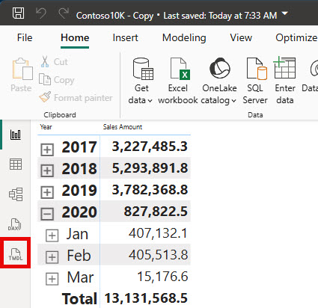
TMDL View Button

Slide 40
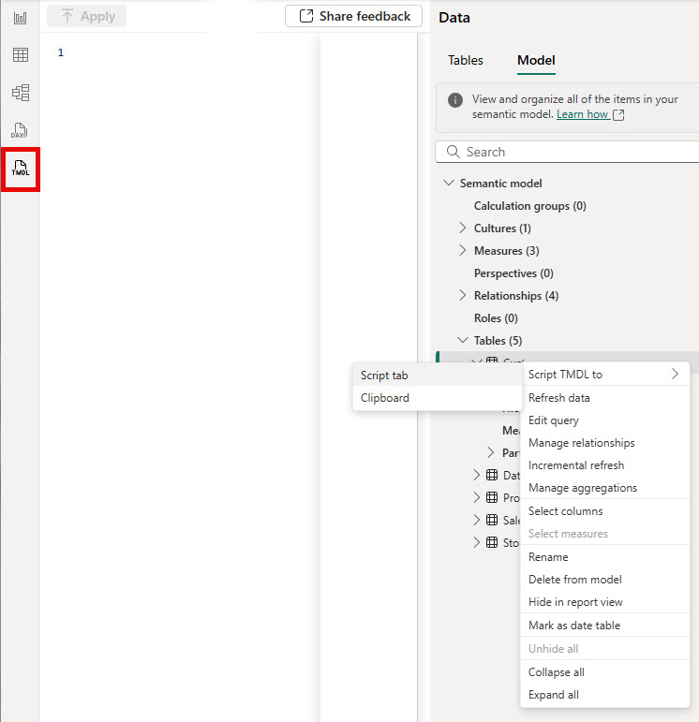
Script TMDL

Slide 41
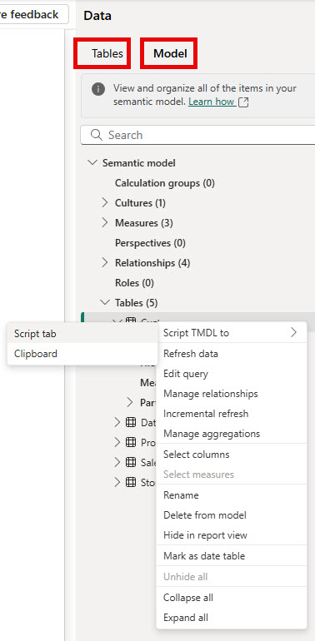
Can be in Table or Model Selection

Slide 42
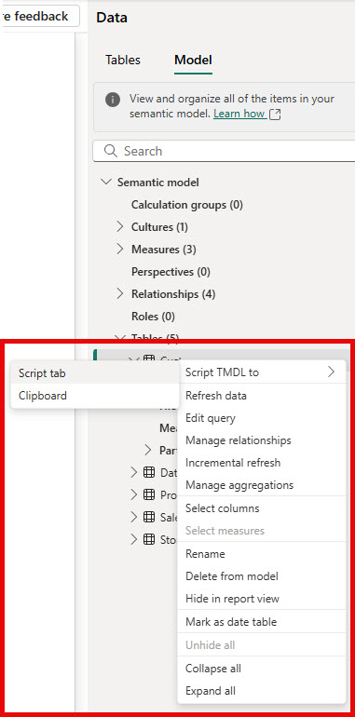
Can script to Script Tab or Clipboard
Also, Drag and Drop to Tab

Slide 43
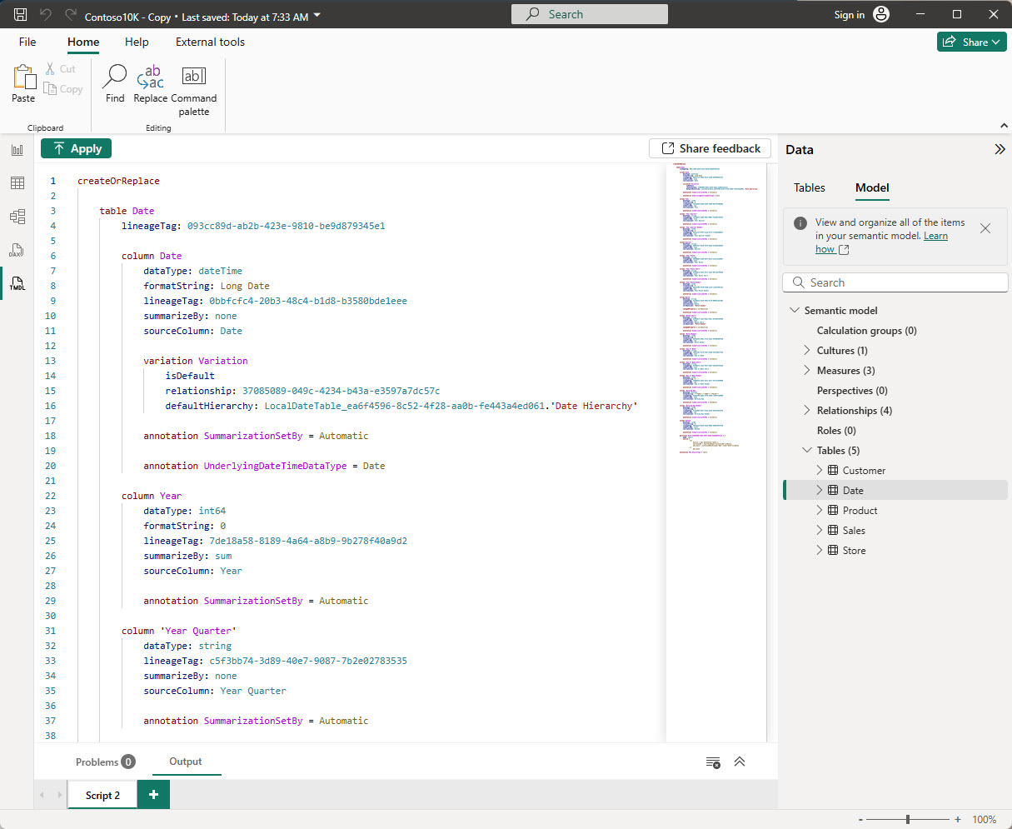
TMDL View – Script Tab

Slide 44
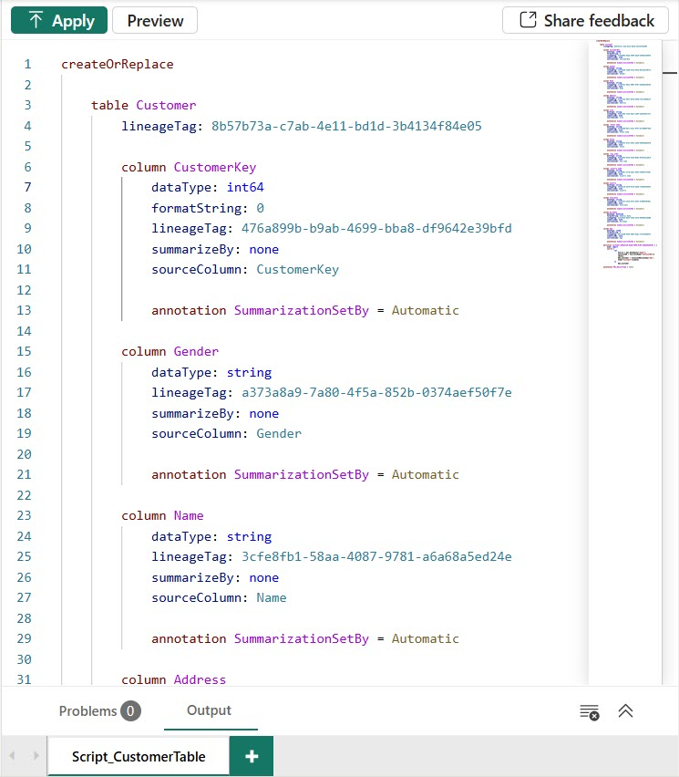
TMDL View – Code Interface

Slide 45
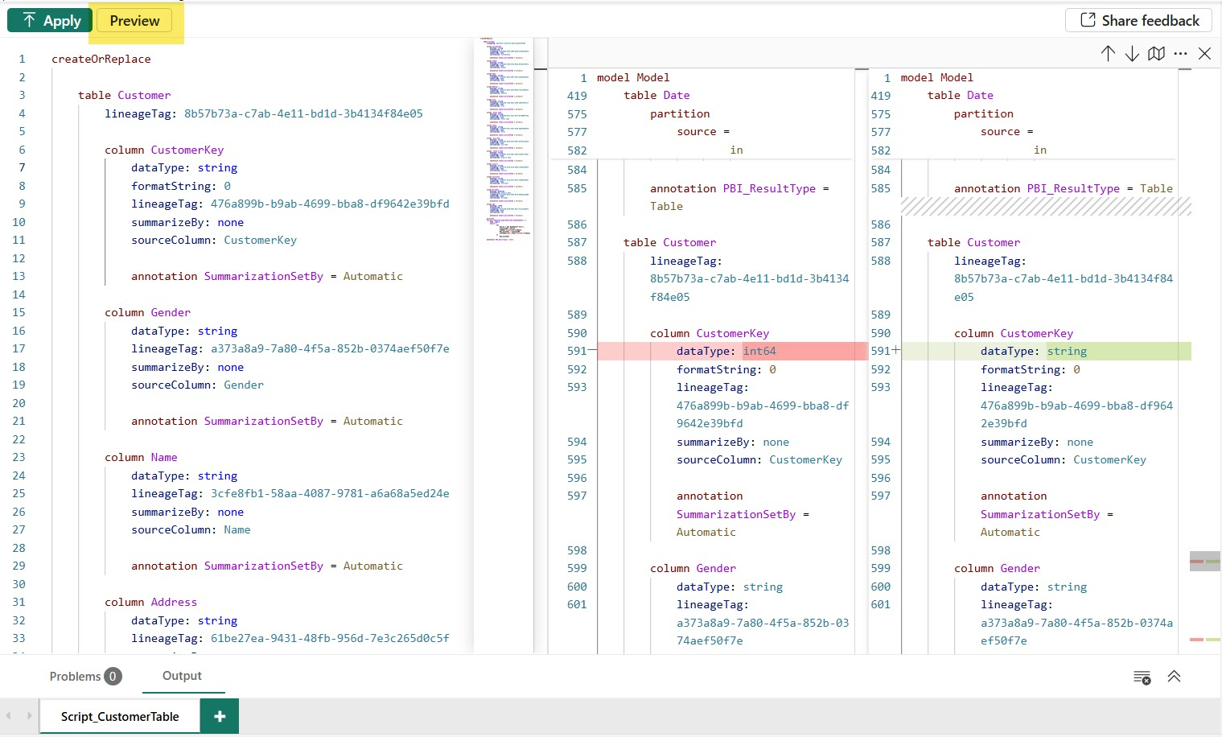
Code Interface - Preview

Slide 46
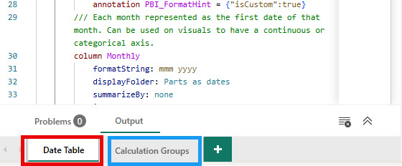
TMDL View – Rename Tabs

Slide 47
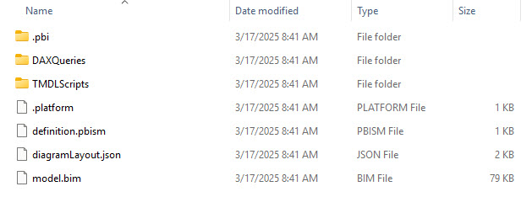
TMDL Scripts – Saved in File (PBIP/PBIX)

Slide 48
Enables functionalities Without External tool
For example:
  Perspectives
  Translations

Slide 49
Share TMDL Scripts
Centralized collection
  SharePoint site or Teams
Sites with TMDL samples
  TMDL Gallery
  FabSnippets
Article in resources regarding security precautions

Slide 50

TMDL View Demo

Slide 51
The TMDL Journey
1. What is TMDL
2. PBIP & TMDL
3. TMDL View
4. External Tools
5. Conclusion

Slide 52
External Tools
Visual Studio Code
  TMDL Extension
  Power BI Studio
pbi-tools
Tabular Editor

Slide 53
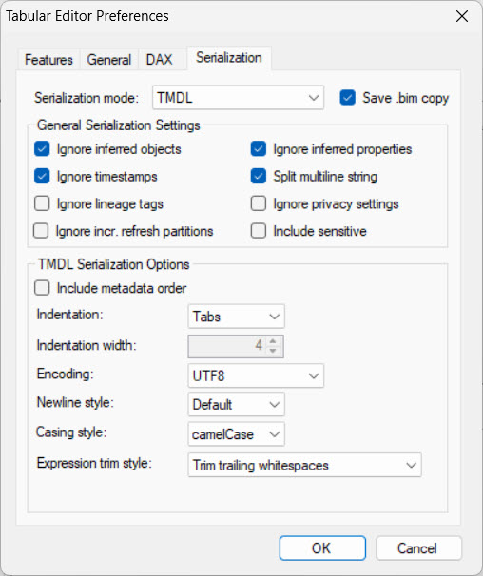
Tabular Editor 2.x – Save to Folder – TMDL

Slide 54
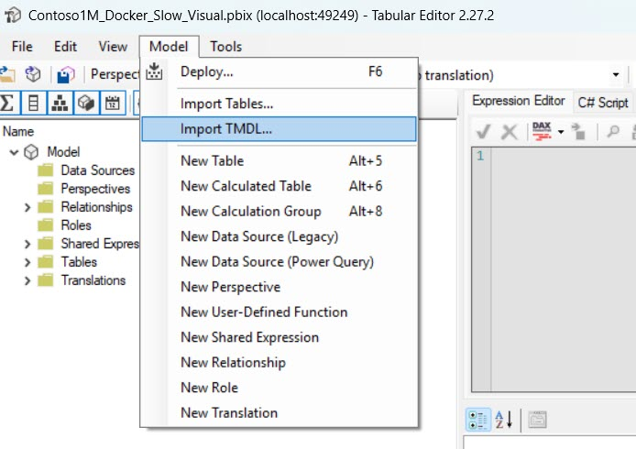
Tabular Editor 2.x – Import TMDL

Slide 55
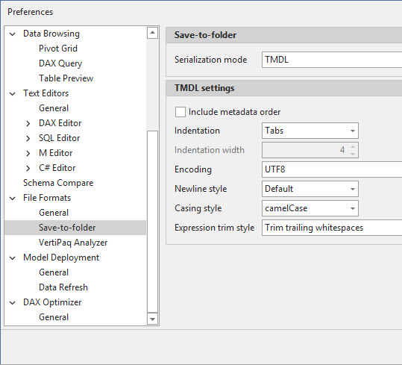
Tabular Editor 3

Slide 56
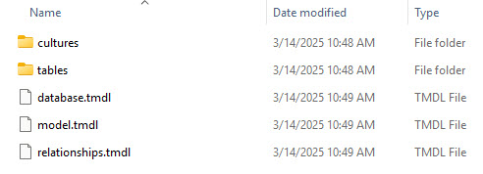
Tabular Editor 2 – Save to Folder

Slide 57
The TMDL Journey
1. What is TMDL
2. PBIP & TMDL
3. TMDL View
4. External Tools
5. Conclusion

Slide 58
Future Expansion
Expanding support for changes that are not currently supported
TMDL View available on the Web
TMDL View Copilot

Slide 59
Endless Possibilities
Assist with Development
  Reuse Modules
Build Models with AI
Best Practices

Slide 60
Resources
Microsoft TMDL Overview
  https://learn.microsoft.com/en-us/analysis-services/tmdl/tmdl-overview
Developer Mode
  https://learn.microsoft.com/en-us/power-bi/developer/projects/projects-dataset#tmdl-format
TMDL View
  https://learn.microsoft.com/en-us/power-bi/transform-model/desktop-tmdl-view

Slide 61
Resources
Power BI TMDL View: Benefits, Security Risks and Best Practices by John Kerski
  https://www.red-gate.com/simple-talk/business-intelligence/power-bi-tmdl-benefits-security-risks-best-practices
FabSnippets
  https://fabsnippets.com
DataZoe – DAX Date table in TMDL
  https://www.datazoe.blog/post/dax-date-table-in-tmdl

Slide 62
Resources
Deep dive into TMDL view for Power BI Desktop
  https://powerbi.microsoft.com/en-us/blog/deep-dive-into-tmdl-view-for-power-bi-desktop-preview/
Microsoft Lineage Tags
  https://learn.microsoft.com/en-us/analysis-services/tom/lineage-tags-for-power-bi-semantic-models
#SML (Saturday Morning Learning)
  www.smlcrew.com

Slide 63
Hope you enjoyed your stay
HOTEL TMDL
Check-Out Receipt
--------------------------------
Guest: SQL Saturday Attendee
Room: The PBIP Suite
------------------------------
TMDL Orientation........FREE
Source Control Access...FREE
TMDL View (GA)..........FREE
Tabular Editor Tips.....FREE
Late Checkout..NOT SUPPORTED
------------------------------
TOTAL:..................FREE
--------------------------------
Thank you for staying at Hotel TMDL
— a YMCA property —

Slide 64
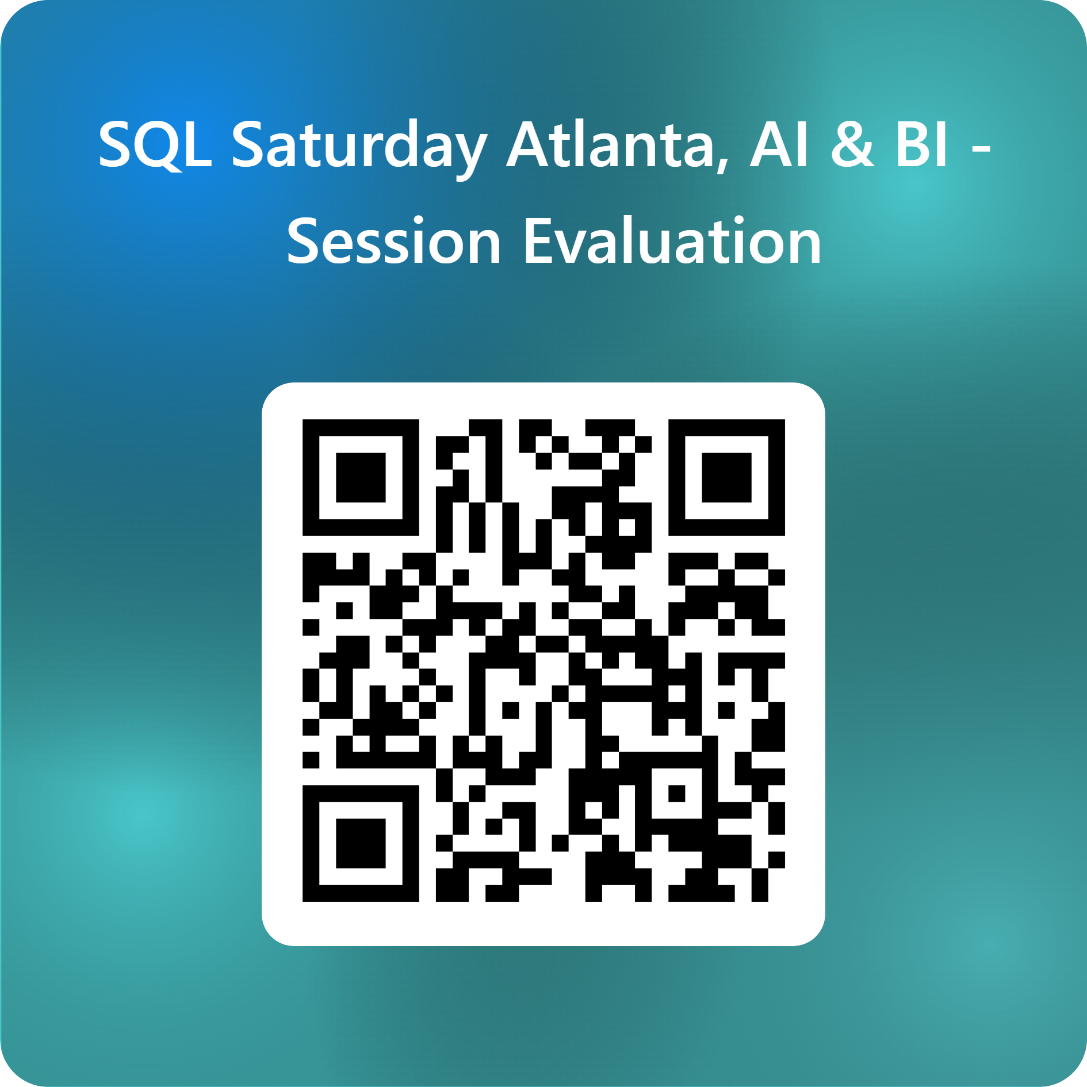
Session Evaluations
SQL Saturday Atlanta 2026 • AI & BI
2
Notes:
[Sources]
- Conference title, event date, and location are based on the official SQL Saturday Atlanta 2026 event page: https://sqlsaturday.com/2026-03-21-sqlsaturday1127/
- Color palette is derived from the user-provided logo image in this conversation.

Slide 65





Thank you
Jason Romans
thedaxshepherd@gmail.com
jason-r-sql-jar
https://thedaxshepherd.com/
@sql_jar
Contact Information
The Dax Shepherd

Slide 66
Session Eval

