Slide 1
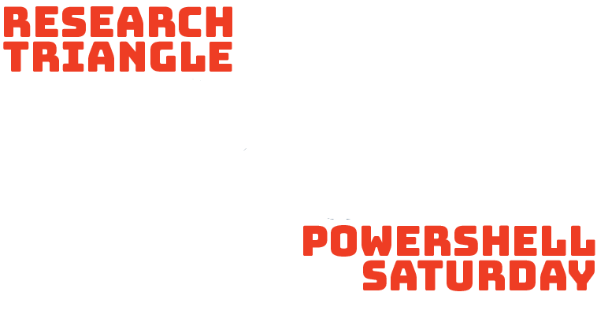
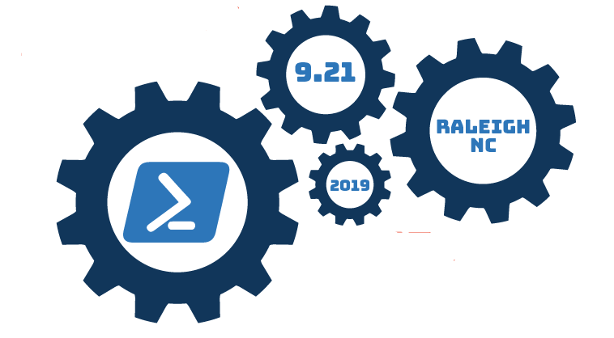
Crossing the Divide:
A System Administrator's Path to DevOps
Dave Carroll
PowerShell Developer
Twitter: @thedavecarroll
Blog: https://powershell.anovelidea.org
Notes:
Welcome to PowerShell Saturday.
The name of this session is Crossing the Divide: A System Administrator’s Path to DevOps.
I am Dave Carroll and I’ve been a systems administrator for over twenty years. This is my story.
In this session, we will examine the decades-old philosophical and cultural differences between operations and development. We will identify the DevOps guiding principles and will also examine the primary DevOps culture assessment framework and another organizational assessment methodology.
Throughout this session, we will briefly discuss some of the essential hard skills, soft skills, and tools that you will use on your own DevOps journey.
Thank you for attending PowerShell Saturday and thank you for choosing to spend the next forty to fifty minutes with me.

Slide 2
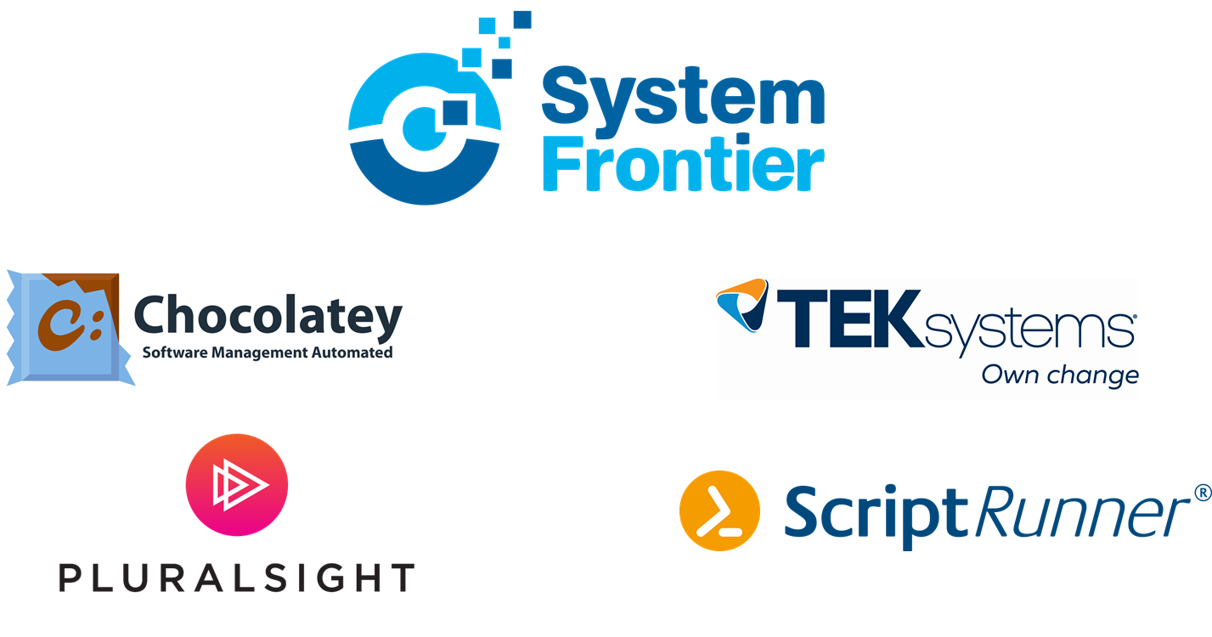
Thank You to Our Sponsors!
@thedavecarroll
Notes:
Before we begin, I want to say that PowerShell Saturday couldn’t happen without people like you.
And it couldn’t happen without sponsors such as System Frontier, Chocolatey, TEKSystems, Pluralsight, and ScriptRunner. They are leaders in the industry, and they want to make your technical lives easier by helping you to work smarter and be smarter.
Please check out their booths when you have some time.

Slide 3
Who Am I
@thedavecarroll
Notes:
Before we can get to the really cool stuff, you should know where my career began and the course that it has taken over the last 24 years.
Since typing a balloon game written in C64 BASIC out of a magazine into my Commodore in the early 80’s, I knew that technology would be a significant part of my life.
I had the C64, then later an Apple IIc. I had an NEC Multispeed laptop in college where I was a computer lab assistant for a couple semesters. The transition from a small town to college didn’t go smoothly, and I dropped out after losing two scholarships.
I had several jobs in fast food until I got tired of the everyday stress and started looking for a job in computers.
My first real computer job was working at a small, Mom and Pop computer store. We repaired and sold PCs and peripherals. We installed networks and setup servers. During my time there, I got my A+ certification, downloaded drivers from vendor BBS’s, and a bunch of other things. It was also the first time that I saw software development firsthand. The owner, a retired telecom engineer, wrote an application for one of our customers in FoxPro.
Since then, I’ve worked for an engineering firm, a community college, and a major university in Southern California. My last 2 years there, I lead a team of 3 system engineers that deployed developer applications to production. When I moved back to Tennessee, I worked for a national medical gas company, and now, a global bank.
In most of the positions, I wore multiple hats. If something needed to be done, I taught myself how to do it and then I did it. For instance, I wrote a homebrew identity management solution using Active Directory, PowerShell, Oracle SQL, and SunOne LDAP with a Linux/Apache/PHP web front end for students and support staff. I became a Jack-of-All-Trades, a widely skilled general technologist with a few deep skills.
For over half of my career, I called myself a systems administrator or engineer. Beginning this year, I started calling myself a PowerShell Developer, because that’s what I am.
How do you label yourself?
With a show of hands:
System Administrator or System Engineer
Application Developer
DevOps Engineer

Slide 4
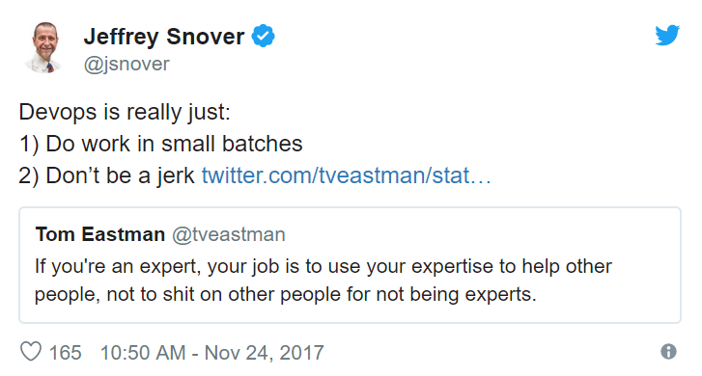
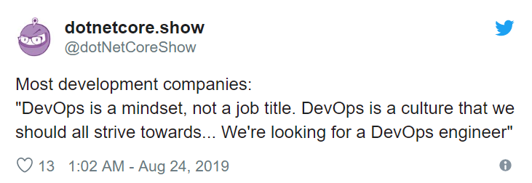
What is DevOps?
Notes:
And what does a DevOps Engineer do day-to-day?
What does DevOps really mean?
For the last question, for every 10 people you ask, you could get 12 or more different responses. It’s not because they don’t know the definition of DevOps, it’s because the definition is subjective. It means something different to virtually everyone.
One of Jeffrey Snover’s Twitter quotes that I like a lot is this:
“DevOps is really just:
do work in small batches and
don't be a jerk”
DevOps is a framework, a set of practices and principles that focuses on the rapid release of applications into production and the care and feeding of them throughout their lifecycle. It’s about having all the necessary skills required to do this and the collaboration between team members and other teams.
“You build it, you run it” - Werner Vogels, Amazon CTO
DevOps starts as a mindset which turns to habits which eventually forms a culture.

Slide 5
History of DevOps
2008 Agile Conference in Toronto
2009 O’Reilly Velocity Conference
“DevOps” coined by Patrick Debois for first DevOpsDays
Ideas spread through social media
The Phoenix Project
Notes:
I had no idea what DevOps really was, and up until a couple years ago, I guess I didn’t care as it was not on my radar.
When I moved back to Tennessee, a lot of open jobs mentioned DevOps, even more so last year when I needed to escape a toxic culture and find a new job. I made note of it, but at the time, I was sure that I wanted to focus on Active Directory, identity management, and, of course, PowerShell.
But when I started blogging on PowerShell and becoming active in the online community, I realized that DevOps was something that I needed to learn more about.
I had the pleasure of attending a local DevOpsDays conference this year, and I was impressed. Not just with the technology, but with the openness and friendliness of the presenters and the attendees. I’m sure most everyone were introverts, but they were talking. And I found myself talking to others as well.
In the few months since the conference that I learned that it was the 10th anniversary for DevOpsDays.
I also learned that, in the 2008 Agile Conference in Toronto, Andrew Shafer held a “birds-of-a-feather” session called “Agile Infrastructure”. Only one person attended, Patrick Debois, a Belgium consultant. He was frustrated dealing with the walls of separation between dev and ops.
At the O’Reilly Velocity Conference 2009, John Allspaw and Paul Hammond gave their presentation called “10+ Deploys per Day: Dev and Ops Cooperation at Flickr”. Debois streamed this and was inspired. He coined the term DevOps when he organized the first DevOpsDays in Ghent, Belgium in 2009.
What is telling is that several people across the globe were coming to the same conclusion – there had to be a better way. They may have met face-to-face, but the reality is that they shared ideas on social media (I think Twitter was the predominant service) and individual tech blogs. They gave each other confidence that the idea of developers and system administrators could work side-by-side to deploy faster and more resilient services.
I don’t recall who suggested that I read The Phoenix Project, but I’m glad I did. The ideas that it shared through a fictional narrative using the Socratic method helped change my mindset and was my turning point in understanding what a DevOps culture could achieve.

Slide 6
The Chasm of IT, aka the Divide
Developers vs Operations
Us vs Them
Wall of Confusion
Notes:
How many times have you heard something like these statements?
Developers just don't care about security.
The systems team is a roadblock. They were supposed to build that VM over a month ago.
We'll never get to zero downtime deployments. They must have lost their minds.
These statements often solicit visceral reactions from developers and system administrators.
In the beginning, however, developers and sysadmins were basically the same person. Especially on early Unix systems, where you had to compile the programs you wanted to run or do without.
The more operating systems and programming languages evolved, the more the duties between the two halves diverged until you have the Dev vs Ops, Us vs Them.
And that has been the status quo for decades. Now, sometimes, the warring factions team up against auditors or security teams, but by-and-large, they were fully entrenched in their defense against the other.
The daily work that each faction does is usually in a black box that the other faction cannot decode.
When one team requests something from the other, they often refer to it as “throwing it over the wall”. Andrew Shafer called this barrier the “wall of confusion”.
The biggest challenge for me has been the shift in mindset. And for others and organizations, this is one of the most significant challenges to overcome on the path to DevOps.

Slide 7
DevOps Guiding Principles - The Three Ways
Systems Thinking
Amplify Feedback Loops
Continual Experimentation and Learning
Notes:
Gene Kim, co-author of the Phoenix Project and other DevOps books, developed The Three Ways which he wanted to use as the guiding principles of DevOps.
Systems Thinking
Focus on the performance for the entire system, not just individual components.
Amplify Feedback Loops
In order to improve the performance of the process, the upstream components must provide feedback to downstream components. Right to left feedback loops are created.
Continual Experimentation and Learning
Fosters risk taking and learning from mistakes.
Repetition and practice are required for mastery.

Slide 8
DevOps Culture Assessment – CALMS
Culture of Collaboration
Visualize work in progress (WIP)
Limit batch sizes
Manage queue lengths
Quick feedback
Automation, automation, automation
Goal of continuous delivery
PowerShell
Pipeline
Shared responsibility
Not “us” vs “them”
Common goal
Encourage communications between development and operations
Documentation
Trust
Distrust must go!
Measure all the things!
Visibility into all systems
Observability
Automation
Lean
Metrics
Sharing
Notes:
You can assess the DevOps culture of your organization by a couple different methods.
The primary method is the CALMS framework.
Collaboration
There is a culture of shared responsibility. Trust has to be regained. It’s not Us vs Them, it’s just Us.
Automation
Team members seek out ways to automate as many tasks as possible and must be comfortable with the idea of continuous delivery.
Lean
Team members can visualize work in progress (WIP), limit batch sizes and manage queue lengths.
Quick feedback is critical.
Metrics
Data is collected on everything and there are mechanisms in place that provide visibility into all systems.
Sharing
User-friendly communication channels that encourage ongoing communication between development and operations.

Slide 9
Collaboration
One Goal
2 Pizza Rule - Amazon
We are all in this together
People > Process > Tools
Notes:
Collaboration begins with a small team focusing on a single goal. That goal is normally a product or application, but it could also be just a feature of either.
Before DevOps, a project team would own the product until deployment where it’s handed off to the operations team which maintains it until they leave the company. Because, let’s face it, technical debt grows for a reason.
With DevOps, the team owns the product from the start and maintains it during its complete lifecycle.
Speaking of a DevOps team, how big should that be?
Jeff Bezos of Amazon instituted a “2 pizza rule” which states the optimum size for an individual team should be determined by how many people 2 pizzas can feed. Typically this is about 8.
Ironically, I learned teamwork by working at a pizza place after college. Always put the customer first. And then working in the small IT teams when I first started in my career, the focus was also the end-user. We would work together, most of the time, to install or repair whatever was needed. One time, however, a team of 12 that included sysadmins and developers was split and the systems team (that I was on) started reporting to a different VP. That shows you how much a toxic manager can impact a team.
Just remember, we are all in this together and we need to focus on the same goal.
People > Process > Tools
The People must change first. Then the Process can change. The tools like AWS Beanstalk or whatever, will NOT make a team DevOps.

Slide 10
Automation – Tools
Source Control
Scripting Languages
Just-in-Time Infrastructure, aka Agile Infrastructure
Configuration Management
Testing
CI/CD Pipeline
Notes:
The goal of automation is continuous delivery.
End-to-end automation is usually triggered via source control commits, which use scripting languages and configuration management tools that tests code and pushes it through the deployment pipeline. Eventually, the application or artifacts are delivered and/or deployed to production assuming all the tests have passed. Ideally, this includes standing up a pristine testing environment in which to deploy the code to test.
There are a tremendous amount of tools that can help with automation, and it seems like more are added every day.

Slide 11
Automation – Source Control
Git
Subversion (SVN)
Mercurial
GitHub
GitLab
BitBucket
Azure DevOps Repos
AWS CodeCommit
Google Cloud Source Repo
Notes:
Let’s talk source control.
Where do you currently store your PowerShell scripts?
Do they have filenames with v2, v3, or timestamps in them?
Can you easily revert to previous versions?
How do you handle multiple team members updating complex scripts?
You need source control. I wished I had seen the multiple benefits of it sooner.
There are several source control types, with the 3 most widely used being git, subversion (or svn), and mercurial.
I’ve worked in shops that have used git, which uses decentralized repositories, and subversion, which is centralized.
I’ve been using git myself since March of last year. I don’t know why it took me so long to get on the bandwagon. A few developers tried their best to get me onboard when I worked at UCSB.
Though git is decentralized, there are many cloud or self hosted web-based services that shares git repositories with code maintainers. Others can fork a repo, creating their own copy of the repo, create a feature branch in which they will add their own code to the repo, and then create a pull request upstream for the repo’s owner to either merge or reject.

Slide 12
Automation – Scripting Languages
PowerShell
XML
Python
JSON
Go (GoLang)
YAML
Ruby
Notes:
I’m not going to spend a lot of time on scripting languages. We all should know about the big players, like PowerShell (duh) and Python, Go, and Ruby.
In DevOps though, you should really be proficient in at least two of these.
Though not scripting languages, I want to mention a few file types. Most of you have seen XML and JSON. We have PowerShell cmdlets to Convert or Export/Import them.
YAML, or yet another markup language, is used a lot in the CI pipeline. We will talk more about this one a little later.

Slide 13
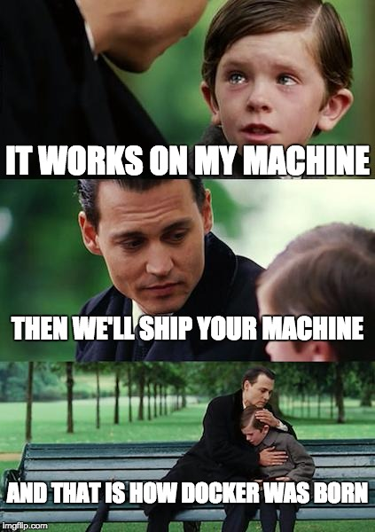
Automation – Just-in-Time Infrastructure
Containerization
Docker
Vagrant
Red Hat OpenShift
Infrastructure as Code (IaC)
AWS – CloudFormation
Azure ARM Templates
Terraform
PowerShell Modules
AutomatedLab
Lab Builder
Orchestration Engines
Kubernetes
Docker Swarm
Notes:
Just-in-Time Infrastructure, or Agile Infrastructure
Describes tightly integrated infrastructure – networks, servers, storage, and security – that can be easily scaled up or scaled down.
This essentially is the cloud slider that allows you to increase or decreases resources.
It starts with Infrastructure as Code (IaC), typically with cloud providers, though there are several private cloud solutions.
Lab environments could also be provisioned using either of these PowerShell modules.
Within your provider, you could further containers, such as Docker or Vagrant. Containers are specialized VM’s which come fully assembled and can be provisioned and discarded easily. Unless you provide access to external resources like a database or a volume, when the container is deprovisioned, everything contained within it would be removed as well.
To manage the container environment, you use orchestration engines such as the Kubernetes.

Slide 14
Automation – Configuration Management
PowerShell Desired State Configuration (DSC)
Puppet
Chef
Ansible
Terraform
Notes:
Now that you have can easily provision and deprovision your required infrastructure, you need some tool that allows you to configure these containers or full VMs.
If they are Windows based, you can use PowerShell Desired State Configuration (DSC) to enforce a specific configuration.
You can also use Puppet, which is a Ruby based.
You can also use Chef, Ansible, or Terraform.

Slide 15
Automation – Testing
Unit
Integration
System
Acceptance
Pester
PSScriptAnalyzer
Linters
Notes:
In order to ensure quality, code must be tested.
Typically, you would have unit tests which test specific pieces of code, such as a function. The type of tests could be white or black box, depending on how you write your tests.
You would then have integration tests which validate that the components interface with each other correctly. This requires white and black box testing.
System tests validate functionality of all the components. It also includes performance, usability, security, and scalability tests. It’s entirely black box testing since you are testing the functional requirements.
Lastly, you have user acceptance testing which gets the application in front of actual users. Sometimes this can be handled by a separate test environment, or it could be handled by rolling out to a subset of users based on feature flags or other audience selection methods.
In the PowerShell world Pester and PSScriptAnalyzer are the two primary methods for testing.
Pester tests can be written for unit, integration, and system testing. You can even test module metadata and the help files.
PSScriptAnalyzer can ensure you are using best practices for your PowerShell code.
Programs (or scripts) like PSScriptAnalyzer that check code for consistency are called linters and the process of checking code is called linting.

Slide 16
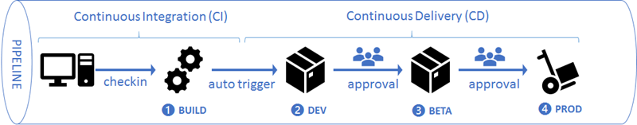
Automation – CI/CD Pipeline
Jenkins
TravisCI
TeamCity
Azure DevOps
AppVeyor
GitHub Actions (beta)
AWS CodeBuild
AWS CodePipeline
Others
Notes:
Continuous integration involves checking in code and having it validated through testing.
Continuous delivery takes this code and saves the executables or scripts, called releases, to a central location.
Continuous deployment takes the releases and pushes them into test or production environments.
There are several CI/CD products available.
Jenkins
Azure DevOps
TravisCI
TeamCity
AppVeyor
GitHub Actions (still in beta)
AWS CodeBuild and AWS CodePipeline
A fully automated CI/CD pipeline is the goal. It provides the fastest way from code to release to deployment.

Slide 17
Lean
Identify and protect constraints
Goal is to eliminate all constraints
Provide feedback loop
Prevent low quality from progressing
TPS
No, not TPS Reports
Respect for People
Make all work visible
Kanban Board
Small batches
Manage Queue Lengths
Online Kanban Tools
Trello
Azure DevOps Project Board
GitHub Project
Kanbanize
Blossom
ProjectManager.com
Continuous Improvement
Notes:
The CALMS assessment component of Lean comes largely from the Toyota Production System, created by Taiichi Ohno.

Slide 18
Metrics
Measure all the things!
Build visibility into systems.
Application Performance Monitoring (APM)
aka tracing.
Log analytics and management.
Notes:
Measure all the things!
Build visibility into systems.
Application Performance Monitoring (APM), otherwise called tracing.
Log analytics and management.

Slide 19
Sharing
Documentation
Markdown
Consistent location
Properly versioned
Presentations
Blogging
Meetups, ignites, lightning, BOF
Notes:
The final part of the CALMS framework is Sharing.
Share your knowledge. Share your journey.
You don’t have to be foremost authority on a topic. There will always be someone that knows less that you, and someone that knows more than you. Always.
One of the downfalls that easily happens to us all is being too busy to document completely.
Markdown is a relatively simple way to create documentation using text-based indicators for headings, emphasis, tables, hyperlinks, and other text formatting. There are several flavors for markdown, but they are largely interchangeable. For instance, Leanpub uses their own implementation and GitHub has their own.
You can use the PowerShell platyPS module to turn markdown into an external help file for a module.
Simply having documentation is not enough. You must be able to find the documentation when you are looking for it.
In the middle of outage, you shouldn’t be desperately hunting documentation on troubleshooting or even design documents. And when you do find it, how can you be sure that it is the latest?
In my last job, I created a repo in our internal GitLab instance for documentation. Everyone could see the latest and greatest. And they could see what I changed.
Use something centralized with proper versioning. Whether it’s GitLab, GitHub, wikis, or Sharepoint, pick something and begin using it. And please don’t upload Word docs with filenames that have timestamps or versioning. If you want to use Word, use the built-in version tracking. Please.
Another way to share is through presentations. That’s one of the reasons you are here today.
You can also blog your adventures in PowerShell or your own journey to DevOps. Your approach to a topic may provide someone else with the aha! moment.
Lastly, by attending meetups or ignites or birds-of-a-feather mini-sessions, you can help each other overcome issues or learn something new.

Slide 20
DevOps Culture Assessment – Westrum Typology
Performance-Oriented
Focuses on mission/goal
Messengers trained
Crossing silos encouraged
Risks are shared
Experimentation encouraged
DevOps Friendly
Rule-Oriented
Protects departments
Messengers ignored
Crossing silos okay, maybe
Maintain turf or fiefdoms
Do things by the book
Pathological
Bureaucratic
Generative
Power-Oriented
Failure is NOT an option
Shoot the messenger
Maintain silos
Lead by fear or threat
Notes:
Dr. Ron Westrum, a renowned sociologist, published the paper, “A Typology of Organisational Cultures” in 2004. In it, he states “…[an organizational] culture is the organization’s pattern of response to the problems and opportunities it encounters”.
The Three Cultures Model is separated into the following types:
Pathological - Power-oriented
Bureaucratic - Rule-oriented
Generative - Performance-oriented
The Generative type aligns itself with a DevOps culture.

Slide 21
DORA State of DevOps 2019
Key Findings
The best strategies for scaling DevOps in organizations focus on structural solutions that build community.
The industry continues to improve, particularly among the elite performers.
There’s a right way to handle the change approval process, and it leads to improvements in speed and stability and reductions in burnout.
Productivity can drive improvements in work/life balance and reductions in burnout, and organizations can make smart investments to support it.
Cloud continues to be a differentiator for elite performers and drives high performance.
Delivering software quickly, reliably, and safely is at the heart of technology transformation and organizational performance.
Notes:
DevOps Research and Assessment produces a yearly “State of DevOps” Report.

Slide 22
DORA State of DevOps 2019
Key Metrics
Lead time for changes
Deployment frequency
Time to restore service
Change failure rate
106x Faster
208x More
2604X Faster Recovery
7x Lower Failure
Notes:
Key Metrics as defined by DORA, DevOps Research and Assessment
Lead time for changes, from commit to deploy
Deployment frequency
Time to restore service
Change failure rate

Slide 23
Soft Skills
Soft skills are important!
Learn how to communicate (including listening)
People (Dev and Ops) are human, fueled by emotions and needs and prone to errors - let people be human!
Be sincere, genuine, and humble
Praise and reward accomplishments
Share your experience and knowledge
Notes:
Soft skills are just as important as hard skills, perhaps even more so, and should be nourished and cultivated.
Collaboration can only come from effective communication which comes from listening and understanding each other.
Knowing that people are driven by emotions and needs, you must allow yourself and others to be human.
Be sincere and genuine when you offer to help others achieve their goals; remember the times when someone helped you. Lead others with integrity and humility by your side while praising and rewarding their accomplishments.
Share your experience and knowledge so others may be inspired and empowered to accomplish big things, too.
Watch Twitter for announcements on the PowerShell Conference book, volume 2 for my chapter on soft skills.

Slide 24
Summary
“DevOps is not a Goal, But a never-ending process of continual improvement” – Jez Humble
“DevOps is not a trend, and will eventually be the standard way of software development and operations, offering everyone a better quality of life.” – DORA State of DevOps 2019
“Plan for unplanned work.” – Dominica DeGrandis
To begin your journey to a DevOps future, you need:
Proficiency in multiple scripting languages
Everyday use of source control
Adopt a continuous improvement mindset
Continuously improve your skills
Effective communication
Notes:
Crossing the divide
Most importantly, you need to adapt to the open - we’re all in this together, it’s everyone’s job - culture.

Slide 25
Questions

