Slide 1
Polls
Do you want to learn about them? Please respond with YES or NO

Slide 2
CaPaBLe
Report written for UNICEF Madagascar, outline fundamental methods of SMS communication
Collect – collect structured data from a trained user
Poll – collect simple data from an untrained user
Broadcast – mass texting for information dissemination
Listen – accept and monitor unsolicited messages

Slide 3
rapidsms-polls
Simple question, simple answer
4 built-in types
  Free-form text
  Numeric
  Location-based
  Registration (automated mapping to user name)
Automatic categorization for free-form text, based on regular expressions
Yes/No polls are a special case of free-form text with built-in regex categories for yes and no
Custom poll types possible

Slide 4
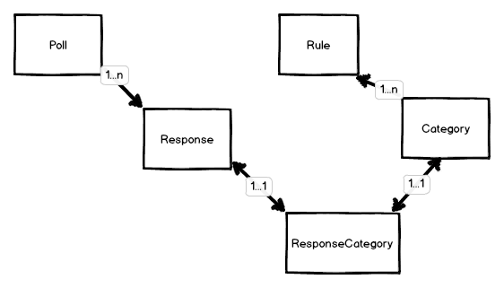
rapidsms-polls object model

Slide 5
IGReport fallthrough configuration
igreport app first: unless already involved in a script, add the user to the corruption hotline script
script second: if the user has an active script session, use this incoming message as a script response
poll third: if the user is a participant in an open poll, their message is a poll response
xforms (when used) is fourth: it handles any structured message when the user isn’t involved in any free-form interaction
SMS_APPS = [
"igreport",
"script",
"poll",
# ”rapidsms_xforms”,
]

Slide 6
Poll app logic
Lookup the incoming message’s connection’s contact
Is the contact a participant in a poll that is open?
Find the most recently-opened poll, and attribute the message as a response to that poll
If no open polls are found for this contact, return false

Slide 7
Poll Response Logic
RESPONSE_TYPE_ALL – a contact can submit as many responses as they like, each one counts
RESPONSE_TYPE_ONE – the first response that a contact submits is the only one that counts towards poll stats
RESPONSE_TYPE_NO_DUPS – the contact can submit as many responses as they like, but only unique responses count

Slide 8
Poll instance methods
poll.start() – create outgoing messages to all participants, mark the poll as started and open
poll.end() – close the poll
poll.reprocess_responses() – re-proess all responses based on new categories
poll.process_response() – process a new incoming message
poll.add_yesno_categories() – add categories to a freeform poll to make it a yes/no poll

Slide 9
Custom poll types
Poll.register_poll_type(
’m',
’MyModel',
parse_mymodel_value,
db_type=Attribute.TYPE_OBJECT,
view_template=’row.html',
edit_template=’editrow.html',
report_columns=
(('Original Text', 'text’)),
edit_form=’myapp.EditForm')

