Slide 1
Script
When one poll just isn’t enough

Slide 2
CaPaBLe
Report written for UNICEF Madagascar, outline fundamental methods of SMS communication
Collect – collect structured data from a trained user
Script is Collect for the untrained user
  Collect uses a single coded message: “user=david account=1234 balance=100.0”
  Script uses a series of questions and answers to gather several pieces of information that are tied together

Slide 3
rapidsms-script
Script is a LINEAR progression of questions, and a set of rules governing how to move from one step to the next
Script uses rapidsms-polls to ask its questions, but can also send static messages, as well as emails
Script is NOT a state machine: signals are emitted at each step transition to allow custom branching and jumping logic between steps
Signals are also emitted upon script completion, allowing for creation of reporting objects based on script responses

Slide 4
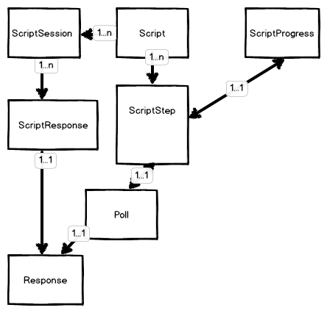
rapidsms-script object model

Slide 5
Entry into a script
Not automatic
In U-Report, any new Connection that doesn’t have a Contact is placed into a Script
In IGReport, any Connection that isn’t already in a Script is placed into a script
ScriptProgress.objects.create(
script=Script.objects.get(slug=‘slug'),
connection=message.connection)

Slide 6
Script Step transitions
LENIENT – any answer will do
STRICT – only valid answers allowed
STRICT_MOVEON – give the user n tries for a valid answer, then move to next question
STRICT_GIVEUP – give the user n tries for a valid answer, then drop the script
WAIT_MOVEON – wait for n seconds for any response then move to the next strip
WAIT_GIVEUP – wait for n seconds then drop the script
RESEND_MOVEON – resend the question n times then move to the next step
RESEND_GIVEUP – resend the question n times then drop the script

Slide 7
Script Step Signals
from script.signals import
script_progress
def transition(**kwargs):
connection = kwargs['connection']
script_progress = kwargs['sender']
script_progress.connect(
transition, weak=False)

Slide 8
Script Completed Signals
from script.signals import
script_progress_was_completed
def finish(**kwargs):
connection = kwargs['connection']
progress = kwargs['sender']
script_progress_was_completed.connect(
finish,
weak=False)

Slide 9
Script Handling Utilities
Find_best_response – looks for the most recent response to a particular poll that is valid
customer_poll = Poll.objects.get(
scriptstep__script__slug=’script',
name=’customer')
Report.customer_name = find_best_response(
session,
customer_poll)
find_closest_match – uses a difflib to fuzzy match a text response to a full object based on its ‘name’ attribute
find_closest_match(
report.customer,
Customer.objects.all())

