Slide 1
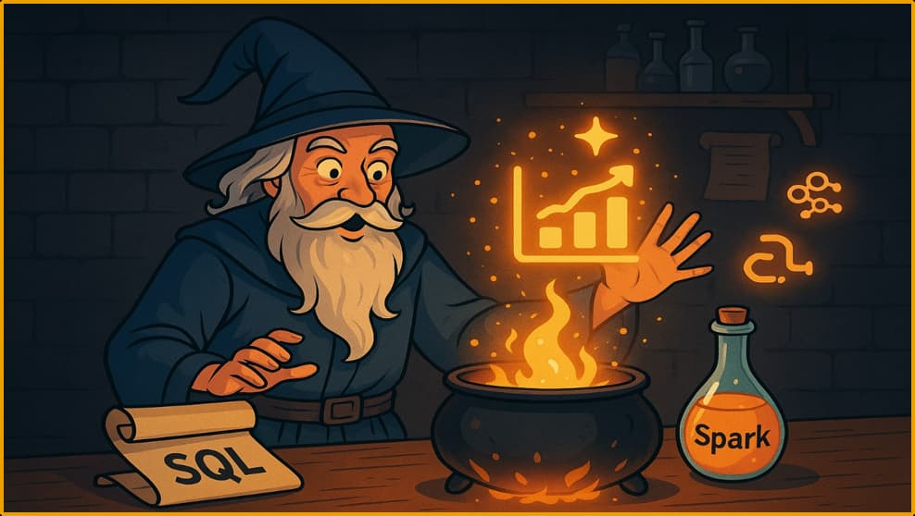
Data on Fire
A Hands-On Intro to Spark in Fabric
Baton Rouge Day of Data • 2026

Slide 2
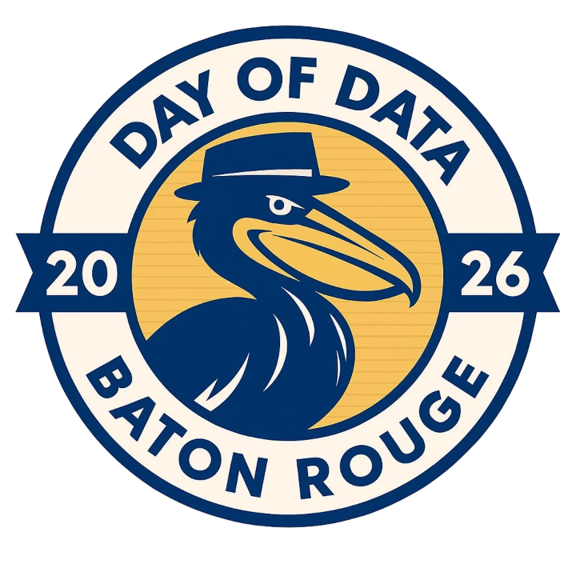

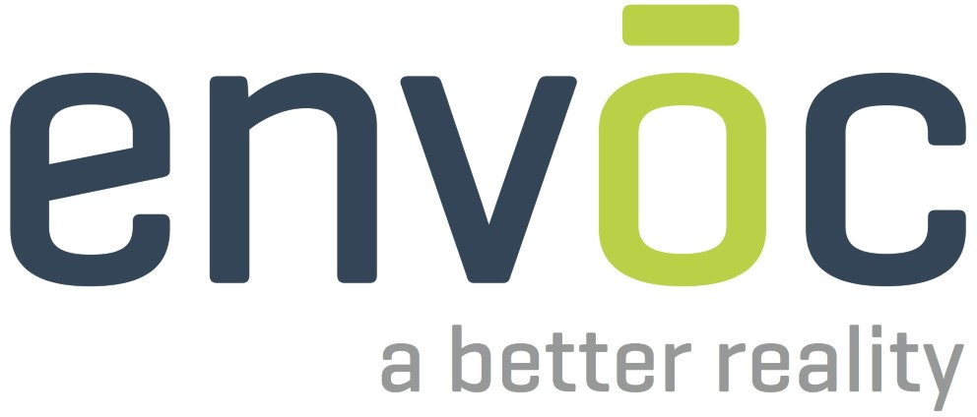





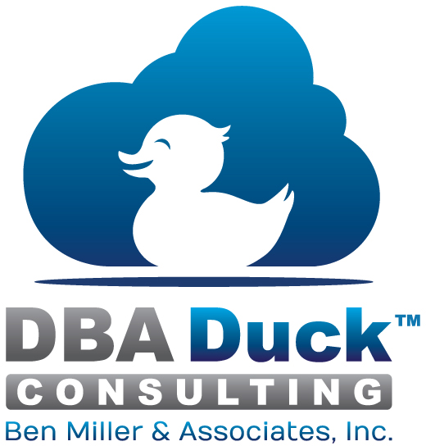










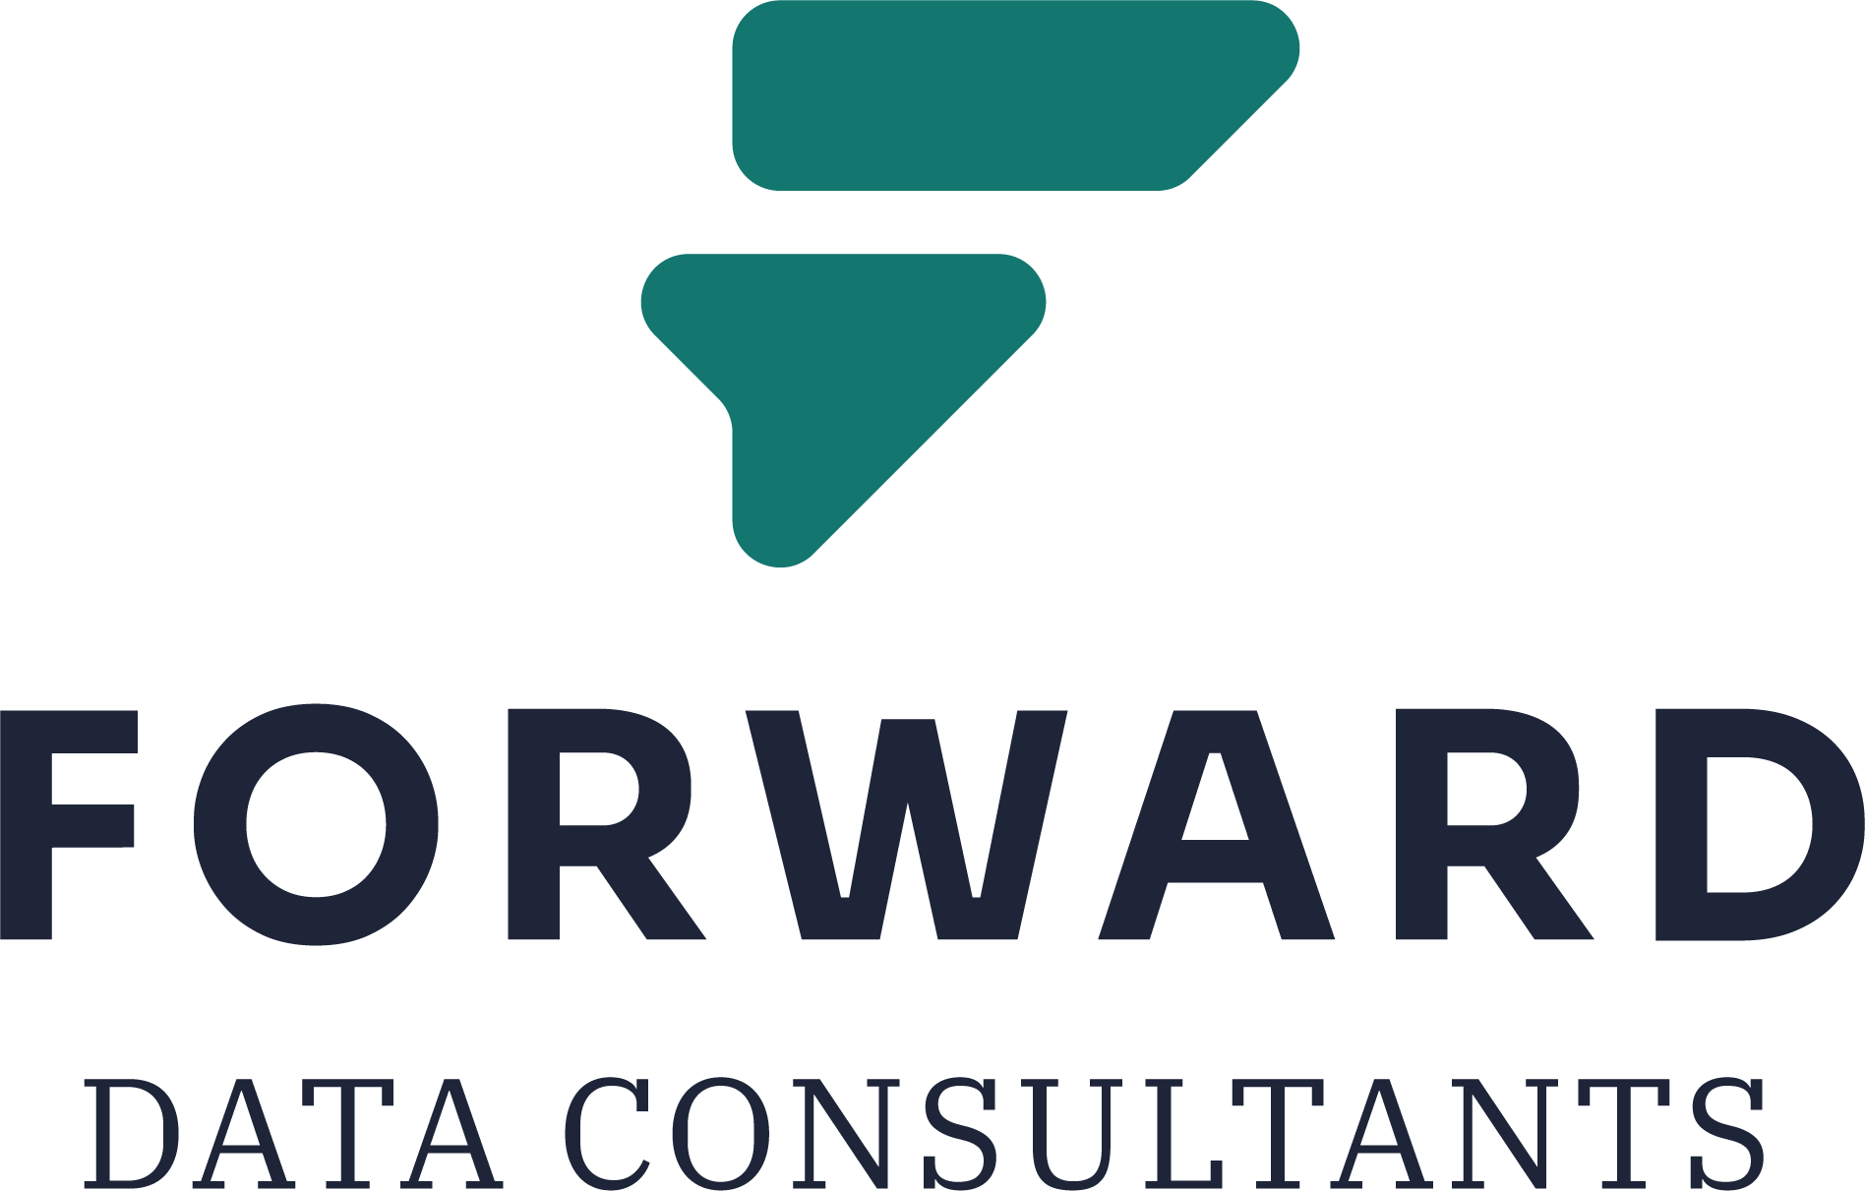
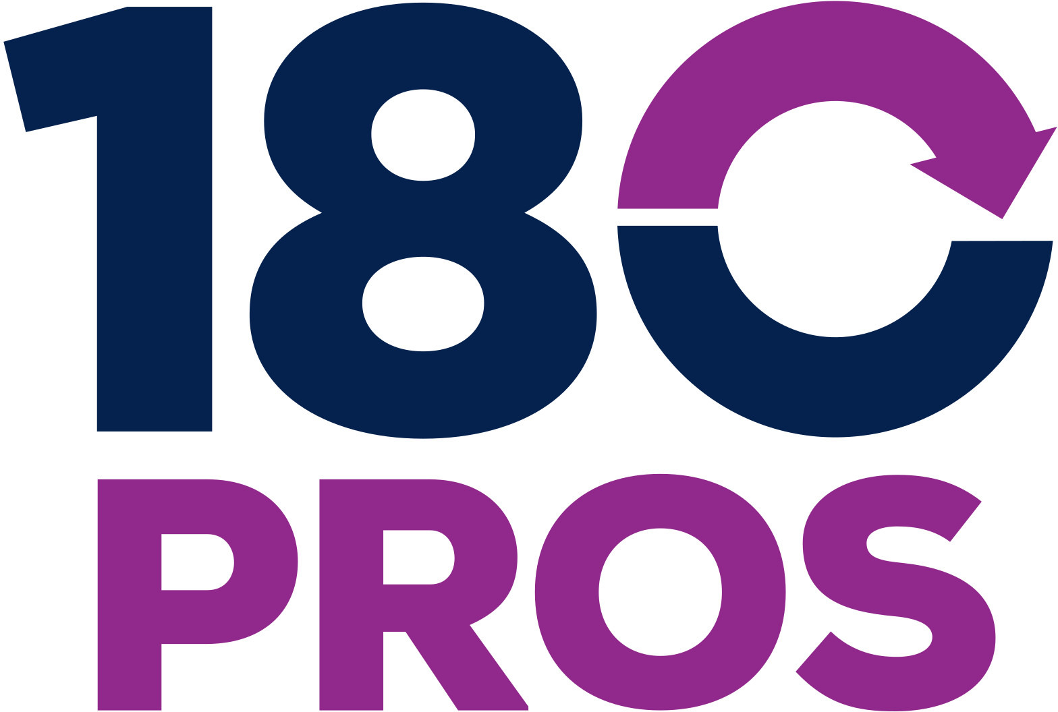


Day of Data Baton Rouge 2026
Thank You, Sponsors!

Slide 3
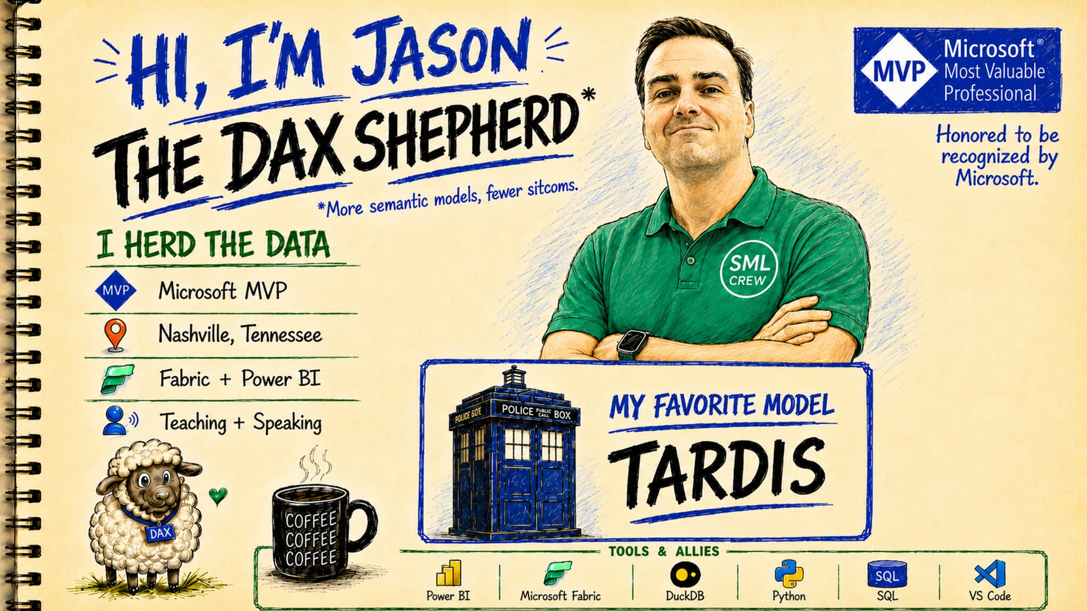

Slide 4
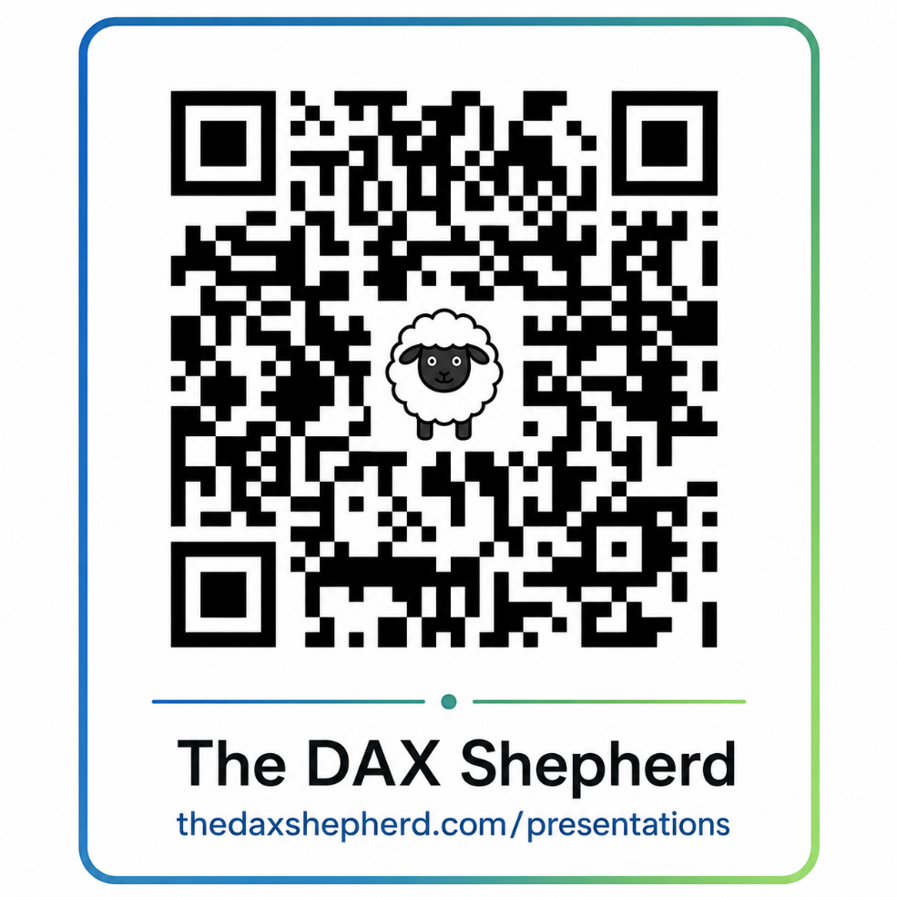
TAKE THIS WITH YOU
DOWNLOAD THIS
PRESENTATION
All slides, resources, and demo files available:
THE DAX SHEPHERD
thedaxshepherd.com/presentations

Slide 5

Standing on the
Shoulders of Giants
Grateful for the people who share their knowledge, encourage us, answer questions, and help the rest of us learn faster.
Photo credit: Unknown Author, CC BY-ND

Slide 6
What We'll Cover
Section 1 / 5
1
Foundations
Spark's origins and the Fabric architecture we'll build on
YOU ARE HERE
2
Python Basics
What you need to know before Spark makes sense
3
PySpark Basics
DataFrames, transforms & actions
4
Putting PySpark to Work
A live notebook demo, real-world results.
5
Wrap-Up
Recap, resources & next steps

Slide 7
What We'll Cover
Section 2 / 5
1
Foundations
Spark's origins and the Fabric architecture we'll build on
2
Python Basics
What you need to know before Spark makes sense
YOU ARE HERE
3
PySpark Basics
DataFrames, transforms & actions
4
Putting PySpark to Work
A live notebook demo, real-world results.
5
Wrap-Up
Recap, resources & next steps

Slide 8
What We'll Cover
Section 3 / 5
1
Foundations
Spark's origins and the Fabric architecture we'll build on
2
Python Basics
What you need to know before Spark makes sense
3
PySpark Basics
DataFrames, transforms & actions
YOU ARE HERE
4
Putting PySpark to Work
A live notebook demo, real-world results.
5
Wrap-Up
Recap, resources & next steps

Slide 9
What We'll Cover
Section 4 / 5
1
Foundations
Spark's origins and the Fabric architecture we'll build on
2
Python Basics
What you need to know before Spark makes sense
3
PySpark Basics
DataFrames, transforms & actions
4
Putting PySpark to Work
A live notebook demo, real-world results.
YOU ARE HERE
5
Wrap-Up
Recap, resources & next steps

Slide 10
What We'll Cover
Section 5 / 5
1
Foundations
Spark's origins and the Fabric architecture we'll build on
2
Python Basics
What you need to know before Spark makes sense
3
PySpark Basics
DataFrames, transforms & actions
4
Putting PySpark to Work
A live notebook demo, real-world results.
5
Wrap-Up
Recap, resources & next steps
YOU ARE HERE

Slide 11
What We'll Cover
Section 1 / 5
1
Foundations
Spark's origins and the Fabric architecture we'll build on
YOU ARE HERE
2
Python Basics
What you need to know before Spark makes sense
3
PySpark Basics
DataFrames, transforms & actions
4
Putting PySpark to Work
A live notebook demo, real-world results.
5
Wrap-Up
Recap, resources & next steps

Slide 12
THE STORY OF SPARK · 1 of 3
The Netflix Prize
What lit the fire for Apache Spark?
Began October 2006
1
Goal: improve Netflix's Cinematch algorithm by at least 10%
2
Prize was $1 million
3
Took until 2009 to win
4

Slide 13
THE STORY OF SPARK · 2 of 3
Hadoop's Limits
Couldn't the Elephant* Help?
* Elephant = Hadoop
Hadoop wasn't built for ML — every iteration re-reads from disk
1
Iterative algorithms needed a faster execution model
2
The shift: keep data in-memory instead of writing to disk each pass
3
Like Analysis Services moving from Multidimensional to Tabular
4

Slide 14
THE STORY OF SPARK · 3 of 3
The 20-Minute Miss
Flashbacks of submitting homework digitally
Front runner: BellKor's Pragmatic Chaos
1
A merger of teams from AT&T Labs and Commendo Research
2
July 26, 2009 — two teams finally met the minimum requirements
3
The Ensemble (Spark) had the better score — but submitted 20 minutes too late
4

Slide 15
What is Powered by Spark
Microsoft Fabric
Azure Databricks
Azure Synapse Analytics
HDInsight
Amazon EMR · Google Dataproc · Snowflake
Plus thousands of in-house data platforms at Netflix, Uber, Pinterest, Shopify…

Slide 16

UP NEXT
Now let us install Spark

Slide 17
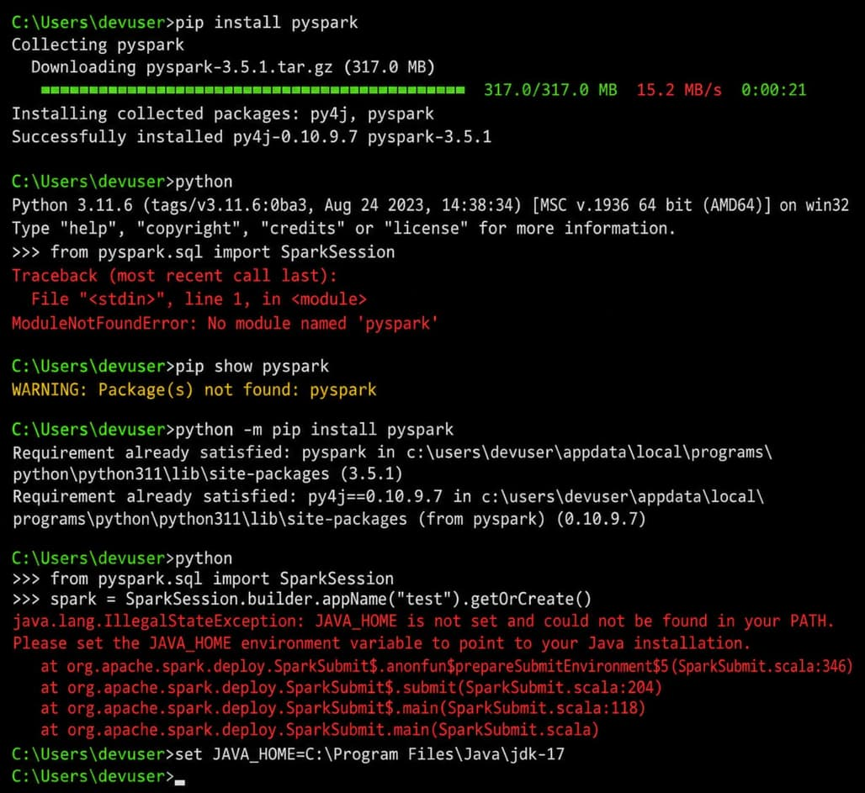
Installing Spark
Step 1 of 42

Slide 18
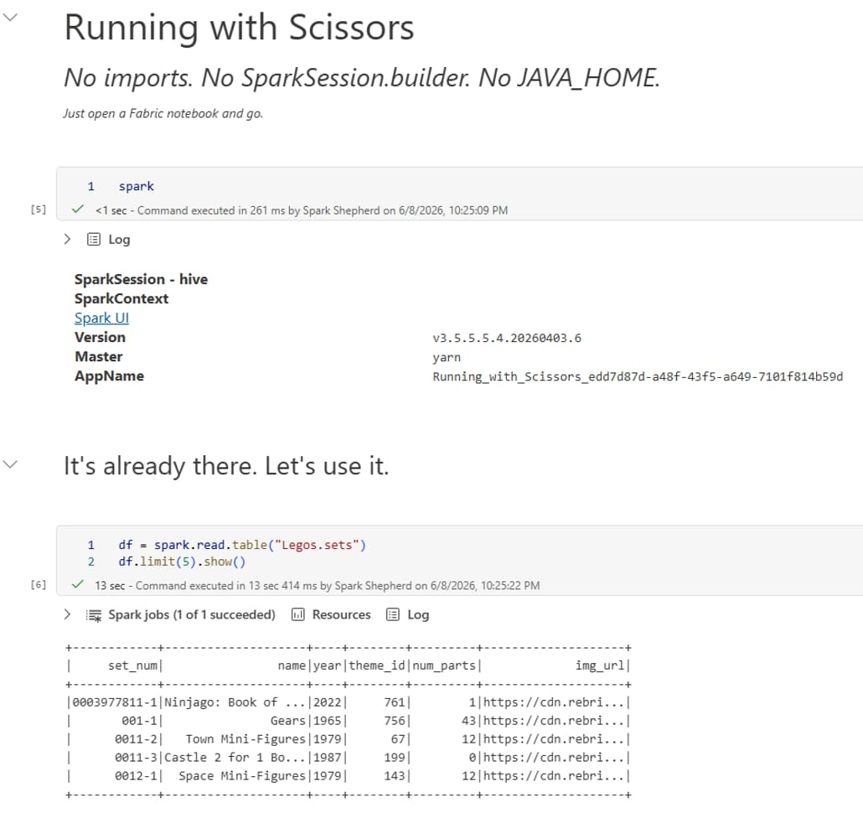
Wait! Microsoft Fabric makes this easy

Slide 19
Notebooks in Microsoft Fabric
Built for Microsoft Fabric.
The Spark fundamentals you'll learn are portable.

Slide 20
Fabric in Visual Studio Code
Familiar IDE
GitHub Copilot
Notebooks
Fabric compute
Stay in the editor your team already uses — no new tool to learn.
AI-assisted authoring for PySpark, SQL, and notebook code.
Author, run, and debug Fabric notebooks with full IDE features.
Connect to lakehouses and Spark pools running in Microsoft Fabric.

Slide 21
MICROSOFT FABRIC
Architecture at a glance
Data is stored in OneLake
One copy of your data, accessible by every Fabric experience
Lakehouse — two zones
Files/ unmanaged files (CSV, Parquet, JSON, …)
Tables/ managed Delta tables, queryable via SQL endpoint
Compute reads from OneLake
Spark notebooks, SQL endpoints, Power BI — all hit the same data
Open formats, no lock-in
Delta Lake + Parquet — readable by any tool that speaks them
Next slide: how all this fits together, visually.

Slide 22
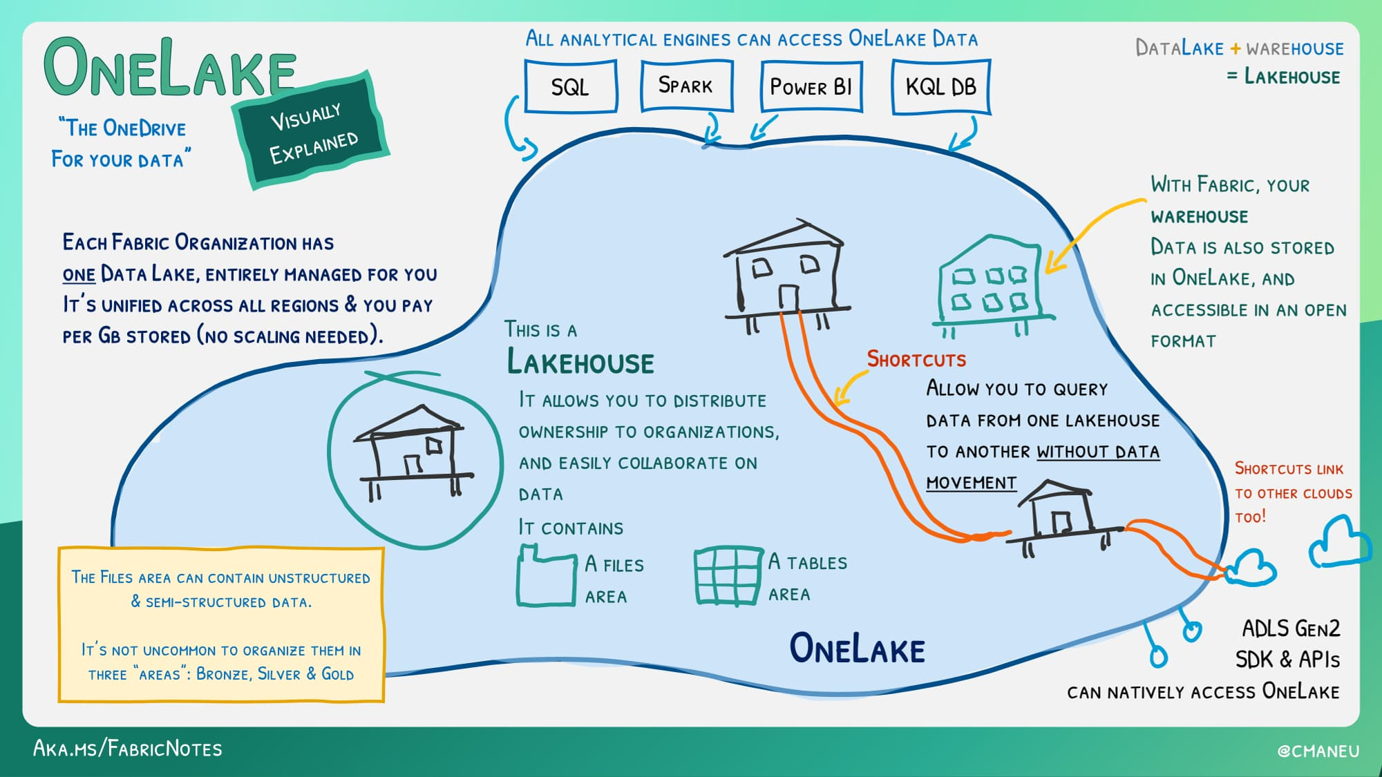
OneLake — “The OneDrive for Your Data”

Slide 23
Get Noticed in the Fabric Community
Browse the Fabric Notebook Gallery — community-shared Fabric notebooks
First Fabric Notebooks Competition (now closed)
Fabric Semantic Link Developer Experience Challenge (now closed)
Browse
Find a notebook in the Gallery that fits a need you have.
1
Build & Share
Solve a pain point and post your notebook to the community.
2
Compete
Watch for the next community challenge and showcase your work.
3

Slide 24
What We'll Cover
Section 2 / 5
1
Foundations
Spark's origins and the Fabric architecture we'll build on
2
Python Basics
What you need to know before Spark makes sense
YOU ARE HERE
3
PySpark Basics
DataFrames, transforms & actions
4
Putting PySpark to Work
A live notebook demo, real-world results.
5
Wrap-Up
Recap, resources & next steps

Slide 25
In Fabric, language choice is also engine choice
Not just syntax — you pick which compute engine runs against OneLake
Spark notebook / Lakehouse — Python, Scala, SparkSQL, or R on the Spark engine
Python notebook / Lakehouse — pure Python, no Spark
Warehouse — T-SQL on the Warehouse SQL engine
Same data. Different language. Different compute engine.

Slide 26
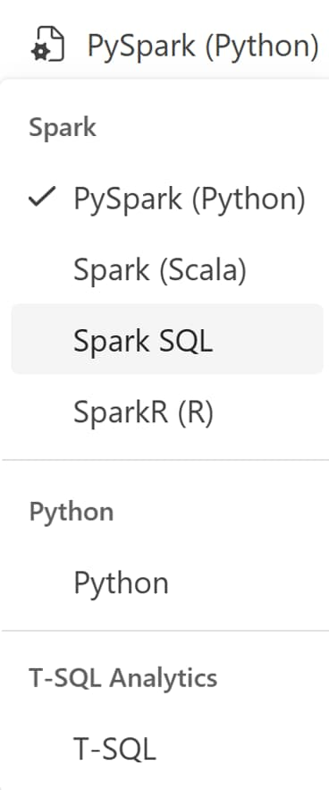
Compute & Language
Spark notebook / Lakehouse
Python, Scala, SparkSQL, R — runs on the Spark engine
Python notebook / Lakehouse
Pure Python — no Spark
Warehouse
T-SQL — runs on the Warehouse SQL engine

Slide 27
Python or PySpark notebook?
Pick Python notebook when…
Pick PySpark notebook when…
Data fits in memory (small to medium)
Rapid exploration & prototyping
Using DuckDB or Polars (pre-installed)
Lower cost, faster startup (default: 2 vCores, 16 GB RAM)
Large datasets (10GB+) exceeding memory
Complex ETL pipelines
High-concurrency or parallel execution
Need Spark APIs: MLlib, SparkSQL, Streaming
Source: Microsoft Learn — Fabric Notebook Selection Guide

Slide 28
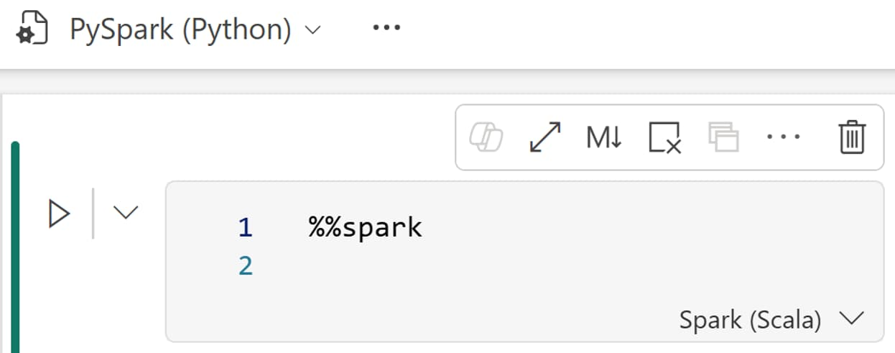
Magic commands — switch language per cell
Notebook language sets the default; cell magics override per cell
Magic command | Runs as
%%pyspark | Python
%%spark | Scala
%%sql | SparkSQL
%%sparkr | R
%%html | HTML

Slide 29
LIVE DEMO
Python Demo
*
* You’re welcome for this being an icon and not an actual snake

Slide 30
What We'll Cover
Section 3 / 5
1
Foundations
Spark's origins and the Fabric architecture we'll build on
2
Python Basics
What you need to know before Spark makes sense
3
PySpark Basics
DataFrames, transforms & actions
YOU ARE HERE
4
Putting PySpark to Work
A live notebook demo, real-world results.
5
Wrap-Up
Recap, resources & next steps

Slide 31
PySpark
Pandas
one machine
across the cluster
Like Pandas, but distributed

Slide 32
PySpark
Pandas
df = pd.read_parquet("sales.parquet")
(df.groupby("region")
.agg({"revenue": "sum"}))
The Python API for Spark. Write familiar DataFrame code; Spark splits the work across the cluster.
Same DataFrame API — scales from MBs to TBs
Lazy evaluation — Spark optimizes the full job before running
Native OneLake — read/write Delta tables directly
SparkSQL on the side — drop into SQL whenever you want
PySpark — same shape, runs distributed
df = spark.read.parquet("sales.parquet")
(df.groupBy("region")
.agg({"revenue": "sum"}))

Slide 33

Spark is Lazy
…in a good way

Slide 34
Transformations queue. Actions trigger.
Transformations
Actions
Describe the work — deferred
Demand a result — Spark runs the job
select()
filter()
withColumn()
groupBy()
join()
show()
count()
collect()
write.save()
toPandas()

Slide 35
WHY LAZY
Benefits of Lazy Evaluation
Saves resources — intermediate work is skipped
Plan can be optimized — Catalyst reorders, prunes, pushes down filters
Sees the whole job — Spark picks the smartest path before running anything
Skips redundant work — the same data isn't read or recomputed twice
For contrast: pandas (non-Spark, historic) runs eager evaluation.

Slide 36
Data Wrangler
*
Power Query for PySpark and Python
Data Moo-ment
* We’re wrangling columns, not cattle.

Slide 37
LIVE DEMO
PySpark Demo
*
* This is where Python starts speaking Parseltongue to Spark.

Slide 38
What We'll Cover
Section 4 / 5
1
Foundations
Spark's origins and the Fabric architecture we'll build on
2
Python Basics
What you need to know before Spark makes sense
3
PySpark Basics
DataFrames, transforms & actions
4
Putting PySpark to Work
A live notebook demo, real-world results.
YOU ARE HERE
5
Wrap-Up
Recap, resources & next steps

Slide 39
Why Semantic Link?
The bridge between notebooks and Power BI
Read your model from Python — no export, no REST calls
sempy (Semantic Link)
Datasets, tables, measures, and DAX — as DataFrames
Semantic Link Labs
Extended utilities — best-practice checks, docs, analyzers

Slide 40
Explore a Semantic Model
List what's in the model
list_datasets, list_tables, list_columns, list_measures
Pull a table into a DataFrame
read_table('FactSales') — straight into pandas
Visualize relationships
plot_relationship_metadata() — see the model topology

Slide 41
Evaluate Measures from Python
evaluate_measure()
Run any measure without opening Desktop
Slice by any column
Year, Region, Product — same syntax
Returns a DataFrame
Pipe into analysis, charts, or downstream notebooks

Slide 42
DAX from a Notebook
%%dax cell magic
Write DAX directly in a cell — results render inline
evaluate_dax()
Ad-hoc queries from Python code, parameterized
Results as DataFrames
DAX output flows into pandas / Spark workflows

Slide 43
See the Invisible
AutoDate hidden tables
Every date column gets a secret table — sempy shows them all
Hidden relationships
Cross-references Power BI Desktop won't display
Referential integrity checks via DAX
Find broken keys and orphan rows before users do

Slide 44
Semantic Link Labs
Best Practice Analyzer
Run BPA rules against any dataset, straight from Python
Auto-generate documentation
Tables, measures, relationships — Markdown out
Metadata automation
Bulk-edit measures, descriptions, perspectives at scale

Slide 45
The Memory Analyzer Payoff
Profile your model's footprint
Column-by-column size — see exactly where memory goes
Clean vs AutoDate-bloated
Same data, side by side — the bloat is shocking
Why it matters
Refresh time, query speed, capacity cost — all downstream

Slide 46
LIVE DEMO
Semantic Link (Labs) Demo
* Welcome to Kovalsky's Laboratory — where notebooks meet Power BI.

Slide 47
What We'll Cover
Section 5 / 5
1
Foundations
Spark's origins and the Fabric architecture we'll build on
2
Python Basics
What you need to know before Spark makes sense
3
PySpark Basics
DataFrames, transforms & actions
4
Putting PySpark to Work
A live notebook demo, real-world results.
5
Wrap-Up
Recap, resources & next steps
YOU ARE HERE

Slide 48
Resources
Fabric Samples
https://github.com/microsoft/fabric-samples
Semantic Link
https://learn.microsoft.com/en-us/fabric/data-science/semantic-link-overview
Semantic Link Labs
https://github.com/microsoft/semantic-link-labs
Dataset – US Airline On-Time Performance (BTS)
https://www.transtats.bts.gov
2022–2024 · ~7M flights/year · flights, airlines & airports tables

Slide 49
Resources
PySpark Book – Data Analysis with Python and PySpark
https://www.oreilly.com/library/view/data-analysis-with/9781617297205/
PySpark Book – Intro to PySpark (Free HTML version)
https://pedropark99.github.io/Introd-pyspark/
Also in the demo repo — whichever isn't today's live demo
Notebook 3 — Writing to the Lakehouse (Files/ vs Tables/, write modes, Delta merge, time travel)
Notebook 4 — Semantic Link & Semantic Link Labs (measures, DAX, BPA, Memory Analyzer)
Notebook 5 — Window Functions in PySpark (ranking, lag/lead, running totals, ntile)

Slide 50
Same Python, Bigger Reach
Python Got You Started
PySpark Raised the Ceiling
Semantic Link Closed the Loop
pandas on the Lego dataset — familiar code, single machine, instant feedback.
The same logic, distributed across a cluster. The data grew — the code barely changed.
Notebooks reading and writing your Power BI semantic models — analysis and BI, finally connected.

Slide 51
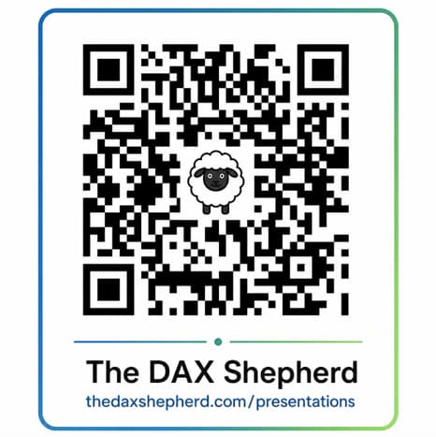
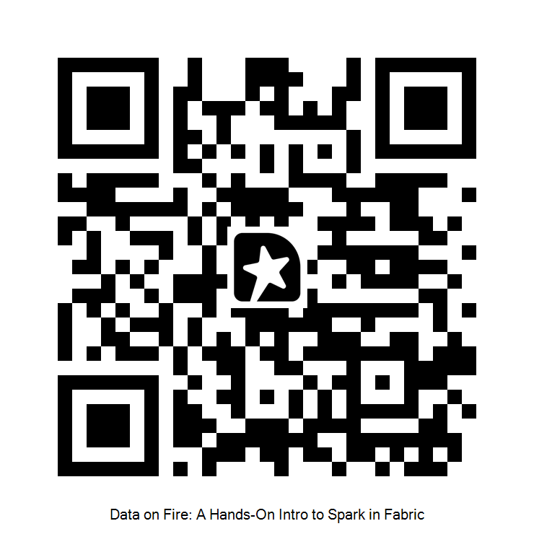

Thank you
Jason Romans
thedaxshepherd@gmail.com linkedin.com/in/jasonromans www.thedaxshepherd.com
Slides + Demos
Session Evaluation

