Slide 1

PLANT DISEASE DETECTION : AN INITIAL PROTOTYPE
By:
Aditya Kesari(19030141CSE038)
Payal(19030141CSE062)
Dhanush(19030141CSE086)
Haffis Najeeb(19030141CSE009)
Vinayak. K(19030141AE022)

Slide 2
objective
To create a prototype for detecting diseases in the plants by making use of Machine learning algorithms.

Slide 3
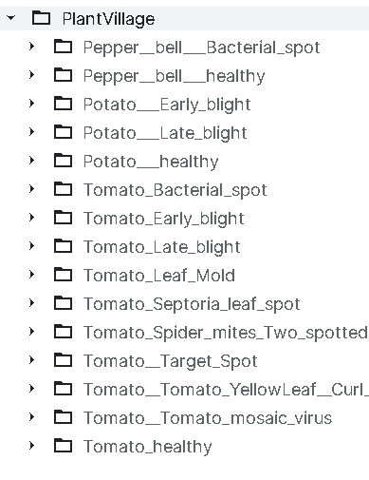
DATASET
Here we are making use of Plant village dataset for disease detection ,it contains images of healthy and diseased plants.
The dataset contains following species:

Slide 4
ALGORITHM
Import the necessary libraries(numpy ,cv2 etc..).
We set the epoch value which assigns how many times the data will be passed through the code.
Along with these we also set the path, image size, labels, etc.
The dataset is split into two parts, one for training the data and the other for validation.
Then using the ImageDataGenerator allows us to augment the image allowing us to pass random transformations to the image.
In the model network various sequential layers of the network are stacked and data is passed through these layers of CNN.

Slide 5
CONTINUE…
Then we display the model summary of all the parameters of the dataset.
Then we make use of epoch to pass the data through the training set inorder to achieve the maximum accuracy.
Then we graphically represent the training and validation accuracy .(Accuracy of training data is higher than accuracy of validation).
WE save the data in the disk.
Then we pass a image to our trained data and note down the following result along with the accuracy.

Slide 6
LIBRARIES USED
Numpy
Pickle
Cv2
Listdir
Sklearn
Keras

Slide 7
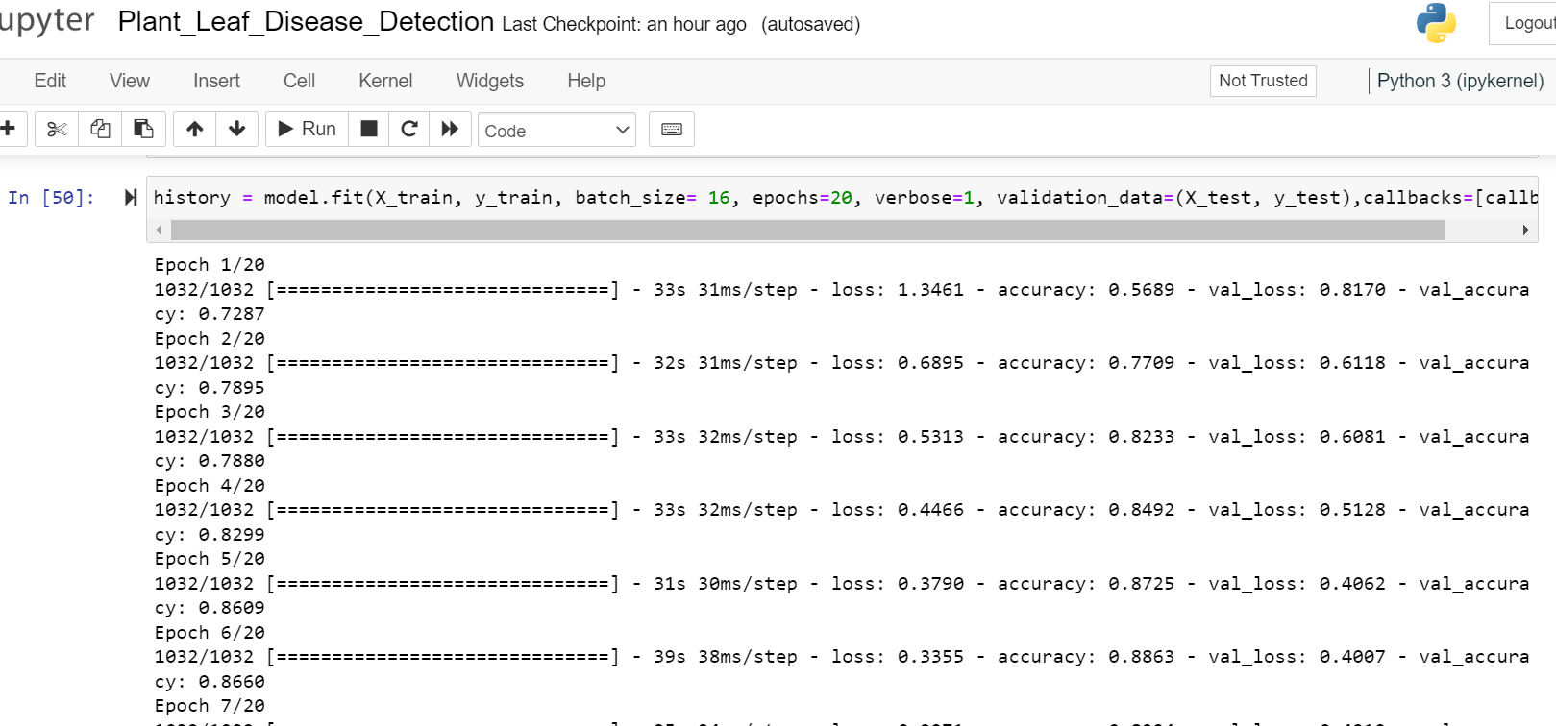
results OBTAINED

Slide 8
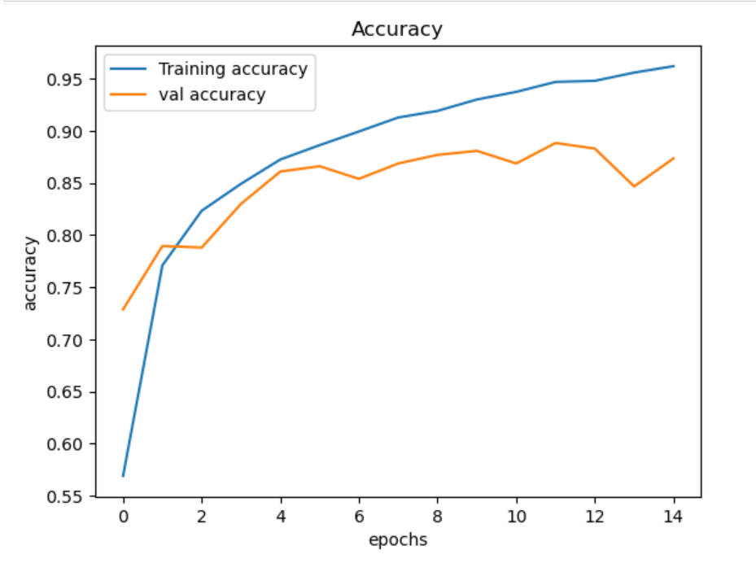
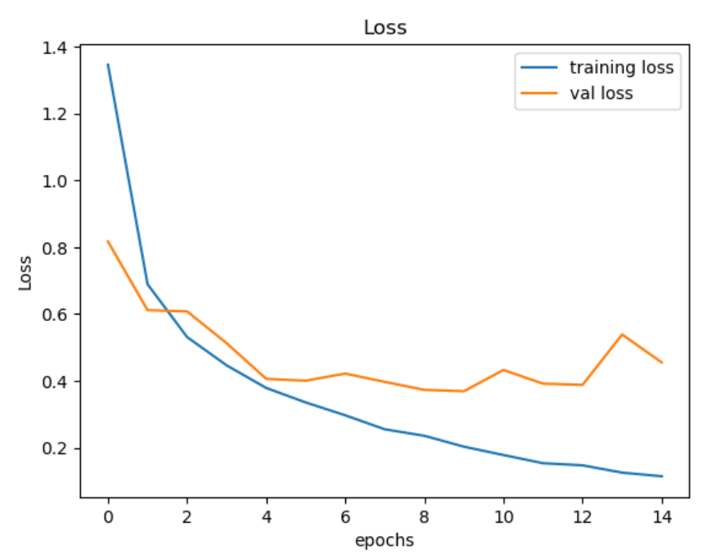

Slide 9
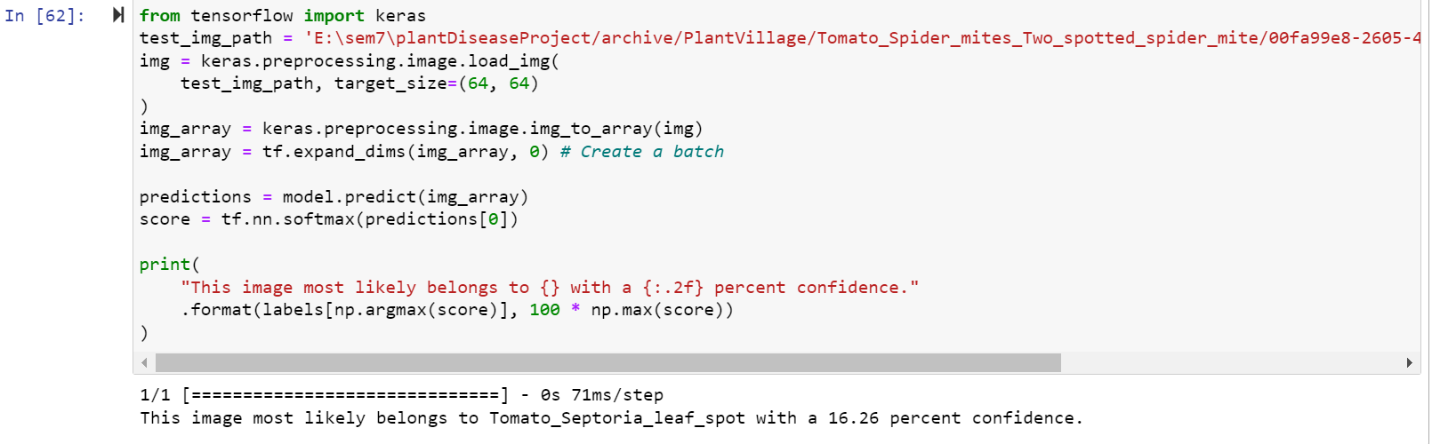

Slide 10
Scope for improvement
Increasing the size of the dataset
Including a variety of species of various plant diseases
Using customized dataset

Slide 11
Thank you

