Slide 1
Modularity
By: Raj Patel, Jessica Lin, Landon Gray

Slide 2
What. Am. I?
Modular system is one that consists of modules
Notes:
complex systems can be divided into simpler pieces called modules

Slide 3
Modular System Types
Top Down
Bottom Up
Notes:
BU: phases executed by focusing on modules then their composition
TD: module composition then the individual design

Slide 4
4 Big Benefits
Decomposition
Composition
Understanding
Modification
Notes:
ability to decompose complex system to smaller pieces
compose complex system from existing modules
understand system in terms of its pieces
modify a system by modifying a portion of the pieces

Slide 5


Decomposition
Notes:
divide the original problem top down into smaller problems and then apply the decomposition to each piece recursively
Divide first, then conquer individually

Slide 6

Composability
combining elementary components in steps into a finished system by starting bottom up
ex: zoids

Slide 7

Capability of Understanding
strong connection to modifiability
system should be understandable in varying contexts
Notes:
lan

Slide 8
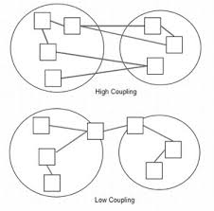
Modifiability
To achieve modular composability, decomposability, understandability, and modifiability, modules must be designed with high cohesion and low coupling
Module has high cohesion if all elements are related.
If two modules depend on each other, then they have high coupling

