Slide 1
Reliability
By: Landon Gray, Raj Patel, Jessica Lin

Slide 2
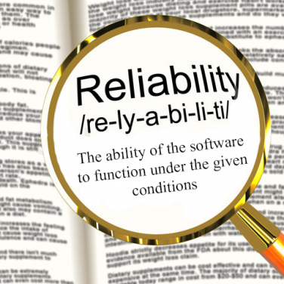
What is it?
probability that the system will behave properly under certain conditions

Slide 3
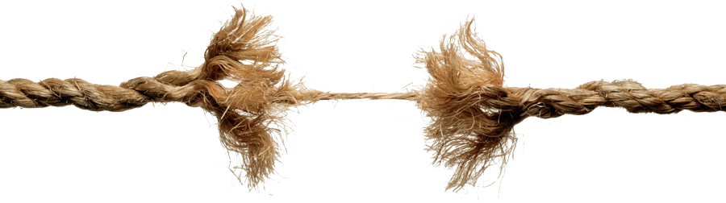
How can we measure Reliability
Stress testing - a deliberately intense or thorough testing used to determine the stability of a given system or entity

Slide 4
Dependable

Slide 5
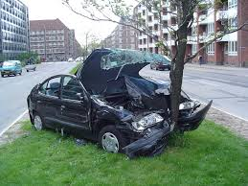
Real Talk
C. TO THE MAXIMUM EXTENT PERMITTED BY APPLICABLE LAW, THE APPLE SOFTWARE AND
SERVICES ARE PROVIDED “AS IS” AND “AS AVAILABLE”, WITH ALL FAULTS AND WITHOUT
WARRANTY OF ANY KIND
VS
Notes:
In classic engineering areas, product not released if it has “bugs”. Software design errors treated as unavoidable to the point that we expect them. Other products guarantee reliability while software gives a disclaimer that manuafcturers aren’t responsible for any damages due to product errors

Slide 6
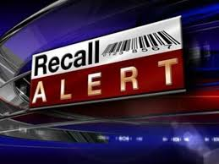
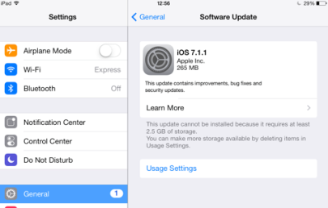
VS

Slide 7
A Boring Diagram
Reliability
Correctness
Notes:
Software design errors treated as unavoidable
A set of reliable projects has a

Slide 8
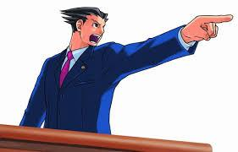
Reliability of Products
Software products are expected to be reliable
They must behave “as expected”
Less consequence = more reliable

Slide 9

Reliability == Bug Free ????
Notes:
In classic engineering areas, product not released if it has “bugs”. Software design errors treated as unavoidable to the point that we expect them. Other products guarantee reliability while software gives a disclaimer that manuafcturers aren’t responsible for any damages due to product errors

