Slide 1



Decentralized Exchange. Nomen est omen. The name speaks for itself..
Decentralized financial ecosystem based on the BitShares 2.0 (Graphene)
February 13th 2018, Saint Petersburg Copyright © 2018 Deex.exchange. All rights reserved.

Slide 2
Decentralized Exchange. Nomen est omen. The name speaks for itself..
1. Workable, Scalable Business
Cryptocurrency exchange with an unprecedented level of data protection, providing access to trading both for market professionals and ordinary users;
A platform for the safe ICO conduct on the basis of a decentralized escrow from DESCROW.ORG;
Transparent decentralized blockchain crypto Fund with the ability to issue tokens and automatically placing them it on stock exchanges; Cryptocurrency debit cards; Own agency network of crypto ATMs for the buying and sale cryptocurrency using fiat money with the ability to work with bank cards.

Slide 3
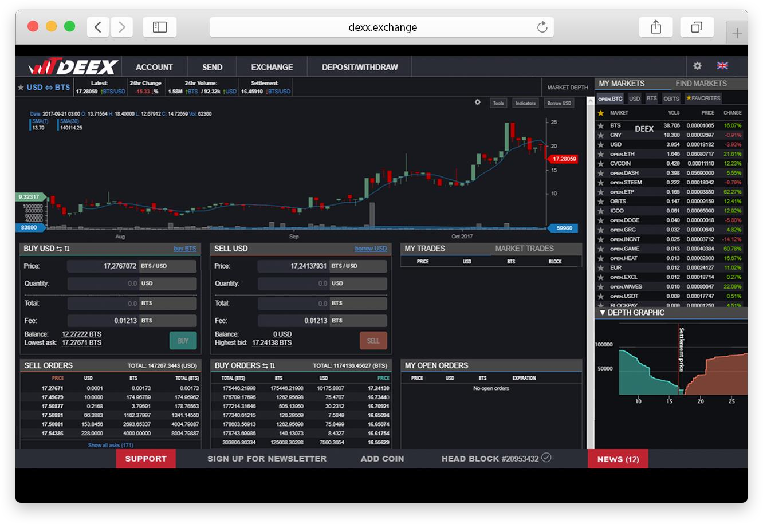
2. MVP (the Minimum Viable Product)
Decentralized Exchange. Nomen est omen. The name speaks for itself..
IT’S ALREADY TESTED!
By more than 1000 users

Slide 4




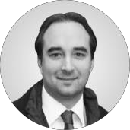

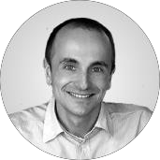

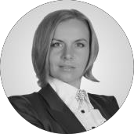
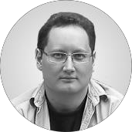
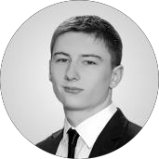
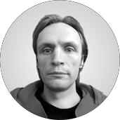
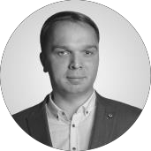
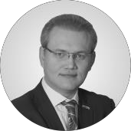
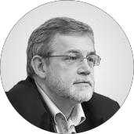
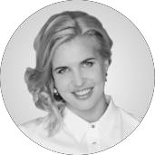

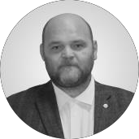
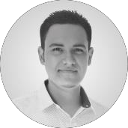
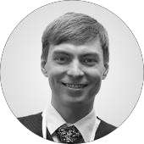
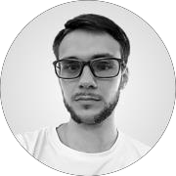
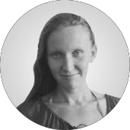

Decentralized Exchange. Nomen est omen. The name speaks for itself..
3. DEEX’ Team and Advisors
The current DEEX’ team is 8 people
DEEX advisors is 11 persons
DEEX TEAM MEMBERS ARE PROFESSIONALS IN SPHERES OF
economics, finance, investment, asset management, exchange business, trading, algorithmic trading, banking, mergers and acquisitions, business planning, corporate governance, state-owned company management, budgeting, payment systems, crisis management, development, implementation and maintenance of IT , analytics, telecommunications, real business and industry, territories management, gaming services, network technologies, internet promotion, advertising, logistics, law, cryptography, marketing, PR, strategic planning, sales.
Copyright © 2018 Deex.exchange. All rights reserved
3

Slide 5

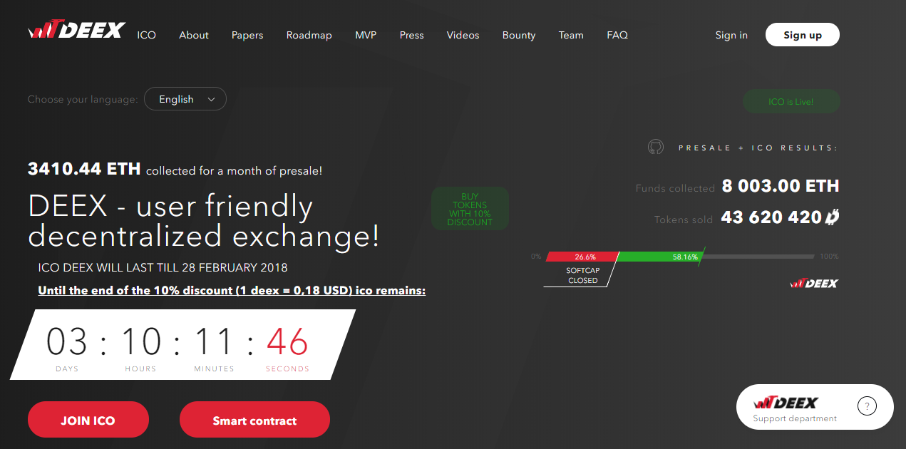
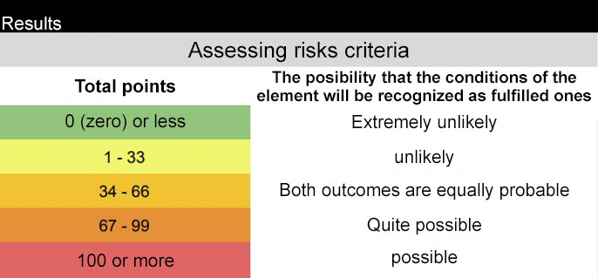
Decentralized Exchange. Nomen est omen. The name speaks for itself.
4. DEEX Tokens
4.1. System login; 4.2. Communication ability; 4.3. Transfer of protected information; 4.4. The right to distribute the token; 4.5. Right to receive a bonus; 4.6. The right to vote; 4.7. The token confirms the tariff plan.
The Howey test has passed through the lower border up to 33 points
Copyright © 2018 Deex.exchange. All rights reserved
4

Slide 6

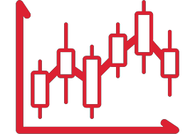







Decentralized Exchange. Nomen est omen. The name speaks for itself.
5. The Concept of the DEEX Project and its Benefits
Convenient GUI compatible with the most modern browsers
Desktop application for trading
Android and iOS mobile app
24/7 technical support
A large number of trading pairs and a wide selection of trading indicators
The ability to restore lost passwords
Own hardware crypto wallet for cold storage of cryptocurrencies and tokens
Two-factor authentication
High liquidity

Slide 7
6. Market positions
Decentralized Exchange. Nomen est omen. The name speaks for itself.
6.1. DEEX & BITSHARES
DEEX operates on the BitShares 2.0 platform, a high-tech decentralized blockchain platform that allows to create highly efficient financial "smart contracts" for all areas of economic activity that are used on the Internet.
The BitShares 2.0 platform gives users a number of undeniable advantages in using:
Decentralization;
High performance — up to 100 000 transactions per second;
Cryptocurrency trading with a stable price (BitAssets/SmartCoin); Possibility of realization of periodic and planned payments;
Refferal renumeration program.

Slide 8
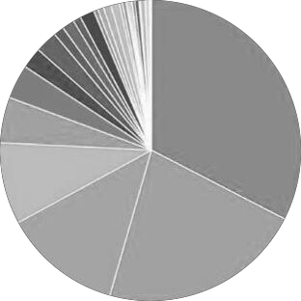
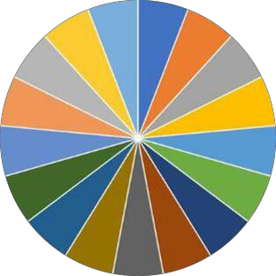
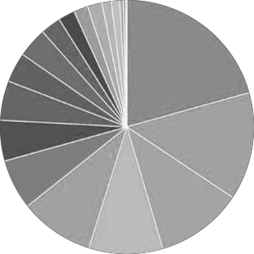
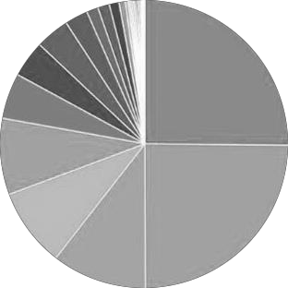
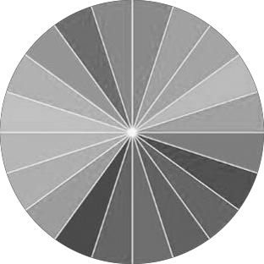
Decentralized Exchange. Nomen est omen. The name speaks for itself..
6.2. Decentralization.
According to the statistics of observers, BITSHARES is the most decentralized system by now.
WAVES (LPOS)
Active Witnesses (17, 73 Standby)
2017-10-11
BITSHARES (DPOS)
Active Witnesses (17, 73 Standby)
2017-10-11
BITCOIN (POW)
Mining Pools 2017-10-11
ETHEREUM (POW)
Mining Pools 2017-10-11
STEEM (DPOS)
Active Witnesses (20, 68 Standby)
2017-10-11

Slide 9
Decentralized Exchange. Nomen est omen. The name speaks for itself.
6.3. DEEX monetization.
The platform will calculate and transfer to the escrow account a floating commission of 0.2% -0.5% for sales of cryptocurrencies, tokens and other digital assets;
The platform will provide an opportunity to buy cryptocurrencies, cryptcurrency pairs and tokens with a shoulder (margin lending). The leverage will be calculated by the algorithm (depending on the reputation, account status and customer history) and executed through the EOS smart contract;
The platform will earn by selling the technology of data exchange with other crypto exchanges through API technology and developer services (SDK) for additional tools that extend the functionality of trading;
Integration in the service of the possibility of carrying out transactional models and obtaining standard deductions from such operations will also bring revenue to the platform that will be credited to the tokens to holders (investors).

Slide 10
7. Legal preparation of the DEEX project
Decentralized Exchange. Nomen est omen. The name speaks for itself.
Completed | In process | Planning
Yes
Yes
 | Yes
 | Yes
 |  | Yes
 | Yes
Compliance with the regulatory base;
Govermental assistance;
Legal entity presence;
Availability of necessary and sufficient documentation;
KYC procedure;
AML (legal risks reduction).
9
9

Slide 11
Contacts:
www.deex.exchange info@deex.exchange
Become a part of decentralized future together with DEEX!
Copyright © 2018 Deex.exchange. All rights reserved.
10

