Slide 1
Nationwide Socio-Economic Impact of COVID In US Between 2020-2021
Bhandari, Nikhil 2769298
Ward, Jason 2542354
Whitenack, Zachary 2667990
Bheemavarapu, Meghana 2754271

Slide 2
Summary
Problem Statement
Analyze how emergence of COVID-19, subsequent vaccination roll-out across states have impacted critical socio-economic sectors like housing and employment (between Jan-2020 and April-2021) in US.
Analyze the said data in relation to how different states voted in the last 2020 presidential election.
Analyze the cumulative cases and deaths resulting from COVID
Approach
Determined the cumulative numbers for all key measures (like Cases, Deaths, Employment etc.) for states and identified states on both side of the spectrum (High and Low) for comparison/analysis.
Used excel to create pivot tables for further analysis and regression models in order to be able to see over time the trend that was occurring.
Conclusion

Slide 3
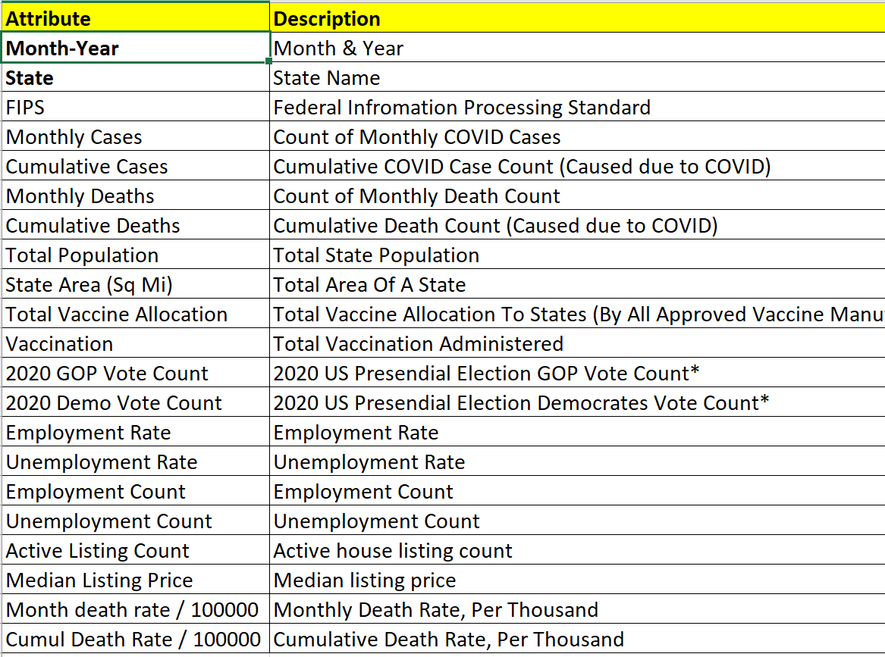
Data Source
COVID and some socio-economic data was extracted from the following sources
CDC
Github
US Bureau Of Labor Statistics
US Census Bureau
Redfin
5 Data Sources
728 records
19 attributes

Slide 4
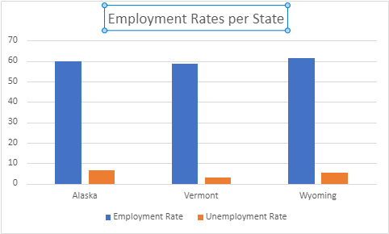
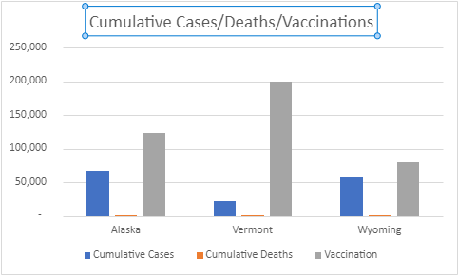
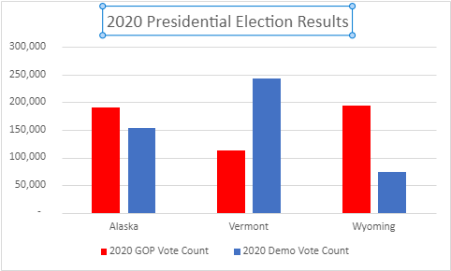
Pre-Analysis Visualization Of The Summarized Dataset

Slide 5
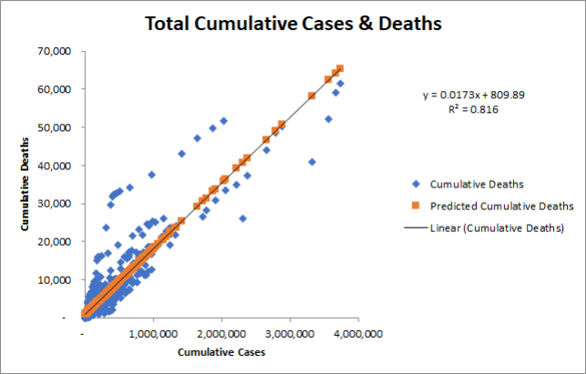
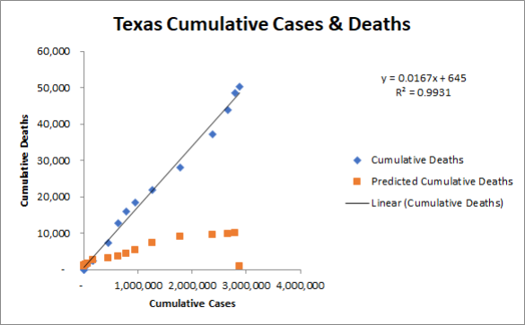
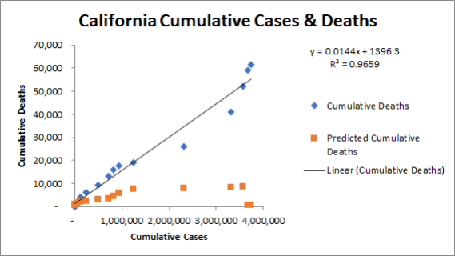
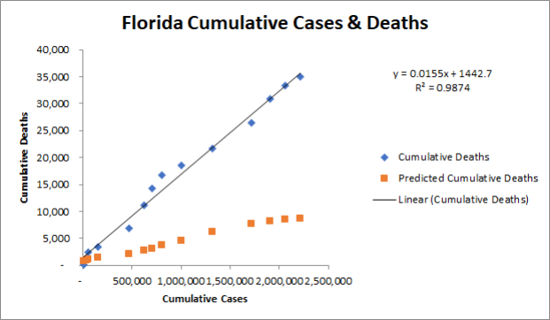
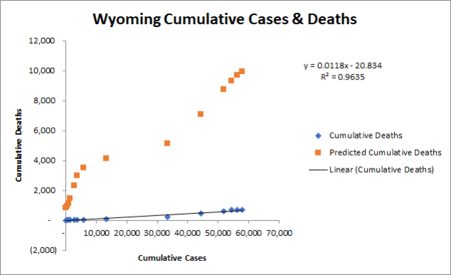
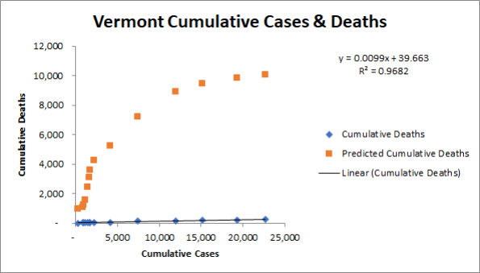
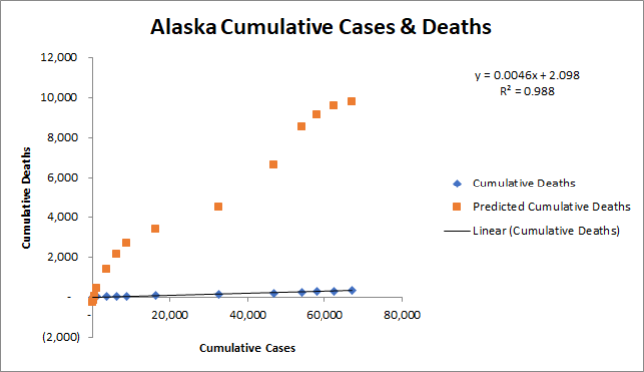

Slide 6
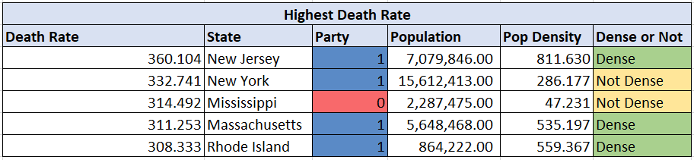
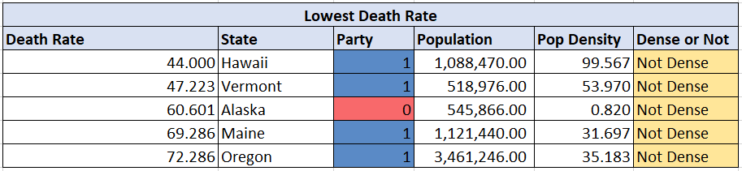
Death Rate Statistics
Average Death Rate (per 100,000 people) : 202.097
Average Population Density : 302.878

Slide 7
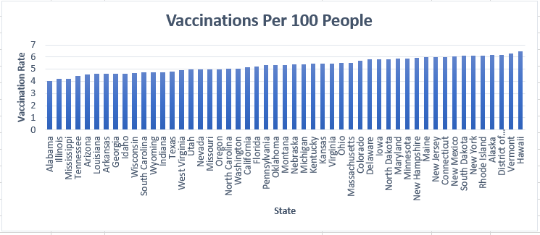
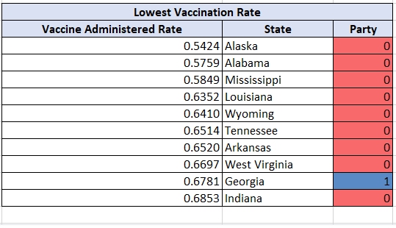
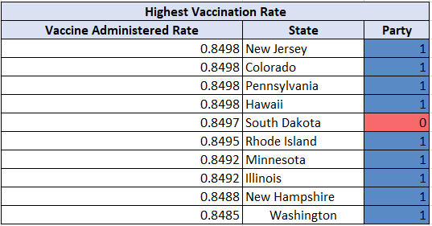
Vaccination Rate Statistics
Average Vaccine Administered Rate : 0.7706

Slide 8
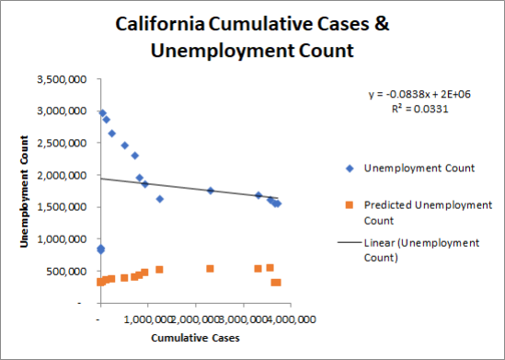
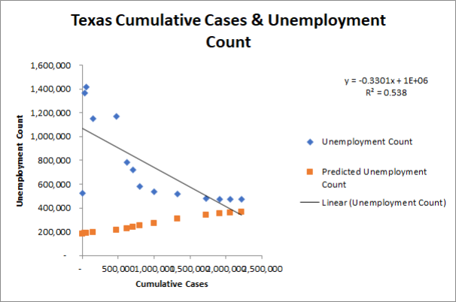
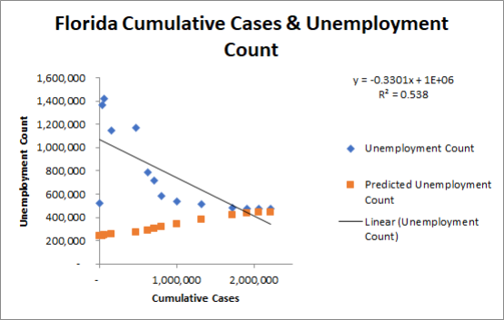
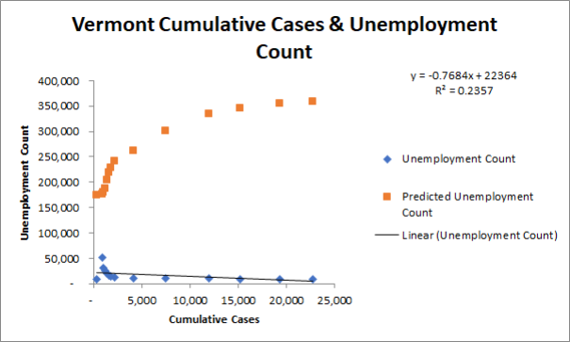
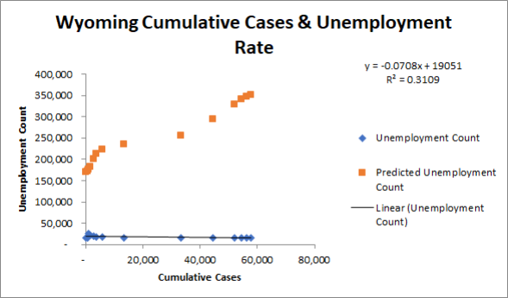
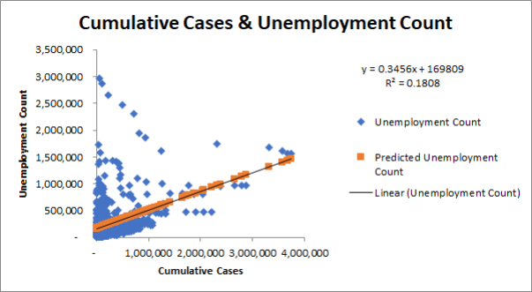
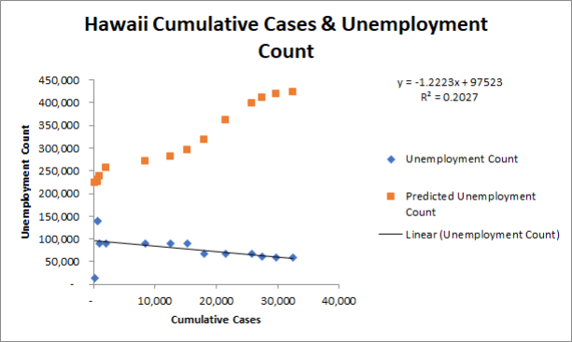

Slide 9
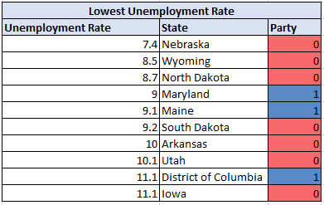
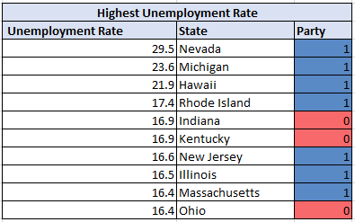
Unemployment Rate Statistics
Average Unemployment Rate : 13.87

Slide 10
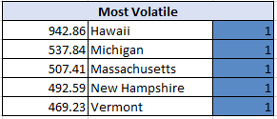
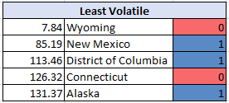
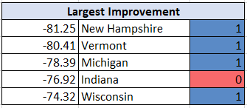
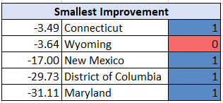
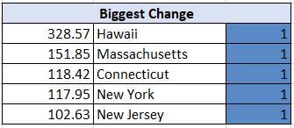
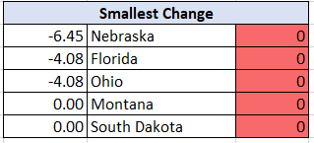
Unemployment Volatility Statistics
Average Percent : 270.98
Average Percent : -57.23
Average Percent : 45.59

Slide 11
Conclusions / Next Steps
Conclusions
Our findings provided a general overview of how each state was impacted by COVID in regards to death, vaccinations, and unemployment
Many of the conclusions were made on a subject basis in the prior portions
Death rate was higher in states with a higher population density with an exception of Mississippi (low density) as opposed to those with lower densities
Vaccination rates were predominately higher in states that voted Democrat in the 2020 election and were lower in states that voted Republican
Top-down level shows that unemployment rate on opposite ends of the spectrum show statistics that seem uniform with general beliefs
The first month (March-April 2020) that COVID hit was when each state's unemployment rate experienced extremely volatility
Actionability
Use towards understanding political axioms at state level based around biases and skepticism
Improvements to be made on vaccination rollouts on future pandemics
Use towards better campaign efforts for future vaccinations to thwart against conspiracies and mistrust
Improvements and Recommendations
Using more advanced technology to perform stronger analyses (a la SAS or Python)
More granular analysis at the county/city level or by race/ethnicity etc.
Further analysis with house statistics / more robust dataset

Slide 12
Appendix
Data Source Details
Daily COVID cases recorded in US (By state, since Jan-2021). Sourced it from an ongoing repository maintained on GitHub by The New York Times.
Weekly vaccination allocation to states by Pfizer, Moderna, and J&J (since their initial rollout) and vaccine administered. Sourced it from an ongoing repository maintained by CDC on their website.
2020 US Presidential election results and votes polled by county. Sourced it from GitHub
Monthly population, employment and unemployment data by state (Since Jan-2020). Sourced it from “US Bureau Of Labor Statistics” website
Monthly housing summary (includes active listing, median listing price, price change etc.) by state (Since Jan-2020). Sourced if from Redfin.
Area of states. Sourced it US Census Bureau website.
Relevant data points were present for all 50 states, but some were by state, and some were by county/jurisdiction, so we had to aggregate it.
Used excel to create regression models in order to be able to see over time the trend that was occurring.

Slide 13
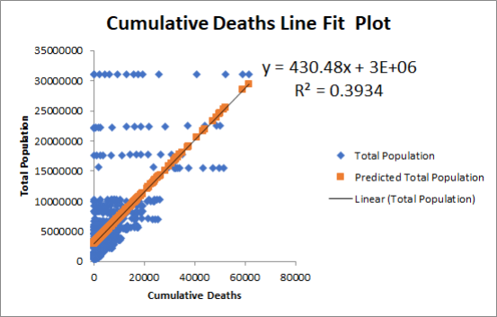
Appendix

Slide 14
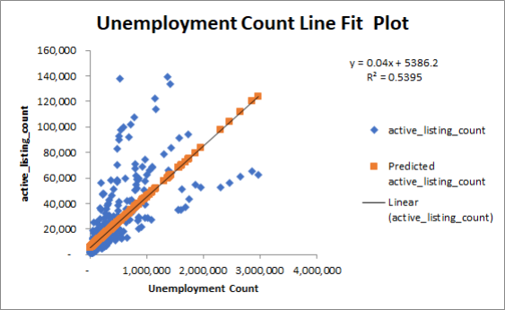
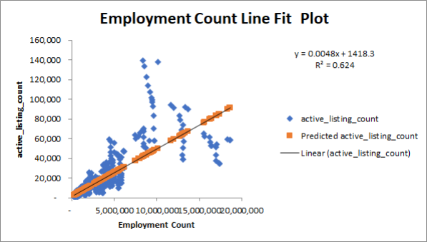
Appendix

Slide 15
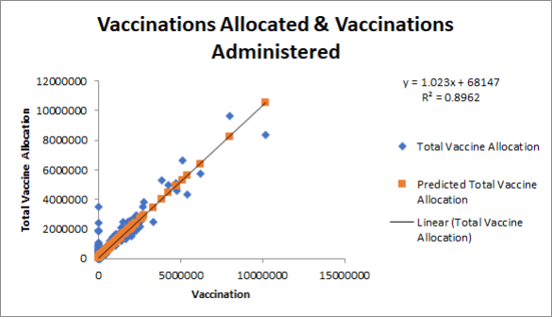
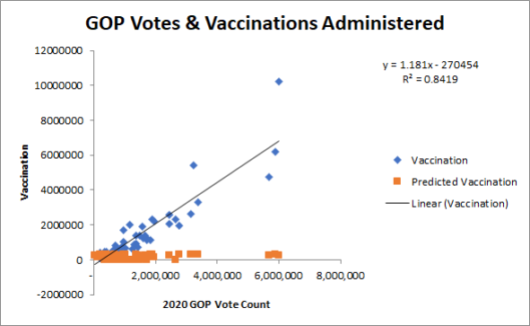
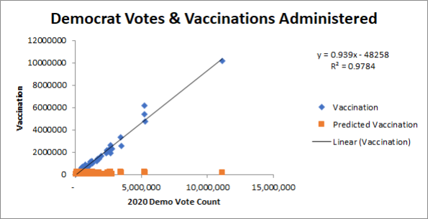
Appendix

Slide 16
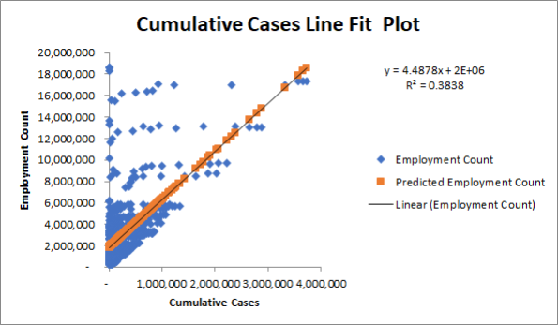
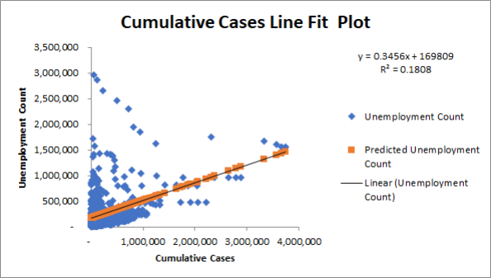
Appendix

Slide 17
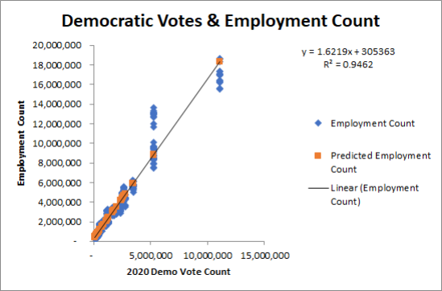
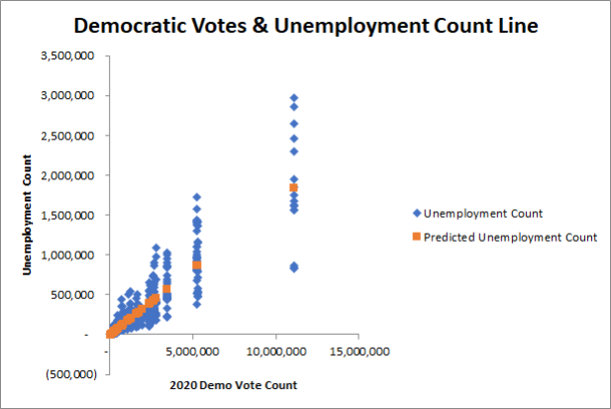
Appendix

Slide 18
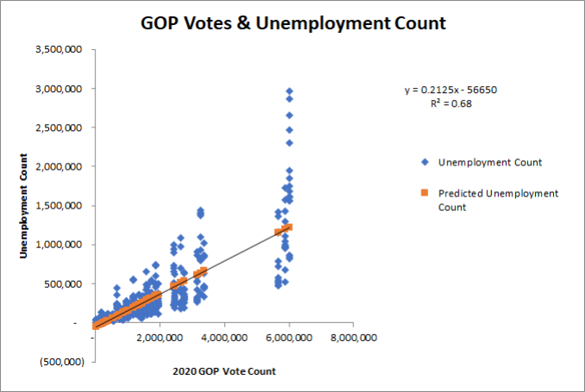
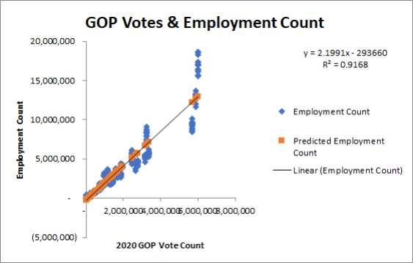
Appendix

Slide 19
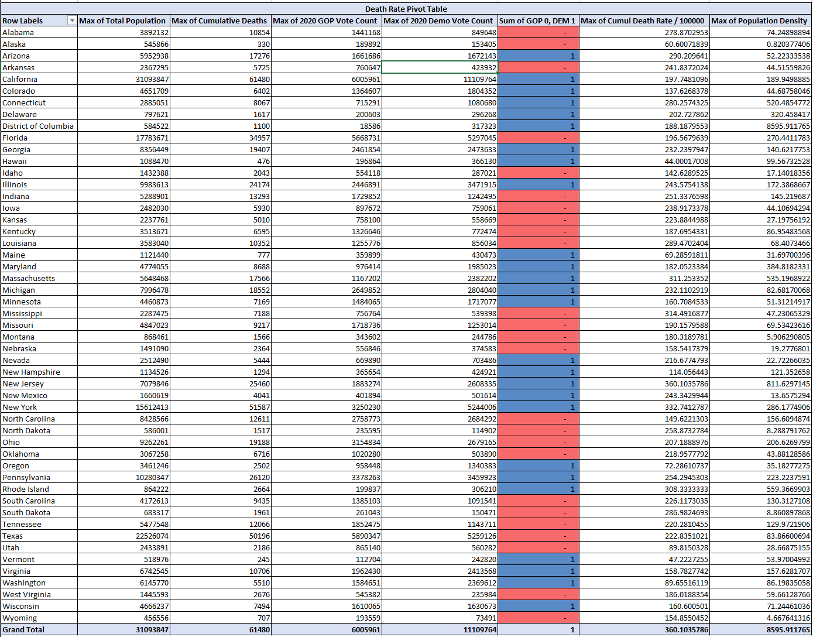
Appendix

Slide 20
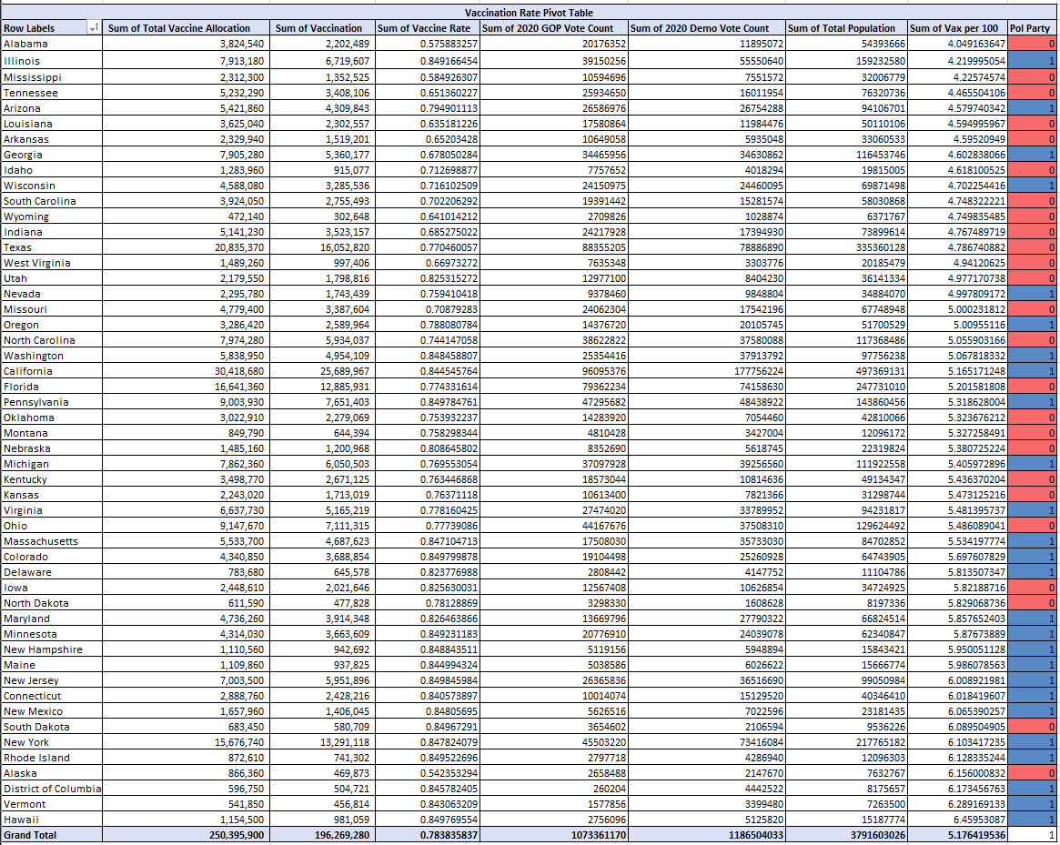
Appendix

Slide 21
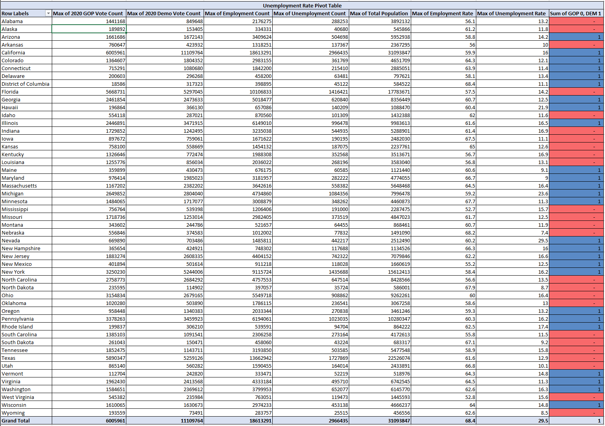
Appendix

Slide 22
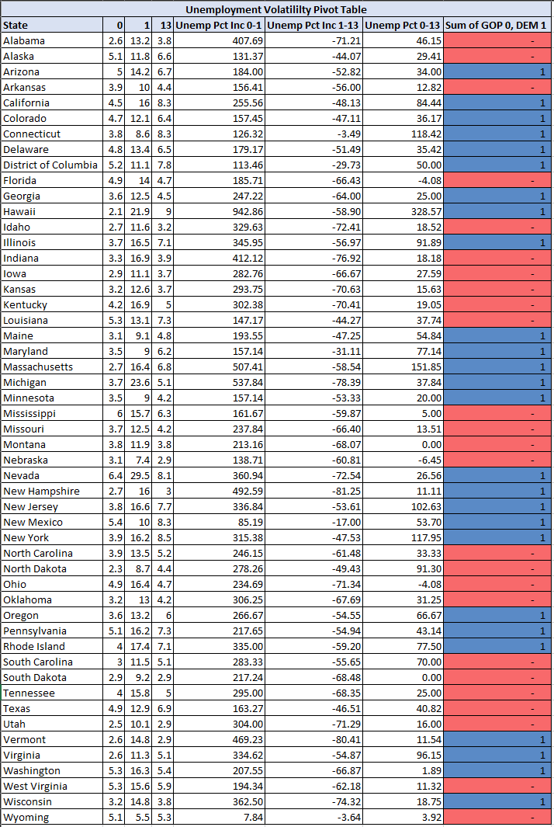
Appendix

