Slide 1
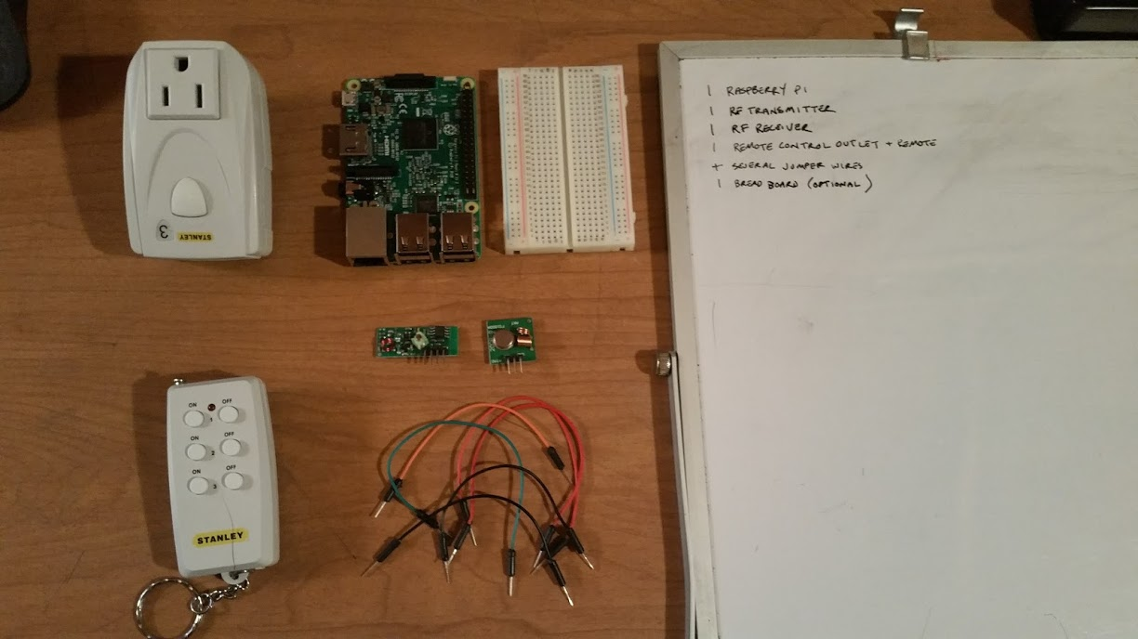
Home Automation with RF Transmitter and Receiver
...and a Raspberry Pi

Slide 2
Raspberry Pi 3

Slide 3
Breadboard

Slide 4
Transmitter

Slide 5
Receiver

Slide 6
Jumper Wires

Slide 7
Remote Control

Slide 8
Remote Controlled Outlet

Slide 9
Approx Cost of Project
$35 Raspberry Pi
$5+ Micro SD
$1 Pack of Jumper Wires
$3 5 Receivers/Transmitters
$2 Breadboard
$10+ Remote Controlled Outlet
Total $56
(Prices from quick search on ebay.. Possibly cheaper if you want to wait a month to get them from China)

Slide 10
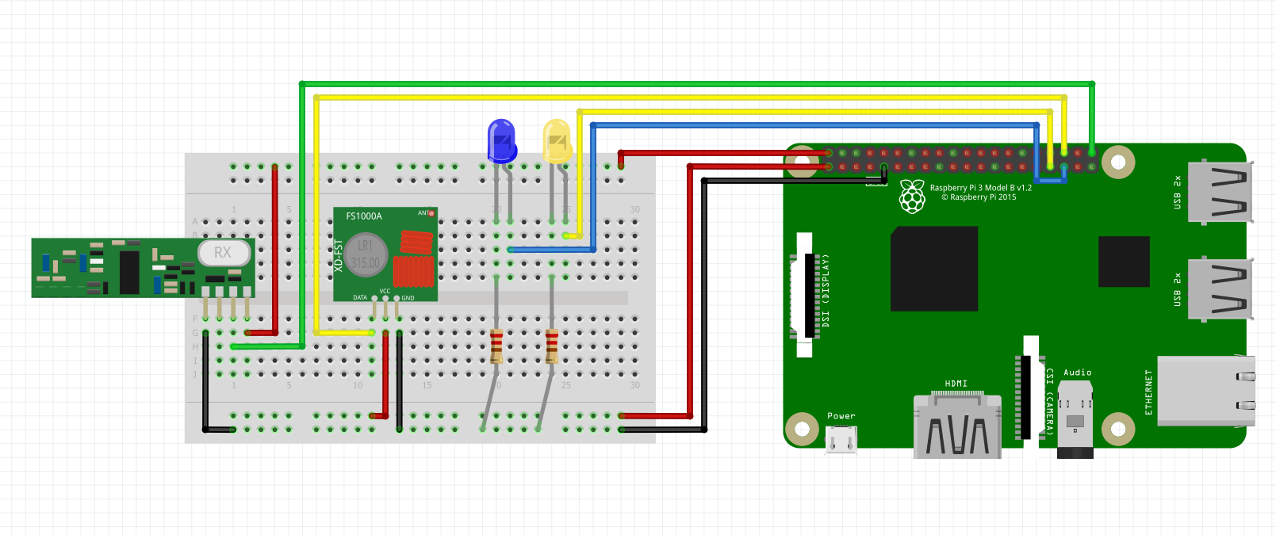
Setup

Slide 11
Sniffer: sniff.py

Slide 12
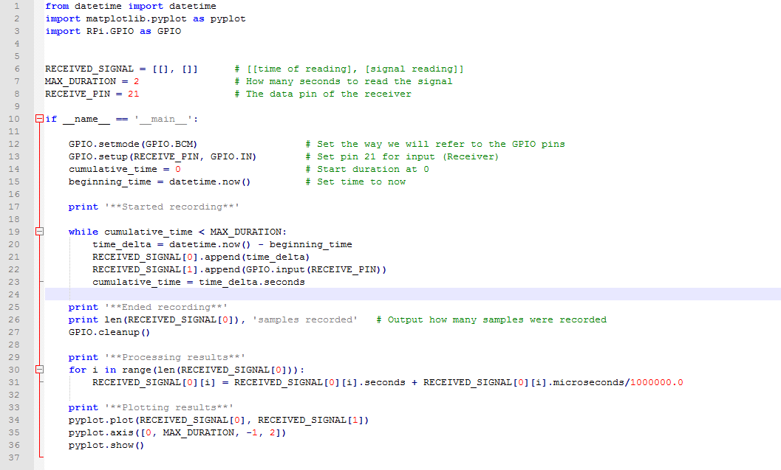

Slide 13
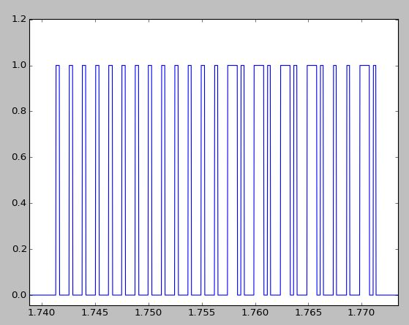

Slide 14
Remote: switch.py

Slide 15
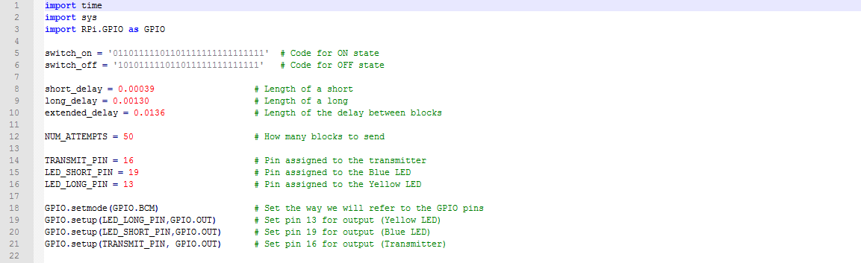

Slide 16
