Slide 1
AI-Based Personalized
Nutrition & Meal Planning System
An Agentic RAG Framework for
Personalized Meal Planning and Nutritional Analysis

Slide 2
Problem Statement
Manual calorie tracking is tedious and often inaccurate
Existing apps lack personalized meal planning based on ingredients
No unified system combining food recognition + nutrition + planning
Users rely on manual logging and fragmented tools
Need for a zero-effort, intelligent nutrition system

Slide 3
Future
Conclusion
Objectives
01
02
To develop a multi-agent AI system for food analysis and meal planning.
To identify food ingredients from images using vision LLMs
03
04
To estimate and validate nutritional macros using LLM + USDA database
To generate personalized 7-day meal plans using semantic recipe search (Qdrant).
05
06
Provide a conversational AI interface for meal planning interactions.
Store and track user macro history over time via database.
4 / 17

Slide 4
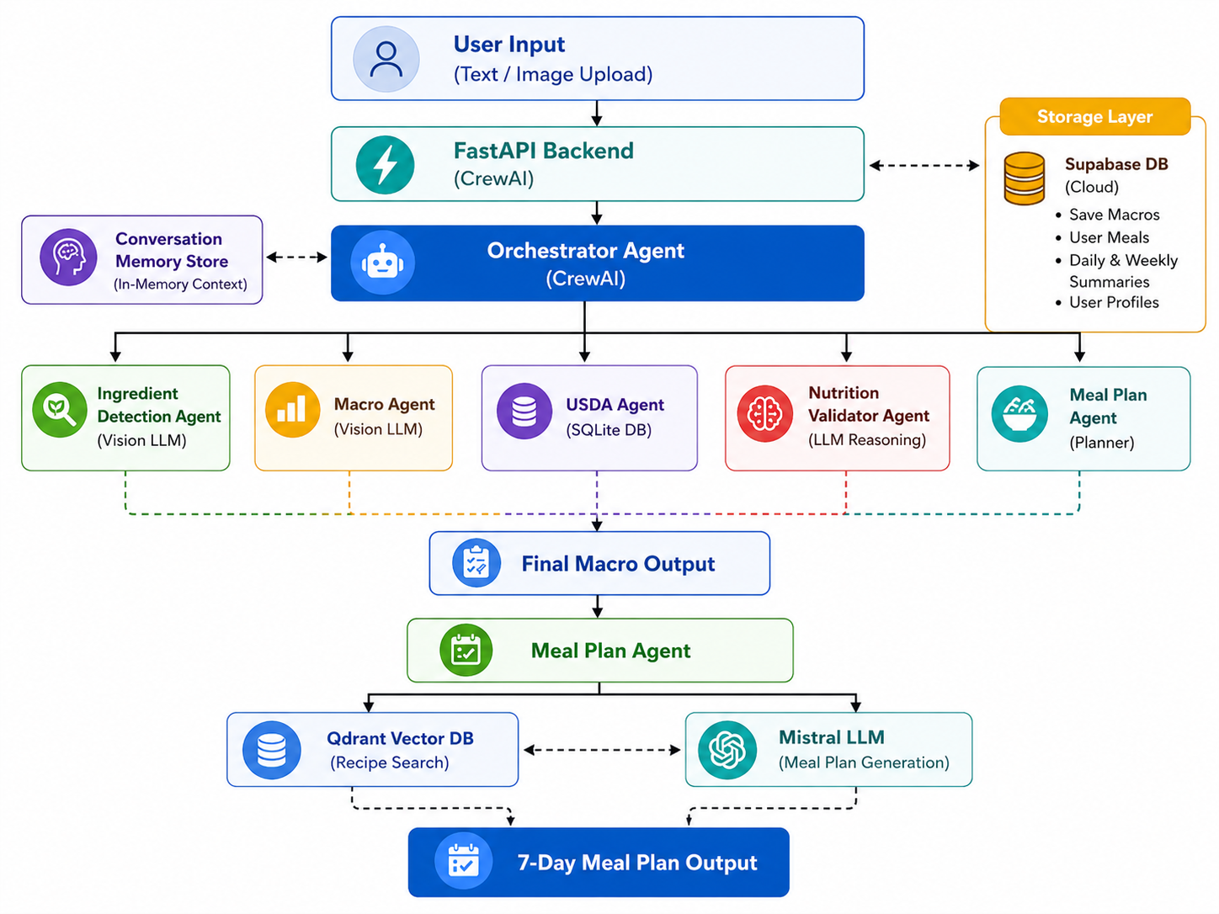
02 / Architecture
Proposed System

Slide 5
Agent Hierarchy & Crew Architecture
Agent Roles & Responsibilities
Agent | Role | Primary Tools
Orchestrator | Coordinates tasks & aggregates outputs | -
Ingredient Agent | Detects ingredients from images | identify_ingredients
Macro Agent | Estimates nutrition from images | get_macros
USDA Agent | Retrieves verified nutrition data | lookup_usda
Validation Agent | Resolves discrepancies between sources | compare_macros
Meal Planning Agent | Generates personalized meal plans | search_recipes, enrich, generate

Slide 6
Algorithms and Models Used
Algorithm / Model | Type | Purpose in System | Reason for Selection
Vision-Language Model (SambaNova LLaMA) | Multimodal AI | Detect ingredients and estimate macros from food images | Handles image + text effectively with high accuracy
Sentence Transformer (MiniLM) | Embedding Model | Convert recipes into vector representations | Fast and efficient semantic similarity
Qdrant Vector Search | ANN Search Algorithm | Retrieve similar recipes based on embeddings | Scalable and high-speed similarity search
USDA Database (SQLite FTS) | Rule-Based Retrieval | Fetch verified nutrition data | Provides authoritative ground truth
Mistral LLM | Large Language Model | Validate macros and generate meal plans | Strong reasoning and structured output
CrewAI Framework | Multi-Agent System | Orchestrates task delegation between agents | Modular, scalable, and efficient workflow management

Slide 7
Dataset Architecture & Processing Pipeline
DATASETS
DATA PROCESSING
USDA SR Legacy
USDA Processing
Source: FoodData Central (2018)
7,793 food items
150+ nutritional attributes
Used: calories, protein, fat, carbohydrates
Standardized per 100g values
CSV to SQLite conversion
Filtering valid food entries
Normalization to per 100g values
FTS5 indexing for fast text search
Two-step search: exact match + token fallback
RecipeNLG
Total: 2.2 Million recipes
Used subset: 1 Million recipes
Fields: title, ingredients, instructions
Recipe Processing
Removal of duplicates and noisy entries
Ingredient normalization and cleaning
Conversion to embeddings (all-MiniLM-L6-v2)
Storage in Qdrant vector database

Slide 8
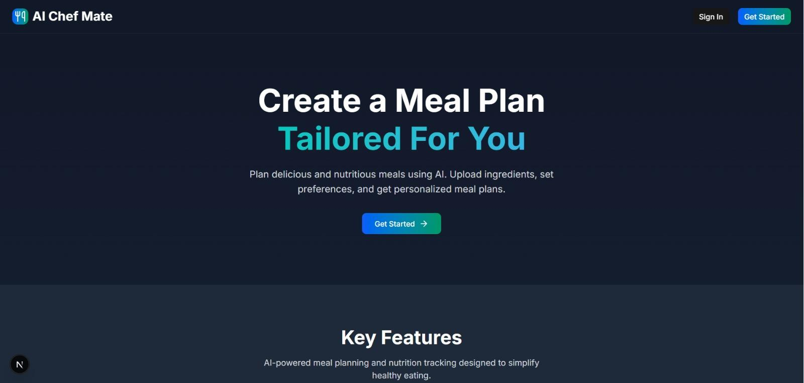
Demonstration
System Interface & Features
AI Chef Mate mobile application screenshots and workflow
Example Interactions:
• "Remove chicken and add more protein"
• "Make Wednesday dinner vegetarian"
• "Reduce calories to 1,600 per day"
Sliding window context management for efficient iterative interactions

Slide 9
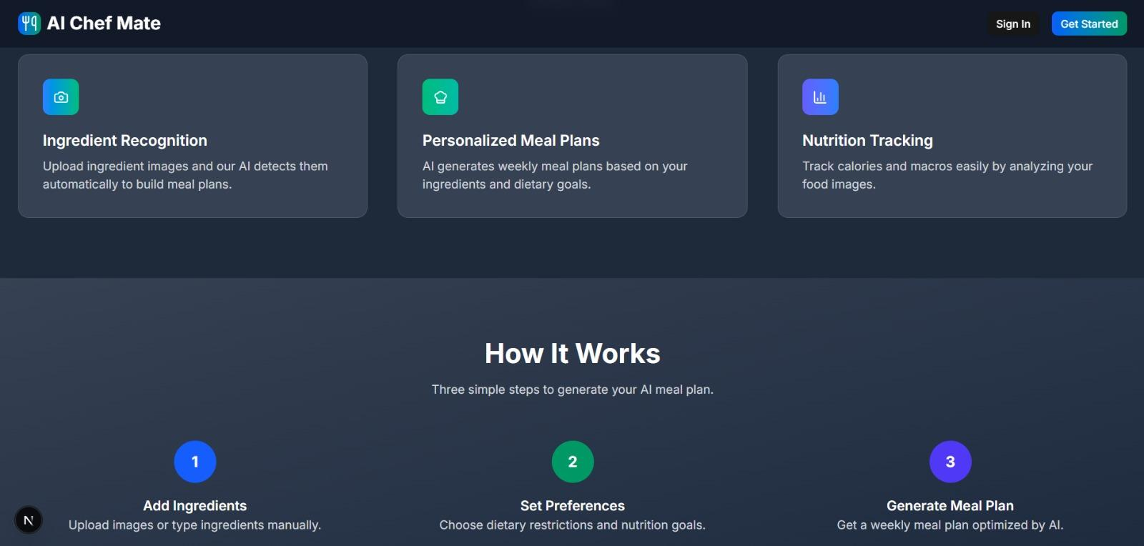

Slide 10
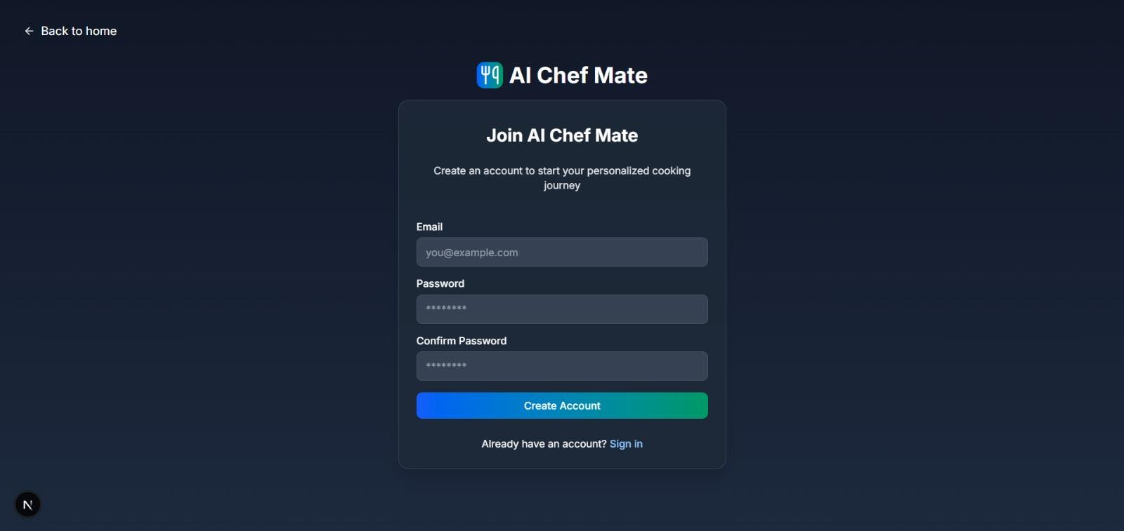

Slide 11
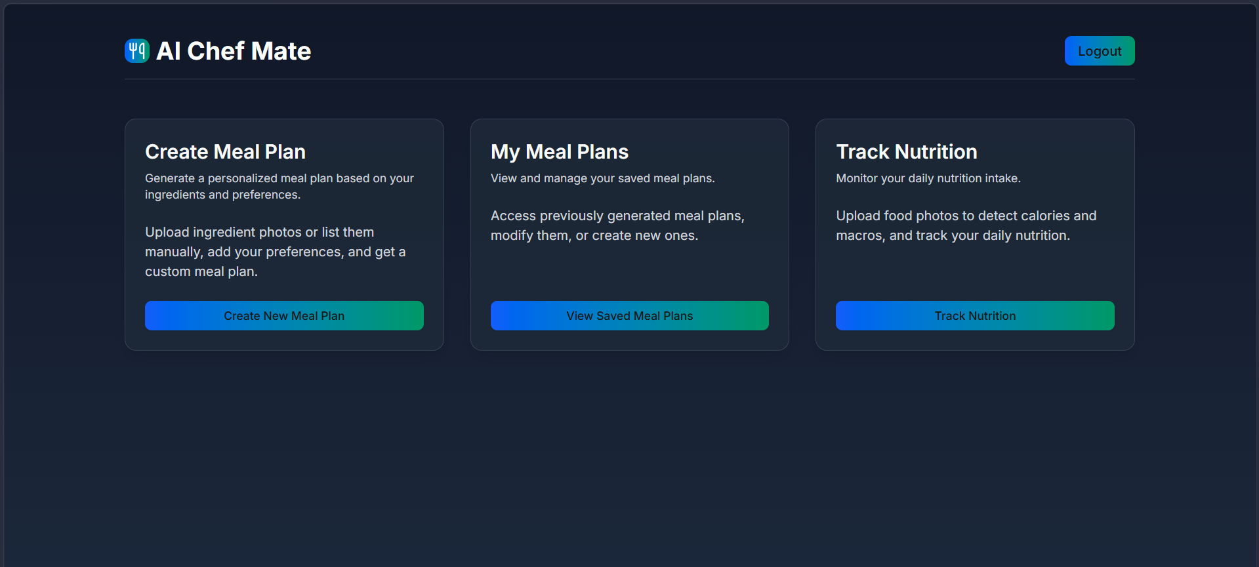

Slide 12
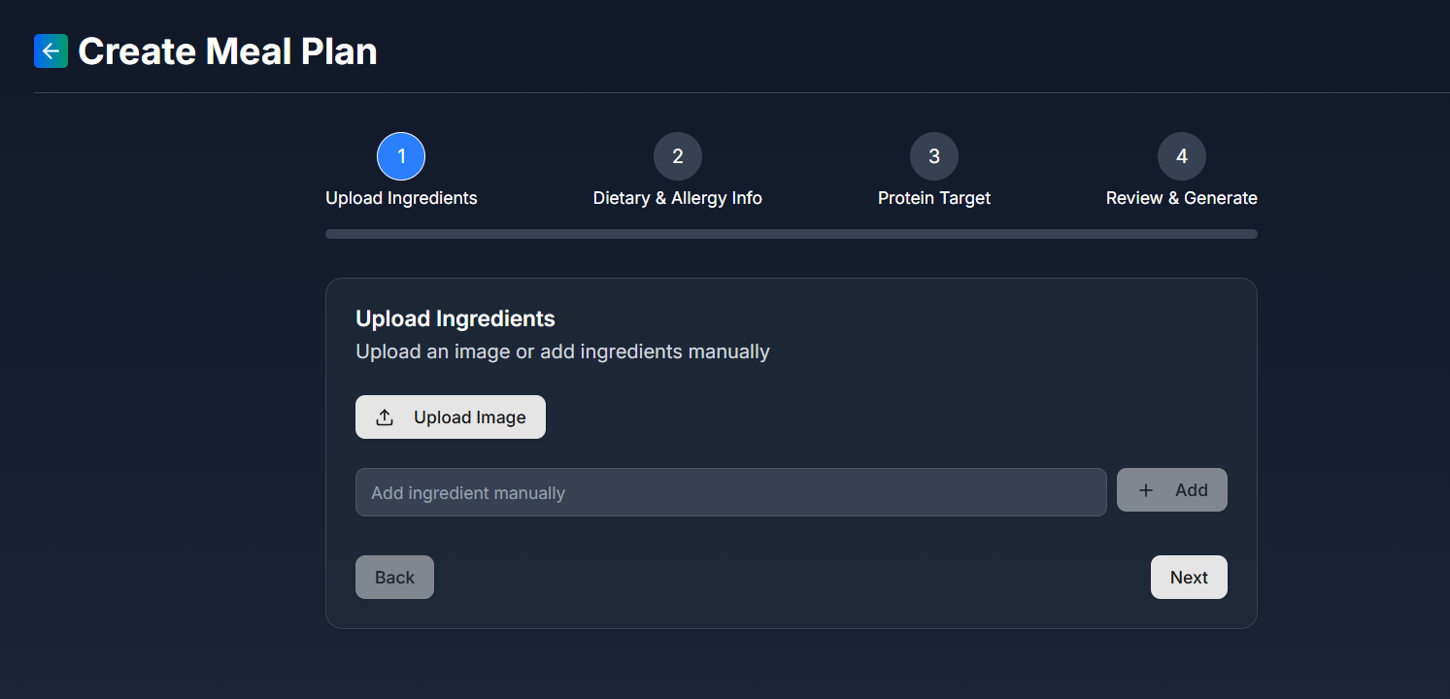

Slide 13
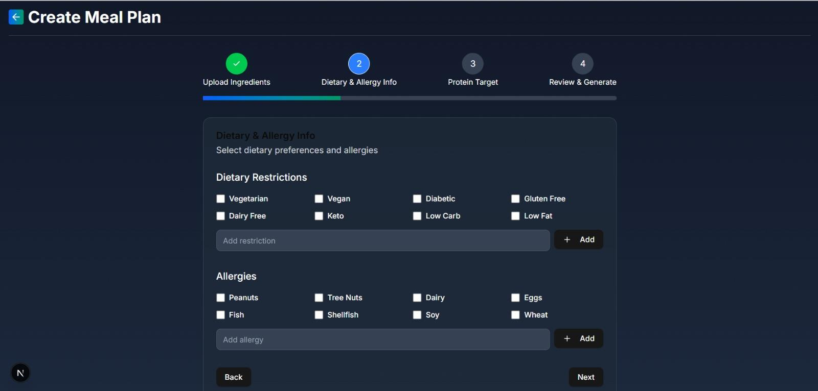

Slide 14
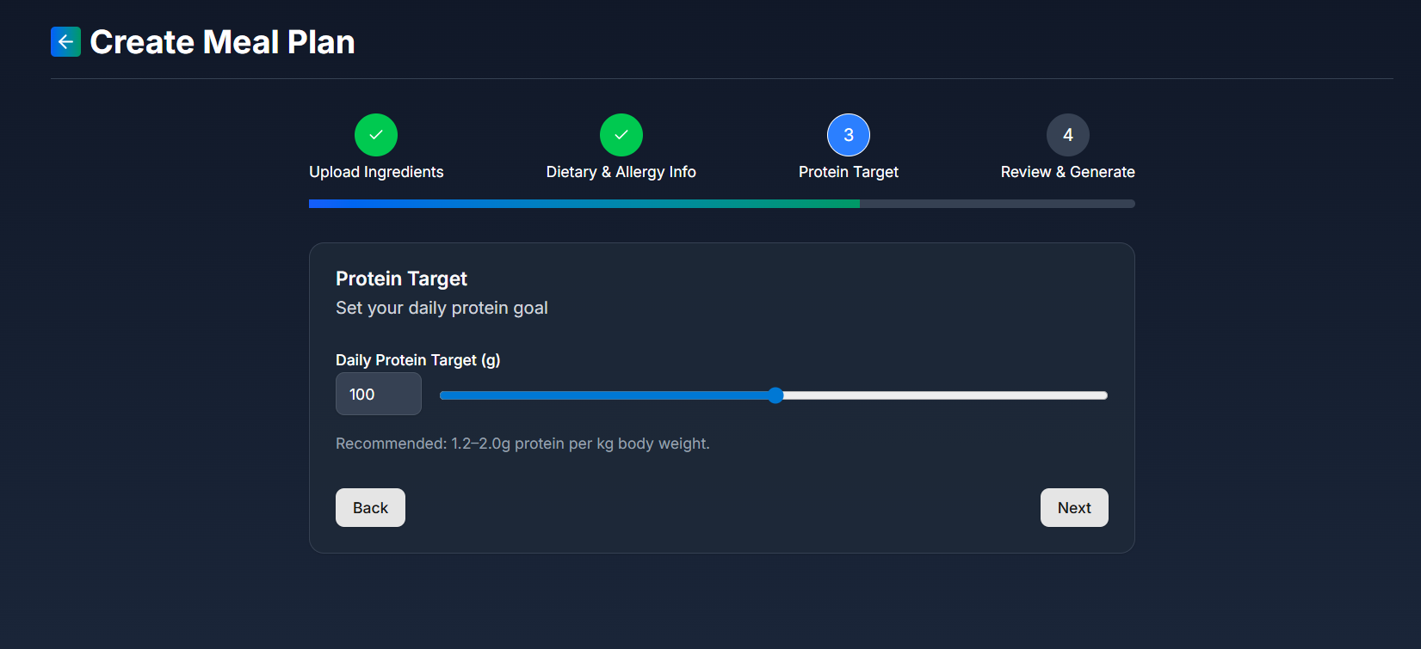

Slide 15
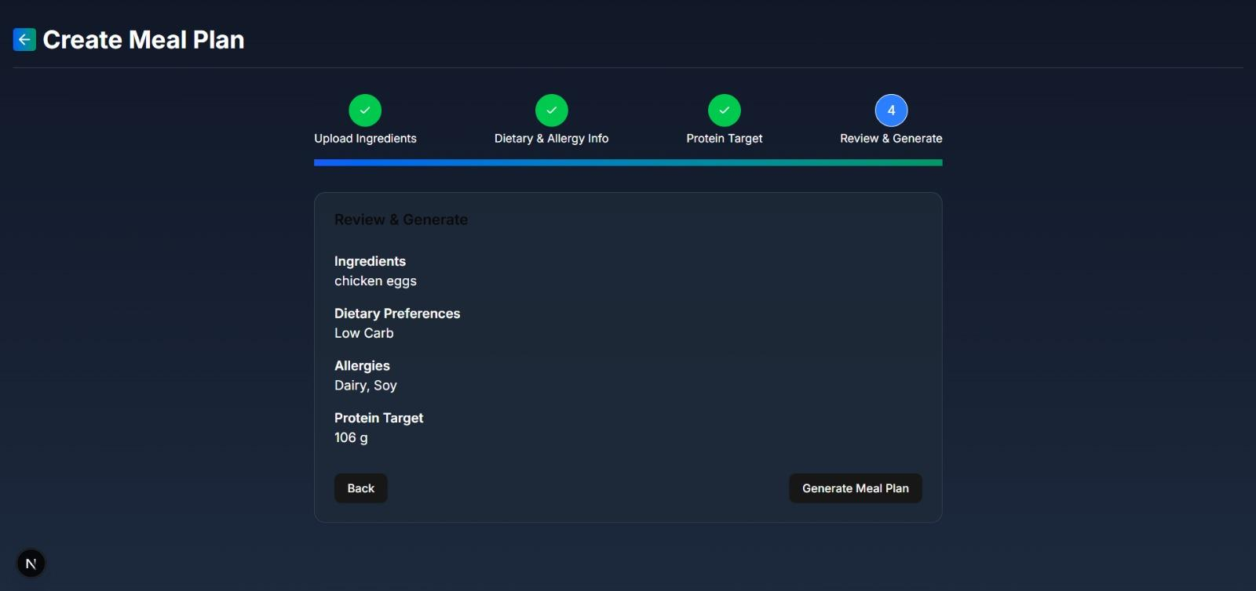

Slide 16
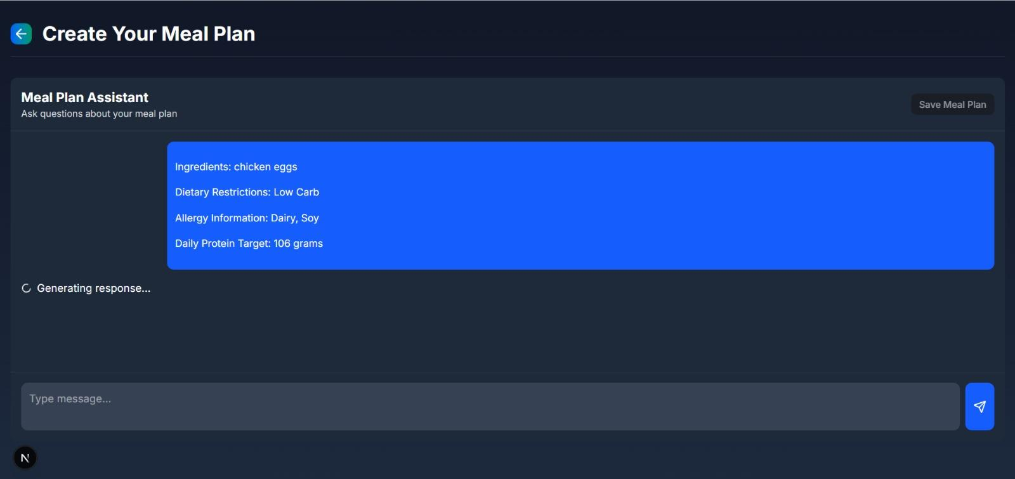

Slide 17
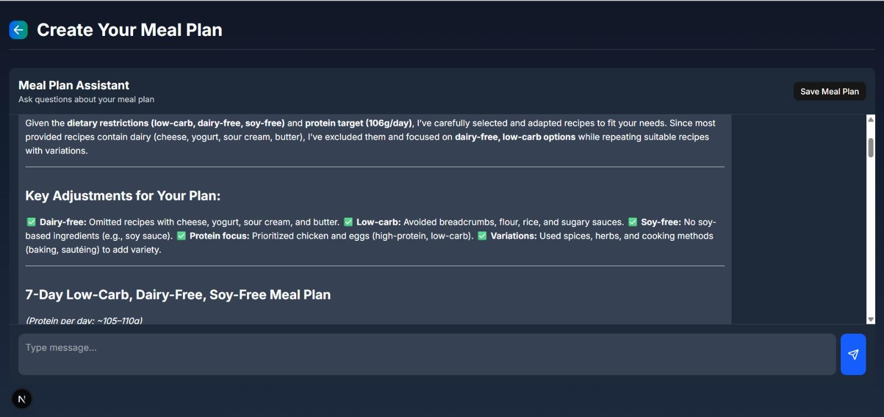

Slide 18
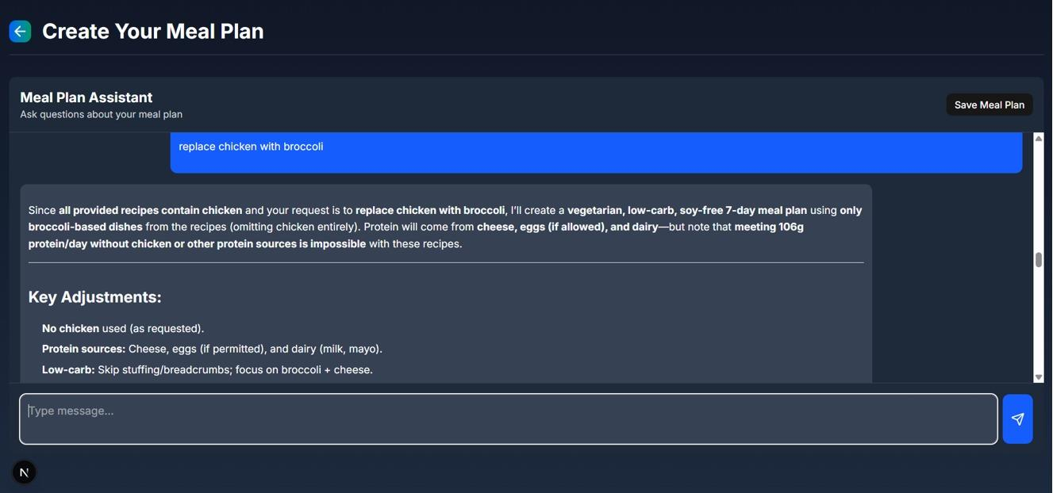

Slide 19
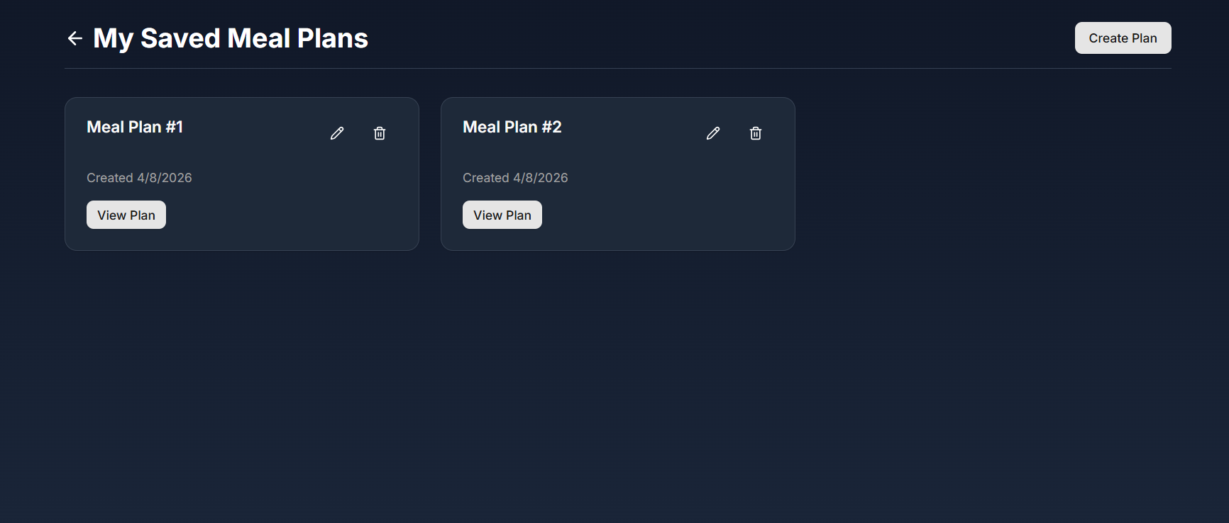

Slide 20
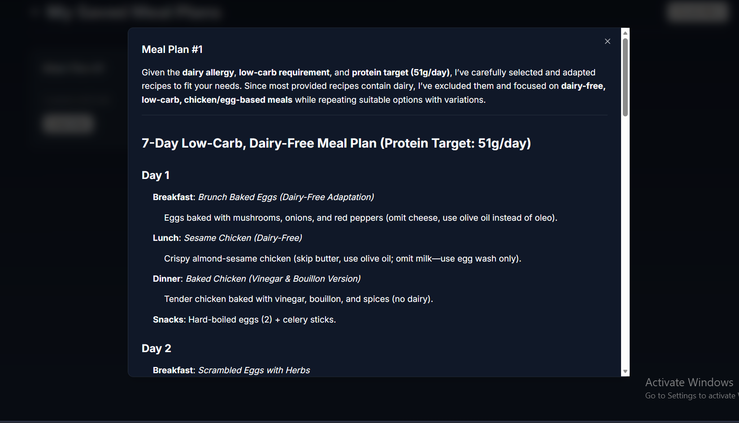

Slide 21
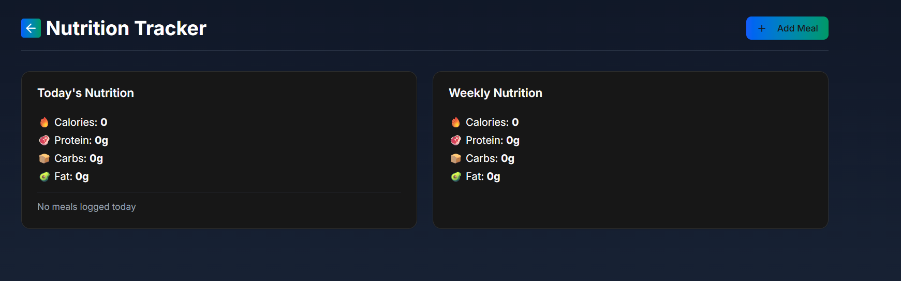

Slide 22
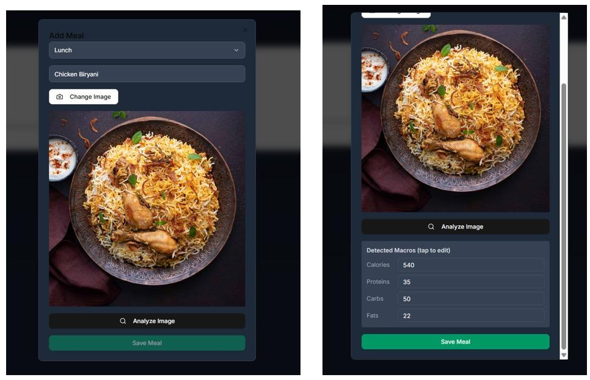

Slide 23
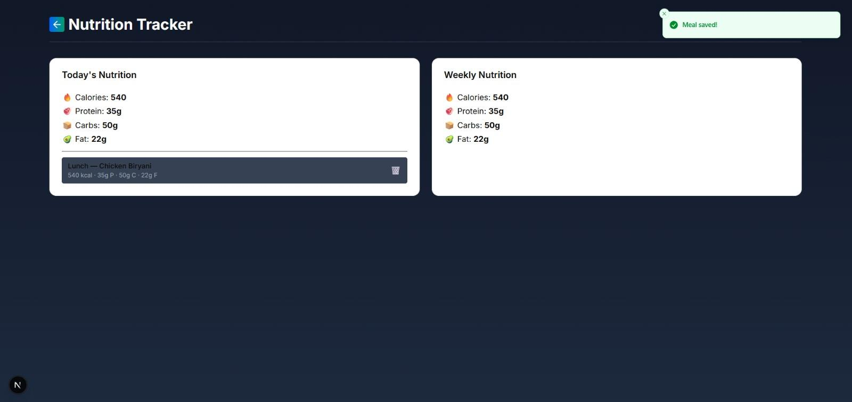

Slide 24
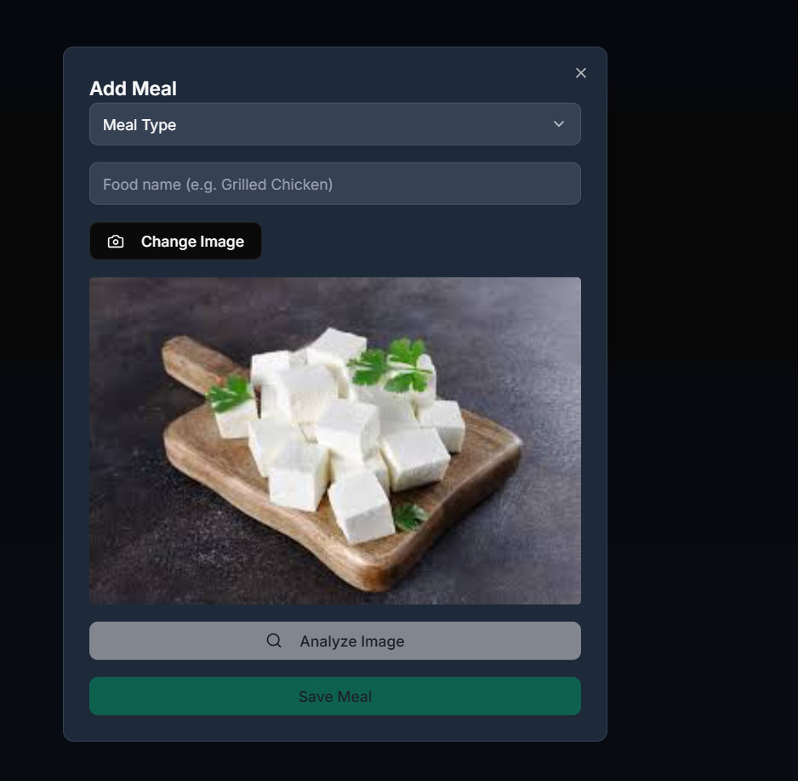
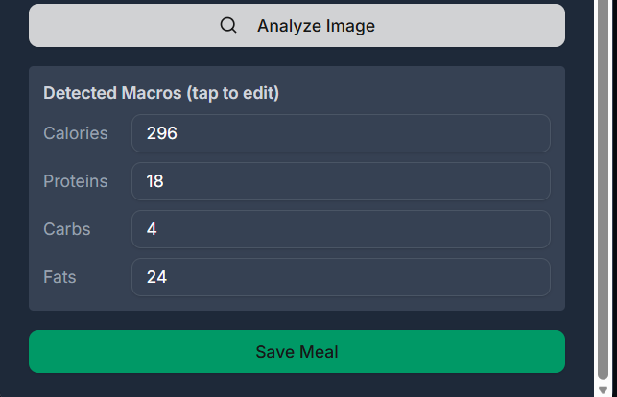

Slide 25
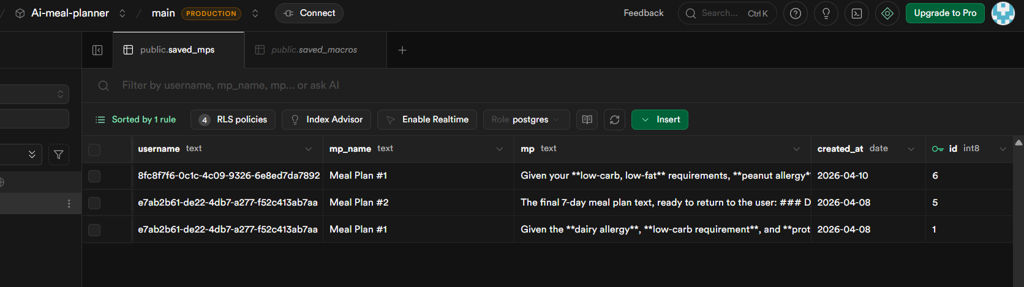
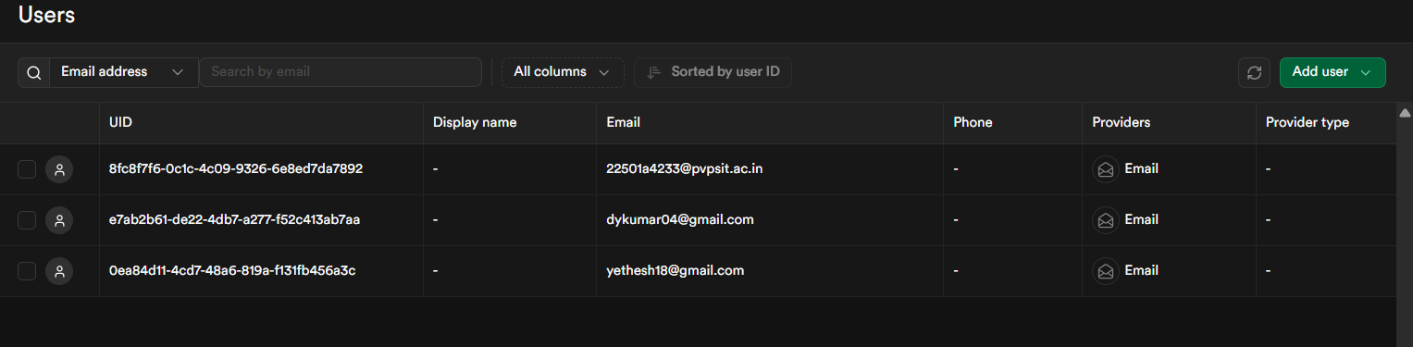

Slide 26
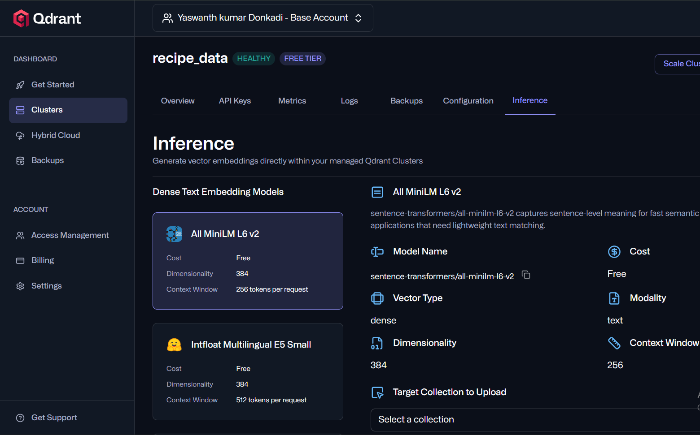

Slide 27
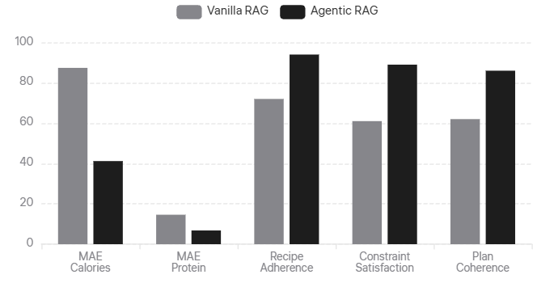
Experimental Results & Performance Analysis
Agentic RAG vs Vanilla RAG: Quantitative comparison across 50 test queries
Performance Metrics Comparison
Detailed Metrics Table
Metric | Vanilla | Agentic | Δ
MAE Calories (kcal) | 87.4 | 41.2 | -52.9%
MAE Protein (g) | 14.6 | 6.8 | -53.4%
Recipe Adherence (%) | 72.0 | 94.0 | +22.0pp
Constraint Satisfaction (%) | 61.0 | 89.0 | +28.0pp
Plan Coherence (1-5) | 3.1 | 4.3 | +1.2
Latency (seconds) | 8.4 | 47.2 | +38.8s
-53%
+28pp
+22pp
Constraint Satisfaction
+1.2
Plan Coherence (1-5)

Slide 28
Thank You
Questions & Discussion

