Slide 1
Communication Technologies 2 (CT2) Machine Learning: Applications and Algorithms Using Alignment with Location Prediction
Fabian Frölich, Johann Götz, Olga Groh
Lecture in WS 2017 / 2018 2018/03/22

Slide 2
Outline
Introduction / Motivation
Concept
Alignment Algorithm
Implementation
Evaluation
Conclusion and Future Work
References

Slide 3
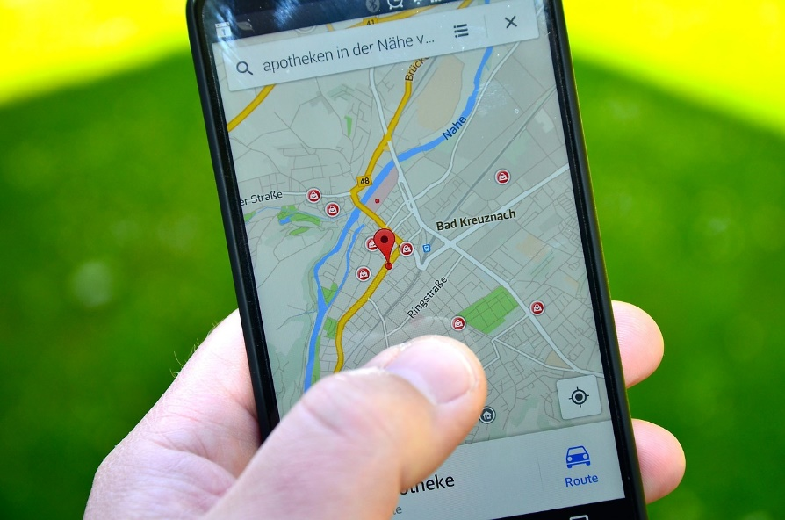
Introduction
Goal: Position prediction with alignment approach on Google Location History data
Working with GPS data
Gathered from modern mobile devices
Using Smith-Waterman algorithm

Slide 4
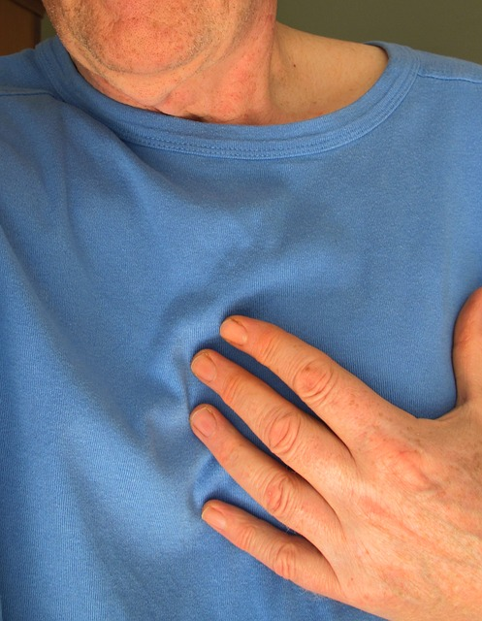

Motivation
Use case:
Position prediction in case of emergency
Radiator turns on in time

Slide 5
Concept
1. Raw data:
Timestamp | Accuracy | Longitude | Latitude | Altitude | Location
1300040100 | 30 | 9.500.700 | 51.330.700 | 0 | Home
1300028400 | 31 | 9.500.300 | 51.330.300 | 0 | Sport
1300010400 | 31 | 9.500.500 | 51.330.500 | 0 | Work
2. Sorted data:
Timestamp | Location
1300010400 | Work
1300028400 | Sport
1300040100 | Home
3. Assigned characters:
Work → A
Sport → B
Home → C
4. Result Sequence: ABC

Slide 6
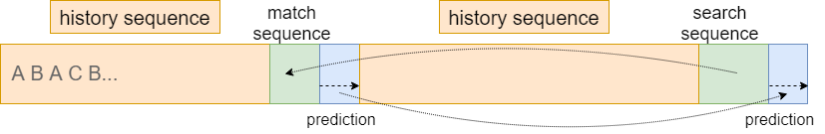
Concept
History sequence: The entire sequence
Search sequence: Last x characters of history sequence
Match sequence: Found search sequence
Prediction: Continuation from match sequence

Slide 7
Conception
Compression

Slide 8
Alignment Algorithm
 |  | A | C | B | A
 | 0 | 0 | 0 | 0 | 0
A | 0 | 2 | 0 | 0 | 2
C | 0 | 1 | 3 | 2 | 3
A | 0 | 3 | 5 | 6 | 10
Reccurences:
Match = 2
Mismatch = -1
Gap = -1

Slide 9
Implementation

Slide 10
Evaluation

Slide 11
Conclusion

Slide 12
References

Slide 13
Thank you for your attention!

