Slide 1
Communication Technologies 2 (CT2) Machine Learning: Applications and Algorithms Alignment with Location Prediction
Fabian Frölich, Johann Götz, Olga Groh
Lecture in WS 2017 / 2018 2018/03/22

Slide 2
Outline
Introduction and Motivation
Conception
Implementation
Evaluation
Conclusion and Future Work

Slide 3
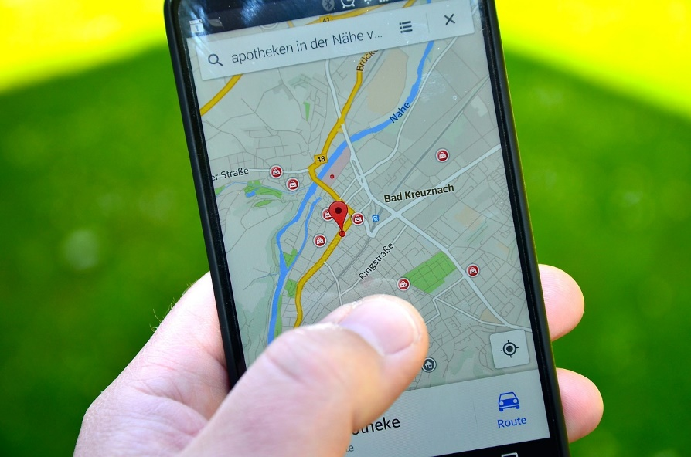
Introduction
Goal: Position prediction with alignment approach on Google Location History data
Working with GPS data
Gathered from modern mobile devices
Using Smith-Waterman algorithm

Slide 4


Motivation
Use cases:
Position prediction in case of emergency
Safety of elder people
Radiator turns on in time in smart-home enviroments

Slide 5
Conception
1. Raw data:
Timestamp | Accuracy | Longitude | Latitude | Altitude | Location
1300040100 | 30 | 9.500.700 | 51.330.700 | 0 | Home
1300028400 | 31 | 9.500.300 | 51.330.300 | 0 | Sport
1300010400 | 31 | 9.500.500 | 51.330.500 | 0 | Work
2. Sorted data:
Timestamp | Location
1300010400 | Work
1300028400 | Sport
1300040100 | Home
3. Assigned characters:
Work → A
Sport → B
Home → C
4. Result Sequence: ABC
Notes:
In our group, we implemented an approach that converts raw data into a sequence. First, this is how the raw data, that we reveive, looks like. The data is devided in rows which contains the latest timestamp on the top. Then, the three components longitude, latitude and altitude form the exact gps coordinates with the correpsonding accuracy. Since the coordinates are too complicated for alignment, we only used the location name, here on the right. So the next step is to sort every row by the earliest timestamp and throw away everything else except the location name. Then, every location is assigned to a character from the alphabet which is sufficient for personal use. Last, the location names form a sequence out of the assigned characters in the timestamp order. This is only a small example. Usually the sequences are much longer than that.

Slide 6
Conception
Compression:
Location data is gathered irregularly
Unchanged locations within 30 min interval are mapped to a single symbol
Achievement of regulated sequences
Data set | uncompressed | compressed | reduction
Sequence 1 | 1858 | 436 | 76,53%
Sequence 2 | 5499 | 1015 | 81,54%
Sequence 3 | 2222 | 581 | 73,85%
Notes:
In this approach we also introduced a compression method. Since the data is sometimes being collected in random time intervals, the sets contain redundant information. This is why we use this method to remove repetitive characters of a sequence within a 30 minutes interval. We tested it on all three available sequences. As you can see, this method compresses them greatly by about 75 to 80 percent. This enables us to work on low performance devices.

Slide 7
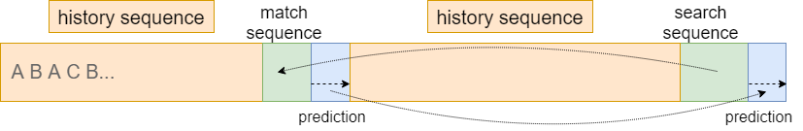
Conception
History sequence: The entire sequence
Search sequence: Last x characters of history sequence
Match sequence: Found search sequence
Prediction: Continuation from match sequence
Notes:
When we have the sequence, original or compressed, the next step is now to predict the next characters after the sequence. We call the whole sequence „history sequence“. At the end of it, we take about 4-5 characters, which form the „search sequence“. Now we use the alignment algorithm to find the most similar sequence in the previous part of the history sequence, which we call „match sequence“. Every character after the the match sequence form our needed prediction which we append at the end.

Slide 8
Conception
Smith-Waterman algorithm used mainly in bioinformatics
Alignment algorithm invented by Temple F. Smith and Michael S. Waterman in 1981
Local Alignment algorithm
Compares evolution based differences in DNA and protein sequences [11]
Runtime O(n²)
Notes:
The alignment algorithm that we use is called Smith-Waterman-Algorithm. It is a local algorithm, that finds the most similar partial sequence in another sequence, in our case, the history sequence, in a runtime of n squared. Usually, the algorithm is used mainly in bioinformatics to compare evolution based differences in DNA and protein sequences. It was invented by Temple F. Smith and Michael S. Waterman in 1981.

Slide 9
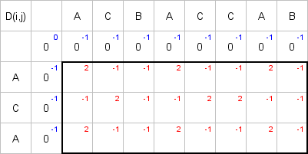
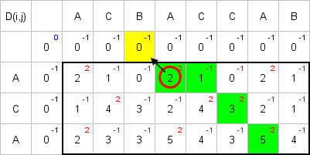
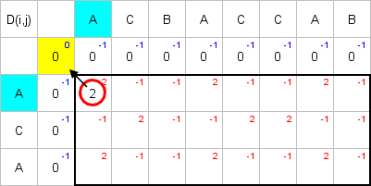
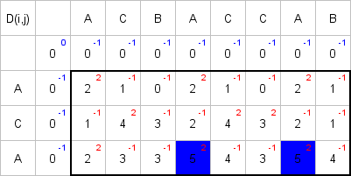
Conception – Alignment Algorithm
Result: A-CA
Reccurences: Match = 2 Mismatch = -1 Gap = -1
Notes:
Why n squared? Well, it‘s because both sequences, the history and search sequence, are aligned in a matrix like here. The first row and column are initialized with zeros. Then, we use reccurence values, as seen on the bottom, to determine the next score dependent on the previous north and west scores. After the whole matrix is filled, the next step is to backtrace the sequence. In order to to that, we find the highest score in the matrix and then we follow the path recursively backwards to the excluded zero, which is not included in the result. The path is decided counterclockwise when more possibilities are found. In this case, the result is A-CA, because the algorithm found a gap in the history sequence.

Slide 10
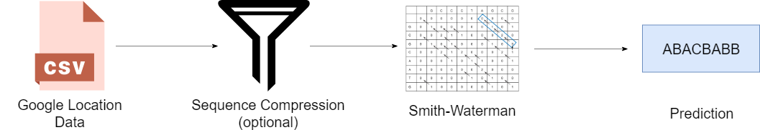
Implementation – Technical Facts
JavaSE 1.8
JUnit 5.0 for different parameter input
Notes:
Here you can see once again the flow of the approach. First we have google location data, which we compress. Then, we use smith-waterman algorithm to get the prediction. Our program is written in JavaSE 1.8. For testing with different paramater inputs, we used Junit 5.0.

Slide 11
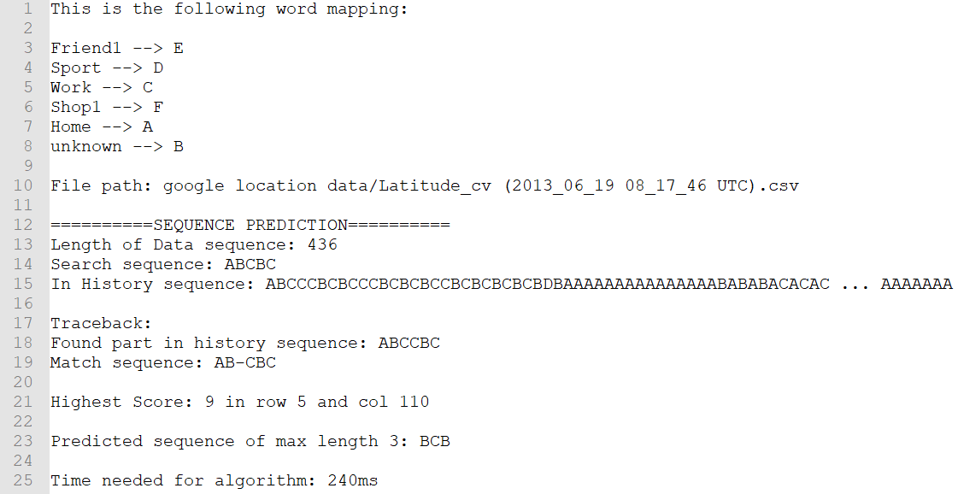
Implementation – Output
Notes:
And this is, how the output looks in our program.

Slide 12
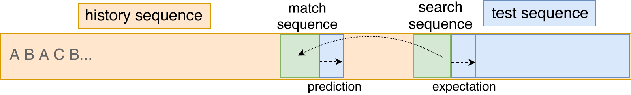
Evaluation
Sequence testing
With original
With compressed
Different search sequence lengths

Slide 13
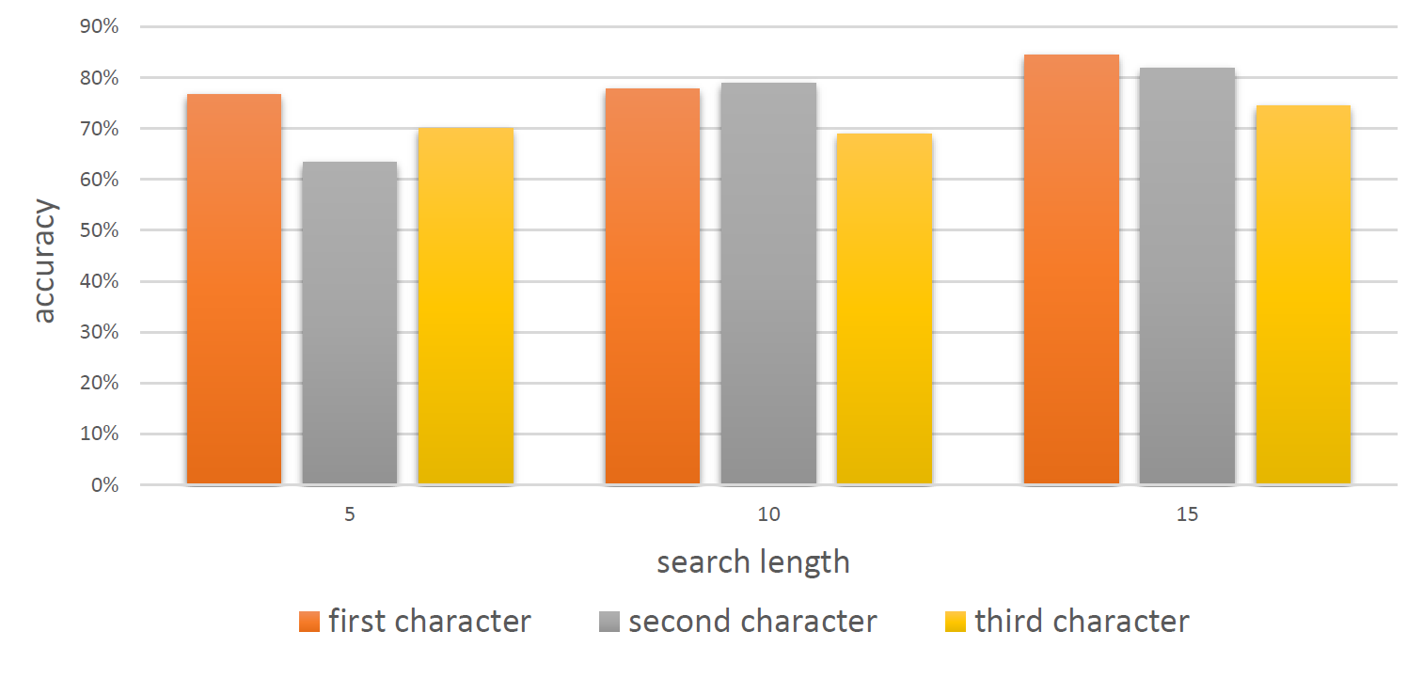
Evaluation
Original sequences

Slide 14
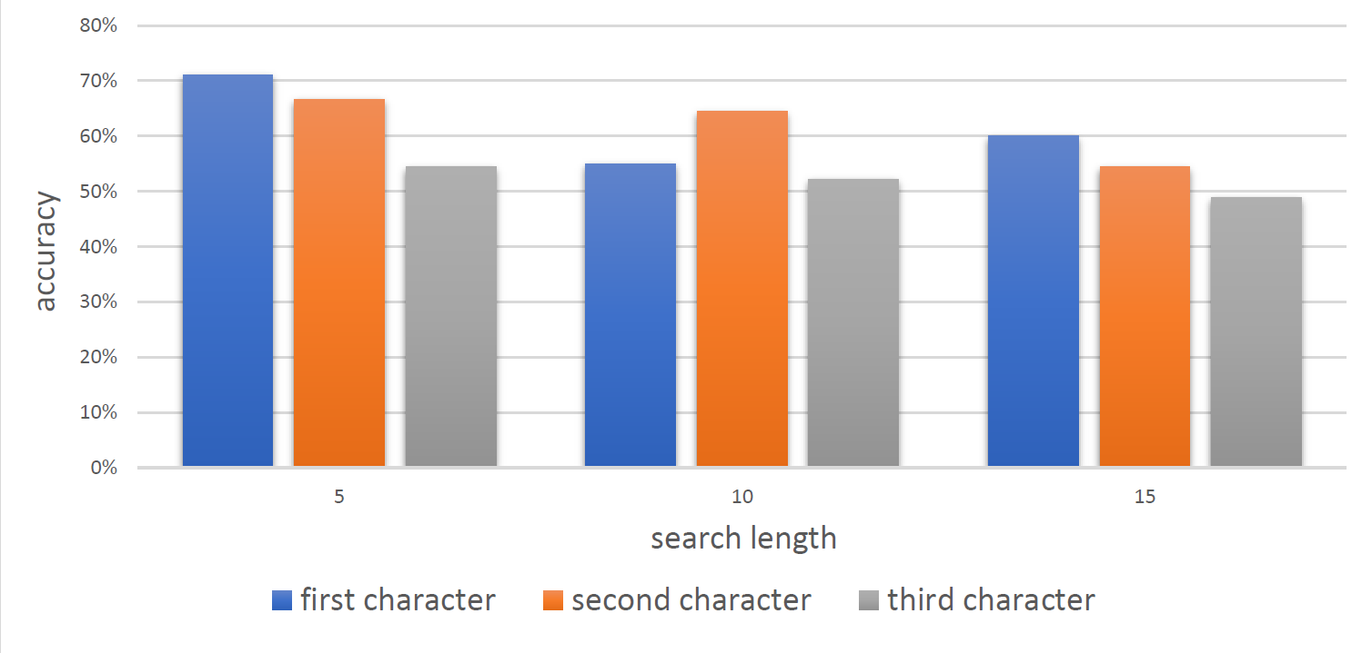
Evaluation
Compressed sequences
Notes:
- Accuracy of the original sequence is better
- Less redundancy for compressed sequences

Slide 15
Conclusion
Smith-Waterman is suited for location prediction and other purposes
Google Location Data was gathered by the device
Uncompressed data accuracy is higher
Usable for high performance devices
Compresed data redundancy is lower
Usable for low performance devices
Future Work:
Real-time applications
Improve sequence prediction with same matrix scores
Take more data into account (longer sequenes, coordinates)
Smart-Home: Radiator, Coffee machine, …

Slide 16
Thank you for your attention!

Slide 17
Related Work
Sigg et al. [9] describe an approach where context sequences can be predicted by using alignment. The utilization of alignment algorithms allows Sigg et al. to find the most similar partial sequences and with the aid of these to predict the next entry.
Craig et al. [3] use a clustering approach for defining whereabouts of one person trough clusters. This is done by dividing a location in preferably small regions and then combining similar adjacent regions to bigger clusters.

Slide 18
References
[1] „Dynamic programming and sequence alignment“ https://www.ibm.com/developerworks/library/j-seqalign/, accessed: 2018-02-07.
[2] „Google maps – timeline“ https://www.google.com/maps/timeline, accessed:2018-02-15.
[3] I. Craig and M. Whitty, “Region formation for efficient offline locationprediction,” IEEE Pervasive Computing, vol. 16, no. 1, pp. 66–73, 2017.
[4] T. Gueniche, P. Fournier-Viger, and V. S. Tseng, „Compact predictiontree: A lossless model for accurate sequence prediction“ in International Conference on Advanced Data Mining and Applications. Springer,2013, pp. 177–188.
[5] D. S. Hirschberg, „A linear space algorithm for computing maximal common subsequences“ Communications of the ACM, vol. 18, no. 6, pp. 341–343, 1975.
[6] A. Kirmse, T. Udeshi, P. Bellver, and J. Shuma, „Extracting patterns from location history“ in ACM SIGSPATIAL GIS 2011, http://www.sigspatial.org/, 2011, pp. 397–400.
[7] S. B. Needleman and C. D. Wunsch, „A general method applicable to the search for similarities in the amino acid sequence of two proteins“ Journal of molecular biology, vol. 48, no. 3, pp. 443–453, 1970.
[8] C. B. Rjeily, G. Badr, A. H. A. Hassani, and E. Andres, „Predicting heart failure class using a sequence prediction algorithm“ in 2017 Fourth International Conference on Advances in Biomedical Engineering (ICABME), Oct 2017, pp. 1–4.
[9] S. Sigg, S. Haseloff, and K. David, „An alignment approach for context prediction tasks in ubicomp environments“ IEEE Pervasive Computing, vol. 9, no. 4, pp. 90–97, 2010.
[10] T. F. Smith and M. S. Waterman, „Identification of common molecular subsequences“ Journal of molecular biology, vol. 147, no. 1, pp. 195– 197, 1981.
[11] M. S. Waterman, „Introduction to computational biology: maps, sequences and genomes“. CRC Press, 1995.
[12] N. Casagrande, „Basic-Algorithms-of-Bioinformatics Applet“, http://baba.sourceforge.net/

