Slide 1


Utilizing YOLO V8 for Camouflaged Military Soldier Density Estimation
VR SIDDHARTHA ENGINEERING COLLEGE, VIJAYAWADA
Department of Computer Science and Engineering
20CS7554: B. Tech Mini Project – II (Final Review)
December 10th, 2024
Batch No: 23
Batch Members
Jampani L N K Surya Sri Charan - (218W1A0586)
Bommana Phani Praharsha - (228W5A0507)
Eda Gayatri - (228W5A0508)
Thotakura Chanakya - (218W1A05C1)
Under the Guidance of
Mr. Srikakulapu Subhakar
Assistant Professor
CSE Dept

Slide 2
Abstract
Accurate estimation of camouflaged military soldier density is vital for strategic planning and operational efficiency in military operations. Recent studies indicate a growing challenge in detecting camouflaged personnel in diverse environments, emphasizing the need for advanced techniques. This project employs YOLO V8, an enhanced object detection model renowned for its speed and accuracy, to effectively identify and count camouflaged soldiers in real time. YOLO V8 utilizes a sophisticated architecture that includes features like improved feature extraction and better handling of small objects, making it particularly suited for challenging detection tasks. By integrating Non-Maximum Suppression (NMS), the model enhances counting accuracy by filtering out redundant detections and retaining only the most reliable instances. The proposed methodology not only supports immediate tactical responses but also aids in long-term military strategy development. To assess model performance, we utilize metrics such as F1 Score, Precision, Recall and Accuracy offering a detailed evaluation of detection accuracy and robustness.
Keywords: Camouflaged Soldier Detection; YOLO V8; Non-Maximum Suppression; Density Estimation; Military Operations.

Slide 3
Presentation Outline
Aim and Motivation
Research Questions
Title Justification
Objectives
Scope
Introduction
6.1. Camouflaged Soldier Density Estimation
6.2. Why Camouflaged Soldier Density Estimation
Study on Existing Technologies
Gap Analysis
SDLC Model
UML Diagrams
10.1. Use Case Diagrams
10.1. Sequence Diagrams
10.2. Activity Diagrams
11. Functional and Non-Functional Requirements
12. Data Collection
13. Data Preparation
14. Methodology
14.1. Proposed Methodology
14.2 Architecture Diagram
14.3. Modules of the Proposed Methodology
15. Output & Results
16. Timeline Chart
17. Summary
References

Slide 4
1. Aim and Motivation
To develop a system for accurate camouflaged military soldier density estimation in images, enhancing real-time situational awareness and supporting strategic military planning.
To utilize advanced object detection techniques, specifically YOLO V8, for improved identification and counting of camouflaged soldiers, thereby facilitating effective operational decision-making.
Address the challenges of Camouflage and improving situational awareness and security in military operations, border control, and surveillance activities.

Slide 5
2. Research Questions
How does Camouflage in military impact real-time Scenarios?
What are the challenges and limitations of Camouflaged Soldier Detection?
How do variations in lighting and weather conditions affect the detection accuracy of camouflaged soldiers using YOLO V8?
What specific features of YOLO V8 enhance its ability to accurately identify and count camouflaged soldiers in cluttered or dynamic backgrounds?

Slide 6
3. Title Justification
Camouflage refers to the practice of disguising oneself or something else to blend in with the surroundings, making it difficult to be detected or recognized.
This technique is often used in the context of military tactics, where soldiers might use camouflage clothing or paint to blend in with their environment to avoid being seen by enemies.
Density estimation in this context refers to the process of estimating the number of camouflaged soldiers in a specific area. Understanding the density of soldiers is crucial for tactical planning and decision-making.
YOLO V8 is an advanced version of the YOLO (You Only Look Once) algorithm, which excels at real-time object detection. YOLO V8 can quickly identify and classify objects in images or video frames, making it particularly useful for applications where speed and accuracy are essential.

Slide 7
4. Objectives
To collect a diverse dataset of camouflaged soldiers in various environments to enhance detection accuracy.
To implement the YOLO V8 model for accurately identifying and counting camouflaged soldiers in real-time video feeds under different conditions.
To analyze the impact of environmental factors, such as lighting and terrain, on the performance of YOLO V8 in detecting camouflaged personnel.
To establish robust evaluation metrics, like Recall, Precision, F1 Score and Accuracy to assess the effectiveness of the model in soldier density estimation.

Slide 8
5. Scope
This Approach can count Camouflaged military Soldiers in the image who are significant.
Limited capability in identifying and counting very small or distant vehicles that might appear insignificant in the scene and struggle with heavily occluded objects.

Slide 9
6. Introduction 6.1 Camouflaged Soldier Density Estimation
Camouflaged soldier density estimation involves quantifying the number of camouflaged personnel present in a specific area at a given time, which is crucial for effective military operations.
Real-time soldier density estimation supports enhanced situational awareness, allowing military leaders to respond quickly to changing battlefield conditions and improve overall mission effectiveness.
6.2 Why Camouflaged Soldier Density Estimation
Accurate estimation of camouflaged soldier density enables military leaders to make informed decisions regarding troop placement and strategy in real time.
Advanced computer vision technology enhances the detection of camouflaged personnel, improving situational awareness and facilitating quicker responses to changing battlefield conditions.

Slide 10
7. Study on Existing Technologies
Title: Dense Pedestrian Detection Based on GR-YOLO. [1]
Journal Details: Li, N., Bai, X., Shen, X., Xin, P., Tian, J., Chai, T., & Wang, Z. (2024). Dense Pedestrian Detection Based on GR-YOLO. Sensors, 24(4747).
Dataset: WiderPerson, CrowdHuman, People Detection Image Dataset.
Description:
The study introduces GR-YOLO, an enhanced dense pedestrian detection model built upon YOLOv8. The model addresses challenges in feature extraction, occlusion, and multi-scale variations through a series of enhancements. Key innovations include the integration of the Repc3 module for better feature extraction, an aggregation–distribution mechanism for improved multi-scale fusion, and the use of Giou loss for enhanced target localization. The RepC3 module replaces or augments specific convolutional blocks in the backbone to enhance feature extraction. The neck is optimized with FPN or PANet to ensure that features from multiple scales are fused effectively, using top-down and bottom-up pathways for better feature flow. GR-YOLO achieves 0.855 of Precision and 0.796 of recall and 0.8244 of F1 Score
Advantages:
Improved accuracy across multiple dense pedestrian datasets (e.g., WiderPerson, CrowdHuman).
Superior performance in detecting occluded and small-scale targets.
Disadvantages:
Relies heavily on high-quality video input.
Potential performance degradation in scenarios with extreme occlusion ad crowd densities.

Slide 11
7. Study on Existing Technologies
Title: Traffic Monitoring System for Smart City Based on Traffic Density Estimation [2]
Journal Details: Bidwe, S., Kale, G., & Bidwe, R. (2022). Traffic Monitoring System for Smart City Based on Traffic Density Estimation. Indian Journal of Computer Science and Engineering, 13(5), Sep-Oct 2022.
Dataset: INRIA and ShanghaiTech dataset
Description:
Bidwe et al. proposed a traffic monitoring system aimed at smart cities, leveraging a five-layer Convolutional Neural Network (CNN) architecture to estimate traffic density. The model classifies traffic into three categories: High, Medium, and Low, using video footage captured by traffic surveillance cameras. The system achieved 99.6% accuracy on the WSDT dataset, with performance evaluation metrics such as precision, recall, and F1-score reaching 0.99. The architecture utilizes convolution and max-pooling layers to extract hierarchical features, followed by a fully connected layer for classification.
Advantages:
High accuracy (99.6%) for traffic density classification.
Real-time application potential for smart traffic management.
Disadvantages:
Relies heavily on high-quality video input.
Limited generalization to unseen datasets or environments without retraining.

Slide 12
7. Study on Existing Technologies
Title: Automated Vehicle Counting from Pre-Recorded Video Using You Only Look Once (YOLO) Object Detection Model. [3]
Journal Details: Majumder, M., & Wilmot, C. (2023). Automated Vehicle Counting from Pre-Recorded Video Using You Only Look Once (YOLO) Object Detection Model. Journal of Imaging, 9(7), Article 131.
Dataset: Custom dataset collected from strip malls in Baton Rouge, Louisiana.
Description:
Majumder and Wilmot developed an automated vehicle counting method using the YOLOv3 model implemented in TensorFlow, integrated with OpenCV. The system efficiently tracks and counts vehicles from pre-recorded videos and outputs counts with a 90% accuracy rate, validated against manual counts. The method emphasizes cost-effectiveness for small projects and supports flexible time intervals for vehicle counting. A benefit–cost analysis reveals a 54% greater benefit over manual methods.
Advantages:
High accuracy (90%) for automated vehicle counting.
Flexible time intervals for vehicle counts, addressing diverse transportation planning needs.
Disadvantages:
Performance may degrade in low-light or adverse conditions.
Challenges with overlapping vehicles and unsuitable camera angles affecting detection performance.

Slide 13
7. Study on Existing Technologies
Title: CNN-based Density Estimation and Crowd Counting.[4]
Journal Details: Gao, G., Gao, J., Liu, Q., Wang, Q., & Wang, Y. (2020). Cnn-based density estimation and crowd counting: A survey. arXiv preprint arXiv:2003.12783.
Dataset: NWPU-Crowd, UCF_CC_50, ShanghaiTech Dataset.
Description: Gao and the team provides a systematic and comprehensive review of CNN-based approaches for crowd counting and density estimation. It categorizes existing methods based on various taxonomies, including Network Architecture, Learning Paradigms and Evaluation Metrics.
Advantages:
High accuracy in estimating crowd density and counting individuals.
Works in different environmental conditions effectively.
Disadvantages:
They need large amounts of labeled training data to perform well.
Overlapping subjects may not be detected correctly.

Slide 14
7. Study on Existing Technologies
Title: Scale-aware CNN for crowd density estimation and crowd behavior analysis. [5]
Journal Details: Sharma, V. K., Mir, R. N., & Singh, C. (2023). Scale-aware CNN for crowd density estimation and crowd behavior analysis. Computers and Electrical Engineering, 106, 108569.
Dataset: WorldExpo’10, ShanghaiTech Dataset.
Description: Sharma and his team presented “Scale-aware CNN for crowd density estimation and crowd behavior analysis” with WorldExpo’10, ShanghaiTech Datasets. This project proposed a model that Utilizes the MMNet a scale-aware convolutional neural network (CNN) designed to tackle challenges in crowd density estimation, such as occlusions and scale variations.
Advantages:
Handling Scale Variations
Contextual Information Integration
Disadvantages:
Computational Complexity
Overestimation and Underestimation Issues

Slide 15
7. Study on Existing Technologies
Title: Managing Crowd Density and Social Distancing [6]
Journal Details: Kulkarni, M., Deedwania, R., Mudgal, P., & Bhope, A. (2021). Managing crowd density and social distancing. International Journal of Engineering Research and Technology, 10, 2278-0181.
Dataset: COCO dataset.
Description: Kulkarni and his team presented "Managing Crowd Density and Social Distancing" with a dataset of COCO (Common Objects in Context) dataset. This project proposes a model that utilizes the YOLO algorithm for monitoring crowd density. The model processes video feeds to detect individuals, count them, and measure the distances between them.
Advantages:
Provides high confidence values for detecting individuals.
Fast detection and classification.
Disadvantages:
Compromised by poor video quality or low lighting conditions.
Requires significant computational power for real-time processing.

Slide 16
7. Study on Existing Technologies
Title: Towards deeper understanding of camouflaged object detection [7]
Journal Details: Y., Zhang, J., Dai, Y., Li, A., Barnes, N., & Fan, D. P. (2023). Towards deeper understanding of camouflaged object detection. IEEE Transactions on Circuits and Systems for Video Technology
Dataset: CAM-LDR DATASET
Description:
Zhang and team presented “Towards deeper understanding of camouflaged object detection” with a dataset of Camouflaged objects Images from CAM-LDR DATASET. This paper tells about the Camouflaged object detection techniques and Ranking of camouflaged objects into easy, medium and hard using R-CNN and some classification Techniques.
Advantages:
1. Ranking of dataset Images.
2. Explains About Various Techniques for Camouflaged object Detection.
Disadvantages:
1. Performance degradation to detect unseen classes

Slide 17
7. Study on Existing Technologies
Title: Efficient Camouflaged Object Detection via Progressive Refinement Network [8]
Journal Details: Zhang, D., Wang, C., & Fu, Q. (2023). Efficient Camouflaged Object Detection via Progressive Refinement Network. IEEE Signal Processing Letters.
Dataset: COD10K, CAMO
Description:
Zhang and team presented “Efficient Camouflaged Object Detection via Progressive Refinement Network” with a dataset of Camouflaged objects from COD10K, CAMO. The Progressive Refinement Network has achieved high accuracy than other models like SINet, SINetV2, JCSOD, Rank-Net, MGL, OCENet.
Advantages:
Better performance than other models.
Good balance in speed-accuracy compared with other models.
Disadvantages:
Can be less accurate if the person in Image is so small.
Performance degradation to detect unseen classes

Slide 18
Summary of Existing Implementation
S. No. | Article Title | Journal Details | Algorithms/ Models | Dataset | Advantages | Disadvantages
1 | Dense Pedestrian Detection Based on GR-YOLO. [1] | Li, N., Bai, X., Shen, X., Xin, P., Tian, J., Chai, T., & Wang, Z. (2024). Dense Pedestrian Detection Based on GR-YOLO. Sensors, 24(4747). | GR-Yolo | WiderPerson, CrowdHuman, People Detection Image Dataset. | Improved accuracy across multiple dense pedestrian datasets (e.g., WiderPerson, CrowdHuman). Superior performance in detecting occluded and small-scale targets. | Relies heavily on high-quality video input. Potential performance degradation in scenarios with extreme occlusion ad crowd densities.
2 | Traffic Monitoring System for Smart City Based on Traffic Density Estimation [2] | Bidwe, S., Kale, G., & Bidwe, R. (2022). Traffic Monitoring System for Smart City Based on Traffic Density Estimation. Indian Journal of Computer Science and Engineering, 13(5), Sep-Oct 2022. | optimized convolutional neural network (ConvNet) | INRIA and ShanghaiTech dataset | High accuracy (99.6%) for traffic density classification. Real-time application potential for smart traffic management. | Relies heavily on high-quality video input. Limited generalization to unseen datasets or environments without retraining.

Slide 19
Summary of Existing Implementation
S. No. | Article Title | Journal Details | Algorithms/ Models | Dataset | Advantages | Disadvantages
3 | Automated Vehicle Counting from Pre-Recorded Video Using You Only Look Once (YOLO) Object Detection Model. [3] | Majumder, M., & Wilmot, C. (2023). Automated Vehicle Counting from Pre-Recorded Video Using You Only Look Once (YOLO) Object Detection Model. Journal of Imaging, 9(7), Article 131. | Yolo V3 | Custom dataset collected from strip malls in Baton Rouge, Louisiana. | High accuracy (90%) for automated vehicle counting. Flexible time intervals for vehicle counts, addressing diverse transportation planning needs. | Performance may degrade in low-light or adverse conditions. Challenges with overlapping vehicles and unsuitable camera angles affecting detection performance.
4 | CNN-based Density Estimation and Crowd Counting. [4] | Gao, G., Gao, J., Liu, Q., Wang, Q., & Wang, Y. (2020). Cnn-based density estimation and crowd counting: A survey. arXiv preprint arXiv:2003.12783. | CNN based Density Estimation | NWPU-Crowd, UCF_CC_50, ShanghaiTech Dataset. | High Accuracy Works Effectively | Overlapping subjects may not be detected correctly.

Slide 20
S. No. | Article Title | Journal Details | Algorithms/ Models | Dataset | Advantages | Disadvantages
5 | Scale-aware CNN for crowd density estimation and crowd behavior analysis.[5] | Sharma, V. K., Mir, R. N., & Singh, C. (2023). Scale-aware CNN for crowd density estimation and crowd behavior analysis. Computers and Electrical Engineering, 106, 108569. | Scale-aware CNN | WorldExpo’10, ShanghaiTech Dataset | Handling Scale Variations Contextual Information Integration | Computational Complexity
6 | Managing Crowd Density and Social Distancing [6] | Kulkarni, M., Deedwania, R., Mudgal, P., & Bhope, A. (2021). Managing crowd density and social distancing. International Journal of Engineering Research and Technology, 10, 2278-0181. Dataset: COCO dataset. | YOLO | COCO dataset. | High confidence values Fast detection and classification | Compromised by poor video quality or low lighting conditions.

Slide 21
S. No. | Article Title | Journal Details | Algorithms/ Models | Dataset | Advantages | Disadvantages
7 | Towards deeper understanding of camouflaged object detection [7] | Y., Zhang, J., Dai, Y., Li, A., Barnes, N., & Fan, D. P. (2023). Towards deeper understanding of camouflaged object detection. IEEE Transactions on Circuits and Systems for Video Technology | R-CNN | CAM-LDR Dataset | Ranking of dataset Images. Classification of Soldiers. | Performance degradation to detect unseen classes
8 | Efficient Camouflaged Object Detection via Progressive Refinement Network [8] | Zhang, D., Wang, C., & Fu, Q. (2023). Efficient Camouflaged Object Detection via Progressive Refinement Network. IEEE Signal Processing Letters. | Progressive Refinement Network | COD10K, CAMO | Better performance than other models. Good balance in speed-accuracy compared with other models. | Can be less accurate if the person in Image is so small. Performance degradation to detect unseen classes

Slide 22
8. Gap Analysis
Handling of Camouflaged Objects: Most previous studies, such as the CNN-based density estimation [4] and Scale-aware CNN [5] focus on crowd counting and density estimation in general or on non-camouflaged objects. These models are primarily concerned with detecting people or objects in environments without considering how objects may blend into the background. Camouflage detection, where objects or people are deliberately designed to blend in with their surroundings, is a more specialized problem not directly addressed by these models.
Limited Object Classification: The models reviewed in [3] and [4], primarily focus on generic crowd density estimation and may not account for the specific challenges posed by camouflaged military personnel. This limitation restricts their applicability in military contexts where multiple object types need to be identified.
Challenges with Dense Clusters: As highlighted in studies [5] and [6] current systems face difficulties in detecting closely spaced individuals, which can result in under-segmentation or over-segmentation. In the context of military scenarios, where soldiers may be closely grouped and camouflaged, these challenges become even more pronounced.
Adaptability to Unseen Classes: The literature indicates that many current models, such as those discussed in [8], can struggle with unseen classes or variations in object appearance. This issue is critical when identifying camouflaged soldiers, as their appearance can vary significantly based on their environment and equipment.

Slide 23

9. SDLC Model
Daily Scrum in Sprint1
Previous work
Discuss for changes and new requirements
Plan today work
Daily scrum in sprint2
Discuss on Design
Updates in the proposed design
Plan today work
Daily scrum in sprint3
Model
Implementation
Discuss performance optimization
Plan today work
Daily scrum in sprint4
Prototyping
Code review
System integration and deployment
Plan today work
Sprint Review
Demo of proposed model
Discuss what’s done and
what wasn’t done
Getting feedback from the scrum master and stakeholders
24
hours
24
hours
24
hours
24
hours
Sprint Planning Meeting
Review Backlogs
Sprint Goal
Estimate Sprint Backlog
Commit to the Sprint
Sprint cycle 2
1-4 weeks
Sprint cycle 4
1-4 weeks
Sprint cycle 1
1-4 weeks
Sprint cycle 3
1-4 weeks
deployment`
Sprint backlog
1.communication with stake holders
2.Functionality Requirements
3.Gap analysis
5.Motivation behind the work
6.Justification of the problem statement
7.Define scope and objectives
1.Design of the model
2.Usecase diagram
3.class diagram
4.Activity diagram
5.Data preparation
6.propose work flow model
7. Resource cost estimation.
1.Model Implementation
2.Coding of proposed
model.
3. Training of proposed model.
4.Testing of proposed model
5.Perfomance Evaluation
6. .Comparison with Existing Models
1.Prototyping
2.Implementing functionalities
3.Integration with proposed model
5.system integration
6.Maintainence
7.Deployment
Finished work
Requirement gathering
Analysis and Design
Implementation and testing
Deployment
Backlogs
Feedback from sprint master and stakeholders
Figure-4: SDLC model for Military Soldier density estimation

Slide 24
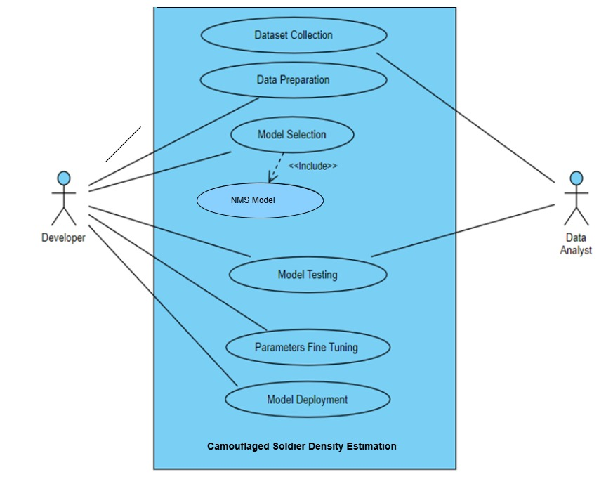
10.1. Use Case Diagram
10. UML Diagrams
Figure-5: Use Case diagram for soldier density estimation

Slide 25
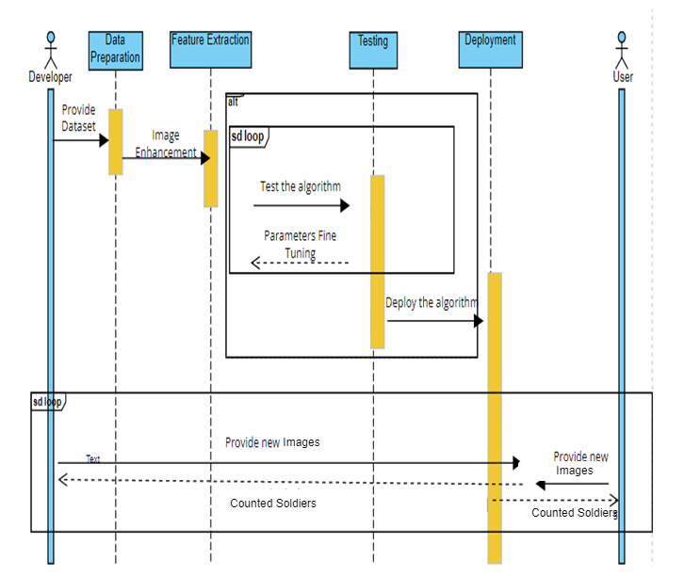
10.2. Sequence Diagram
10. UML Diagrams
Figure-7: Sequence diagram for soldier density estimation

Slide 26
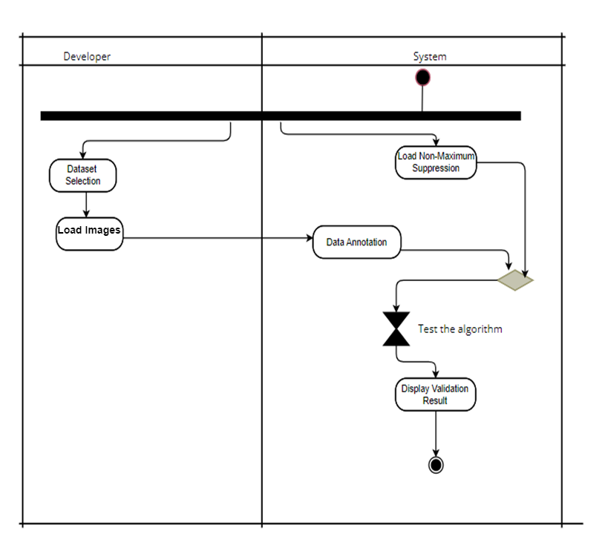
10.3. Activity Diagram
10. UML Diagrams
Figure-9: Activity diagram for soldier density estimation.

Slide 27
11.1. Functional Requirements
Table-2: Functional requirements optimizing traffic signals through adaptive control
Requirement ID | Requirement | Must/Want | Comments
FR001 | Data collection and analysis | Must | Collect real-time data for enhanced battlefield analysis. Analyze historical data to identify detection trends.
FR002 | soldier counting | Must | Essential for estimating the number of camouflaged soldiers. Use algorithms like Non-Maximum Suppression (NMS) for accuracy.
FR003 | Soldier density estimation | Must | Crucial for effective military operations and strategy. Supports informed decision-making in real-time.
FR004 | Customization and Integration | Must | Adapt algorithms to specific environments or scenarios. Ensure seamless integration with other military systems.

Slide 28
11.2. Non-Functional Requirements
Table-3: Non- Functional requirements optimizing traffic signals through adaptive control
Requirement ID | Requirement | Must/Want | Comments
NF001 | Portability | Must | Ensure that the system can be deployed across different hardware platforms and operating environments without significant modifications.
NF002 | Reliability | Must | Software reliability is vital for accurate segmentation analysis, mitigating issues like bugs and hardware challenges. The system should operate reliably under normal operating conditions and handle unexpected inputs or failures gracefully.
NF003 | Performance | Must | The system should process images or video frames within a specified time frame, ensuring that it meets real-time processing requirements.
NF004 | Scalability | Must | Scalability is essential for the system’s seamless expansion without compromising performance. Handle varying scales of input, from single images to streaming video feeds.

Slide 29
12. Dataset Collection
Name of the Dataset: MSC1K
Description: The dataset consists of two primary components: the Camouflaged Soldier Images dataset and the Tactical Scenario Image Dataset. These are essential for tasks related to soldier counting, density estimation, and situational analysis. The Camouflaged Soldier Images dataset contains high-quality images captured in various environments, like woodlands and snowfields.
Number of Images : 1078 images
Train set size : 647 images
Valid set size: 216 images
Test set size : 215 images
Resolution: 640x640

Slide 30
13. Data Preparation
1. Data Preprocessing
Video Resizing: Since videos consist of multiple frames, resizing of each frame to a suitable size for model and computational resources.
Data Splitting: Divide the dataset into training and testing sets based on the provided train/test set sizes and distribution of videos from both datasets is maintained in each set.
2. Data Annotation
Each frame in the video needs to be annotated with pixel-level semantic segmentation labels and align the segmentation labels with their corresponding frames accurately.
3. Data Loading
Load the dataset efficiently during training and testing phases and using video processing libraries along with deep learning frameworks for handling video loading and manipulation.
4. Data Normalization
Normalize the pixel values of video frames to a common scale ( [0, 1] or [-1, 1]) to aid model convergence.

Slide 31
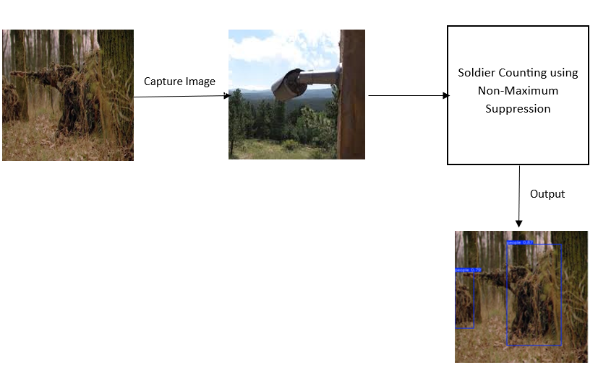
14.1. Proposed Methodology
14. Methodology
Figure-11: Proposal methodology for soldier density estimation

Slide 32
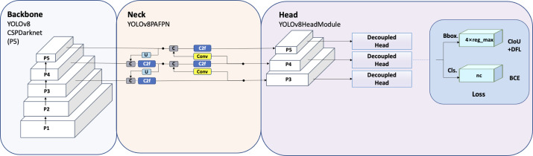
14.2. Architecture Diagram
14. Methodology
Figure-11: Architecture Diagram of Yolo v8

Slide 33
14.2 Algorithm for Soldier Counting
14. Methodology
____________________________________________________________________________________
Algorithm: Non-Maximum Suppression (NMS)
___________________________________________________________________________________
Input: Confidence scores, Segmented masks, IoU threshhold, Score threshold
Output: To display total number of soldiers present in the given frame.
M_nms ← ∅ (Initialize empty set for keeping segmented masks)
for i ∈ segmented mask then iterate over all the masks
discard i if it is not the required mask
for j ∈ segmented mask then iterate over all the masks to compare with i
if IoU(i, j) > λ_nms then (λ_nms= IoU threshold)
if score(c, i) > score(c, i) then (c= minimum threshold)
discard ← True (set discard to True if i has lower score)
If i is not discarded after comparing with all other masks
M_nms ← M_nms ∪ i (add i to the final set)
return M_nms (return the final set of masks)
__________________________________________________________________________________

Slide 34
14.3. Modules of Proposed Methodology
Dataset Collection:
This is the initial step is to collect dataset consisting various images of Camouflaged military soldier.
Soldier Counting:
In this phase, relevant camouflaged soldiers are counted from the captured video frames using YOLO V8. This includes identifying soldiers in various environments and conditions.
The implementation of the Non-Maximum Suppression (NMS) algorithm, in conjunction with YOLO V8, ensures accurate soldier counts even in densely populated areas by minimizing duplicate counts and enhancing the accuracy of soldier detection in the image.
Soldier Density Estimation:
Soldier density estimation quantifies the number of camouflaged soldiers or the level of congestion in a specific area at a given time.
Estimated soldier count and Density:
The model's output provides soldier counts and corresponding density estimations for each pixel in the original image, reflecting the presence of camouflaged soldiers in the scene.

Slide 35
14. Comparison with previous implementations
S.NO | Author | Article Title | Algorithm | Performance Metrics
1. | Li et al. (2024) [1] | Dense Pedestrian Detection Based on GR-YOLO | Fusion Aggregation Distribution Mechanism helps in Neck Structure Optimization | GR-YOLO achieves 0.855 of Precision and 0.796 of recall and 0.8244 of F1 Score
2. | Bidwe et al. (2022) [2] | Traffic monitoring system for smart city based on traffic density estimation | Trajectory Tracking Method is used tracks the trajectory of vehicles as they move through the scene and counts them when they cross a virtual detection line. | F1 Score of 0.92 and accuracy of 0.89 is achieved.
3. | Majumder and Wilmot (2023) [3] | Vehicle counting and traffic flow parameter estimation for dense traffic scenes | Used Yolo V8 NMS algorithm | Accuracy-86%

Slide 36
14. Comparison with previous implementations
S.NO | Author | Article Title | Algorithm | Performance Metrics
4 | CZhang et al. (2023) [7] | Toward Deeper Understanding of Camouflaged Object Detection | Resnet Algorithm is used to rank the Camouflaged Images
5. | Ours | Uitilizing Yolo V8 For Camouflaged military Soldier Density Estimation | NMS Algorithm is used in object detection tasks to refine the bounding boxes predicted by a model. | Precision- 0.9890 Recall-0.8404 F1 Score-0.9086 Accuracy-0.8326

Slide 37
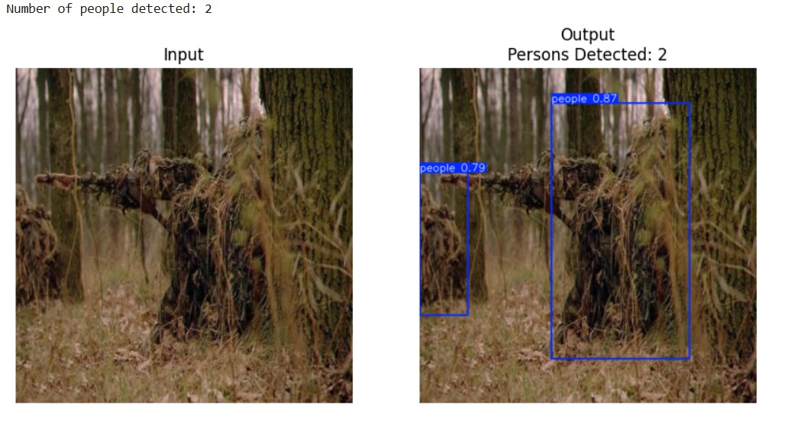
15. Output & Results
Output:
The implementation of the proposed work utilizes the YOLO V8 model, which takes input images of camouflaged soldiers and provides real-time detection outputs. This model is designed to accurately identify and locate camouflaged personnel within various environments, delivering bounding box coordinates and class probabilities for each detected soldier. The system aims to enhance situational awareness and operational efficiency by effectively estimating soldier density in the given images.

Slide 38
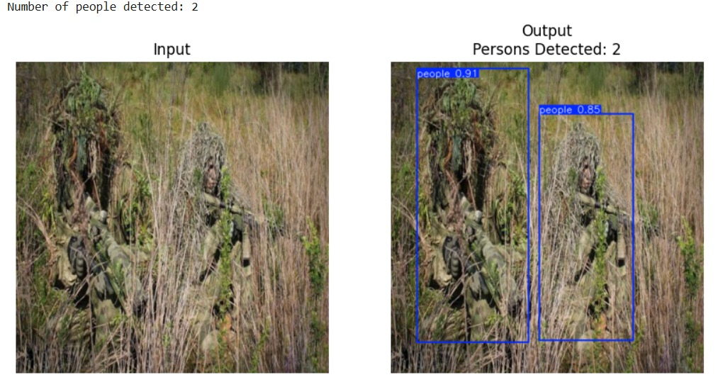
15. Output & Results

Slide 39
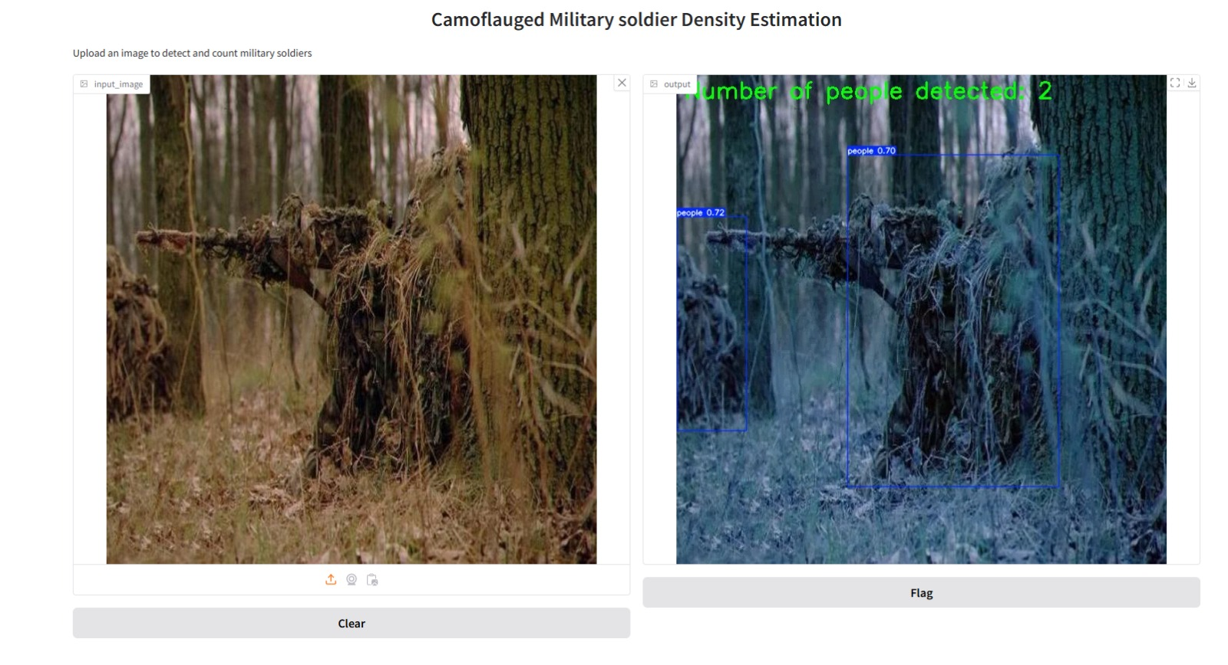
15. Output & Results
Gradio:
Our YOLO model is saved as a pickle file. With the Python module Gradio the Graphical User Interface (GUI) is implemented by deploying the Pickle file in it. In which there will be a URL generated for 72 hours to use the interface. The user interface will be taking the image type as input and produces output as shown in Figure

Slide 40
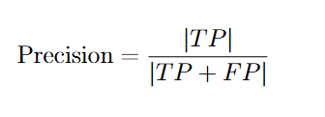



15. Output & Results
Results:
Performance metrics:
Our Model has achieved
Precision of 0.9890
Recall of 0.8404
F1 Score of 0.9086.
Accuracy of 0.8326.

Slide 41
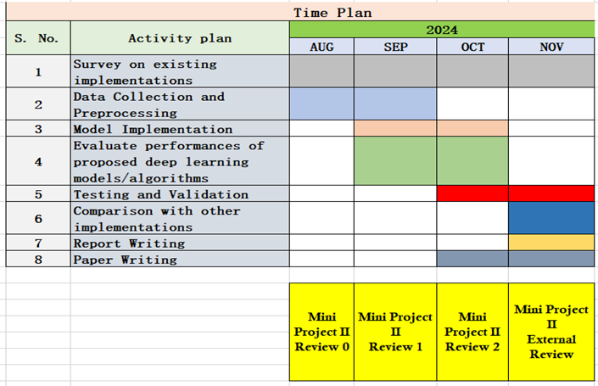
16. Timeline Chart
Table-4: Timeline chart for Mini Project – II work

Slide 42
17. Summary
This project aims to develop a system for accurate camouflage military soldier density estimation using advanced counting techniques, including YOLO V8, to enhance real-time military operations and support strategic planning.
The project will employ the Non-Maximum Suppression (NMS) algorithm alongside YOLO V8 for reliable counting of camouflaged military soldiers in images and videos, extending its application to real-time scenarios.
Evaluation criteria such as Precision, Recall, F1 Score and Accuracy will be established to provide comprehensive insights into the model's performance across various military scenarios and datasets.

Slide 43
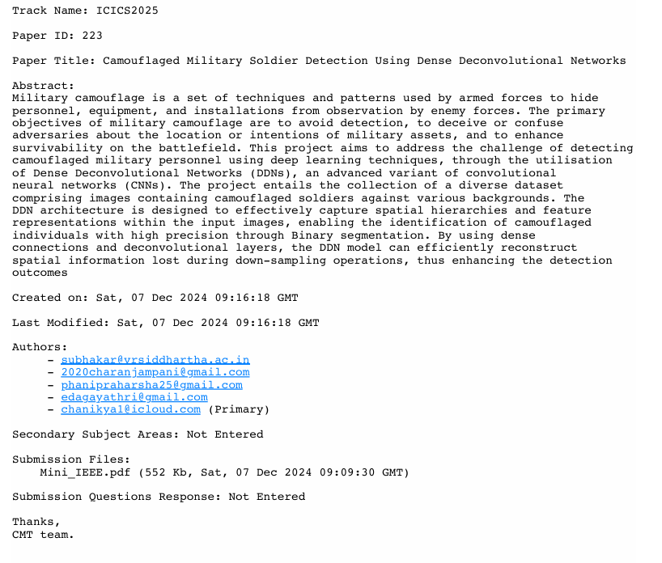
18. Epics Publication Status
Paper Published in the Fifteenth International Conference on Computing, Communication and Networking Technologies (ICCCNT)
S. R. Kishan, S. Hameed, J. Charan and Y. Srikar, "RFID-Based Elevator Access Control System," 2024 15th International Conference on Computing Communication and Networking Technologies (ICCCNT), Kamand, India, 2024, pp. 1-5, doi: 10.1109/ICCCNT61001.2024.10724057.
Mini-1 Publication Status
Applied to International Conference of Information and Communication Systems (ICICS)

Slide 44
References
Li, N., Bai, X., Shen, X., Xin, P., Tian, J., Chai, T., & Wang, Z. (2024). Dense Pedestrian Detection Based on GR-YOLO. Sensors, 24(4747).
Bidwe, S., Kale, G., & Bidwe, R. (2022). Traffic Monitoring System for Smart City Based on Traffic Density Estimation. Indian Journal of Computer Science and Engineering, 13(5), Sep-Oct 2022.
Majumder, M., & Wilmot, C. (2023). Automated Vehicle Counting from Pre-Recorded Video Using You Only Look Once (YOLO) Object Detection Model. Journal of Imaging, 9(7), Article 131.
Gao, G., Gao, J., Liu, Q., Wang, Q., & Wang, Y. (2020). Cnn-based density estimation and crowd counting: A survey. arXiv preprint arXiv:2003.12783.

Slide 45
Sharma, V. K., Mir, R. N., & Singh, C. (2023). Scale-aware CNN for crowd density estimation and crowd behavior analysis. Computers and Electrical Engineering, 106, 108569.
Kulkarni, M., Deedwania, R., Mudgal, P., & Bhope, A. (2021). Managing crowd density and social distancing. International Journal of Engineering Research and Technology, 10, 2278-0181.
Y., Zhang, J., Dai, Y., Li, A., Barnes, N., & Fan, D. P. (2023). Towards deeper understanding of camouflaged object detection. IEEE Transactions on Circuits and Systems for Video Technology
Zhang, D., Wang, C., & Fu, Q. (2023). Efficient Camouflaged Object Detection via Progressive Refinement Network. IEEE Signal Processing Letters.

