Slide 1
Smart Procurement: An Example Process of Achieving Best Value In Oncology
www.digipharm.io

Slide 2




1. Identification.
Healthcare provider identifies a certain treatment could save lives and improve patient outcomes, but they face a daunting financial hurdle. The cost of this innovative therapy puts it out of reach or results in considerable losses when it does not benefit patients as expected.
High costs
Drain on Budgets
15-70% oncology ORR rates (JAMA)
Volume-based payments
www.digipharm.io

Slide 3



2. Partner with us.
Fair costs
Value-based payments
With the support of our independent third party solution, the provider launches a value-based procurement (VBP) initiative to ensure patients receive the life-saving treatments they desperately need whilst protecting procurement budgets.
Protect budgets
Transform Procurement
www.digipharm.io

Slide 4
3. Engage with manufacturer.
Dedicated independent system for monitoring and managing VBP initiatives
Eliminate requirement for ‘trust’ & aligns incentives
We support procurement negotiation between key stakeholders with its expertise in implementing and deploying value-based procurement models.
Provides synchronised data viewpoints and outcome validation
Relieves administrative burden for all
Enables a win-win scenario for all parties
Allows VBP at scale
www.digipharm.io

Slide 5



4. Define VBP contract criteria.
Efficacy thresholds: e.g. Survival, Progression, Remission, PROMs
Discontinuation: e.g. Grade 3+ AEs & Intolerance
Contracting parties define the key Outcomes/KPI’s and reporting requirements that will inform the basis of the VBP agreement.
Milestones: Parties define criteria relating to data reporting, reconciliation, contract periodicity
Financials: Acquisition costs & Compensation e.g. replacement vials
Agree a win-win scenario for all parties
Define a suitable framework that combines volume discounts with value-based conditions
www.digipharm.io

Slide 6
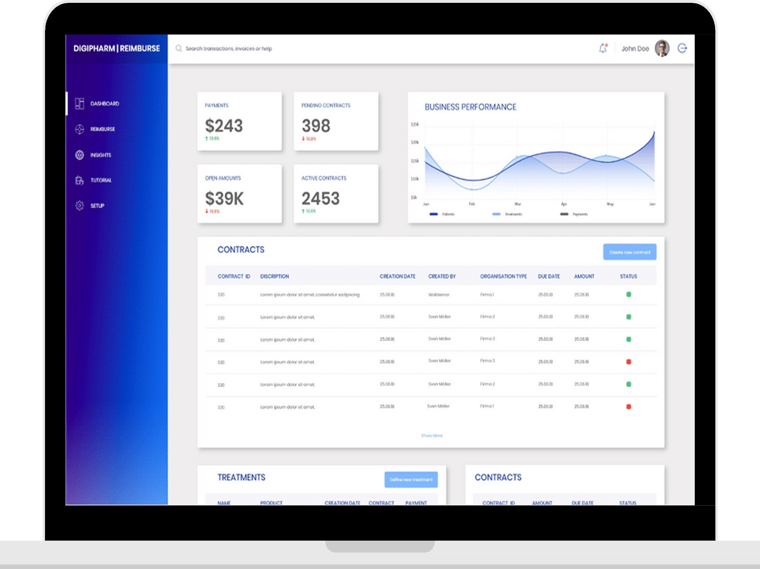
5. Develop and Deploy.
We ensures all relevant data is available with the appropriate data quality to inform the VBP agreement.
We deploy a smart contract that contains the pre-agreed contract criteria on its ‘Reimburse’ platform, which transparently manage the agreement for all parties.
‘Digital Healthcare Company of The Year – 2024’ - Corporate LiveWire
‘Best Value Healthcare Solutions Company 2024’ Technology Innovator Awards 2024
.
‘Best Blockchain-based HealthTech Contracting Platform 2024’ W&F Fintech Awards
.
Digital Healthcare Platform of the Year 2024 – UK LUXlife Award for Excellence in Innovation 2024

Slide 7
6. Validate and Share.
We, as an independent third party, validates all outcome data received using additional complementary data points to ensure the performance evaluation of the health technology is accurate.
Contracting outcomes are shared with contracting parties on the ‘Reimburse’ platform to enable monitoring with relevant alerts.
‘Digital Healthcare Company of The Year – 2024’ - Corporate LiveWire
‘Best Value Healthcare Solutions Company 2024’ Technology Innovator Awards 2024
.
‘Best Blockchain-based HealthTech Contracting Platform 2024’ W&F Fintech Awards
.
Digital Healthcare Platform of the Year 2024 – UK LUXlife Award for Excellence in Innovation 2024

Slide 8
7. Pay for performance.
Based on the real-world value of the therapy. The provider receives a refund or compensation in the form of replacement vials for all doses provided to patients that do not benefit from the therapy according to the multi-party agreement.
Where patients benefit from the therapy the provider does not receive any compensation or refund.
‘Digital Healthcare Company of The Year – 2024’ - Corporate LiveWire
‘Best Value Healthcare Solutions Company 2024’ Technology Innovator Awards 2024
.
‘Best Blockchain-based HealthTech Contracting Platform 2024’ W&F Fintech Awards
.
Digital Healthcare Platform of the Year 2024 – UK LUXlife Award for Excellence in Innovation 2024

Slide 9
8. Resource reallocation and enhanced savings
Due to significant cost savings the healthcare provider is now able to reallocate limited. The provider also identifies additional savings opportunities using our AI-based waste identification tool.
Savings Across All Technologies & Services
Financial Sustainability
Improved Outcomes & Patient Satisfaction
Evidence-Based Decision Making

Slide 10










Through our solutions, healthcare organisations unlock cost savings while improving patient outcomes.
Don't just take our word for it. Our platforms have been successfully implemented by leading institutions. Our satisfied customers have achieved remarkable results, enhancing access, patient outcomes and significant cost savings
www.digipharm.io

